Slide 1


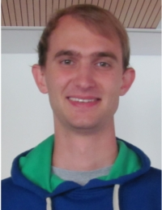







Group D Phase 2 Project
A. Ambuehl | W. Smith
J. Leem | O. Thomas
M. Lücken

Slide 2
Contents
1. Phase 1 – Cancer population dynamics in the colonic crypt
2. Phase 2 – Modelling human immune response to IVA

Slide 3
1. Phase 1 work
Cancer population dynamics in the colonic crypt

Slide 4
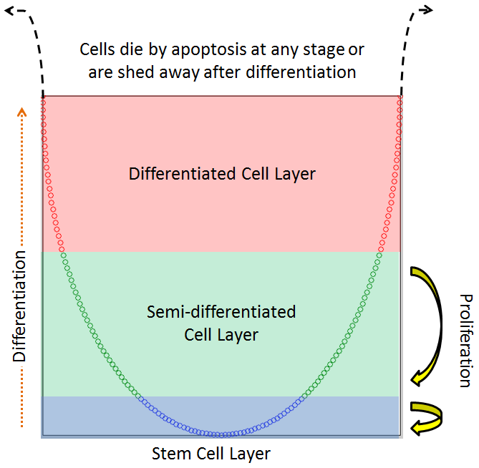

Background – the colonic crypt

Slide 5
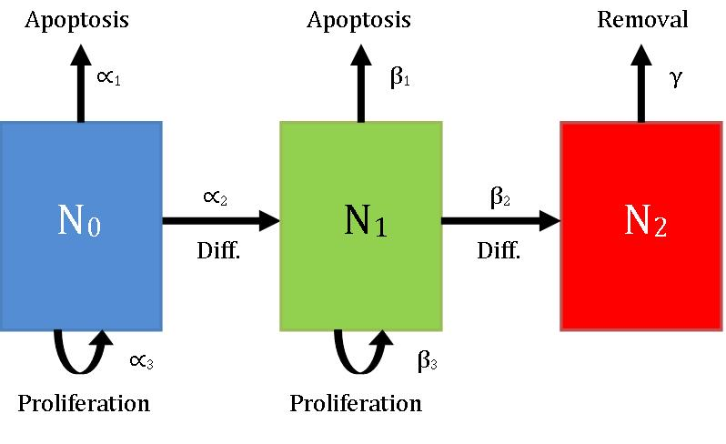

Background – the colonic crypt
Multiple groups have applied simple compartment models to the crypt:

Slide 6
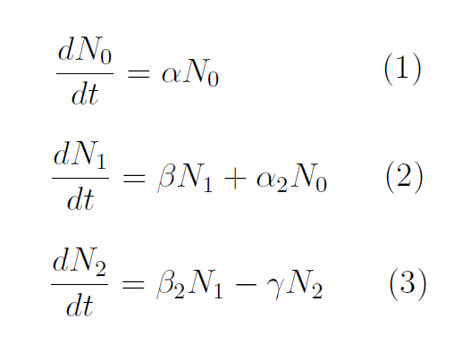
Modelling 1: continuous vs. discrete
Johnston et al. used both discrete and continuous models
We focused on the continuous model
Assumes large time and population scales

Slide 7
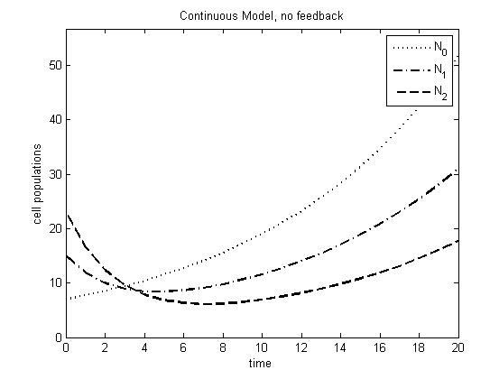
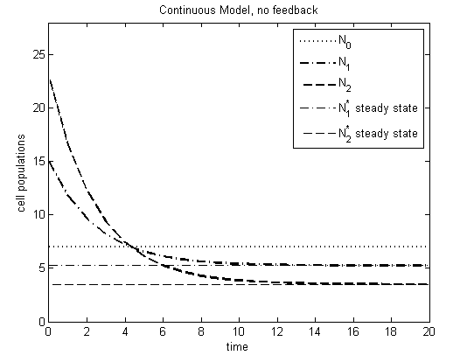
Modelling 2;3: adding feedback
The 3-compartment system is pretty boring: very limited stability
Adding feedback (populations govern parameters) generates more interesting behaviour!

Slide 8
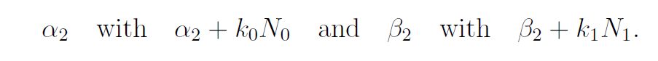
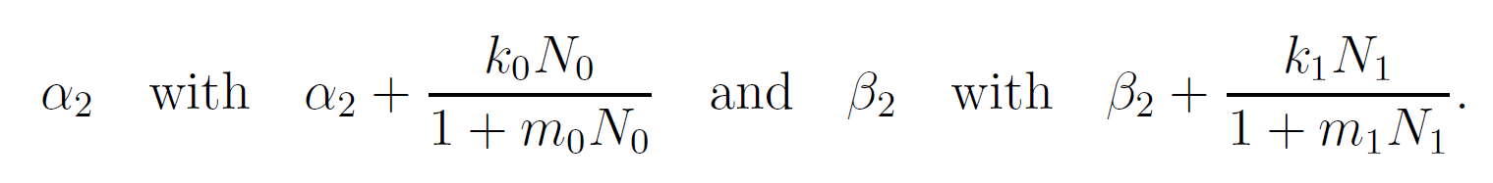
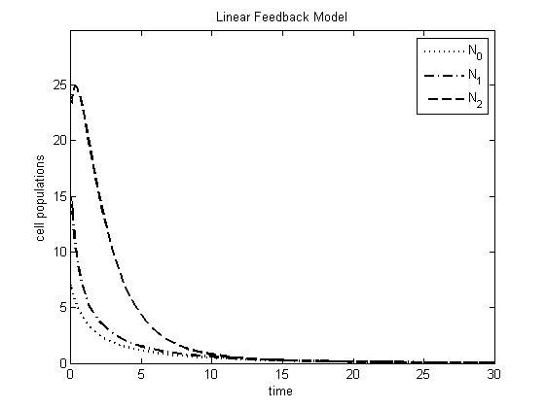
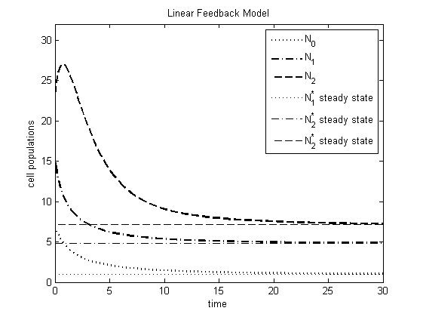
Modelling 2;3: adding feedback
Two types of feedback were reproduced:
Linear: replace…
Saturable: replace…

Slide 9
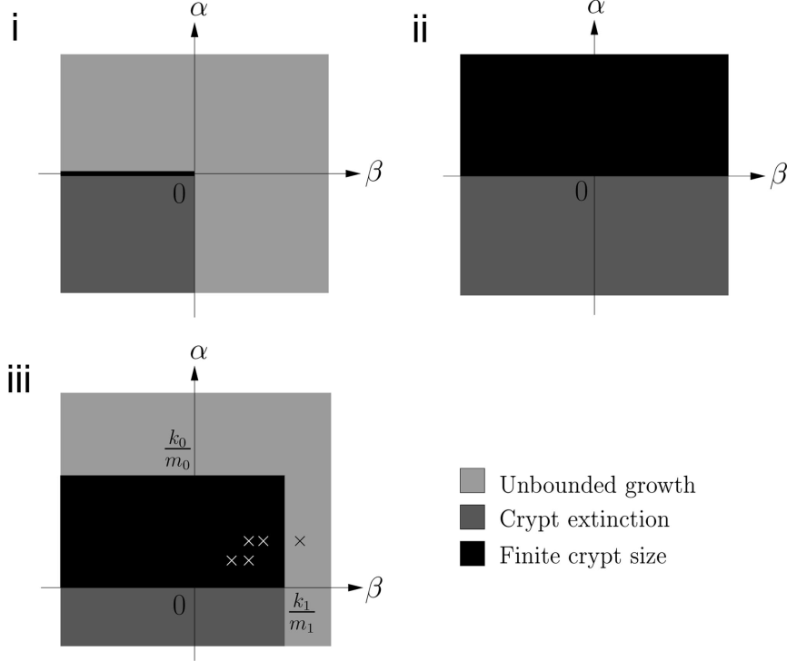
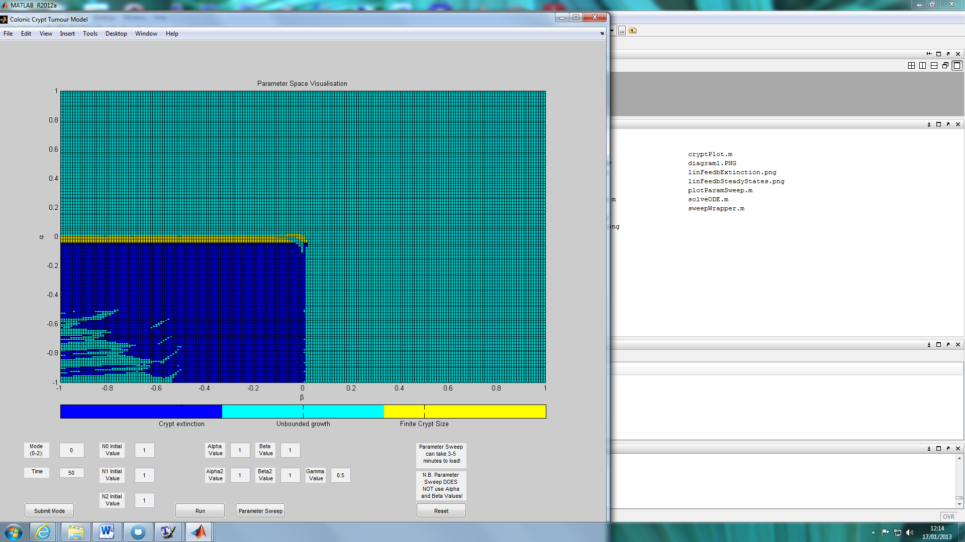
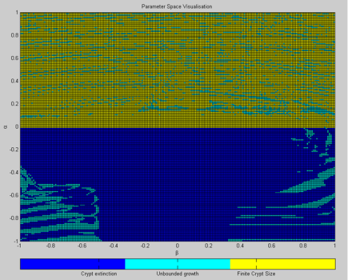
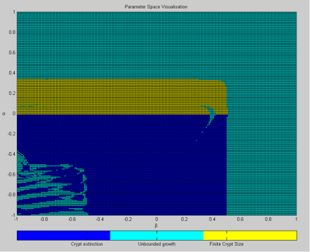
Parameter Sweeps – stability analysis
Phase space plots highlight parameter combinations leading to stable crypt sizes, unbounded growth or crypt death
ANALYTICAL
NUMERICAL
LHS: Johnston, Maini et al. 2007
RHS: Ambuehl et al. 2013, CC-BY-SA-3.0

Slide 10
Stability Analysis for parameter sweep plots
Numerically determining solution stability within a reasonable time is hard
We tried 2 methods:
MALTE

Slide 11
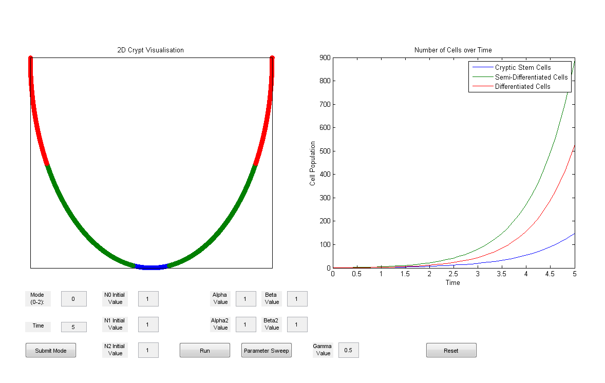
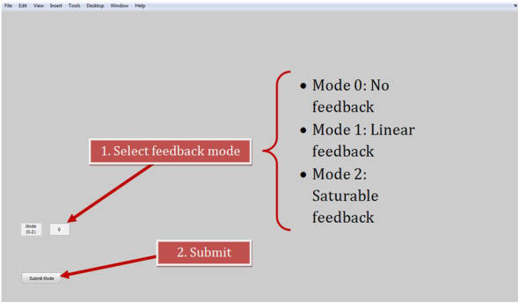
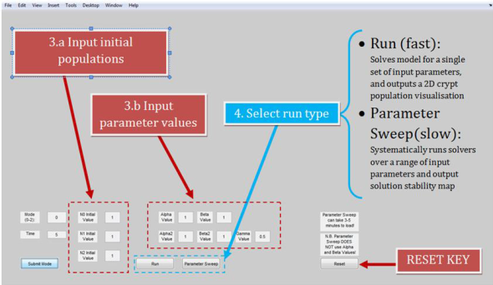
Our Work – The GUI
Code only – no GUIDE!
It has a dynamic crypt plot (cells imposed on a parametric sine curve)
Not as robust as we’d like – crashes quite easily if the user gives it too much to do

Slide 12
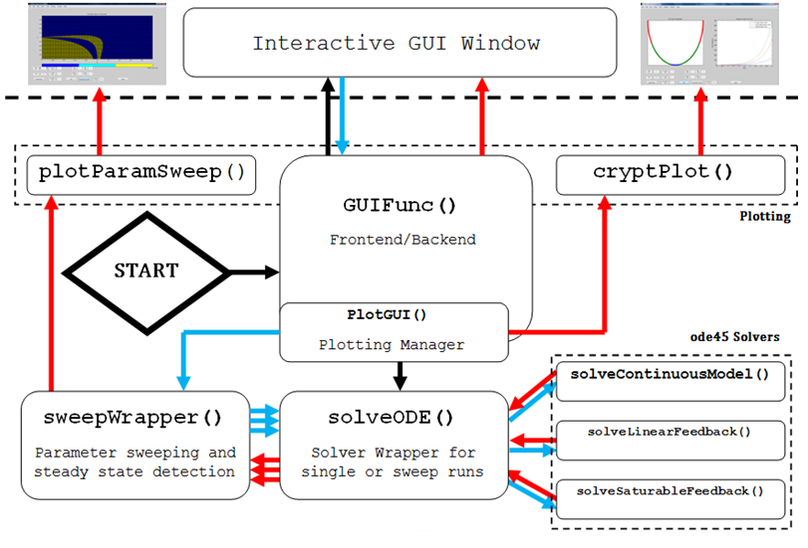
Our Work – The code

Slide 13

Phase 1 Conclusions
Reproduced behaviour of 3-compartment ODE set, under 3 different feedback modes
Implemented and compared stability analysers
Wrapped 3 solvers into a GUI, featuring dynamic crypt visualisations
Used GUI to corroborate analytical stability plots!

Slide 14
2. Phase 2
Human Immune Response Modelling

Slide 15
The Problem – Human Immune Response Modelling
The human immune system is a complicated entity
The model of Hancioglu et al. (2007) seeks to capture some of its behaviour…
… specifically the interplay between innate and adaptive immunity
Group G (Pearce et al.) were tasked with implementing model in MatLab®

Slide 16
Biology of the immune system
Jin, can you help out here?
Just want some quick introductory facts/pictures/diagrams

Slide 17
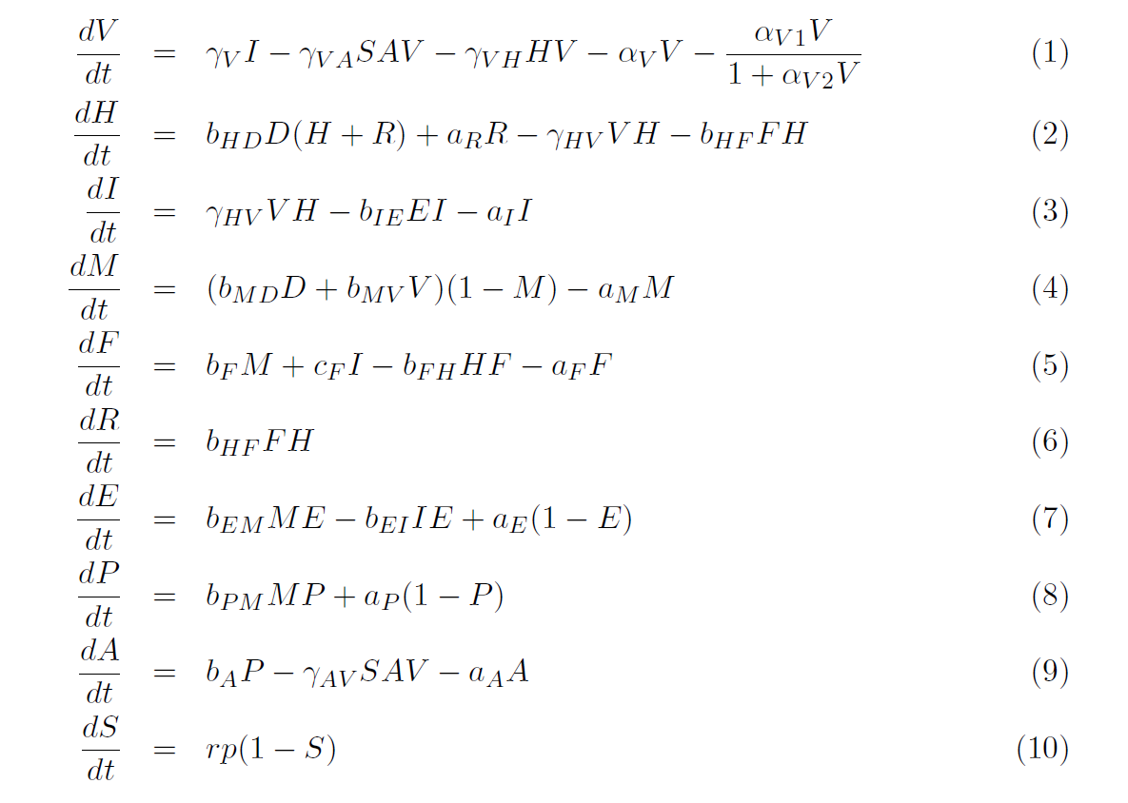
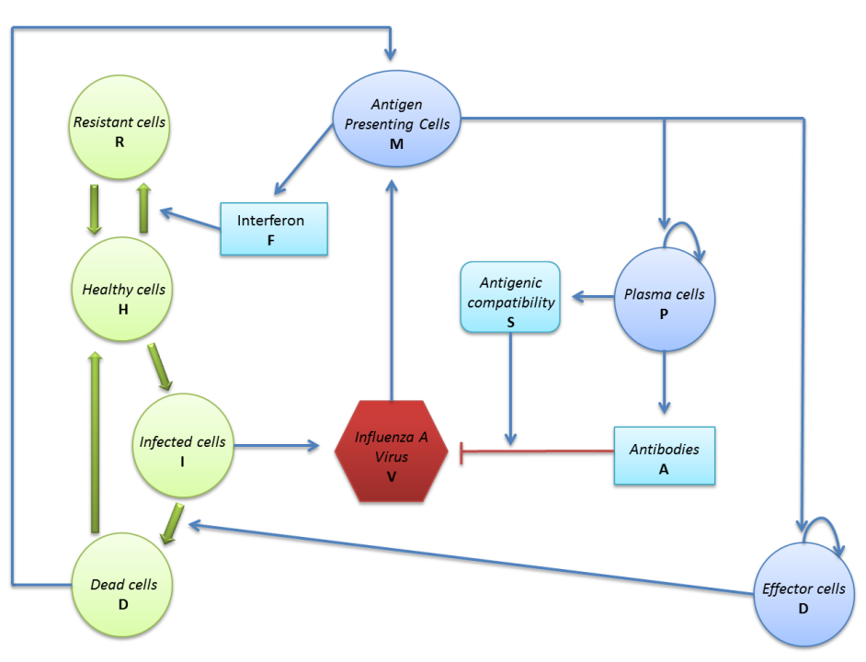
The Hancioglu model

Slide 18
Phase 2 – Inherited Code
So, how did they do?

Slide 19
Inherited Material - Checklist
What | Check | Comments
Clear report? |  | Well-explained mathematics and good documentation of results. Authorship clear.
User-friendly GUI? |  | Beautiful GUI. Drop-down menus are a good solution to the multi-parameter problem. Needs a ‘running ’ bar and a reset key.
Clear Licencing? |  | Yes, throughout. Immaculate spelling of CC-BY-3.0. We all felt thoroughly safe.
Code Commenting? |  | Quite thorough.
Code Structure?

Slide 20
Extensions 2: Influence of antiviral drugs
A number of papers have discussed the inclusion of drug variables in human virus response (e.g. Smith and Perelson 2011…)
Approach 1: 2-compartment pharmacokinetic model (adds extra ODEs to describe )
Approach 2: Analytical expression for drug effects

