Slide 1
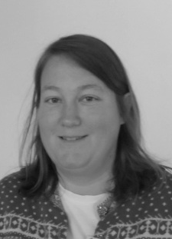
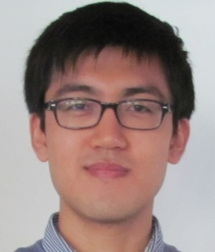
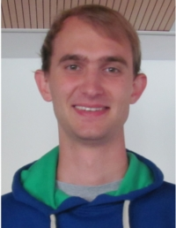

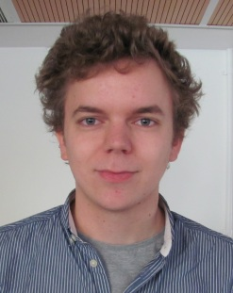





Group D Phase 2 Project
A. Ambuehl | W. Smith
J. Leem | O. Thomas
M. Lücken

Slide 2
The Problem – Human Immune Response Modelling
The human immune system is a complicated entity
The model of Hancioglu et al. (2007) seeks to capture some of its behaviour…
… specifically the interplay between innate and adaptive immunity
Group G (Pearce et al.) were tasked with implementing model in MatLab®

Slide 3
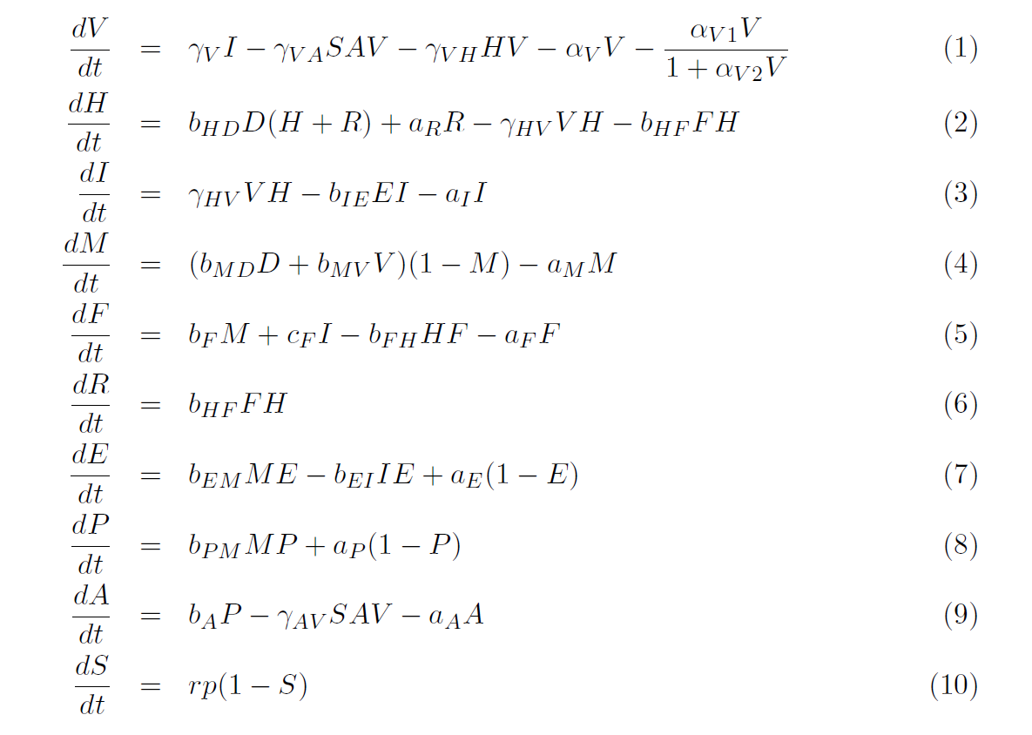
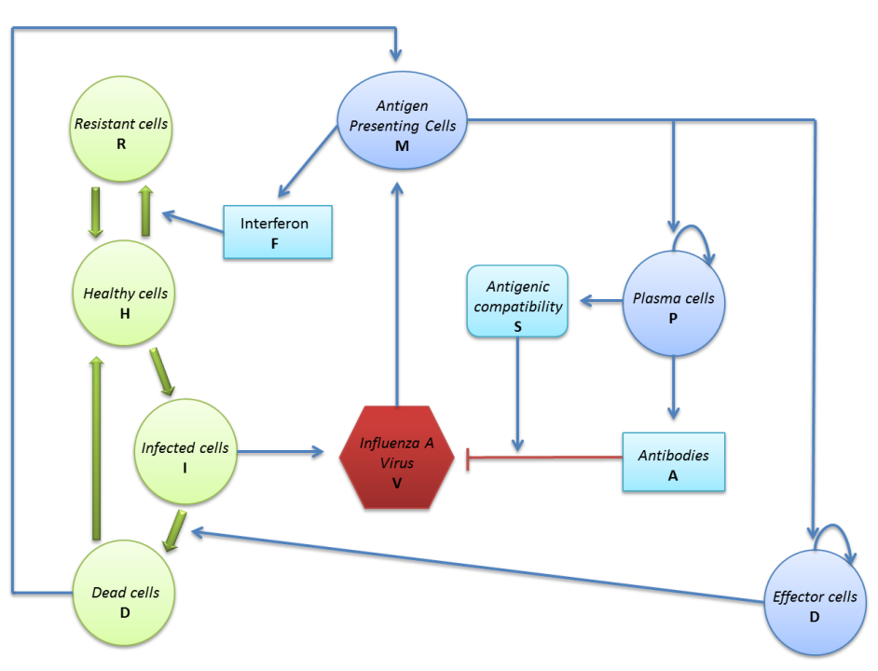
The Hancioglu model

Slide 4
Phase 2 – Inherited Code
So, how did they do?

Slide 5

Inherited Material - Checklist
What | Check | Comments
Clear report? |  | Well-explained mathematics and good documentation of results. Authorship clear.
User-friendly GUI? |  | Beautiful GUI. Drop-down menus are a good solution to the multi-parameter problem. Needs a ‘running ’ bar and a reset key.
Clear Licencing? |  | Yes, throughout. Immaculate spelling of CC-BY-3.0. We all felt thoroughly safe.
Code Commenting? |  | Quite thorough. Autocomments left by GUIDE of dubious value.
Code Structure? |  | Clear, well structured, but incorporation of new variables proved difficult, owing to GUIDE’s heavily nested data stream.

Slide 6
Phase 2 Modifications
Introduction of Stochasticity
In both Matlab (Owen) and C++ Mex Files (Malte)
Addition of Drug Response
Will, Antonietta
Refinement of Biological Accuracy of Model
Jin
Incorporation of new features into GUI

Slide 7
Stochastic modelling
We established two points at which adding stochastic noise would be biologically justified
Production rates of virus from infected cells
Variation in burst size is known to be significant (Mitchell et al. 2011)
Affinity Maturation process will be stochastic in nature
Selection of most successful antibody from series of candidates (Grimaldi et al. 2005)

Slide 8
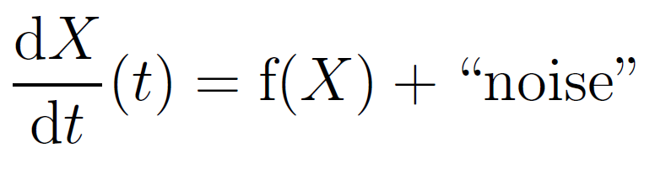
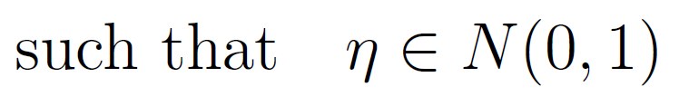
Adding noise to populations
Add noise into population ODE
Adapt Euler method to give Euler-Maruyama method
f(X) is the “drift function”
G(X) the “diffusion function”
δt is the timestep

Slide 9

Adding noise to rates
Alternatively, we can add noise to specific processes
This demands adding of noise functions within the drift function f(X)
We can adapt regular ODE solver:

Slide 10
Implementation in Matlab®
These two approaches were coded into two separate solvers in Matlab
Noise function encoded such that:
Allows for a wide range of noise types
Zero-checking necessary to avoid highly divergent areas of phase space
Code ran fast enough for parameter testing

Slide 11
Stochastic Matlab® Results
Adding noise to affinity maturation rate had little appreciable effect on other outputs
It only really functions as a Boolean, anyway.
Adding stochasticity to virus production produced some exciting results
Brings about the possibility of several waves of infection.

Slide 12
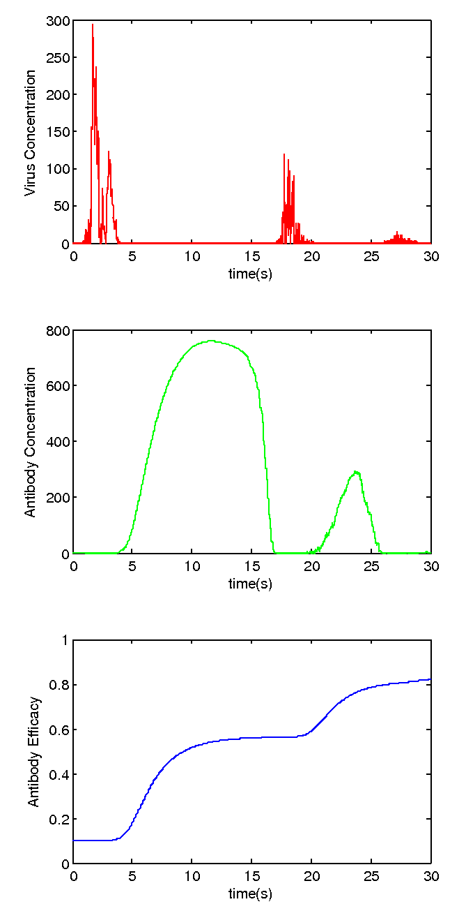
Multiple Waves
Noise in V allows infection to re-emerge when antibody count decays away
Antibody Efficacy grows each time
Population “remembers” how to fight disease, finding it easier to rebuff

