Slide 1


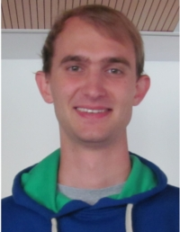







Group D Phase 2 Project
A. Ambuehl | W. Smith
J. Leem | O. Thomas
M. Lücken

Slide 2
Contents
1. Phase 1 – Cancer population dynamics in the colonic crypt
2. Phase 2 – Modelling human immune response to IVA

Slide 3
1. Phase 1 work
Cancer population dynamics in the colonic crypt

Slide 4
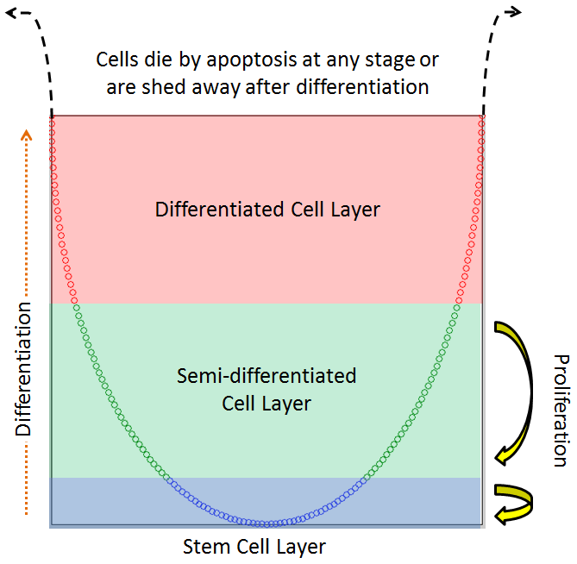

Background – the colonic crypt

Slide 5
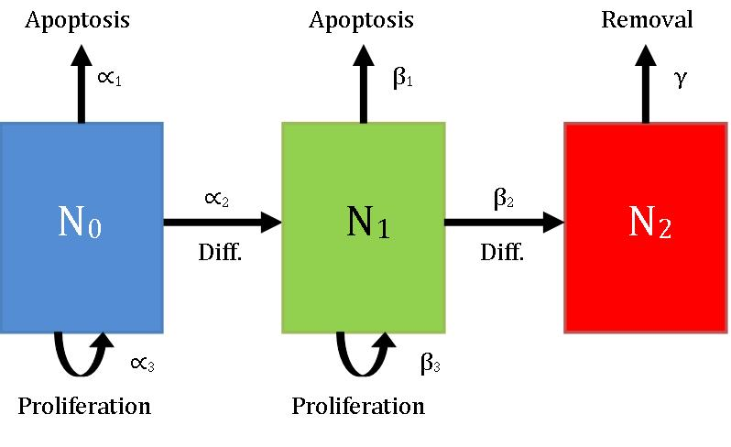

Background – the colonic crypt
Multiple groups have applied simple compartment models to the crypt:

Slide 6
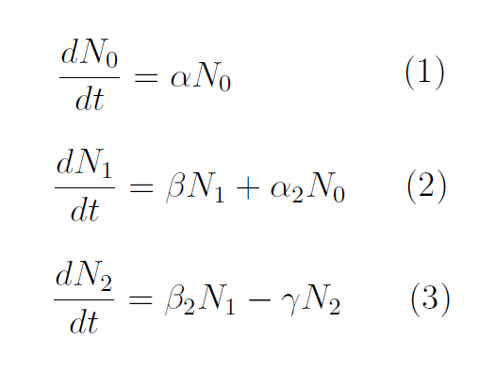
Modelling 1: continuous vs. discrete
Johnston et al. used both discrete and continuous models
We focused on the continuous model
Assumes large time and population scales

Slide 7
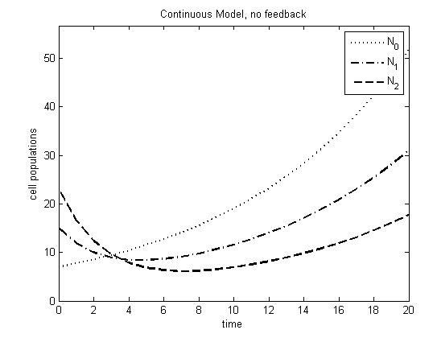
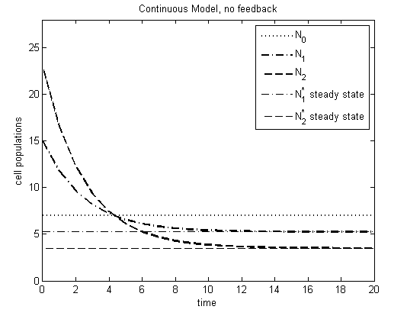
Modelling 2;3: adding feedback
The 3-compartment system is pretty boring: very limited stability
Adding feedback (populations govern parameters) generates more interesting behaviour!

Slide 8
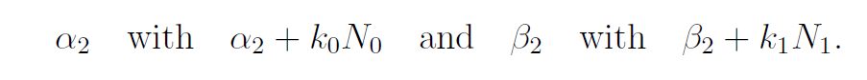
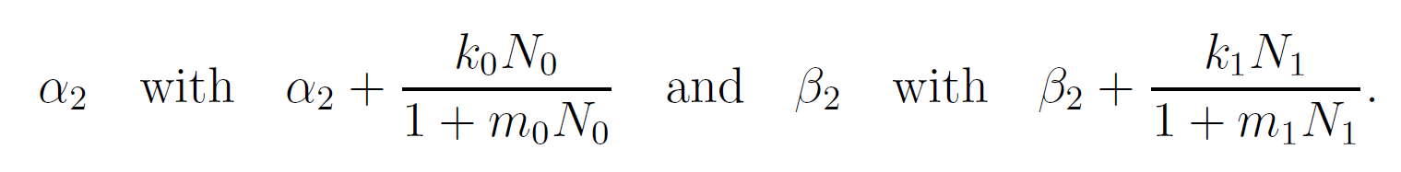
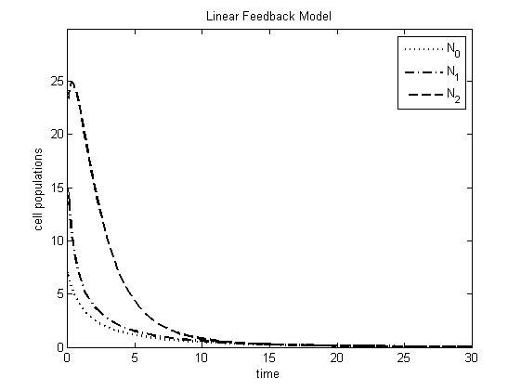
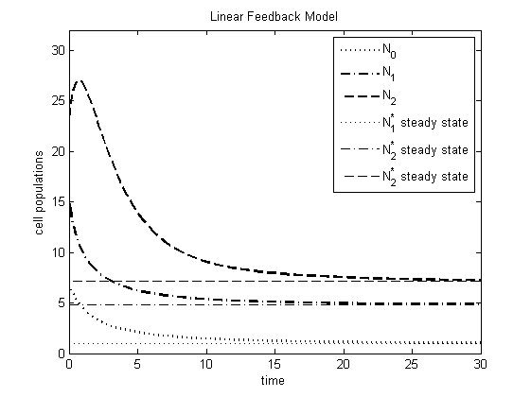
Modelling 2;3: adding feedback
Two types of feedback were reproduced:
Linear: replace…
Saturable: replace…

Slide 9
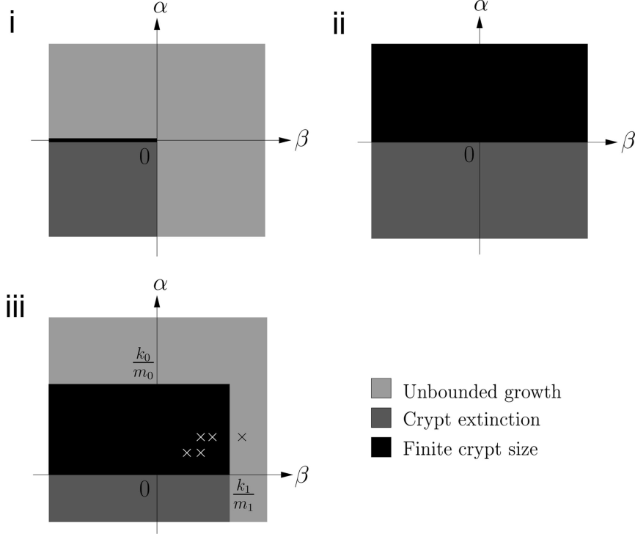
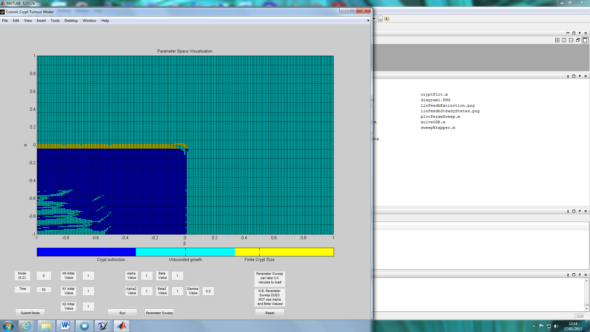
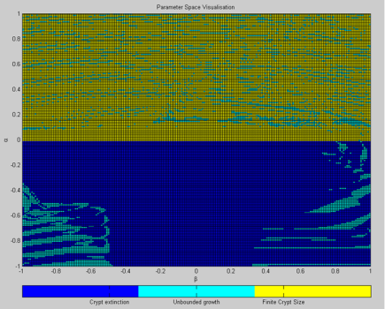
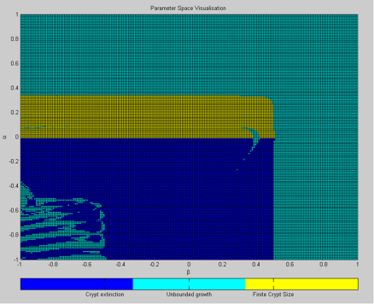
Parameter Sweeps – stability analysis
Phase space plots highlight parameter combinations leading to stable crypt sizes, unbounded growth or crypt death
ANALYTICAL
NUMERICAL
LHS: Johnston, Maini et al. 2007
RHS: Ambuehl et al. 2013, CC-BY-SA-3.0

Slide 10
Stability Analysis for parameter sweep plots
Numerically determining solution stability within a reasonable time is hard
We tried 2 methods:
Tangent gradient at
simulation end < 0.01
|Gradient| decreases at
the end of the simulation

Slide 11
Stability Analysis for parameter sweep plots
Numerically determining solution stability within a reasonable time is hard
We tried 2 methods:
Tangent gradient at
simulation end < 0.01
|Gradient| decreases at
the end of the simulation

Slide 12
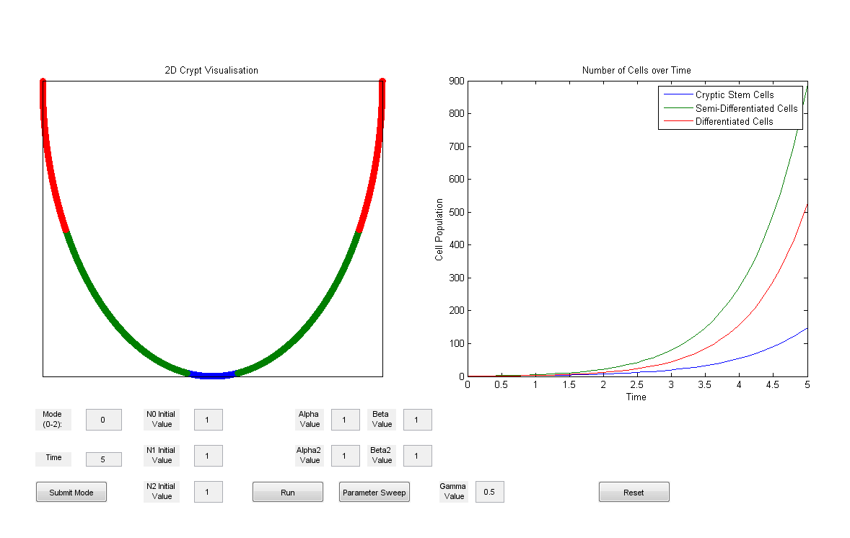
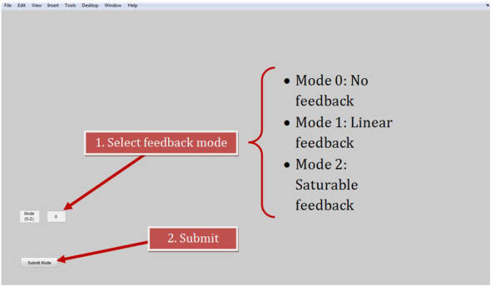
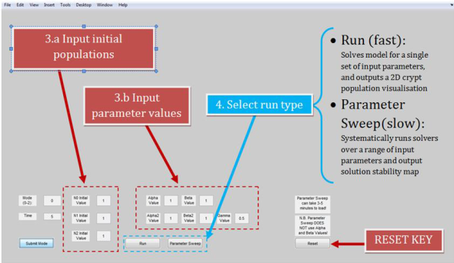
Our Work – The GUI
Code only – no GUIDE!
It has a dynamic crypt plot (cells imposed on a parametric sine curve)
Not as robust as we’d like – crashes quite easily if the user gives it too much to do

Slide 13
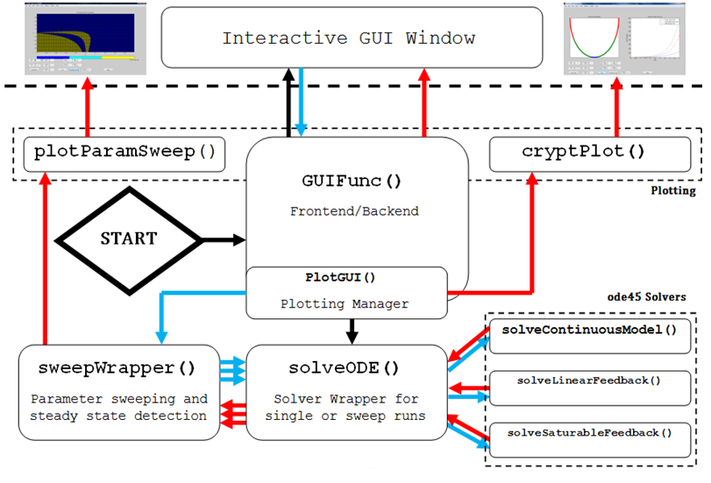
Our Work – The code

Slide 14

Phase 1 Conclusions
Reproduced behaviour of 3-compartment ODE set, under 3 different feedback modes
Implemented and compared stability analysers
Wrapped 3 solvers into a GUI, featuring dynamic crypt visualisations
Used GUI to corroborate analytical stability plots!
Johnston et al. omitted information on possible scaling of α and β values complicating reproducibility

