Slide 1
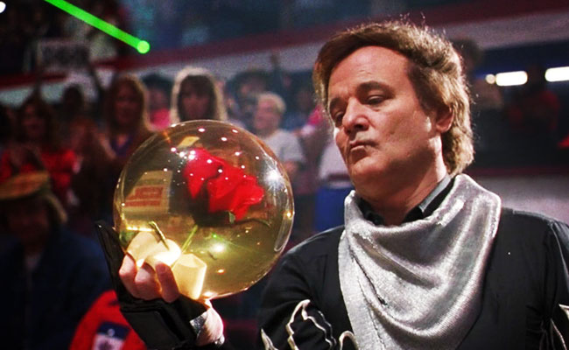
DS Project – Bowling Data

Slide 2
Introduction
Bowling?!?
USBC Nationals
Data
Approach
Goals

Slide 3
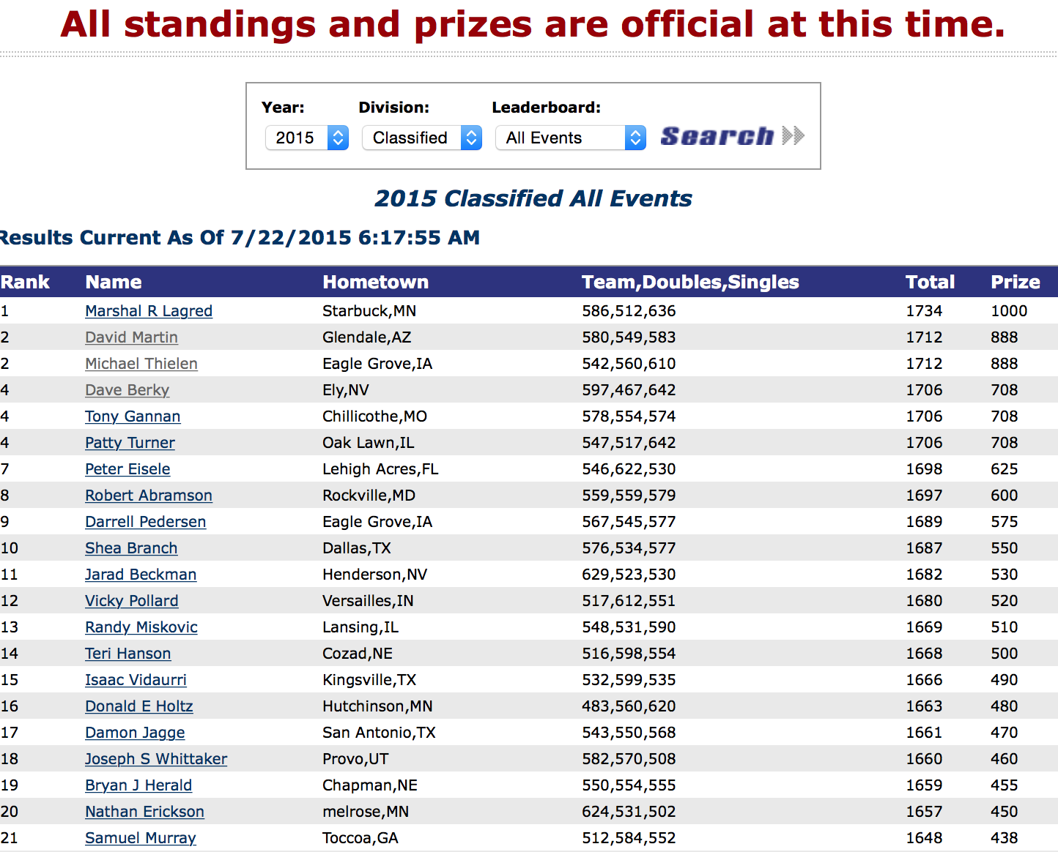
Getting the Data
No APIs available
Kimono

Slide 4
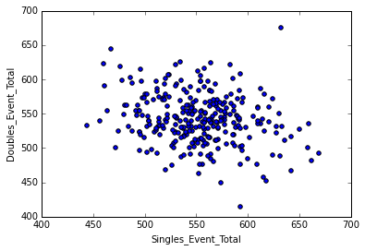
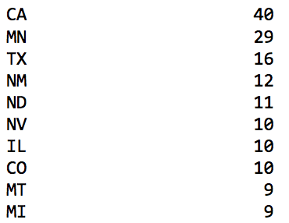
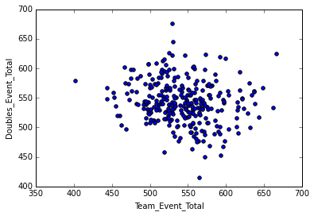
Data Exploration

Slide 5
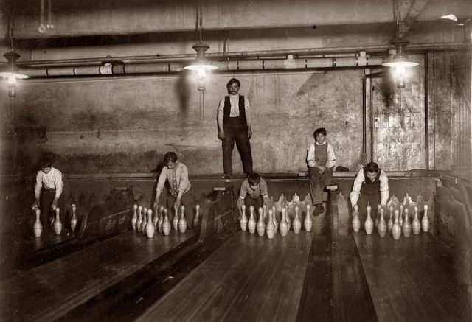
Figuring out the Goal
What to do with the data??
Flagging Possible ‘Cheaters’
Pulling in Average data – very manual process

Slide 6
Kmeans Clustering
No outputs? What to predict?
Generating Clusters to create possible outputs
Feature engineering to get better clusters

Slide 7
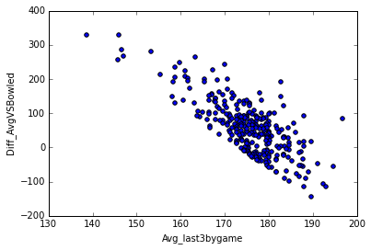
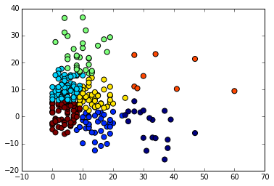
Process
Multiple attempts to view clusters
First Attempt to cluster
Problem with Averages though
After taking into account a Average across 3 years

Slide 8
Final Clusters
def avg_range(row):
data = [row['Avg_2013'], row['Avg_2014'], row['Avg_2015']]
return max(data) - min(data)
Good Clusters with Lots of info
Which clusters we care about
Mapping outputs
logbaggers = {2:1, 6:1}
df['Log_Bagger_Response'] = df['cluster'].apply(lambda x: logbaggers.get(x,0))

Slide 9

Logistical Regression
Logfeatures = ['Total_avgBG', 'avg_range_total', ‘avg_range']
zip(Logfeatures, logreg.coef_[0])
print metrics.accuracy_score(y_test, y_pred) = 0.986486486486
scores = cross_val_score(logreg, X, y, cv=5, scoring='accuracy')
0.98305085, 0.98305085, 0.98305085, 0.96551724, 1.
array([[68, 0], sensitivity: 5/6 = .83333
[ 1, 5]]) specificity: 68/68 = 1

Slide 10
KNN
KNNfeatures = ['Total_avgBG','Avg_last3bygame','avg_range']
knn = KNeighborsClassifier(n_neighbors=5)
scores = cross_val_score(knn, KnnX, Knny, cv=5, scoring='accuracy')
np.mean(scores)
array([ 0.96610169, 0.96610169, 0.93220339, 0.98275862, 0.98275862])
mean: 0.96598480420806543

Slide 11
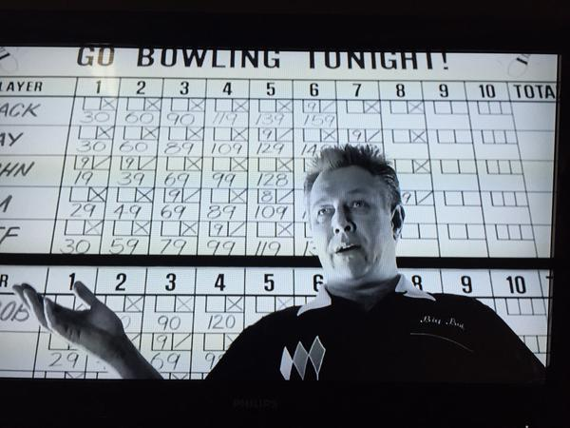
Conclusion
Too much Manual data gathering
Things to do in the Future

