Slide 1

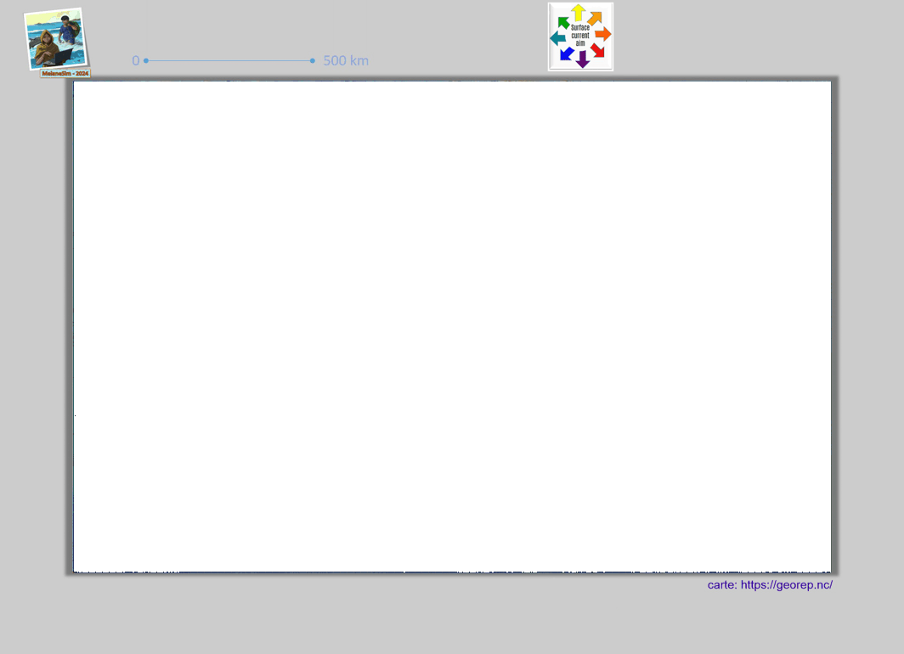
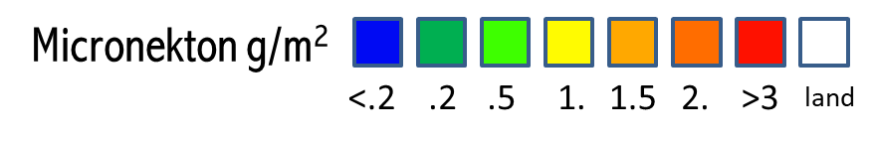

Slide 2
Micronekton g/m²
<.2
.2
.5
1.
1.5
2.
>3
land
else if (value > 0 && value <= 0.2) value = 1;
else if (value > 0.2 && value <= 0.5) value = 2;
else if (value > 0.5 && value <= 1) value = 3;
else if (value > 1 && value <= 1.5) value = 4;
else if (value > 1.5 && value <= 2) value = 5;
else if (value > 2 && value <= 3) value = 6;

