Slide 1



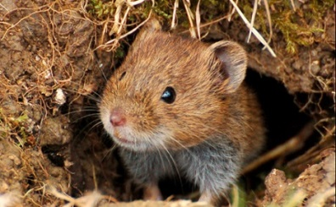
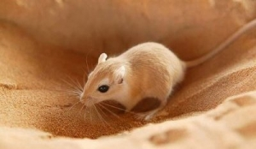
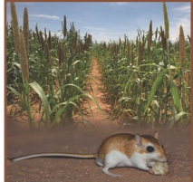
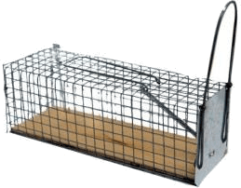
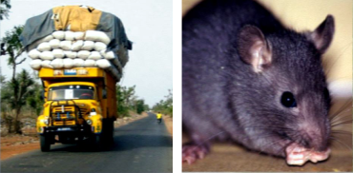
1
Common vole (Microtus arvalis) in a Changing Agricultural Landscape
2
Common vole (Microtus arvalis) in a Changing Agricultural Landscape
Invasion of Senegal Sahel by nigerian gerbil (Gerbillus nigeriae)
CMR experiment on a Mastomys population in Bandia (Senegal) reserve
Black rat (Rattus rattus) colonization of Senegal over the past century

Slide 2
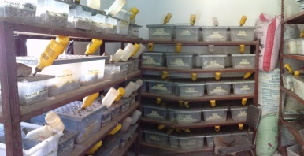
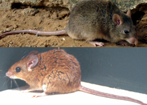

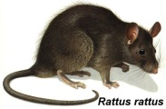
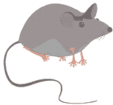
Hybridization of Mastomys natalensis & erythroleucus (cage experiment)
Theoretical test bed model : Hybridization of Mastomys natalensis & erythroleucus
Colonization of Senegal by invasive commensal rodents.
Mus musculus

Slide 3
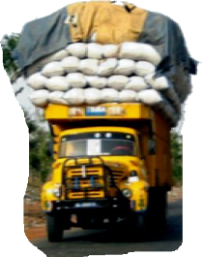
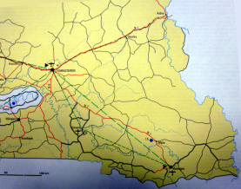
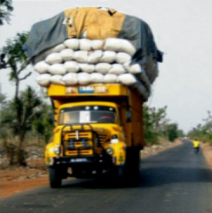

Black rat (Rattus rattus) colonization of Senegal over the past century
Black rat (Rattus rattus) ecology in Southeastern of Senegal

Slide 4
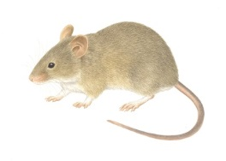

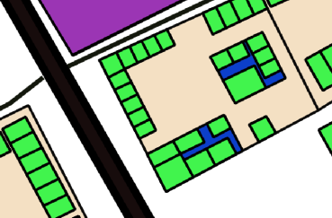




Zoonose propagation and transmission by house mouse (Mus musculus)
Village colonization by house mouse (Mus musculus)
Zoonose propagation and transmission by house mouse (Mus musculus)

Slide 5


