Slide 1
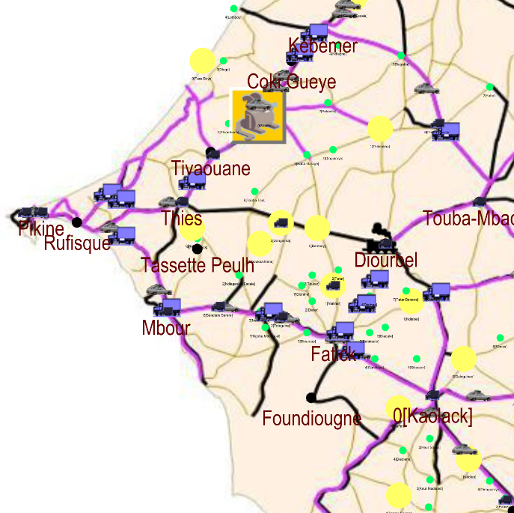





Cerise
Truck
Collective taxi Train
Vehicle loading rodent
City
Town
Market day
Observed passenger flows

Slide 2
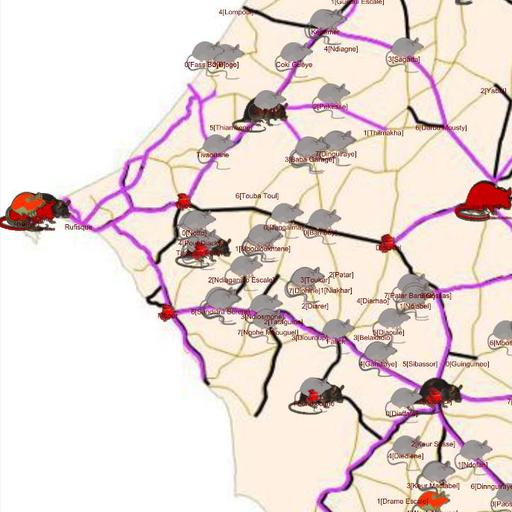
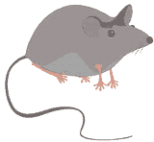
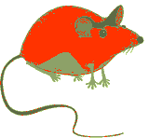
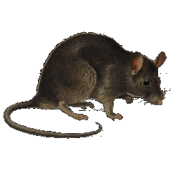


Cerise
Adult house mouse
Pregnant house mouse Adult black rat
Pregnant black rat
Juvenile

