Slide 1
Homelessness in America
Jake Lehrhoff

Slide 2
Background
Did you see a homeless person today?
What do you do as you walk by?
Why?
As many as 1 in 3 homeless people in America are mentally ill
Drug abuse and dependency are in DSM-5

Slide 3
Research Goals
Investigate state homeless populations
Analyze the link between temperature and homeless populations
Probe the relationship between mental health spending and homeless populations

Slide 4
Data
2009 Annual Homeless Assessment Report (AHAR) to Congress
2013 Annual Homeless Assessment Report (AHAR) to Congress
National Alliance on Mental Health – State Mental Health Cuts: The Continuing Crisis
Average winter temperature by state

Slide 5
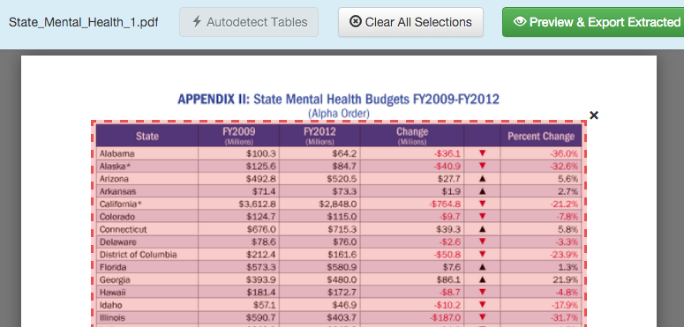
CSV = Friend, PDF = Enemy
Homelessness and Budget data came from pdf’s
Tabula can convert a pdf table into a csv

Slide 6
Cleaning Data
Removing commas and symbols from numerical data
as.numeric.func <- function(x, y) {
as.numeric(gsub(y,"", x))
}
Removing extra space after state name
homeless2009a$State <- substr(homeless2009a$State, 1, nchar(homeless2009a$State) - 1)

Slide 7
ReadHTML
XML package
Split into 2 tables so had to be joined
Created “cold,” “moderate,” and “warm” levels
labels <- c("cold", "moderate", "warm")
minW <- min(data$AvgW)
maxW <- max(data$AvgW)
RangeW <- (maxW-minW)
breaksW <- c(minW, minW + RangeW/3, minW + 2 * RangeW/3, maxW)
data$Wtemp <- cut(data$AvgW, breaks = breaksW, include.lowest = TRUE)

Slide 8
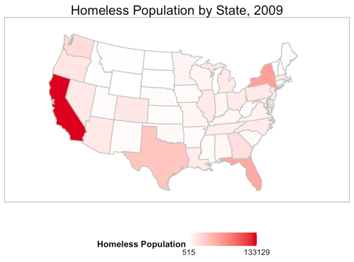
Homeless Population by State
Notes:
California has a huge homeless population. NY, FL, and TX are pretty big too.

Slide 9
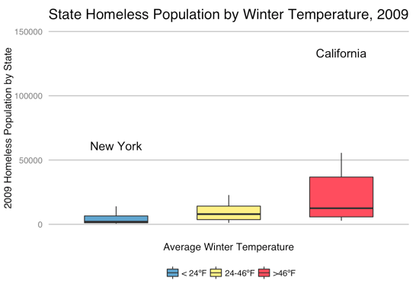
Homelessness and Climate
Notes:
New York and California are outliers
But The issue is obviously that we haven’t looked at the homeless RATE. There are a lot of people in NY and CA

Slide 10
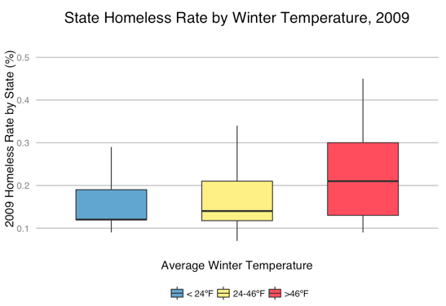
Homelessness and Climate
Notes:
No more outliers

Slide 11
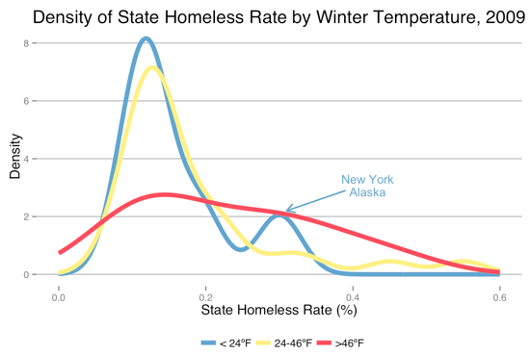
Homelessness and Climate
Notes:
NY and Alaska skew data to the right.
Warm weather states have a much flatter distribution

Slide 12
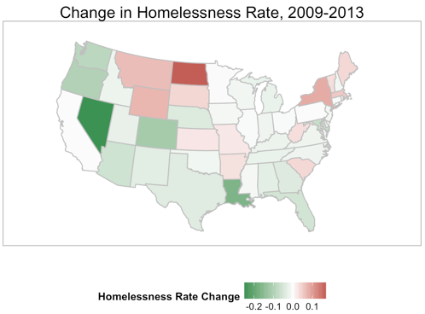
Changes in Homelessness
Notes:
Homeless rate changes
NV is doing something right
ND and the surrounding states - ?? OIL
Louisiana – recovering from Katrina

Slide 13
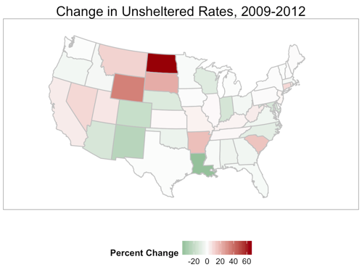
Unsheltered Homeless
Notes:
Even more troubling

Slide 14
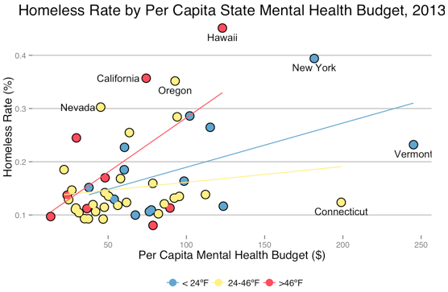
State Mental Health Budgets
Notes:
NV, CA, OR – not spending much on mental health
HI – high homeless, but other factors
NY – high spending/high homeless
CT and VT – high spending, low homeless

Slide 15
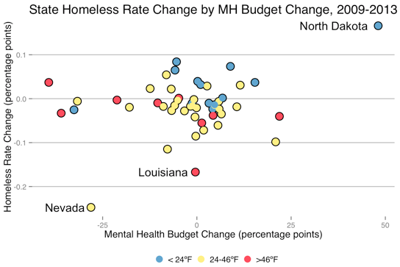
State Mental Health Budgets
Notes:
ND – dealing with huge population
NV – things are looking good – but about to see rates shoot up
Louisiana – slow improvement, other types of welfare

Slide 16
Conclusions
Homeless rates are only marginally higher in warm climates
There is a weak, positive relationship between mental health spending and homelessness
North Dakota is in a homeless crisis
After improvements, Nevada may be reverting to the mean
Louisiana’s improvements are likely due to other welfare supports beyond mental health care

Slide 17
Resources
US Department of Housing and Urban Development
National Alliance on Mental Health
CurrentResults Weather data

Slide 18
Thank you!

