Slide 1
Hollywood’s Sequel Problem
By Jake Lehrhoff

Slide 2
Scope
Scrape
Daily box office receipts: http://www.the-numbers.com/
Lifetime box office receipts: http://www.boxofficemojo.com
Movie ratings: http://www.rottentomatoes.com
Compile data in a Shiny app
Blow everyone’s minds*
*verify common knowledge

Slide 3
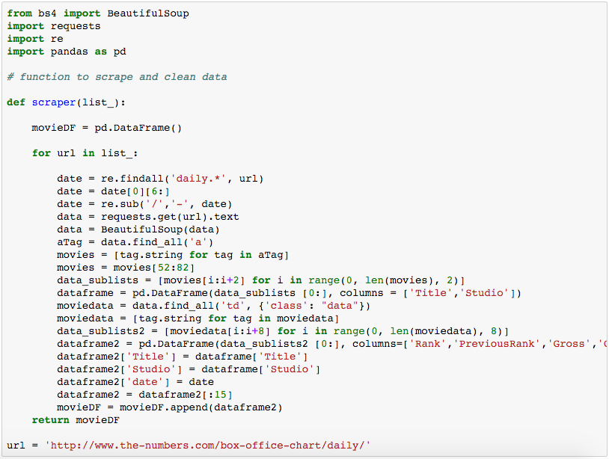
Scraping Daily Data

Slide 4
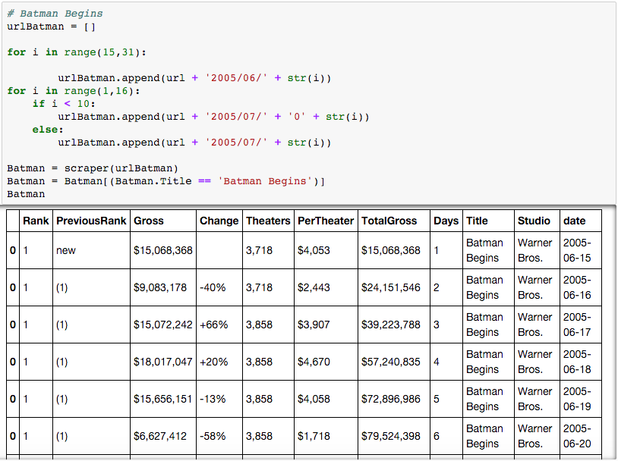
Scraping Daily Data

Slide 5
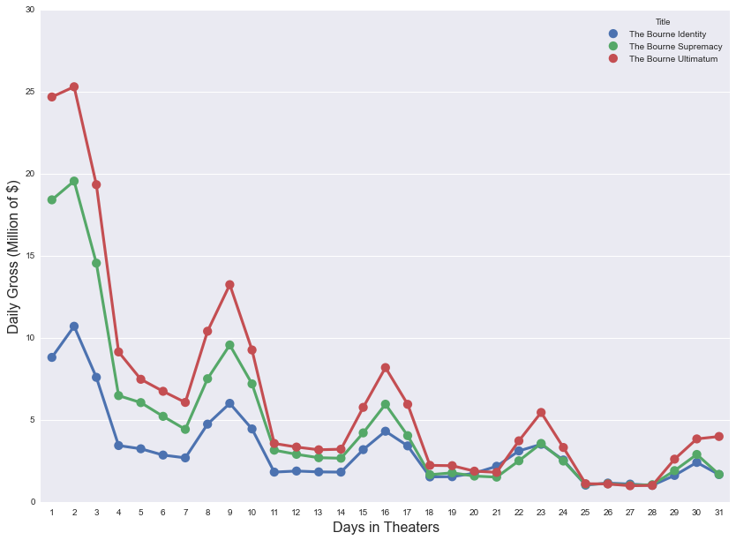
Graphing Daily Data

Slide 6
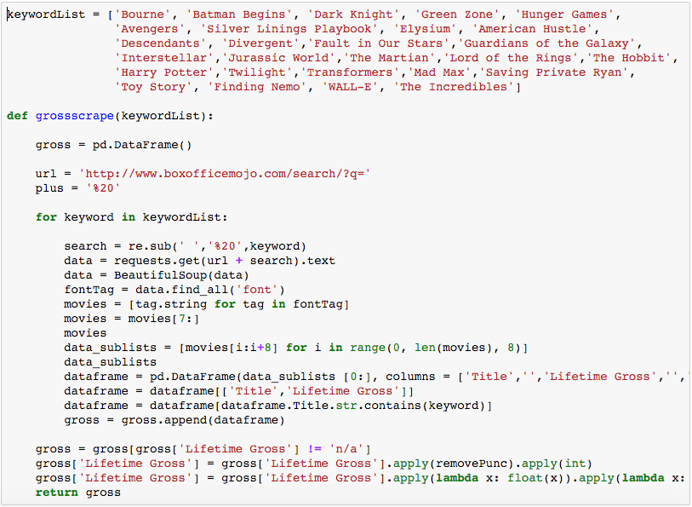
Scraping Lifetime Data

Slide 7
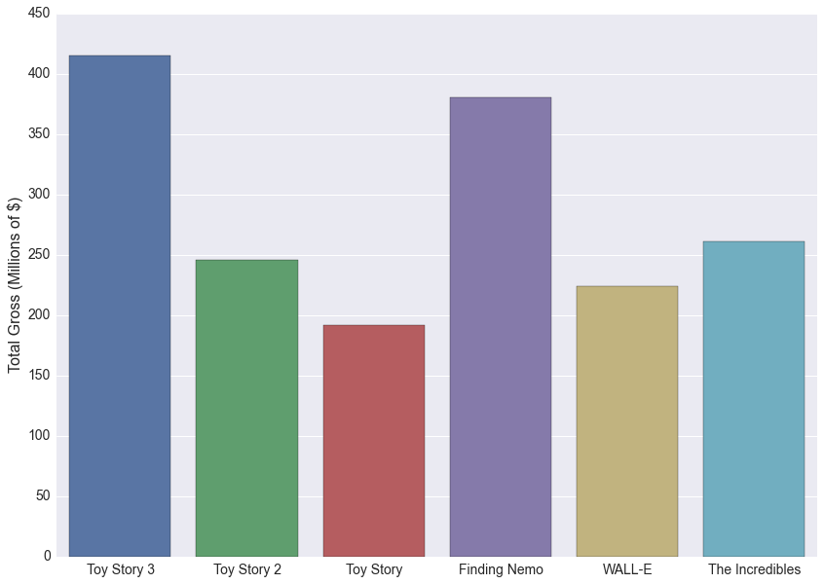
Scraping Lifetime Data

Slide 8
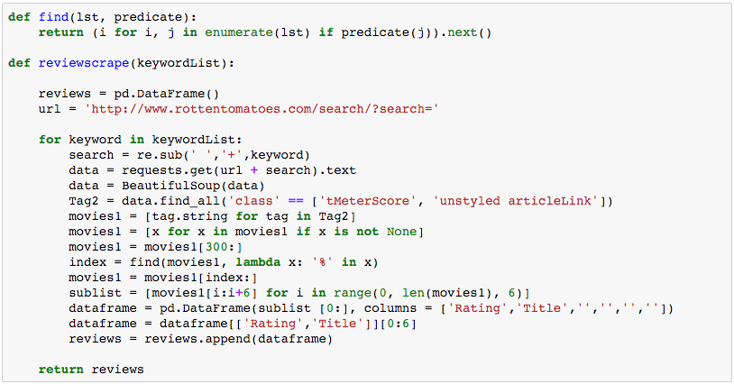
Scraping Ratings Data

Slide 9
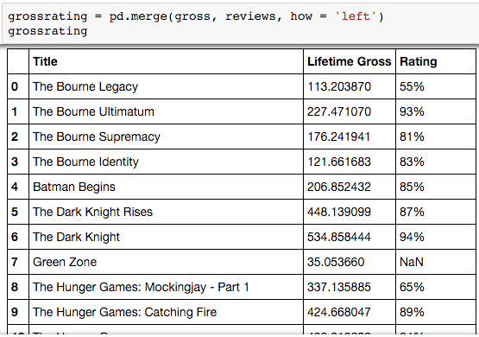
Scraping Ratings Data

Slide 10
Shiny!

Slide 11
Next Steps
Twitter data
Search twitter for chatter about current movies
Possible metric for predicting box office receipts
Tweet rate and number of theaters has been more predictive than the sum of all of Hollywood’s exit polls and focus groups
Tweet rate + NLP = Good idea*
Tweet rate + NLP + responsiveness to twitter marketing = Awesome idea?
*It’s been done by Fast Company

