Slide 1
Title candidates:
Is best available information good enough? Using open forest inventory data for conservation planning in Fennoscandian boreal forest.
How informative is open forest inventory data for conservation prioritization?
Open forest inventory data as basis for conservation prioritization in Boreal forest landscapes.

Slide 2
1. Intro

Slide 3
1.1 Data availability and available data
Reliable and extensive data on species occurrence is rarely available.
In most Fennoscandian countries (Finland included) there is a wealth of forest inventory data available and the data is relatively accurate
Detailed inventory data is often in restricted use, but more and more publicly funded data are becoming openly available (e.g. Metla's MSNFI data).
- open data policies have a huge potential for conservation planning
Using forest inventory data as a basis for conservation prioritization effectively surrogate use for the primary forest biodiversity data (species and habitats occurrence data) → how well do inventory data work?
Setting the reference for surrogacy is complicated, but we have a fairly good understanding what is valuable in boreal forests from conservation point of view
Open data and open methods play a crucial role especially in research that is aimed to provide decision-support information

Slide 4
1.2 Spatial conservation prioritization
Conceptual and methodological ways of defining priorities for given conservation actions (conservation, restoration etc).
Importantly, conservation of highest priorities is only one aspect; equally important is where the lowest conservation priorities are → these are areas for alternative land use.
Forest management has a long history of multi-objective planning so detailed conservation prioritization should fit into existing customs well.
Priorities given by scientific analyses often not verified but rather taken at face value → multitude of available forest inventory data also opens up possibilities to assess and validate prioritization results.

Slide 5
1.3 Conservation planning in boreal forests
Major ecoregion with large geographical extent and important role for example in carbon storage and sequestration.
While not the most species-rich or threatened ecoregion on the planet, there is still good opportunity to protect/manage large continuous areas of forest
Much conservation research has been done in boreal forest context on various fields → most impact from implementation point of view on work done in general forest management planning
Regional conservation programmes (e.g. METSO) often must reconcile varying interests and objectives of forest owners, but again much of the general context is forestry management
Forestry is mostly driven by market economics and conservation has also been shifting into more voluntary-based models emphasizing the role multi-use and ecosystem services → need for fine-grained spatial plannign

Slide 6
1.4 Aims and scope
Main questions of the work are:
  Can conservation prioritization analysis based on forest inventory data capture conservation value in boreal managed forest landscapes?
  How well does freely available multi-source forest inventory data perform compared to more detailed commercial stand-based inventory data?
  What are the requirements for data imposed by the conservation objectives (e.g inclusion of connectivity and complementarity)?
Additional the work presented aims at addressing the following practical issues:
  Ways to integrate conservation planning into operative forestry management and planning
  Making use of the available data considering the existing ownership restriction
  Assessing what kind of (forestry) data would be useful for conservation planning

Slide 7
1.4 Aims and scope
In this work, we approach the aforementioned questions by a case-study of conservation prioritization in the regional forest center of South-Savo, Finland.
Work described was done in the context of METSO – the forest biodiversity conservation programme for Southern Finland – with the aim of putting the results into practice.
Similar forest inventory data exists at least in other Fennoscandian countries with similar kinds of forest planning needs
We also demonstrate new ways of assessing the results especially from forest planning perspective

Slide 8
2. Material and methods

Slide 9
2.1 Study area and context
Study area is the province of South-Savo in Southern Finland with a total area of XX ha of which XX ha is forested
XX% owned by private forest owners, XX% by the state and XX% by others
Area dominated by XXX type of forest management regime with high turnover rate in the landscape (a lot of small-scale operations)
Regional forest center does XX of planning using a variety of data sources
The forest biodiversity programme METSO is an ongoing effort to halt the decline of biodiversity in Southern Finland by 2020 (2016?). Instruments include e.g. the expansion of PA network.
The need for SCP in the regions involves informing the authorities 1) what to prioritize and 2) where to approach forest owners.
Different authorities have different operative planning systems and different access to data → facilitating collaborations and providing boundary objects (?) important

Slide 10
Table 1. Different data sets used in the analysis and validation. Code refers to a specific abbreviation used elsewhere in the text and figures. Availability is a broad categorization: 1 = available for research purposes upon request with strict conditions, 2 = available for research purposes upon request with lax conditions, 3 = freely available.
Notes:
Data | Data type | Code | Use | Coverage (%) | Production method | Source | Availability
Multi-source National Forest Inventory Data | Raster | MSNFI | Analysis | 100 | Statistical esimator based on field plots and remotely sensed data | Finnish Forest Research Institute (FFRI) | 3
Stand-based forest inventory data | Vector | STINV | Analysis | 46.36 | Field inventories | Finnish Forest Centre, Metsähallitus Natural Heritage Services | 1 / 2
Existing protected areas | Vector | PA | Validation | 1.87 | Field inventories | Metsähallitus Natural Heritage Services | 1
Woodland key-habitats | Vector | WKH | Validation | 0.50 | Field inventories | Finnish Forest Centre | 2
METSO deals (permanent) | Vector | MD | Validation | 0.13 | Field inventories | Centre for Economic Development, Transport and the Environment | 2

Slide 11
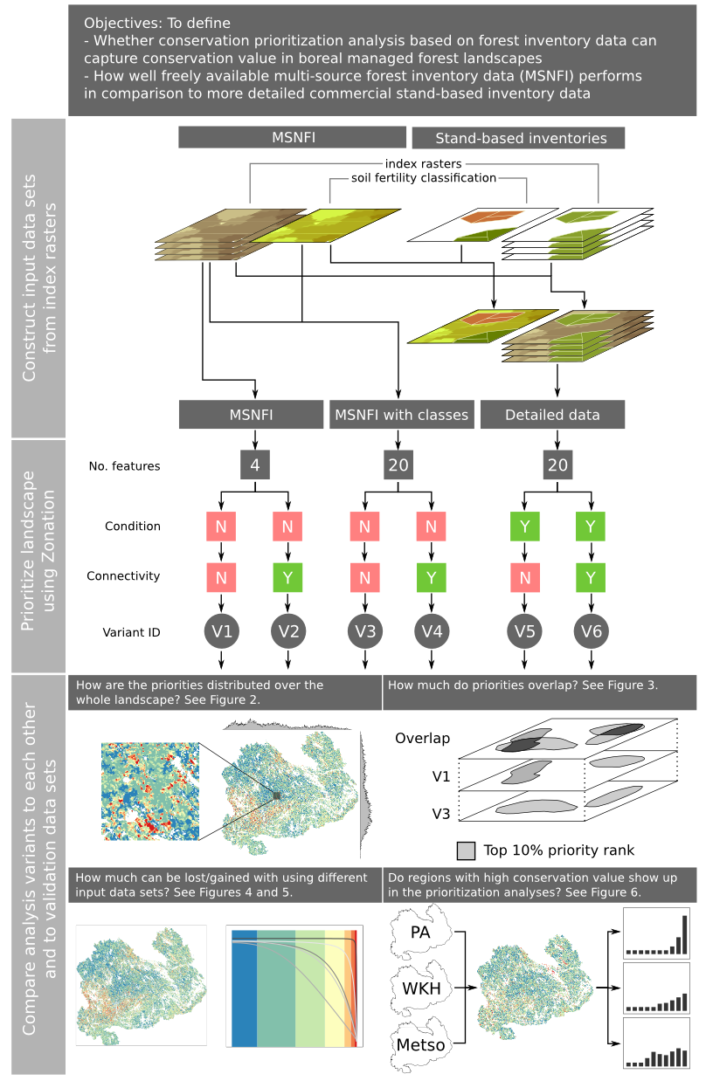
Figure 1. Schematics of the prioritization analysis and how the results are analyzed. Figure is divided in three different section: First describes how the index rasters (see XXX for description) from different input data sets were combined. Second sections describes the main characteristics of the spatial conservation prioritization analysis with Zonation. The third section summarizes how the results were analyzed in order to answer the main questions.

Slide 12
2.3 Data for conservation prioritization
Data used must be available across the entire study area.
Source of the data matters as different data sets have different levels of uncertainty etc.
Prioritization data sets (more description in Table 1):
  Segmented multi-source National Forest Inventory data from Finnish Forest Research Institute
  Stand-based forest inventory data from South-Savo Forest Center
  Stand-based forest inventory data from Metsähallitus Natural Heritage Service
Variables used: average diameters and volume per tree species group, soil fertility class
To study the effect of the data source used, 3 different input data sets were constructed (Figure 1): 1) MSNFI, 2) MSNFI with classes (MSNFI-cl), and 3) detailed with classes (detailed-cl).

Slide 13
2.3.1MSNFI
General description (Sakari?)
Freely (openly?) available online
Digital maps available online are continuous estimates for various structural forest characteristics, but they only include average diameter and volume estimates over all tree species, not per tree species groups.
Covers 52.6% of landscape.
Thus, FFRI produced new segmented versions of the original estimate maps that have per tree species estimates for average diameter and volume.
Implementation details for segmentation described in SXX (?) (Sakari).
Two different input data sets produced from MSNFI data:
  MSNFI: Index rasters for each tree species group (n=4).
  MSNFI with classes: Index rasters for each tree species group and soil fertility class (n=20).

Slide 14
2.3.2 Stand-based inventory data
Data inventoried by the Finnish Forest Centre (FFC) of Metsähallitus Natural Heritage Servics (FFPS) as part of forest planning.
Covers 47.4% of landscape.
Stands inventoried with regular intervals.
Furthermore, information on planned forestry operations was used to discount location where operation of varying intensity were planned.
One input data sets produced from stand-based inventory data:
  Detailed with classes: index rasters for each tree species group and soil fertility class (n=20). Also includes data

Slide 15
2.4 Data for results validation
Validation data comprises of independent data sets that mark the location of known conservation value locations
Only the spatial location marked by areas is used, no additional quantitative or qualitative data
Validation data covers a relatively small fraction of the landscape

Slide 16
3. Methods

Slide 17
3.1 The ecological model of conservation value
Forest inventory collected and used primarily for other purposes than biodiversity conservation.
How do we translate the forest inventory data (structural forest characteristics) into a quantitative measure of conservation value?
Ecological model of conservation value gives a subjective formulation for how we perceive conservation value of forests for a wide array of forest species.
We built a set of simple indices based on information from forest inventory data sets and information elicited from ma group of experts.
Based on expert knowledge, where average diameter of standing tree stock is transformed through a sigmoidal benefit function and the value retained is multiplied by the volume of standing stock (both by tree species group).
Furthermore, the index layers are divided into 5 different categories based on soil fertility classification
See supplementary material SXX (?)

Slide 18
3.1 The ecological model of conservation value
Index aims at capturing forests that are mature where average diameter is used (instead of age) the measure this.
Combination of benefit function transformed average diameter and volume avoids giving too much value to young managed forests which may have a relatively high volume.
Division into soil fertility classes: 1) enables different weighting for different soil fertility classes, and 2) divides the landscape into more common and rarer classes. Both points are important, because of the way how Zonation operates (see section “Spatial conservation prioritization”)

Slide 19
SXX Construction of indices
Get slide from old ESMK materials.
Distributions of soil fertility classes in different input data sets.

Slide 20
3.2 Spatial conservation prioritization
All Zonation analysis (n=6) had the following analysis features used (should this be a table after all?):
  Additive benefit function (abf)
  Weights (SXX?)
  Analysis are mask
These analysis features were varied between different variants:
  Condition (penalty) layer
  Connectivity between forest types (this needs a more technical explanation which needs to make the distinction between “local quality“ and “connectivity transformed features”. Maybe.)

Slide 21
3.3 Interpretation of results

Slide 22
3.3.1 Comparison between analysis variants
Between variants V1-V6
Summarize the distribution of high priority location along the x- and y-axis of the whole landscape to see if there are patterns in the distribution in the prioritization results. (Fig2)
Demonstrate the effect of accounting for connectivity on local scale. (Fig2)
Spatial overlaps between different fractions of different solutions can be used to determine “consistently valuable/less valuable locations”. (Fig3)
It's important to compare not only the best part, but also the worst part of the landscape to see if areas not priority for biodiversity conservation stay consistently in the same place. (Fig3)

Slide 23
3.3.1 Comparison between analysis variants
Comparing variants V1 and V2 to variants V3-V6 shows the effects of how classification enables a more fine-tuned control over what forest types exactly are included in the analysis and hence in the top priorities. (Fig4)
Classification is also meaningful from ecological point of view as the forest types used reflect actual habitat types more realistically.
Using connectivity usually leads to a decrease in the representation levels of features describing local quality → trade-off. (not really visible in Fig4).
If the questions is how “better” do V5 and V6 perform in relation to data (V3 and V4) and classification used (V1 and V2), one can use Zonation to load the ranking order from one variant (e.g. V1), data from another (e.g. V5), look at the performance levels of this “pre-loaded” analysis and compare what's the difference to V5. If the performance it's much worse, then this should be evident from the comparison. (Fig5)
Performance levels do not tell much about whether the solution really is good or not from conservation point of view. For this, one must look at Fig6 at the same time.

Slide 24
3.3.2 Comparisons to validation data
Zonation always produces relative priorities that completely depend on the input data and the analysis features used. Priorities do not necessarily tell anything about the absolute conservation value of the results.
To assess how well the prioritization analysis capture real conservation value, one can compare the prioritization results to known locations of high conservation value.
In this study, we compare the results of variants V1-V6 to 3 validation data sets:
  Protected area network (PA)
  Woodland key habitats (WKH)
  Sites acquired for the METSO programme (METSO)
The assumption is, that if the prioritization analysis is working, then these locations should come up as relatively high priorities. (pick up the issue of what we really want in the discussion).
The question is also that how well do V1-V6 based on freely available MSNFI data perform when compared to the more detailed data. (Fig6).

Slide 25
4. Results

Slide 26
4.1 Spatial patterns of rank priorities 1/2
MSNFI
  Spatial pattern of priorities the most concentrated in particular places
  Highest priorities are located in areas with mature forest with relatively large volumes on (coniferous) trees
  Lowest priorities can be found in …
MSNFI with classes (MSNFI-cl)
  Spatial pattern more equally spread around the landscape
  Highest priorities are located in areas with high amount other deciduous tree species on fertile soils. Also very dry (xeric) soil types come out as high priorities (although this was not intentional).
  Lowest priorities are found in areas with low overall tree volume (including peatlands) and on mid-fertility soil type classes.

Slide 27
4.1 Spatial patterns of rank priorities 2/2
Detailed data
  Spatial patterns of priorities the most equally spread across the landscape
  Highest priorities are located in areas with high amount other deciduous tree species on fertile soils. Also very dry (xeric) soil types come out as high priorities (although this was not intentional). However, the distribution of soil fertility classes is different to that of MSNFI and hence the priority locations are slightly different.
  Lowest priorities are found in areas with low overall tree volume (including peatlands) and on mid-fertility soil type classes.
  Large protected areas tend to stand out better than in the MSNFI and MSNFI-cl variants.

Slide 28
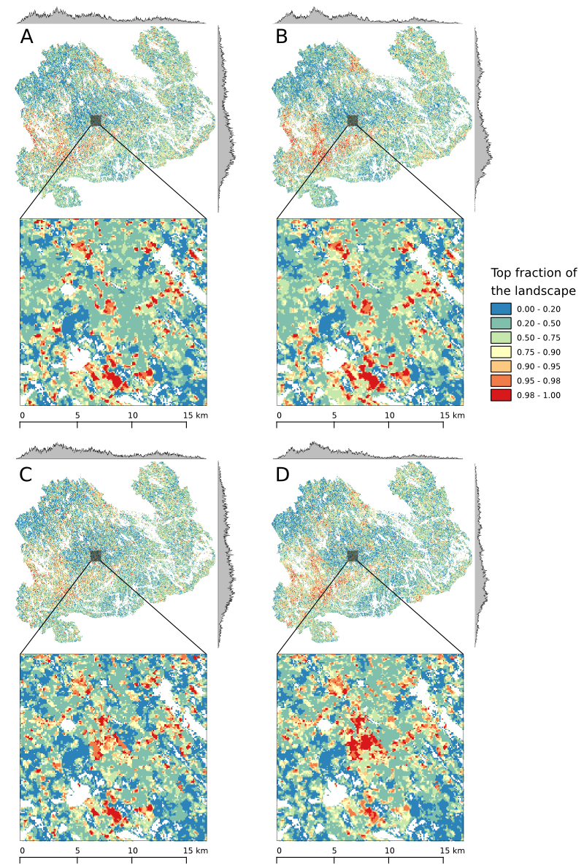
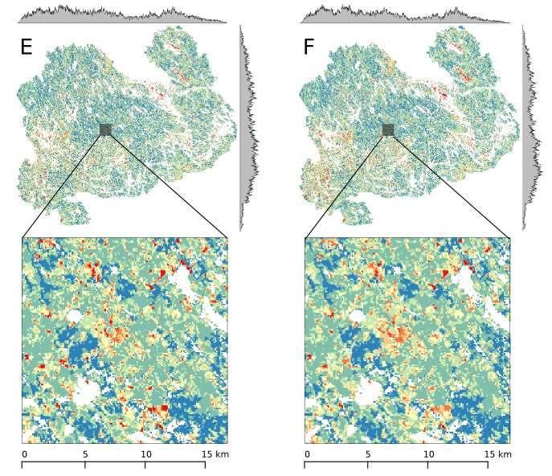
Figure 2. Rank priority maps of each variant showing the distribution of different priority classes over the landscape. The marginal plots on top and on the left side of each rank priority map show the count of cells in the top 10% of the overall landscape (i.e. the best 10% of the landscape) along both latitudinal and longitudinal gradient (or rows and columns).Note that the y-scale in each marginal plot (i.e. count) is different. Smaller insets show the priority pattern on a more local scale.

Slide 29
4.2 Spatial overlap of priority fractions
Spatial overlap of different priority classes can be studied between different variants to determine: 1) how robust are the results, 2) whether there are distinctive patterns in the differences between the different variants.
Difference between input data sets: local quality (V1, V3, V5)
  Best and worst classes (lowest and highest 10%) quite well overlapping (relatively speaking)
  Again relatively speaking, V1 has higher overlaps with lower priority classes in V3. In other words, priorities in V3 are systematically elsewhere than in V1.
  On the other hand, V3's higher priority classes overlap to some extent with the lower priority classes of V1, and there is more variation than the other way around.
Difference between input data sets: connectivity
  Results qualitatively the same, but with lower Jaccard coefficient values.

Slide 30
Figure 3. The spatial overlap of priority classes of 10% between different variants as defined by Jaccard coefficient. Rank priority map of each variant is divided into 10 equal interval bins (i.e. 10% priority class) and the spatial coverage is compared to each bin of another variant. Having a value of 1 indicates that the spatial coverages match completely whereas 0 means that there is no overlap. First two rows show comparisons between variants based on different input data sets. Third row shows comparisons between variants based on the same input data set and is thus a comparison between variants with and without connectivity.

Slide 31
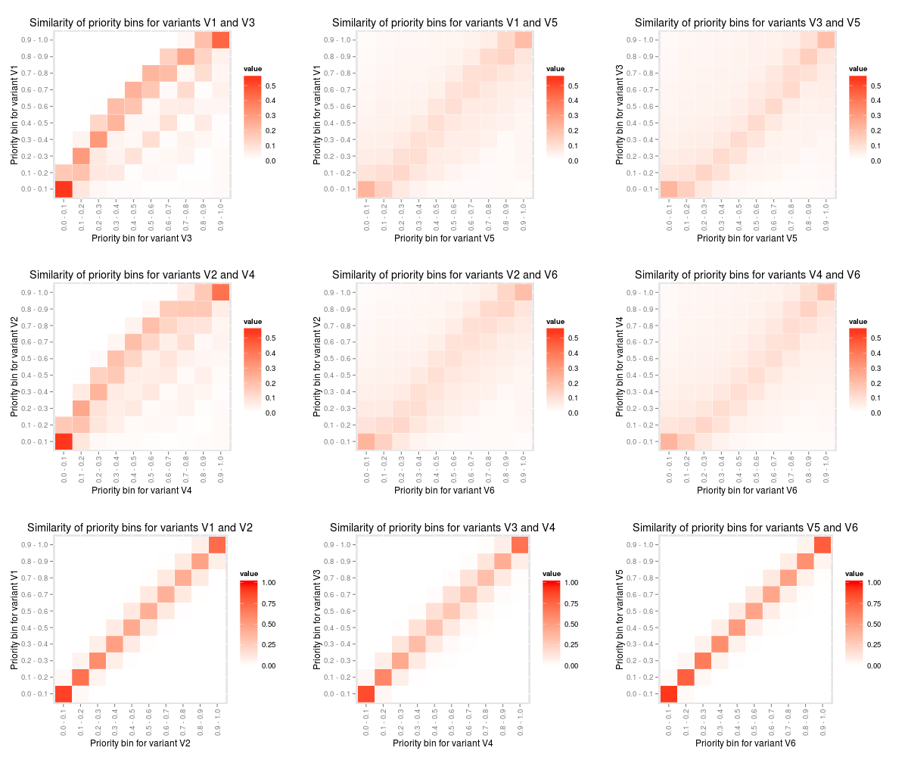

Slide 32
4.3 Feature representation
Within data sources, variants with connectivity have higher on average feature representation, but this is largely due to the fact that many of the features are connectivity transformed duplicates of the original feature stack.
However, looking at the representation level of the non-transformed features (“local quality”) stack we see a slight drop in overall performance. The drop is not very large as the transformed and non-transformed features are highly correlated. (THIS HAS NOT BEEN IMPLEMENTED YET)
msnfi-only results tend to have slightly lower representation in selected top fractions as the data varies more smoothly across the landscape.

Slide 33
Figure 5. Cost of using coarser data in terms of representation of more detailed data. Solid lines in the figure represent the average occurrence level of biodiversity features overall (panel A) or per soil fertility group (panels B-F). These lines are results of variant 5 (V5). Other lines represent the occurrence levels of the same biodiversity features from variant 5, but when the ranking has been determined by the results of V1 (dotted line) and V3 (dashed line) respectively. By comparing these lines to the solid line compares how much representation of the detailed – and presumably more accurate – data would be lost if the prioritization would be done using coarser data. E.g. for biodiversity feature from soil fertility class “herb-rich” the cost would be ~70%. The same comparison for V2, V4, and V6 resulted in very similar results and is not shown here.

Slide 34
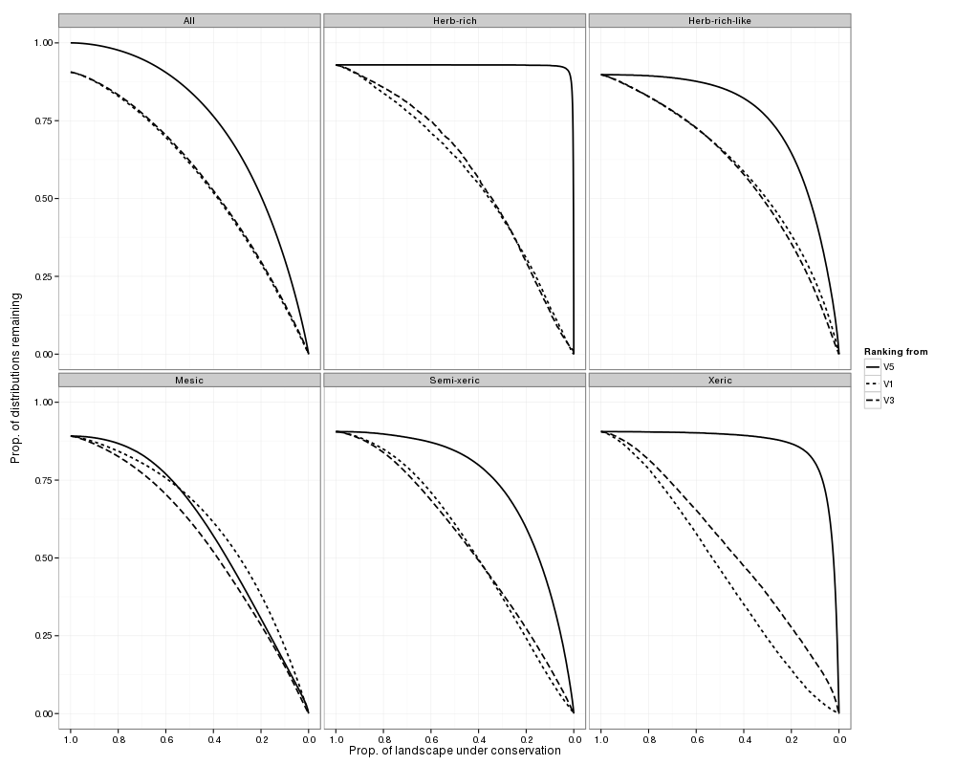

Slide 35
4.4 Comparison to spatial validation data
Between the different variants for the detailed data source, all areas contained in the spatial validation data sets come out with larger than average priority with a priority rank distribute strongly skewed to the left.
  Especially protected areas come out consistently with a high average priority
  When considering only the local quality, also the done METSO-deals have a high mean priority.
  Woodland-key habitats
Between the different variants for the msnfi-only data source the outcome is different
  Protected areas still come out with higher than average priority, but skewness of the histogram of rank priorities is not as pronounced.
  Woodland key habitats have an average priority that is not different from averages.
  Done METSO-deals also have higher than average priority.

Slide 36
Figure 6. The average priority rank and the distribution of rank priorities of the landscape within the independent spatial validation data. First row corresponds to protected areas, second to woodland key habitats, and the third one to made METSO-deals. Columns show the difference between variants with and without connectivity included. Each of the spatial validation data is assumed to have on average higher conservation value than the surrounding managed forest.

Slide 37
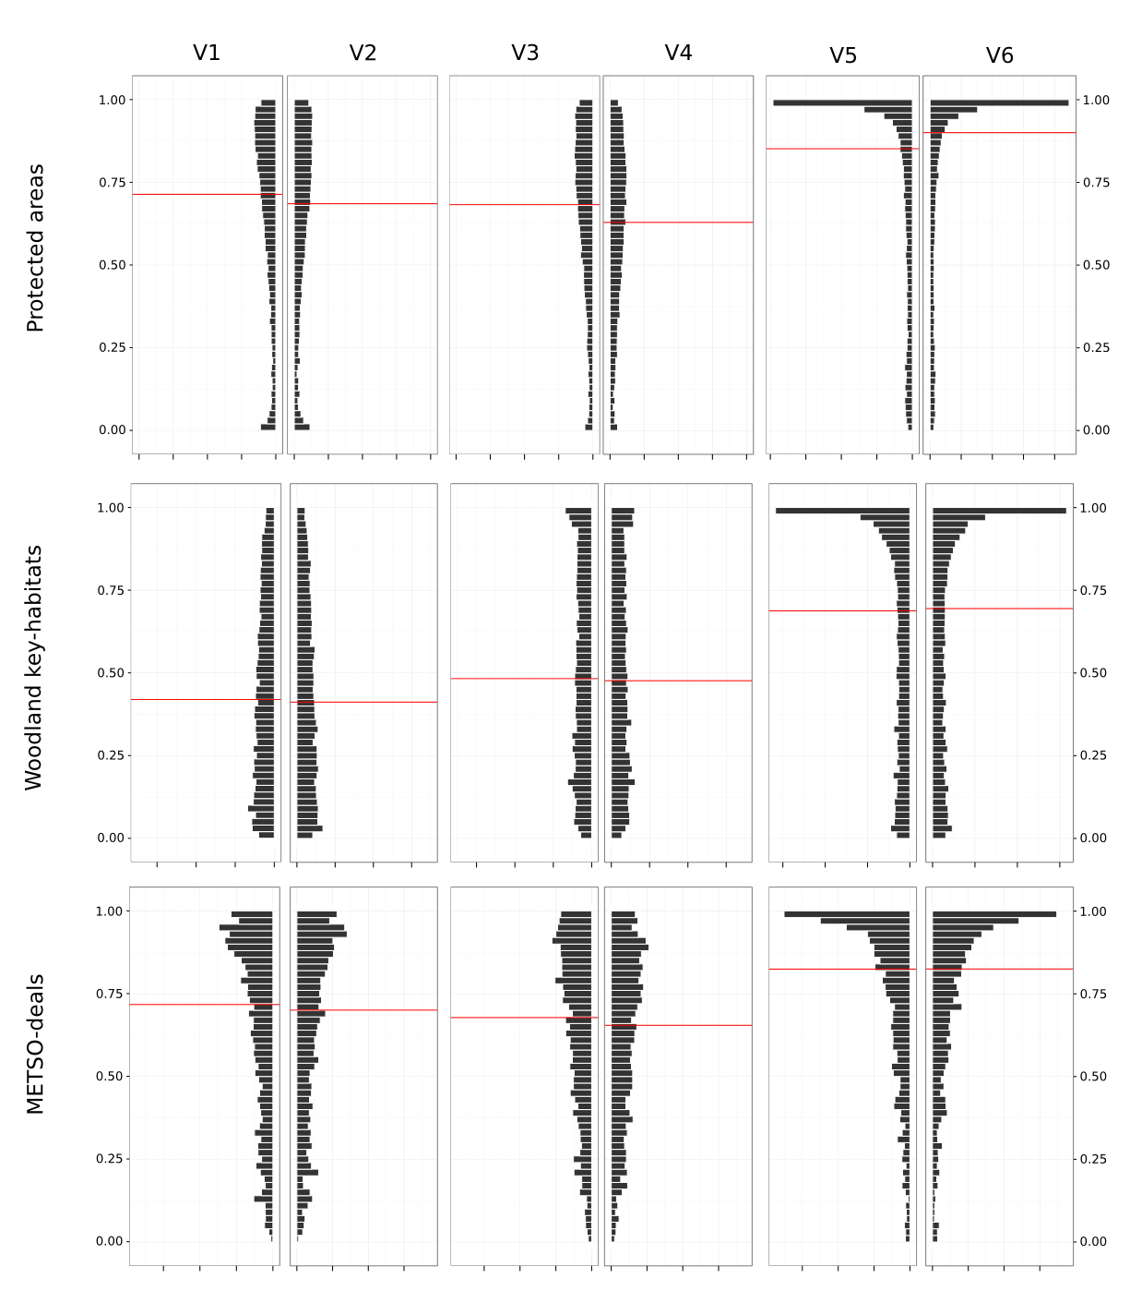

Slide 38
5. Discussion

Slide 39
Main messages
Freely available national forest inventory data can be used to inform practitioners and decision-makers on the spatial location on conservation priorities, but only when the scale is coarse and when the qualitative characteristics of the ecological model emphasize certain things (i.e. volume) → more suitable when reference is Pas.
More detailed stand-based forest inventory data will almost always outperform the coarser MSNFI-only data and is a requirement if planning requires small scale and detailed habitat characteristics information.
Just introducing classification will improve the prioritization slightly, because the forest types used in the classification are more connected to actual habitat types.
For large-scale planning (and depending on the ecological model used) MSNFI may be suitable.
In many cases, the best and the worst sections of the landscape are relatively consistent, which implies that best are always best and vice a versa.
In none of the variant comparisons do the best and the worst section overlap significantly, which makes the methodology more robust for planning purposes.

Slide 40
Main messages
However, as shown in figure 5, there is a risk in ending up with significantly less performing solution if using the less detailed data.
Increasing the complexity of the analysis and including several important ecological factors such as connectivity might introduce trade-offs in which case there is no single best solution, but rather a suite of solutions.
Current forest planning operation mostly consider the occurrence of biodiversity in small, well-contained areas → Primary objective is to increase the area (even modest increases can lead to large gains if placed right).
However, in light of what e.g. Hanski (2011) has suggested, it might be better to concentrate on aggregations of relatively high priority areas surrounded by good enough areas (“conservation landscapes”).
Free/open data has significant advantages over closed data especially in decision-making context:
  Makes results more repeatable if needed (also by others)
  Enables comparison to the original data

Slide 41
Main messages
Assessing results of spatial conservation prioritization

Slide 42
Connectivity
We “lose” surprisingly little when taking connectivity into account. On the other hand this is explained by the data and the way the prioritization was constructed.
Results are not likely to be overly sensitive to the connectivity distance used (Arponen et al. 2012).
“Null-sum game”: Increasing priorities somewhere will lower them somewhere else and hence there are almost always trade-offs involved when accounting for connectivity.

Slide 43
Caveats
Known issues with MSNFI
  May be imprecise on the scale of single pixels
  Averages distributions
  Does not pick up e.g. other deciduous tree species
  May systematically categorize certain soil fertility classes wrongly
Ecological model is not “fitted” with real ecological data, thus it only conveys information on our subjective views attached to conservation value.

Slide 44
Future aspects
Other forestry data available that we didn't use (e.g. costs, ownership information)
Habitat suitability indices (Tikkanen, Kouki et al.) would form a stronger foundation for the ecological model, but also require a more strict definition of which species we're talking about (which is not necessarily bad)
Simulating forest dynamics fairly well understood (e.g. Mönkkönen et al. 2014) and could be included in the ecological model with moderate amount of work

Slide 45
Supplementary material

Slide 46
Figure SX. Graphical representation of the feature setup in the Zonation analysis.
- Weights
- Aggregate weights for combinations
- Feature duplication
- Matrix connectivity
- Interaction connectivity

Slide 47
Issues
Utility of different data and validation of the prioritization results need to be welded together firmly → cannot come out us too separate issues (this outline still doesn't have a very strong emphasis on data issues)
Should the validation results actually be statistically tested (sampling from distribution)

Slide 48
Glossary
Analysis feature/Biodiversity feature = Input data that Zonation uses, in this study equals the index rasters.
Forest type = A class created by how the indices are built, i.e. a combination of tree species group (e.g. birch) and soil fertility class (e.g. herb-rich) creates a forest type of “birch-herb-rich”.
Index raster = A raster with values of index describing the perceived conservation value of a given location (pixel). Index value determined by average diameter and volume of standing stock by tree species. There are 4 tree species groups (pine, spruce, birch, other deciduous) and thus there are 4 index rasters in the most basic situation. There 4 index rasters may be further divided into discrete classes based on soil fertility classes (n=5) in which case the number of index layers is 20.
Input data set = Data set in which a Zonation analysis is based. In this work, we are using 3 different input data sets (MSNFI, MSNFI with classes, and detailed with classes) of increasing detail to compare the performance of freely available, but less accurate data to more detailed, but less available inventory data.
Landscape = The study area, or the whole area for which the spatial conservation prioritization is done for.
Variant = A Zonation analysis version with A) given input data set, and B) given Zonation analytical options (such as connectivity) enabled. In this study, we have Zonation analysis based on 3 different input data sets and for each we have 2 different Zonation setups: with and without connectivity. Hence, this study has 6 different variants (V1-V6).

