Slide 1
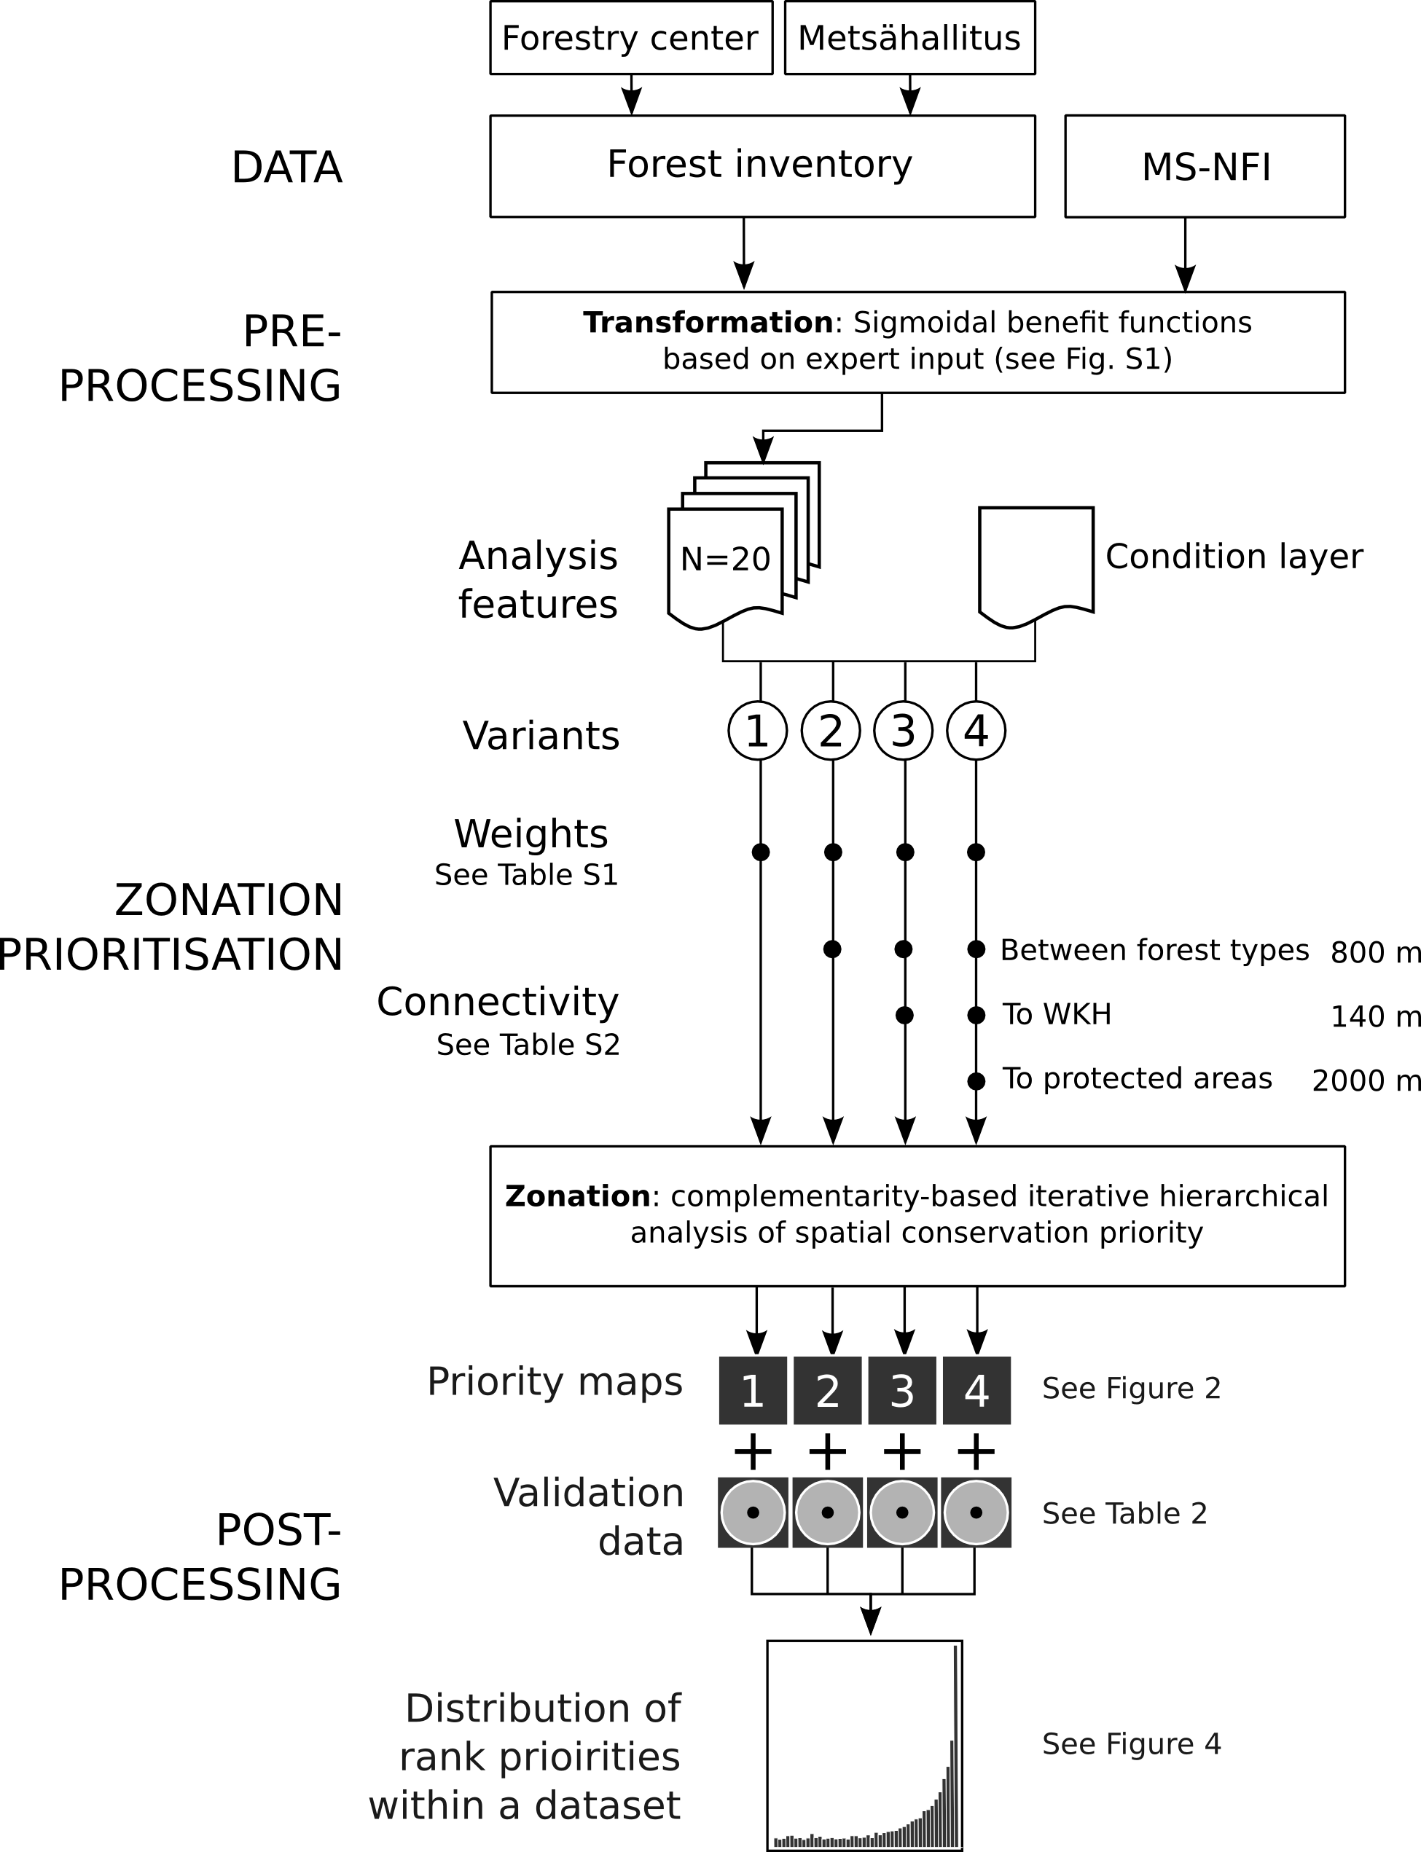
Figure 1. Schematics of the analysis setup. Different parts of the analysis were done in different software environments (see text). Analysis feature layers (index layers) were constructed from 3 different data sources (Table 1 and a condition layer (see text) was applied on all of them. Different Zonation analysis variants are indicated by arrows 1-4 (see Table 3) with closed circles indicating the analysis features used. Each analysis variant resulted in a priority maps (Figure 2) and feature-specific performance curves (Figure 3). For validation purposes, each rank priority map was compared to a set of independent validation data to determine the mean and the distribution of ranks (Figure 4).
Notes:
  Would have to be modified for MSNFI-only
  Would have to be modified if the number of variants drops from 4

Slide 2
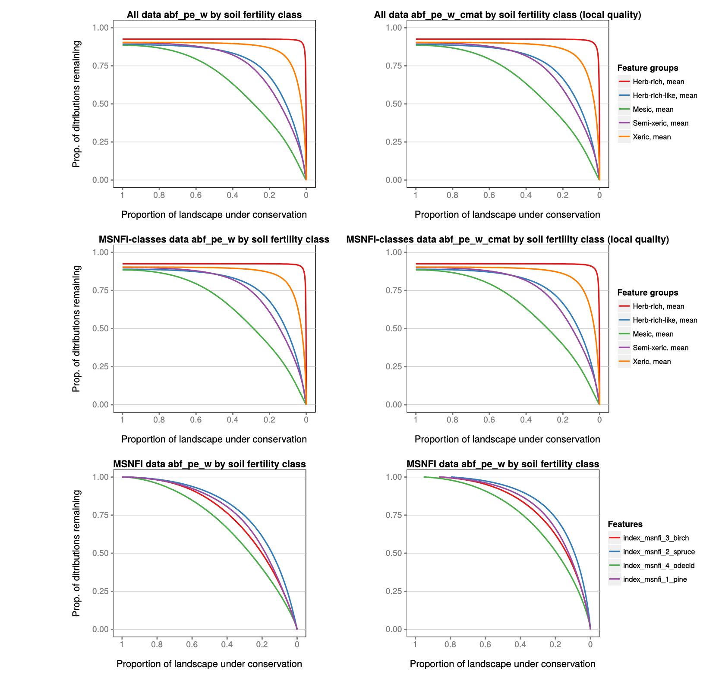

Slide 3
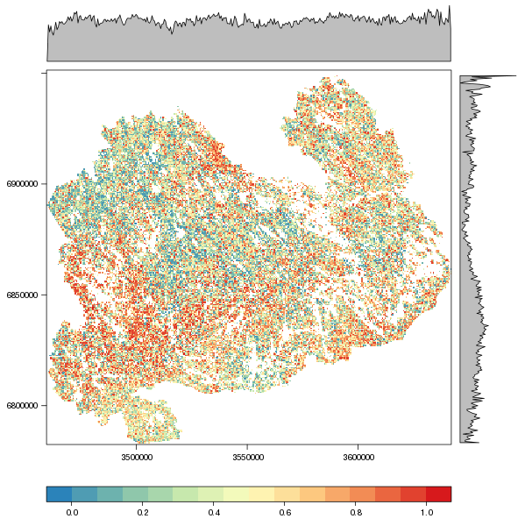
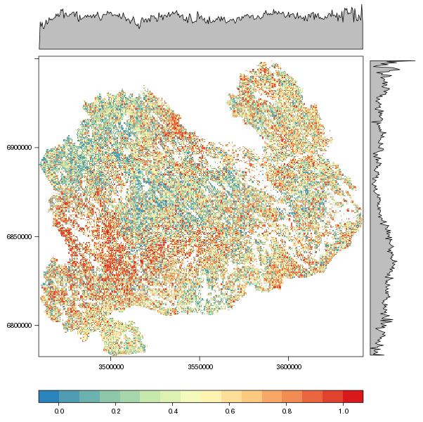
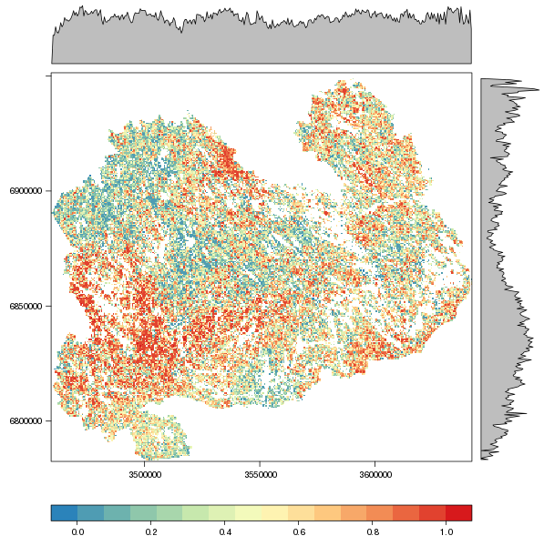
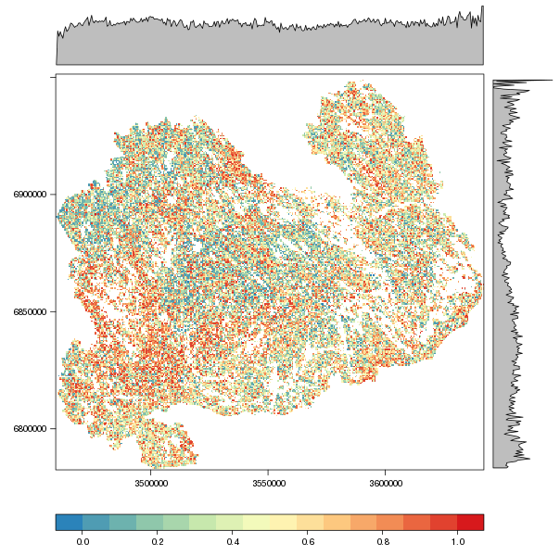
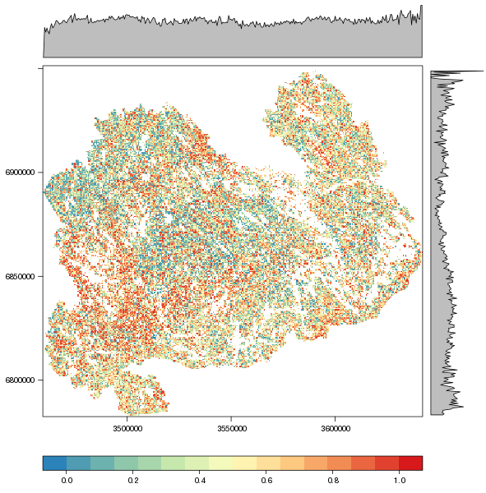
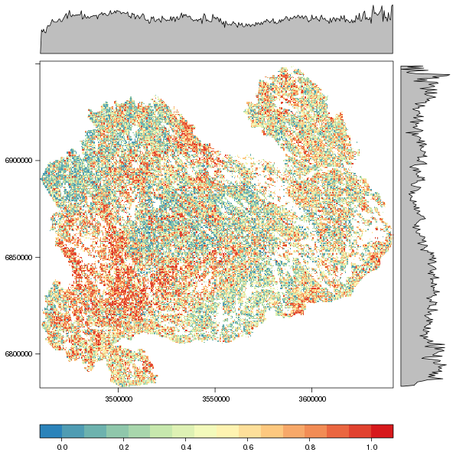
MSNFI-only – no classes
MSNFI-only – with classes

Slide 4
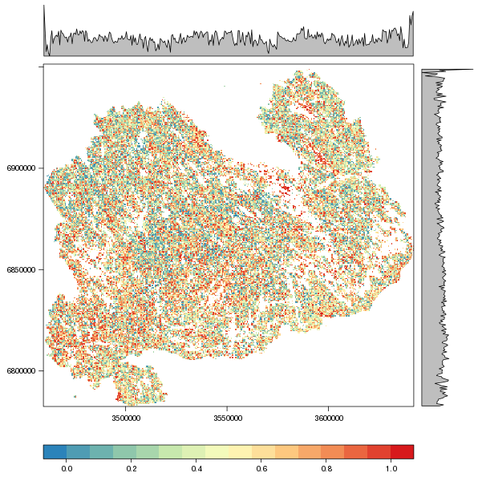
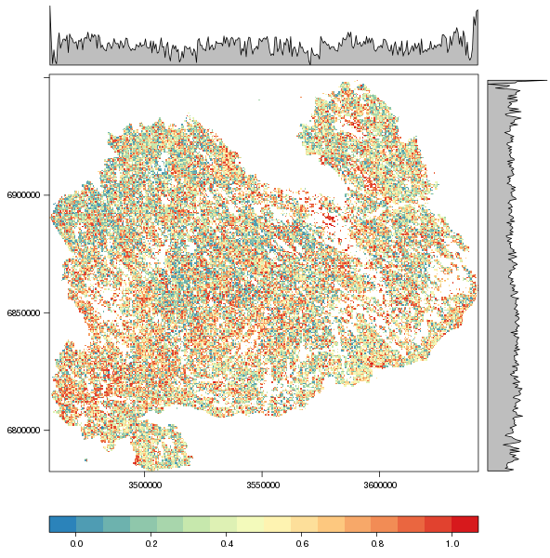
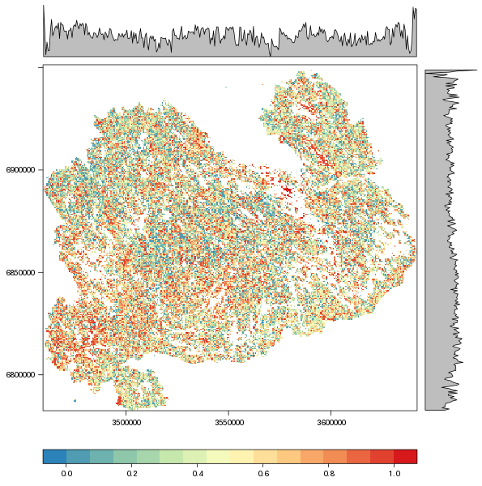
MSNFI-only – with classes
All data – with classes

Slide 5
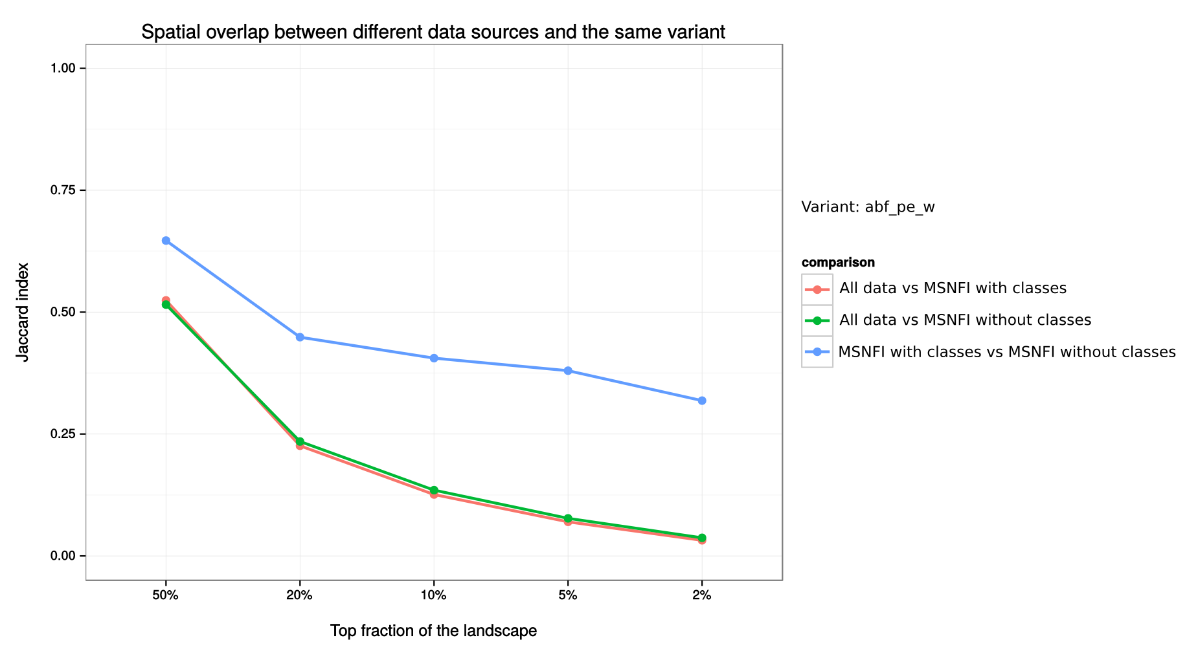

Slide 6
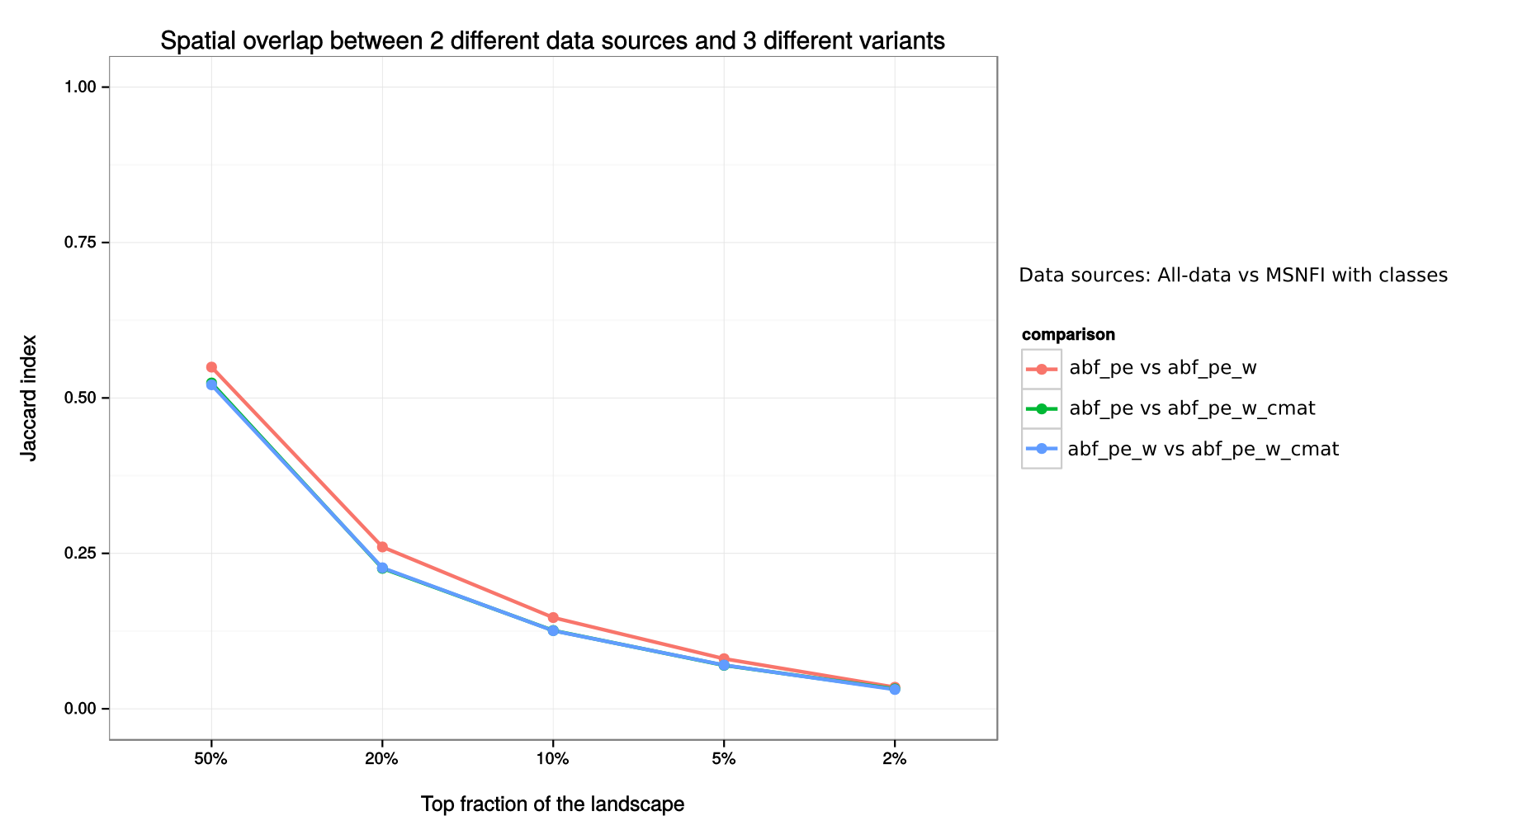

Slide 7
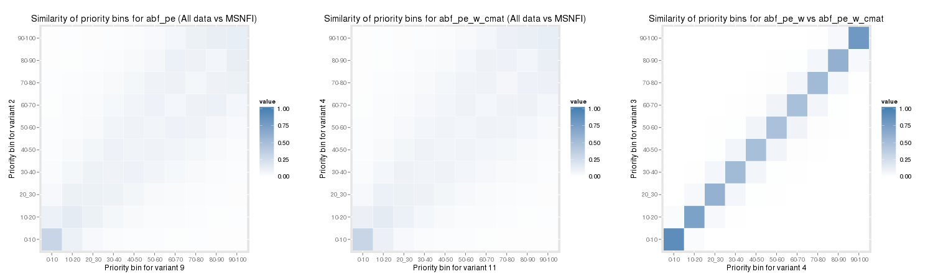

Slide 8
