Slide 1
Study of the spatio-temporal variability of the onset date over an Angolan region

Slide 2
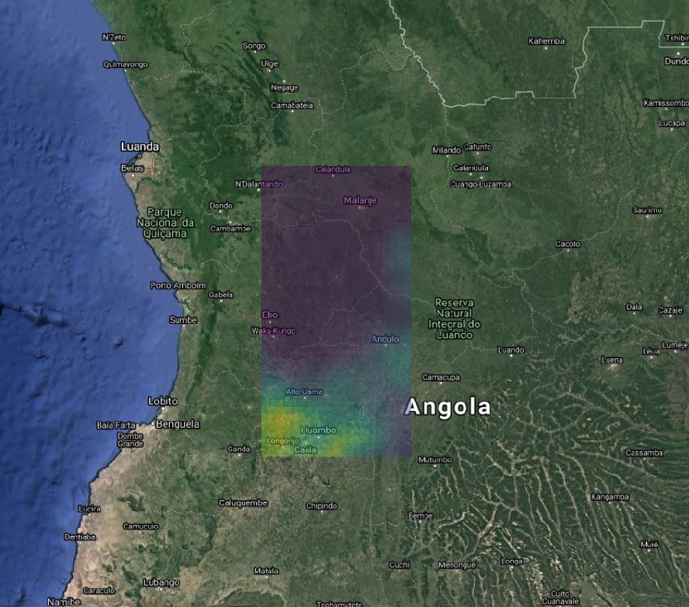
Scope of study and methodology
Study domain: [15E :17°E ; 13°S :9°S]
Cities coordinates
Malanje (9.55°S ;16.34°E)
Huambo (12.77°S; 15.73°E)
Period: [1981:2010]
Computation of the Anoumalous Accumulation (AA) indice according method of Liebmann, over a period of one year (1st Jan to 31 Dec.). The onset date correspond to the date on which the minimal value of AA is reached
A script was developed in python. The jupyter -notebook and main results are available on the following Github repository
Malanje
Huambo

Slide 3
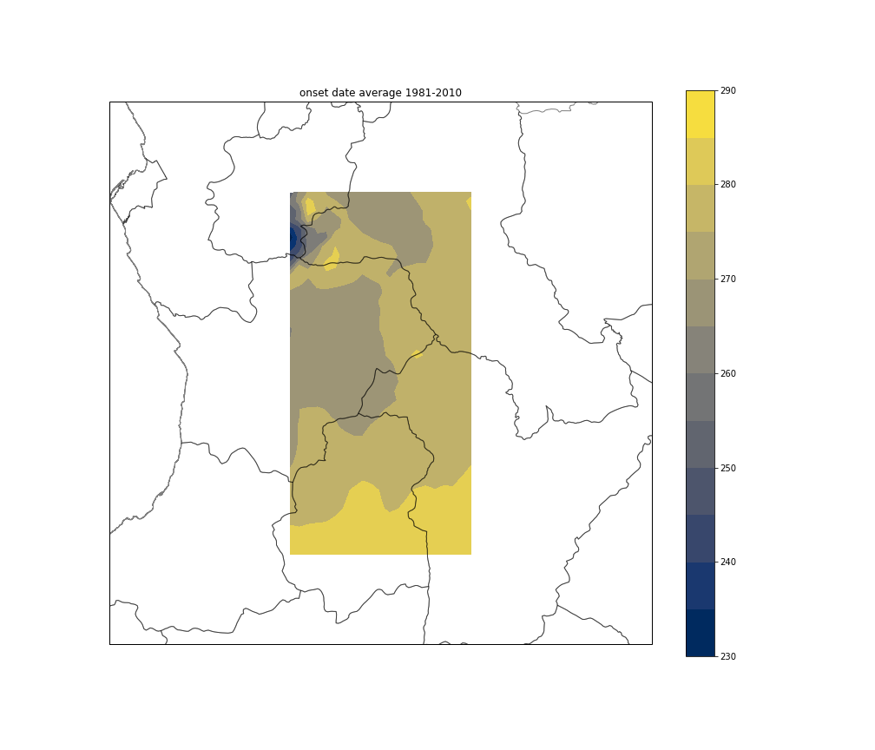
Spatio-temporal variability of the study domain
The averaged spatial distribution of the onset date follows a northwest – southeast meridian gradient, with an earlier (later) date in the Northern (Southern) part of the domain.
The Noth-Western part of the domain shows a strong southwest-nordeast gradient.
Strong local gradient
Main spatial gradient
Average onset date on the 1981-2010 period. Scale is in Julian days ( 230 <-> 18-Aug. and 290 <-> 17-Oct. )

Slide 4
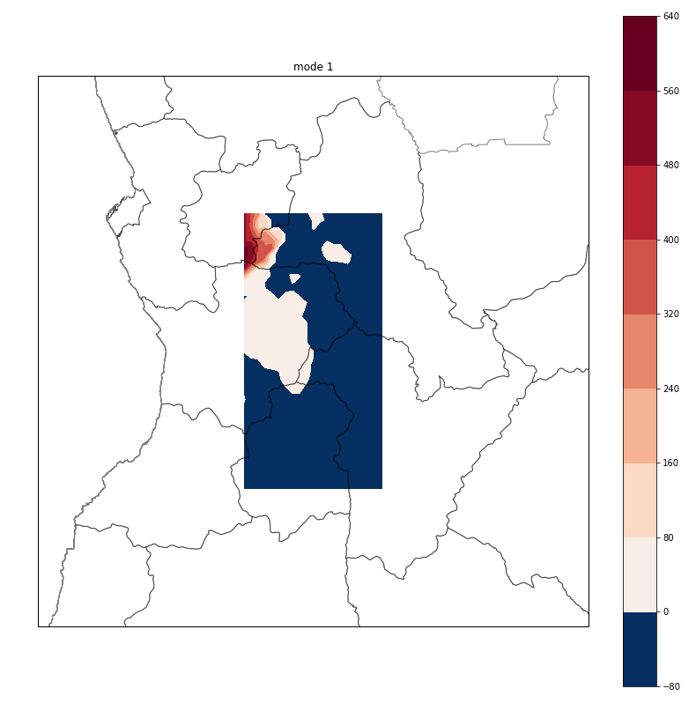
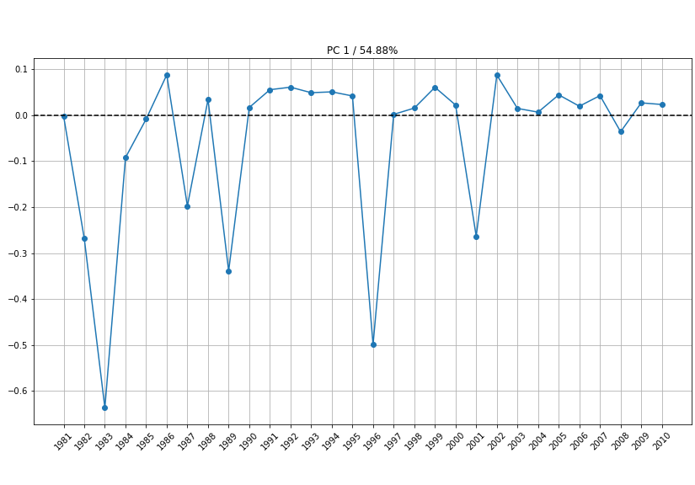
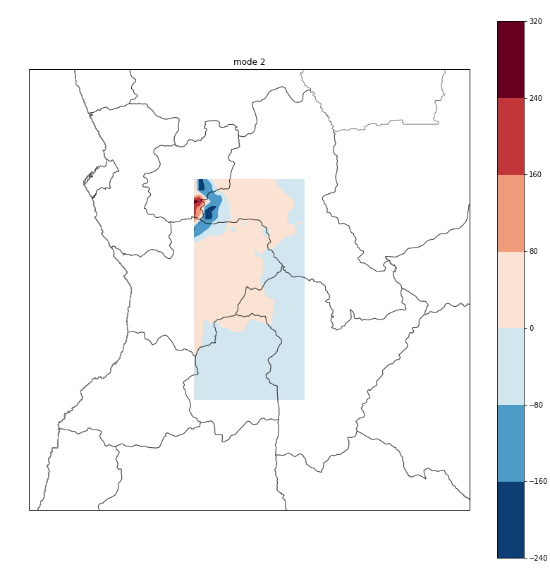
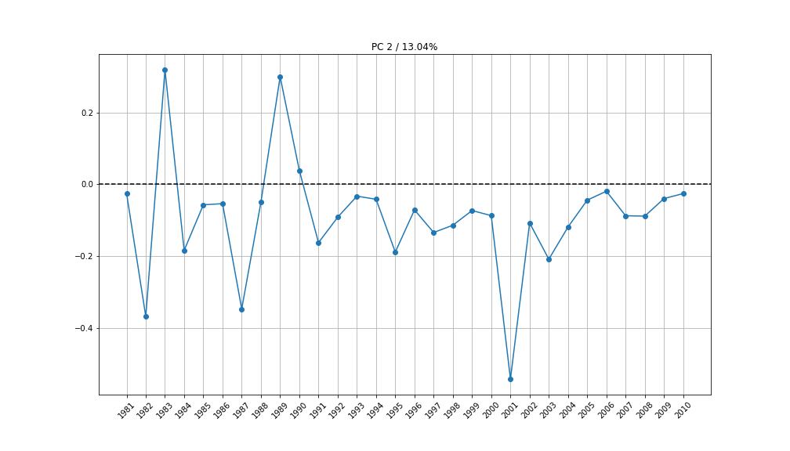
PCA/EOF Analysis
First (Second) mode explains around 55% (12.5%) of the total variance of the domain over the period 1981-2010
First mode shows a gradient spatial pattern with a strong positive anomaly in the NorthWest which drive the variability of the mode. 1983 and 1996 are years with the stronger anomalies.
Second mode shows a dipolar spatial pattern in the North West region. 1983,1989 and 2001 are years with the stronger anomalies.
This analysis shows that the interannual variability of the onset over the study domain is drived by the NorthWest area. The rainy season begins north-northwest of the domain, and moves southwards. The start of the rainy seasons depends of the position and the variability of the ITCZ, which influence more the North than the South of the domain.

Slide 5
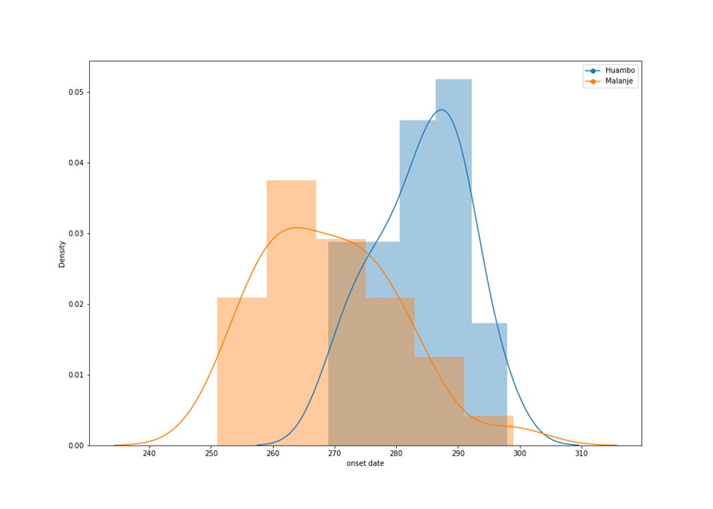
Temporal Analysis of Huambo and Malanjo
According to the KS-test, both stat.distribution are gaussian
Malanje onset date is on average 15 days before Huambo onset date ( 26 sept. vs. 11 oct.)
Malanje onset date have a larger standard-deviation (10.80 vs. 7.45), showing a stronger interannual variability.
These results are consistent with a move from the North of the ITCZ, bringing rainfalls: The rainy saison starts earlier in the northern city, and depends more on the mean position of the ITCZ, and its variability.
Statistical distribution of Huambo and Malanje’s onset date over the period 1981-2010. Julian days 240 <-> 28-Aug. and 310 <-> 6-Nov.

