Slide 1
QuadrupleScore
Jose Lemus, Billy Witrock, Saad Mazhar, Irving Pena
Notes:
Hi, My name is Saad, this is Jose, Billy, and Irving, and our team is called QuadrupleScore. And for our project, we decided to add a distribution element to a classical board game we all love: Scrabble!

Slide 2
Introduction
The purpose of our project was to create a variation on the classic game Scrabble
For those who don’t know, here are the rules of Scrabble:
15 x 15 master board
Each player is distributed 7 tiles from a bag of 100 tiles initially. This bag replenishes players as they use up their tiles
Players take turns trying to make a word with the letters they are given. The word must use a letter already on the board
The game ends when either no tiles are left in the bag or when no one can make a move
To make it more interesting
Now each player has their own version of the board and can make moves across a distributed system, thus removing the requirement of everyone being in the same room
In our version of Scrabble, players simultaneously race to put their tiles down first. There are no turns and there is no waiting
Other players’ words appear on your screen as soon as they are deemed valid, and anyone who is in the middle of their turn when a word is placed down will have their tiles placed back in their hand
Notes:
I’m hoping everyone here has played Scrabble at least once in their life, but for those that have not, here is how the game is played:
There’s a 15 x 15 master board on which everyone makes their move
Each player is distributed 7 tiles from a bag of 100 tiles initially, and these tiles represent letters in the English alphabet. This bag replenishes players as they use up their tiles
Players take turns trying to make a word with the letters they are given. The word they create must overlap one tile already found on the board
The game ends when either no tiles are left in the bag or when no one can make a move
To make it more interesting
We made it so that players simultaneously race to put their tiles down first. There are no turns and there is no waiting
Other players’ words appear on your screen as soon as they are deemed valid, and anyone who is in the middle of their turn when a word is placed down will have their tiles placed back in their hand
Now each player has their own version of the board and can make moves across a distributed system, thus removing the requirement of everyone being in the same room

Slide 3
Minimum and Maximum Deliverables
Minimum Deliverable
Have a distributed game of Scrabble working using Python and Erlang
Players would interact with the game via the Linux terminal instead of a GUI, and the board and tiles would be represented in ASCII
Maximum Deliverable
Have players interact with a GUI
Have the option of single-player Scrabble, where a player would play against an AI whose difficulty could be set. Depending on the difficulty, the AI would split the board into multiple threads, find all the possible words in a section of the board, and either play the move with the highest score (when AI set to difficult), or chose a move at random (when AI set to easy)
Notes:
Minimum Deliverable
Have a distributed game of Scrabble working using Python and Erlang, where players would interact with the game via the Linux terminal instead of a GUI, and the board and tiles would be represented in ASCII
Maximum Deliverable
Have players interact with a GUI
Have the option of single-player Scrabble, where a player would play against an AI whose difficulty could be set. Depending on the difficulty, the AI would split the board into multiple threads, find all the possible words in a section of the board, and either play the move with the highest score (when AI set to difficult), or chose a move at random (when AI set to easy)

Slide 4

Demo
Notes:
Saad

Slide 5
Major Design Choices
Using Erlang to only send messages. No game logic is handled
Middle modules

Slide 6
Distribution
Client
Server
Receive
Receive
Update
Move
Player Modules
Gui, local state
Game Modules
Master state
Notes:
Jose

Slide 7
Messages
Move
Key word | move
Player PID | player@lab118i
Word | hi
Starting position | (0,0)
Direction | right
Used Tiles | [(value, score, multiplier, id)...]
Update
Key word | refresh
Board | [[‘0’, ‘t’ …] [‘0’, ‘a’, …] …]
Scores | [4, 10, 28, 8]
Old tiles | [(value,…)...]
New Tiles | [(value,...)...]
Notes:
Convert to tuples

Slide 8
How is everything connected?
How do they interact?
What modules are used?
What classes are used?
Notes:
Billy

Slide 9
Major Design Choices
Erlang only to send messages no game logic
Middle modules

Slide 10
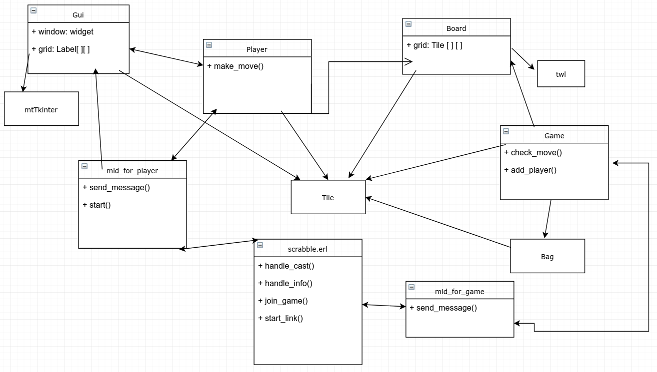
Notes:
Billy

Slide 11
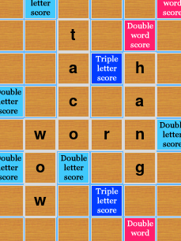
How a score is calculated
What happens if hypothetically the word “worn” has just been placed? (yes it is impossible, but let's just play along)
Notes:
Billy

Slide 12
How a score is calculated
What happens if hypothetically the word “worn” has just been placed? (yes it is impossible, but let's just play along)
Notes:
Billy

Slide 13
How a score is calculated
What happens if hypothetically the word “worn” has just been placed? (yes it is impossible, but let's just play along)
Notes:
Billy

Slide 14
How a score is calculated
What happens if hypothetically the word “worn” has just been placed? (yes it is impossible, but let's just play along)
Notes:
Billy

Slide 15
How a score is calculated
What happens if hypothetically the word “worn” has just been placed? (yes it is impossible, but let's just play along)
Notes:
Billy

Slide 16
How a score is calculated
What happens if hypothetically the word “worn” has just been placed? (yes it is impossible, but let's just play along)
Score = 12
Main multiplier = x1
Extra score = 0
Is_valid = True
Mutex = Lock()
Notes:
Billy

Slide 17
Large Roadblocks We Encountered
Notes:
Jose

Slide 18
Erlport Problems
Python Instance
Erlport
Installing
Use code from pull request
Some caveats
Handlers
Main thread
Fine for server, not for player
Calls made from threads
Unexpected message
Crash
Thread 2
Thread 3
Thread 1
Handler
Notes:
Jose

Slide 19
Erlport and Tkinter Problems
-tKinter does not like multithreading!
-tKinter event loop needs to be on the main thread
-Event loop is infinite by design, program can’t receive messages
-Discovered late in development
-Solution? mtTkinter to the rescue!
Notes:
Ivring

Slide 20
Evaluation and reflection
Toy examples aren’t always enough
Weren’t able to determine conflicts until we had a fairly significant amount done
More research before committing
Not getting surprised by library features (...or lack thereof!)
Be more flexible
Stuck with erlport, should have investigated sockets

Slide 21
Questions?

