Slide 1
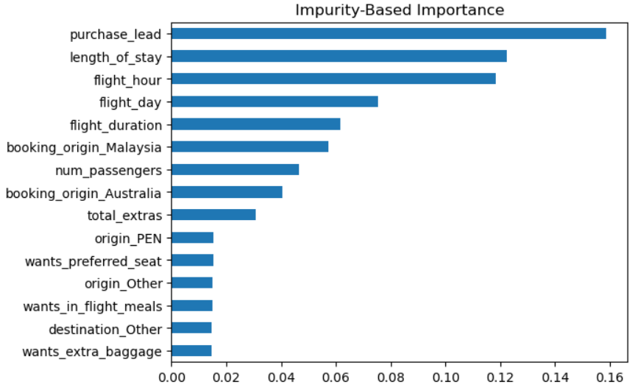
Bookings Hinge on Origin Market, Trip Type and Add-On Interest
Random Forest Model
Accuracy: 85% , ROC-AUC 0.78 , PR-AUC 0.37
Useful for ranking, not precise per-customer prediction
Key Findings
Overall conversion is only 15%
  Round trips convert at 15%
  One-way and circle trips convert about 5%
Booking origin matters
  Malaysia (34%) had the highest conversion rate and had the highest feature importance in the model
  Indonesia (26%) and Thailand (23%) also had high conversion
    Compared to Australia and New Zealand (5%)
Customers who select extras convert more
  Customer who select 3 extras convert 19%
  Customers who select none convert 11%
  It was useful to add the total_extras variable to the dataset
Mobile converts 11% vs 16% on web
Recommendations
Shift marketing spend toward high-converting Asian origin markets
  Further analyze and diagnose the AU/NZ funnel
Move extra baggage, seat, and meal options early in the booking flow
Improve the mobile booking experience.

