Slide 1
figures

Slide 2
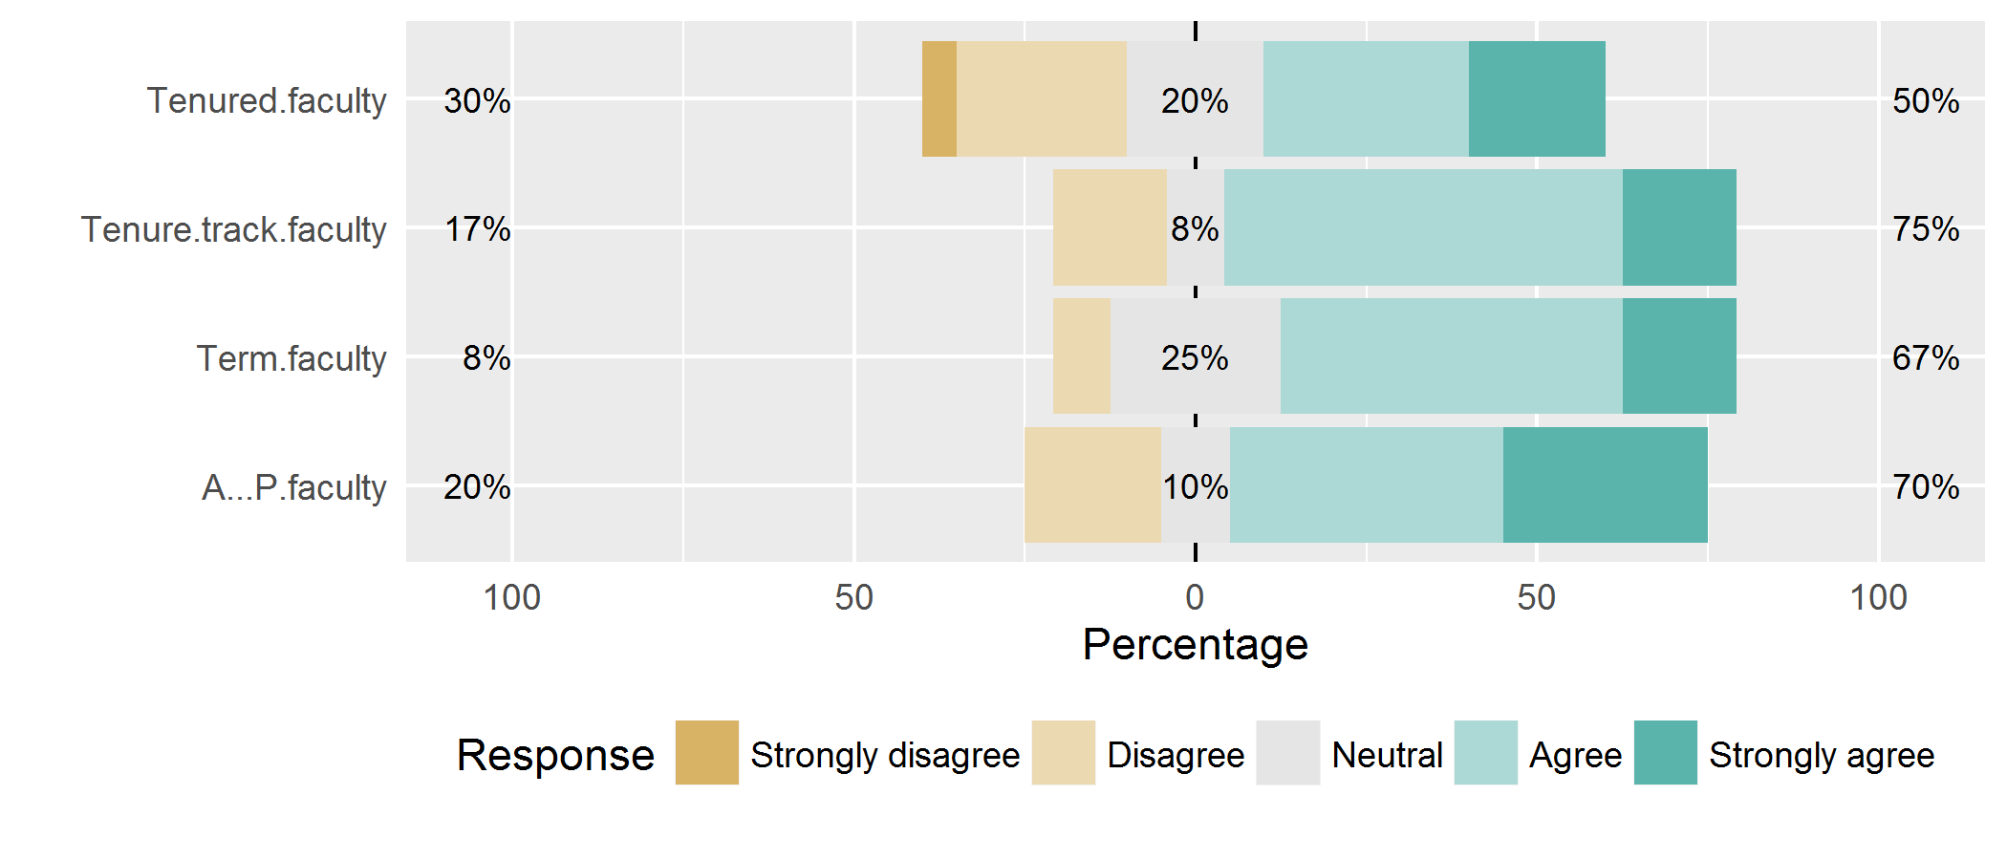
1 - Voice opinions about polices/procedures

Slide 3
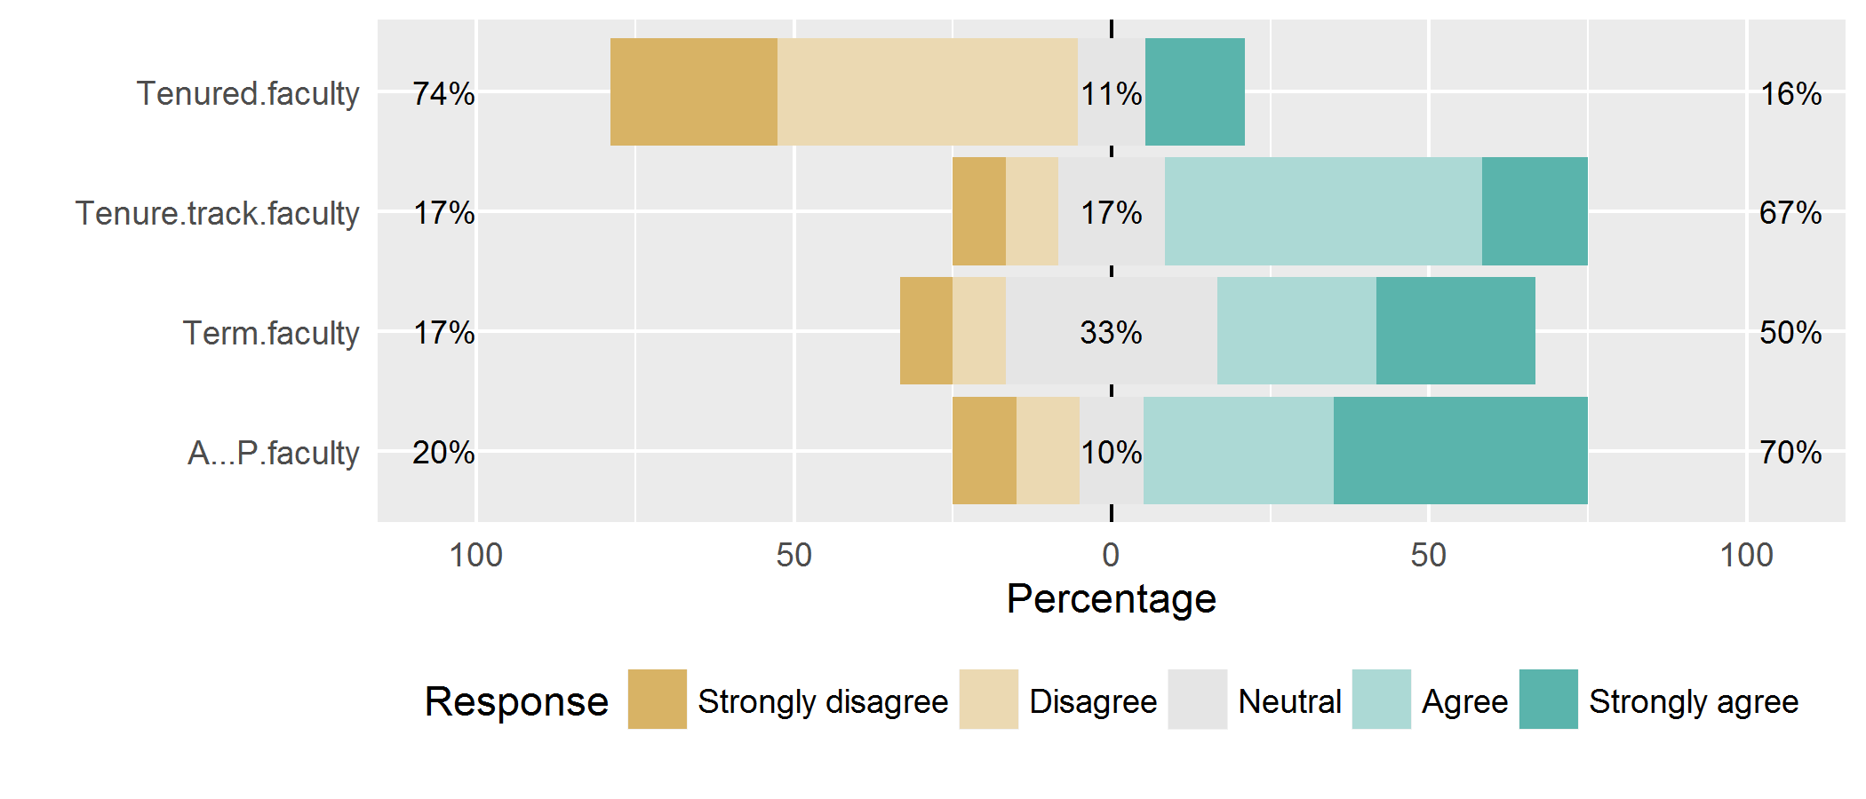
2 – input into decisions

Slide 4
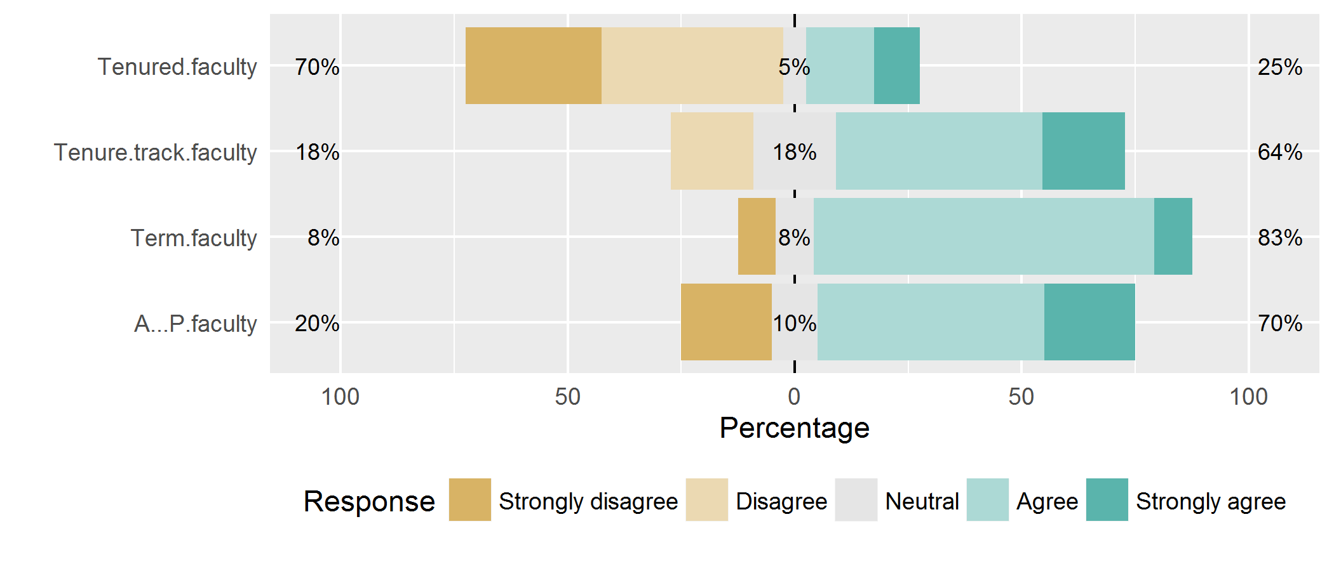
3 – leadership communicates rationale

Slide 5
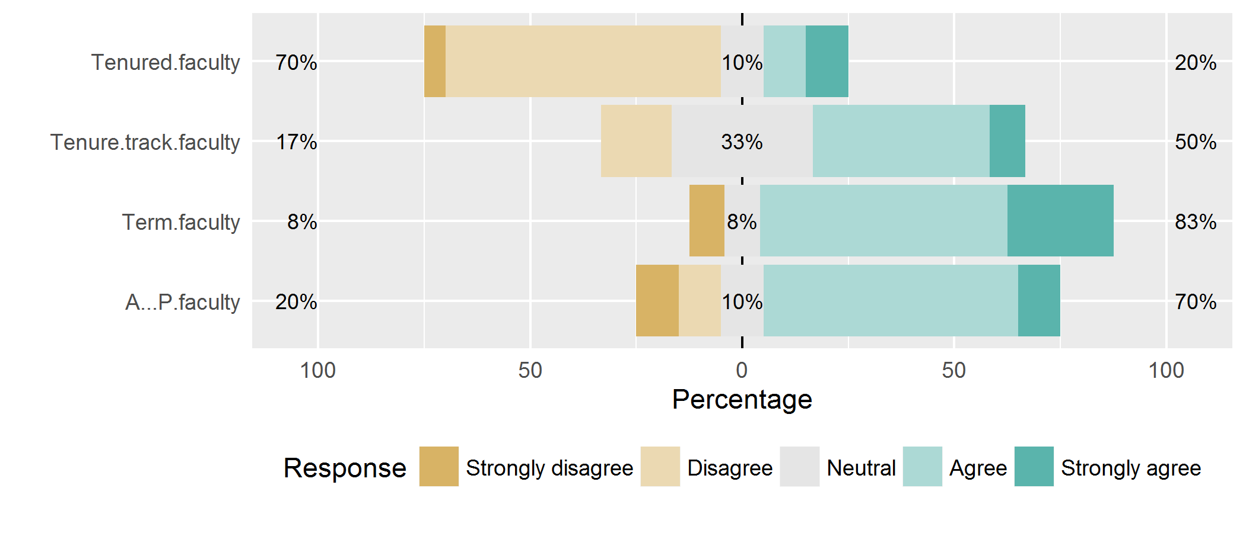
4 – leadership shares information openly

Slide 6
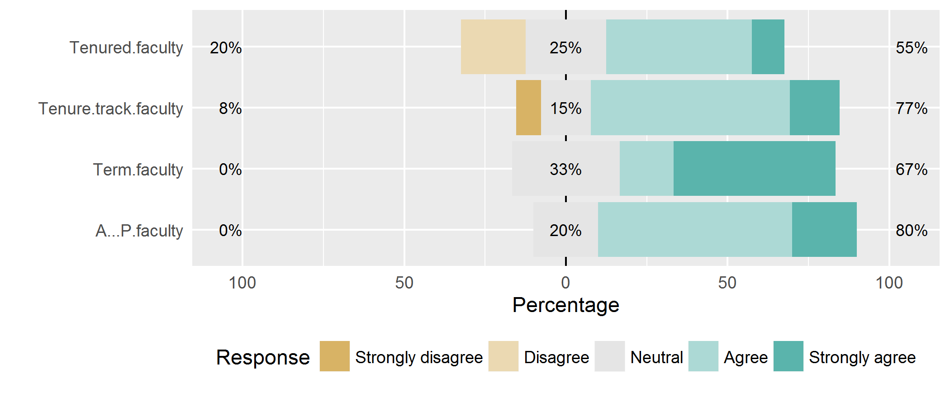
5 – familiar with priorities in strategic plan

Slide 7
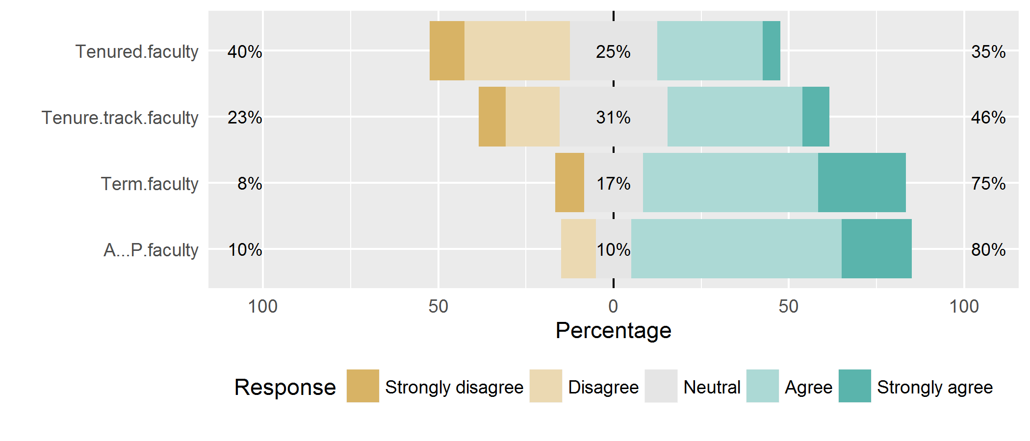
6 – updated sense of strategic plan progress

Slide 8
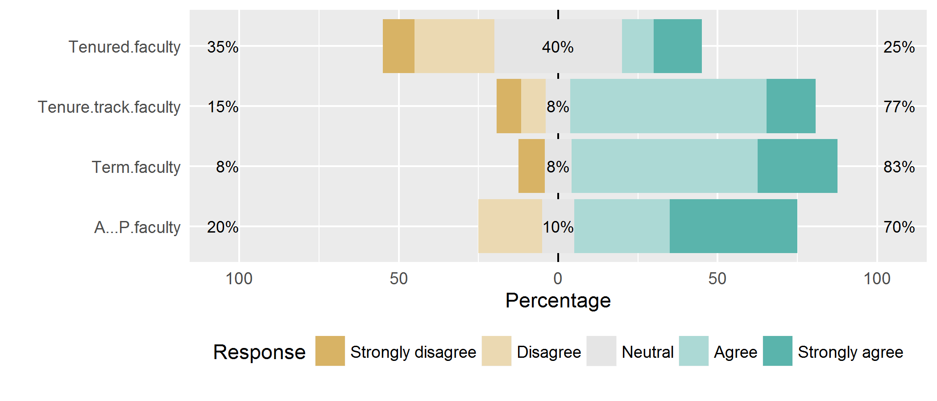
7 – satisfied with overall direction of school

Slide 9
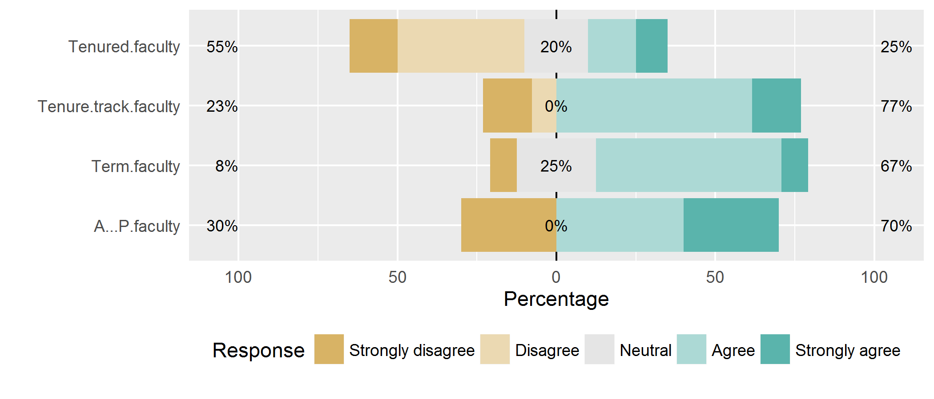
8 – open communication between faculty and administration

Slide 10
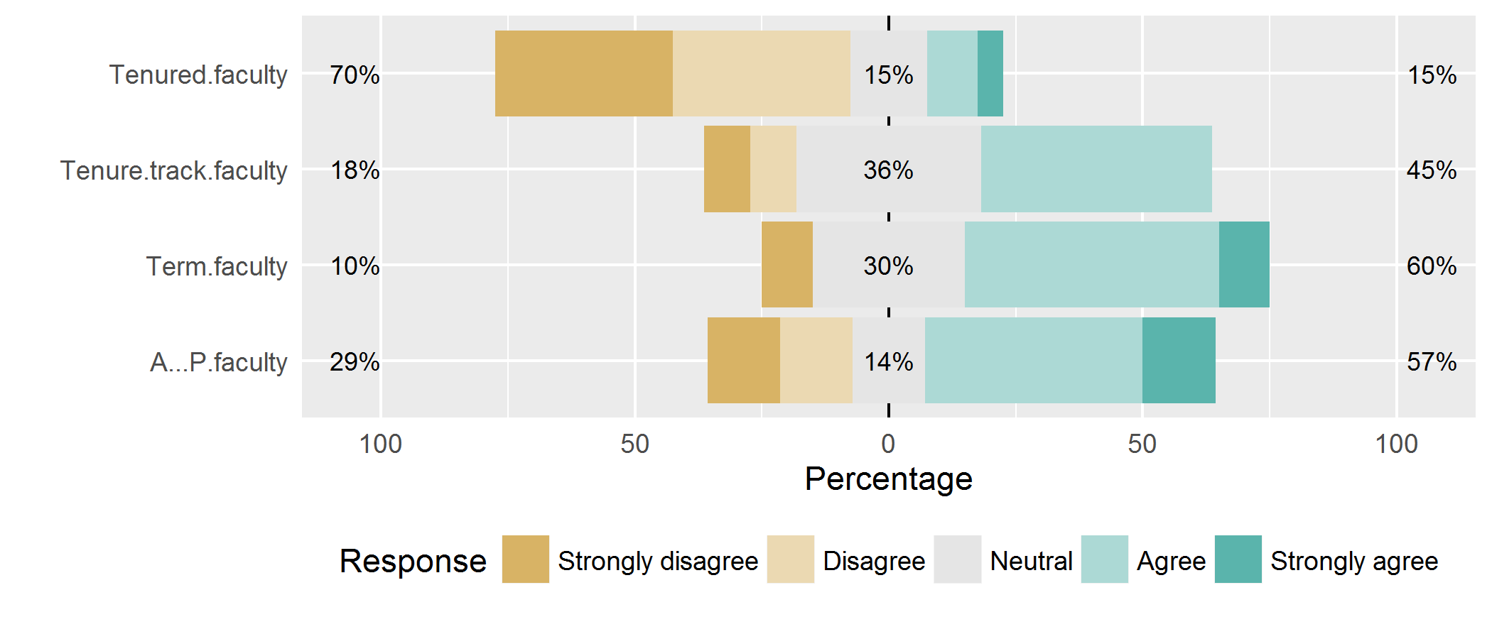
9 – our shared governance is effective

Slide 11
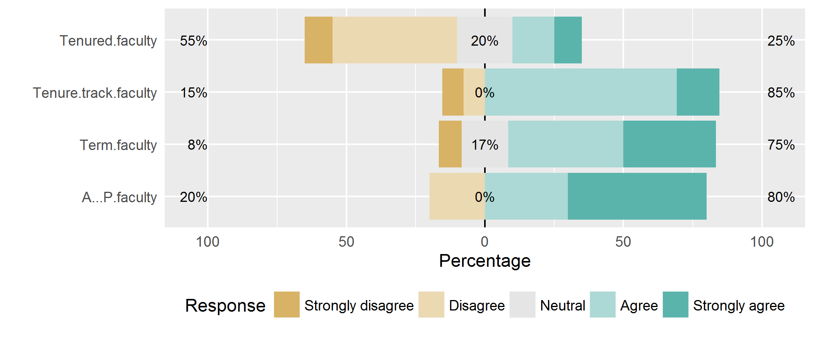
10 – leadership of school is effective

Slide 12
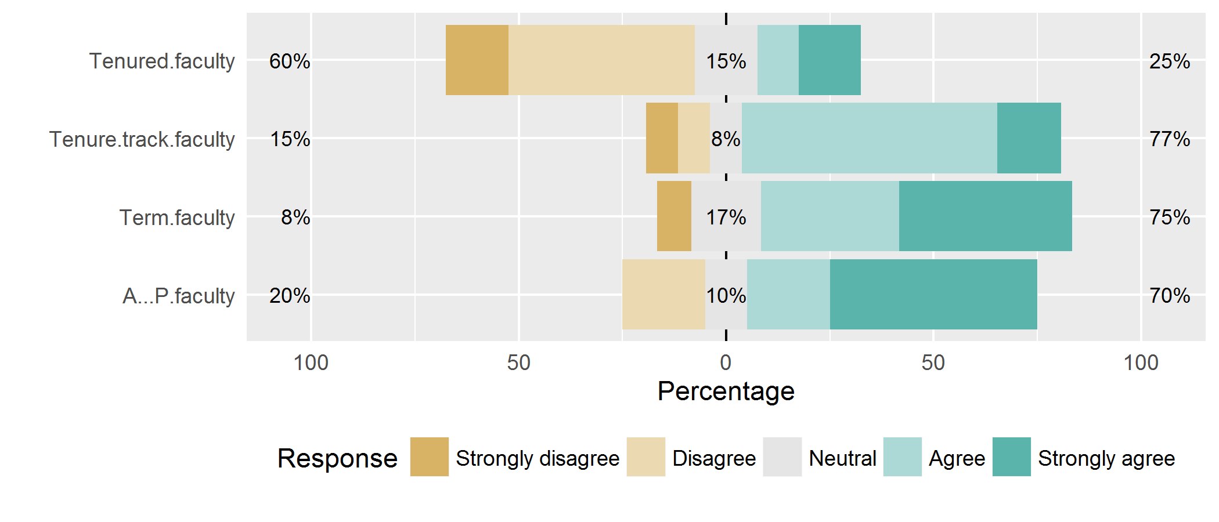
11 – overall, I’m satisfied with school leadership

Slide 13
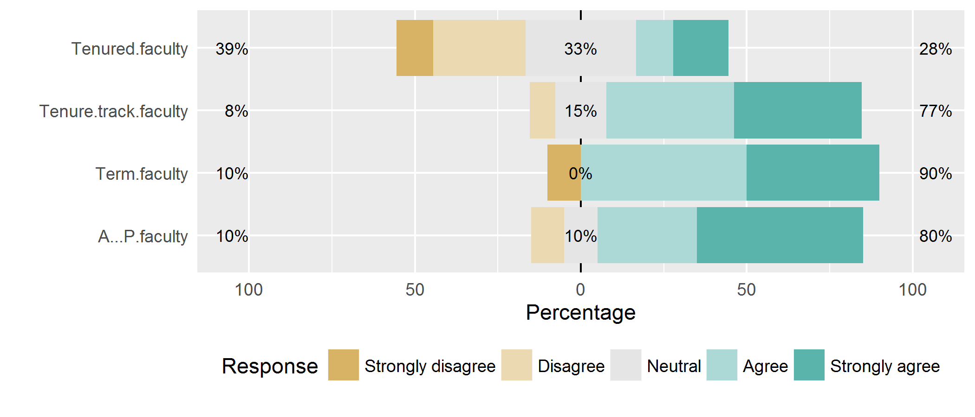
12 – School is a good place to work

Slide 14
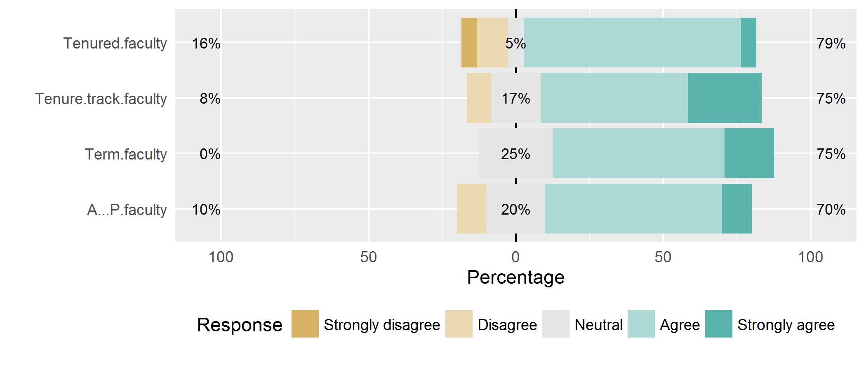
13 – Faculty are collegial

Slide 15
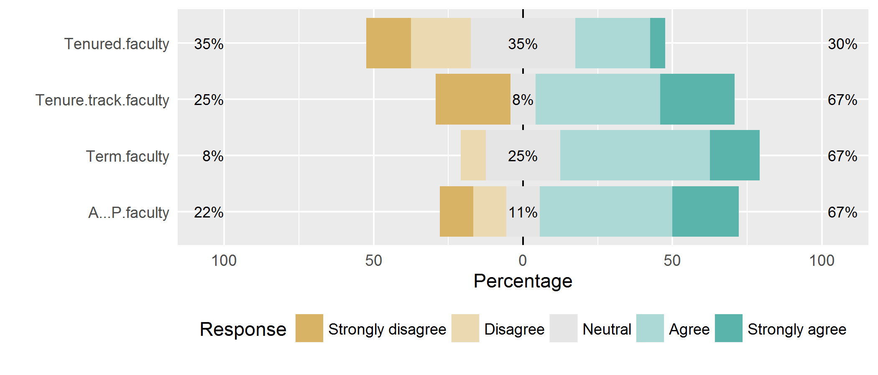
14 – Faculty are recognized

