Slide 1
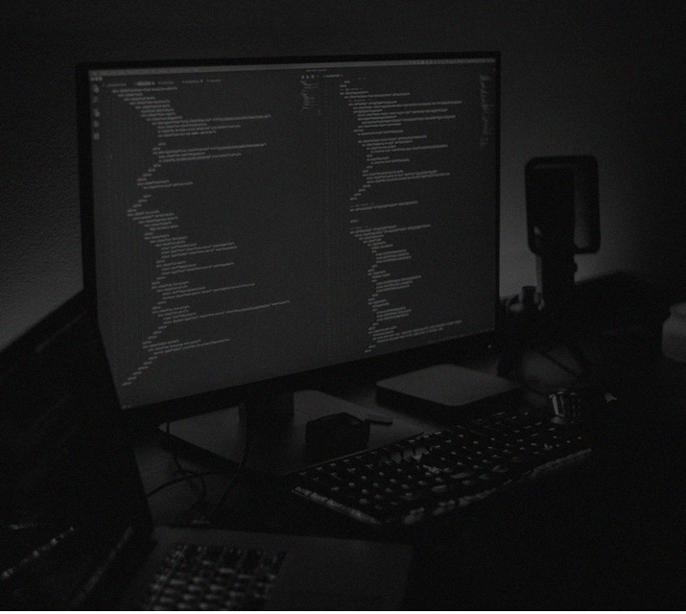


Slide 2
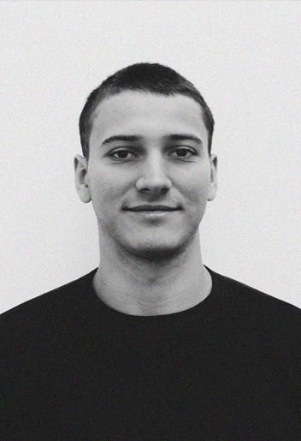




Leonardo Lemos
DESENVOLVEDOR // MIXD
@jleonardolemos
@leonardo-lemos
/jleonardolemos
/jleonardolemos

Slide 3
&
PHPUnit & Laravel
LEONARDO LEMOS
PHPUNIT & LARAVEL

Slide 4
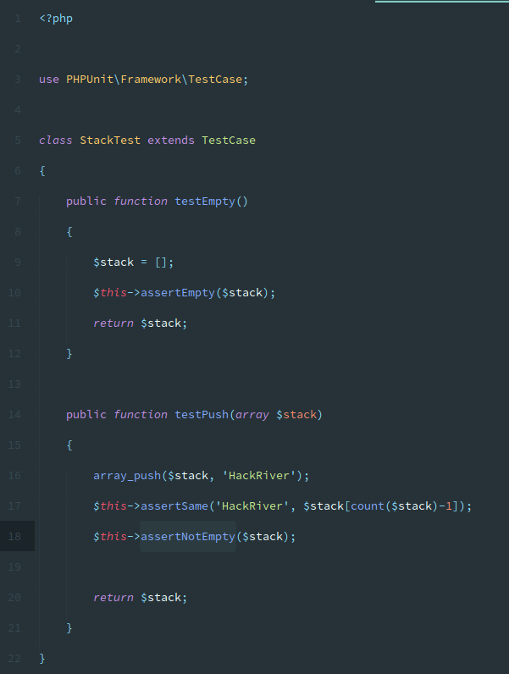


Slide 5
&
Laravel, tipos
de testes
LEONARDO LEMOS
PHPUNIT & LARAVEL

Slide 6
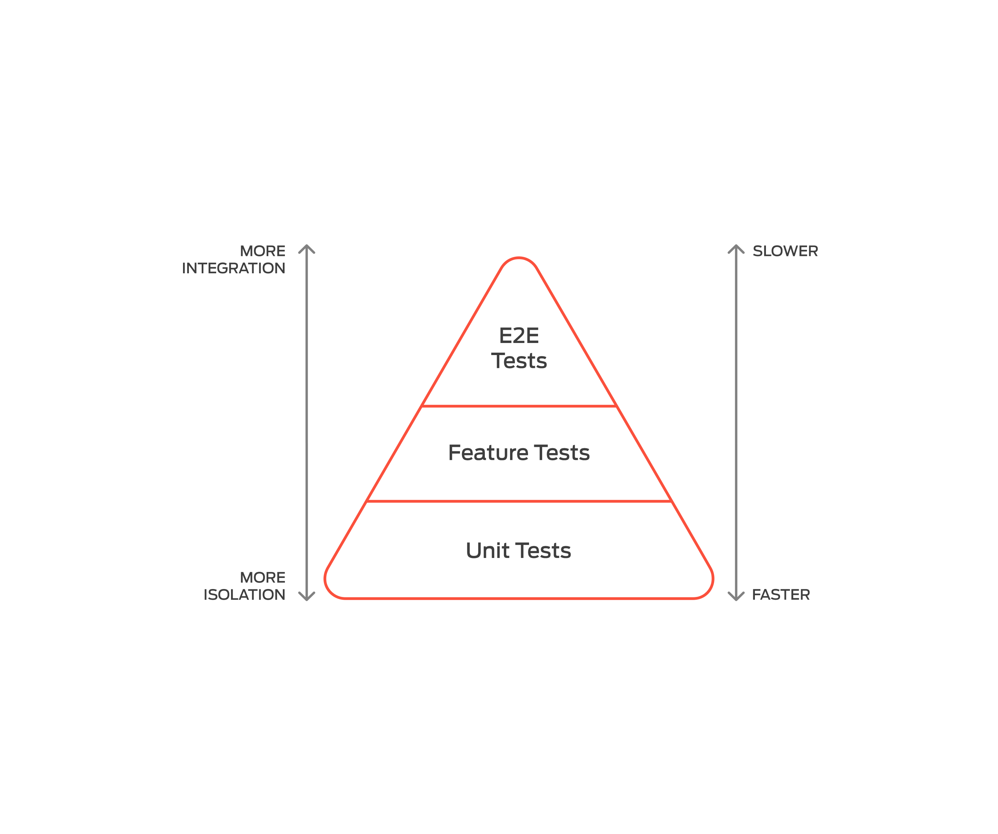

Slide 7
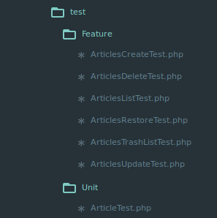

Slide 8
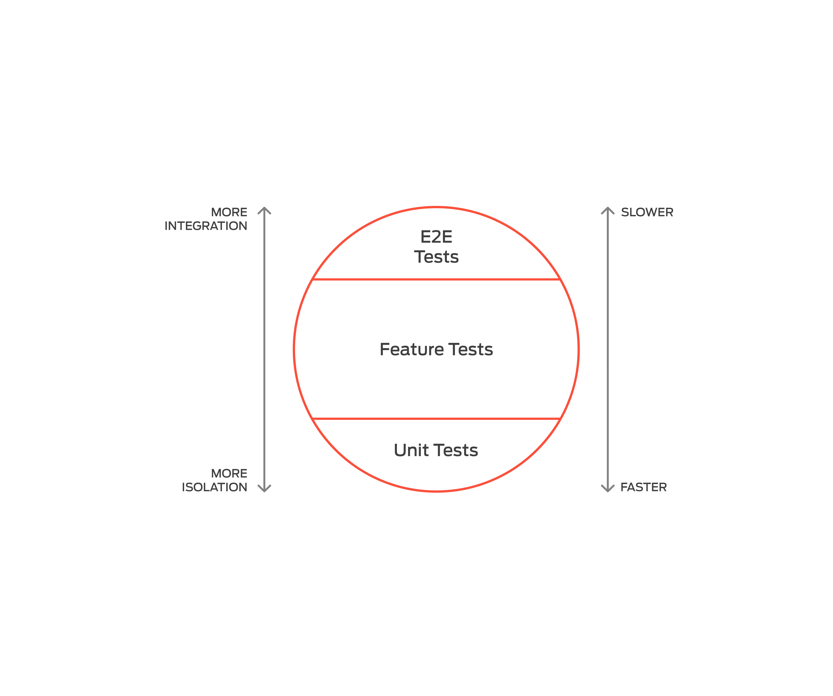

Slide 9
&
Testes Unitários
LEONARDO LEMOS
PHPUNIT & LARAVEL

Slide 10
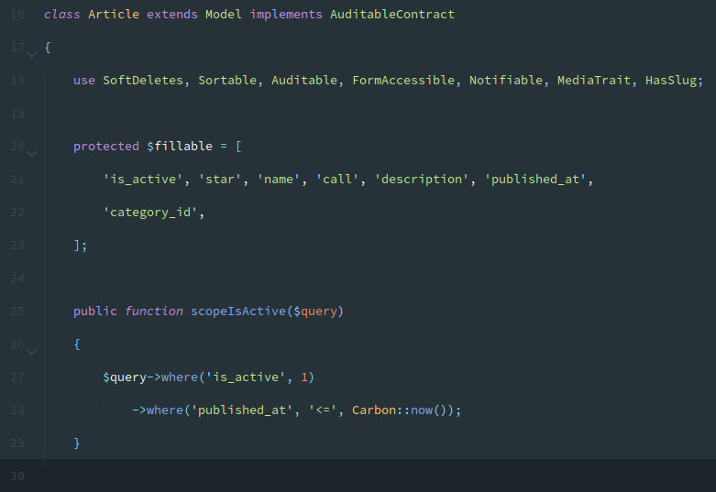

Slide 11
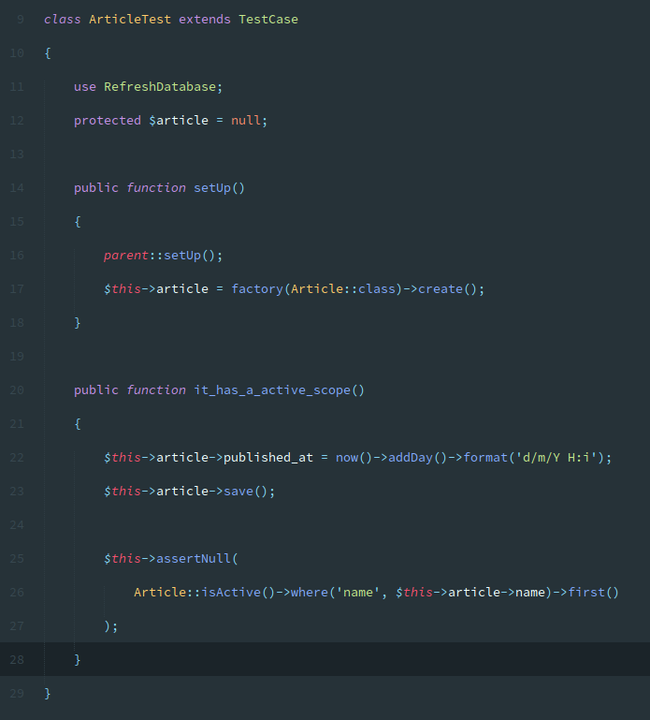

Slide 12
&
Teste de Feature
LEONARDO LEMOS
PHPUNIT & LARAVEL

Slide 13
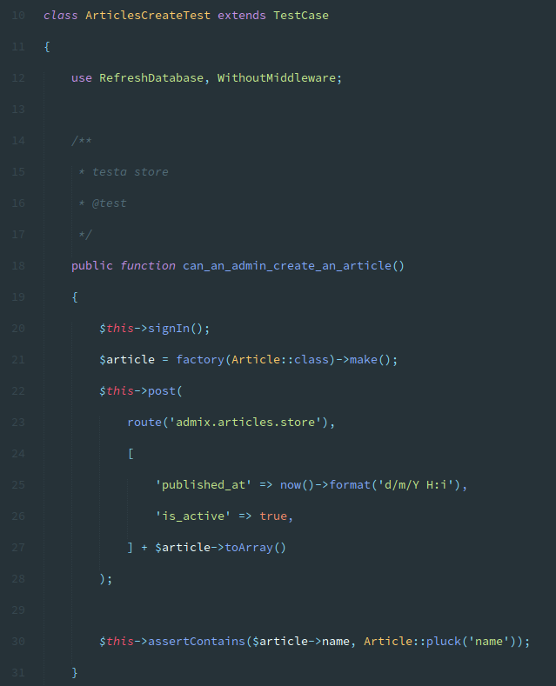

Slide 14
&
Dusk
LEONARDO LEMOS
PHPUNIT & LARAVEL

Slide 15
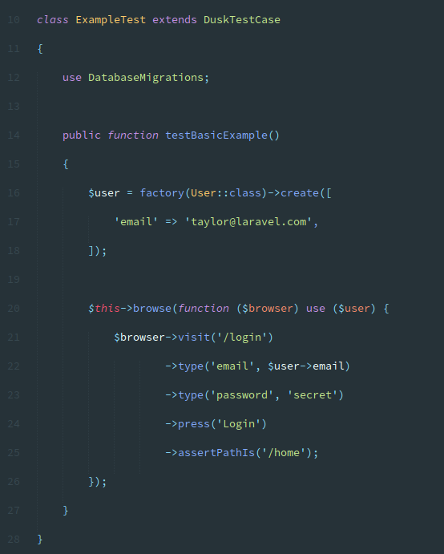

Slide 16
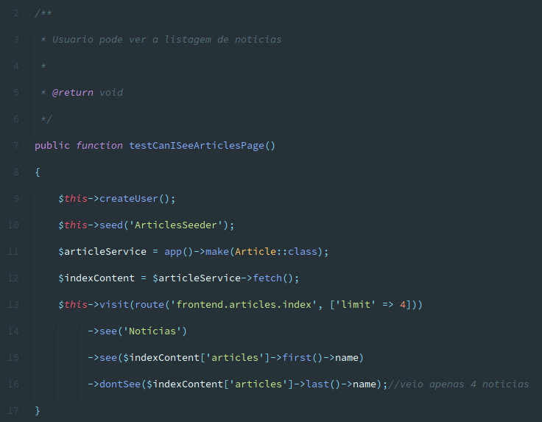

Slide 17
&
Model Factory
LEONARDO LEMOS
PHPUNIT & LARAVEL

Slide 18
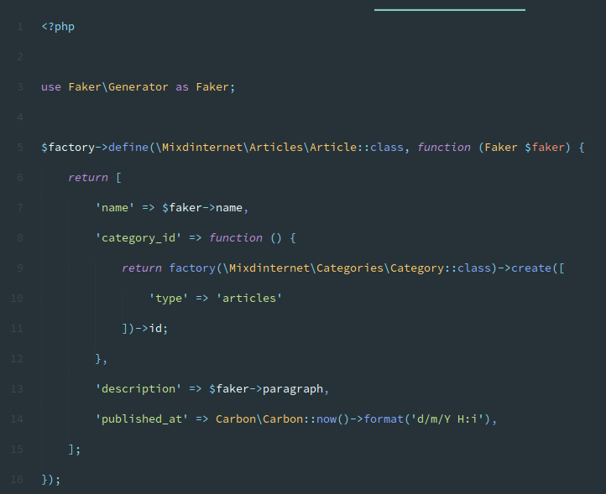

Slide 19
&
Code Coverage
LEONARDO LEMOS
PHPUNIT & LARAVEL

Slide 20
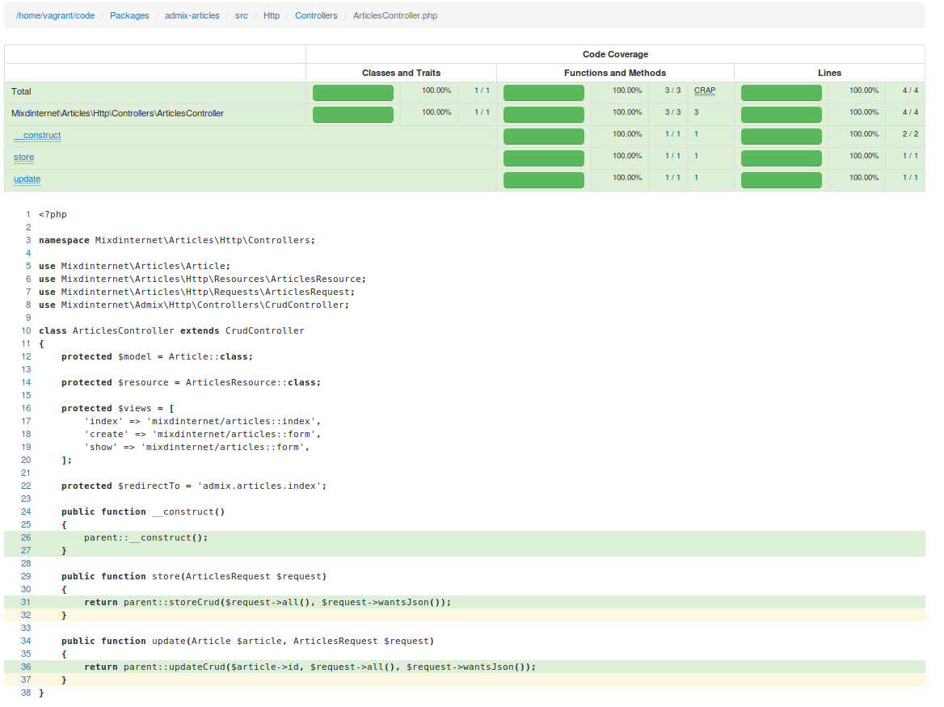

Slide 21
&
Coverage Dusk :(
LEONARDO LEMOS
PHPUNIT & LARAVEL

Slide 22
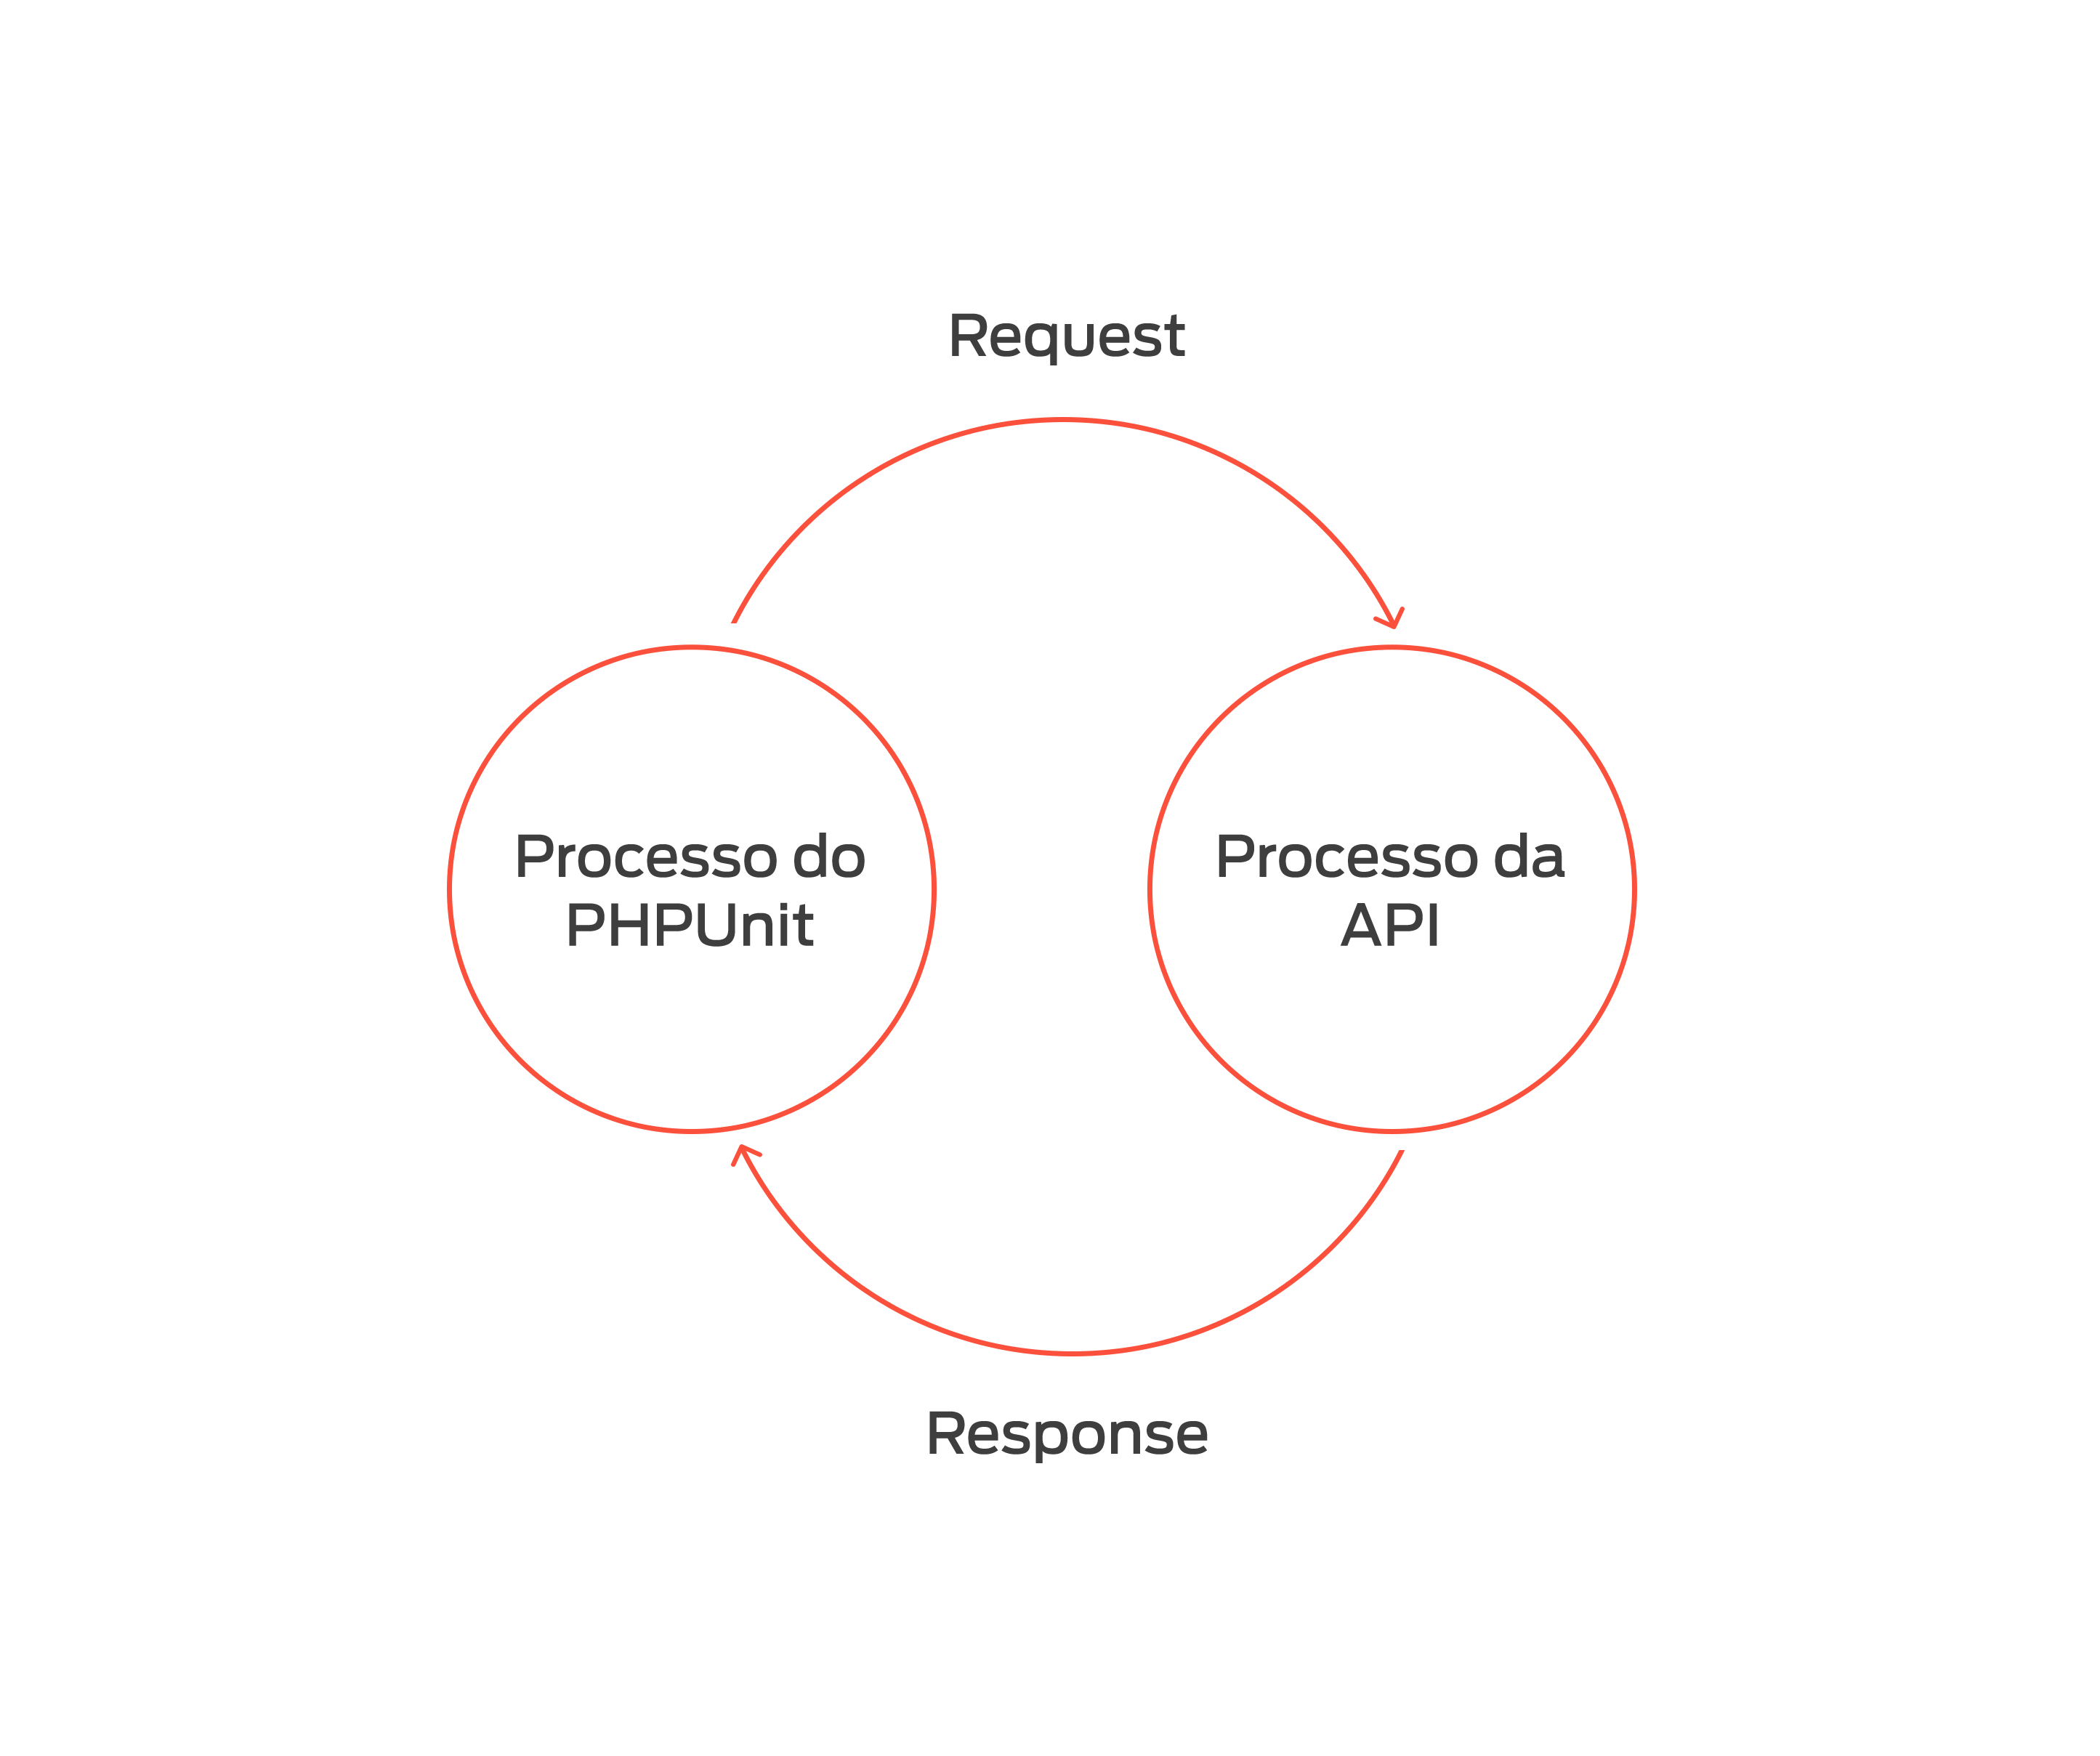

Slide 23
&
Mas e o nosso ->post() ?
LEONARDO LEMOS
PHPUNIT & LARAVEL

Slide 24
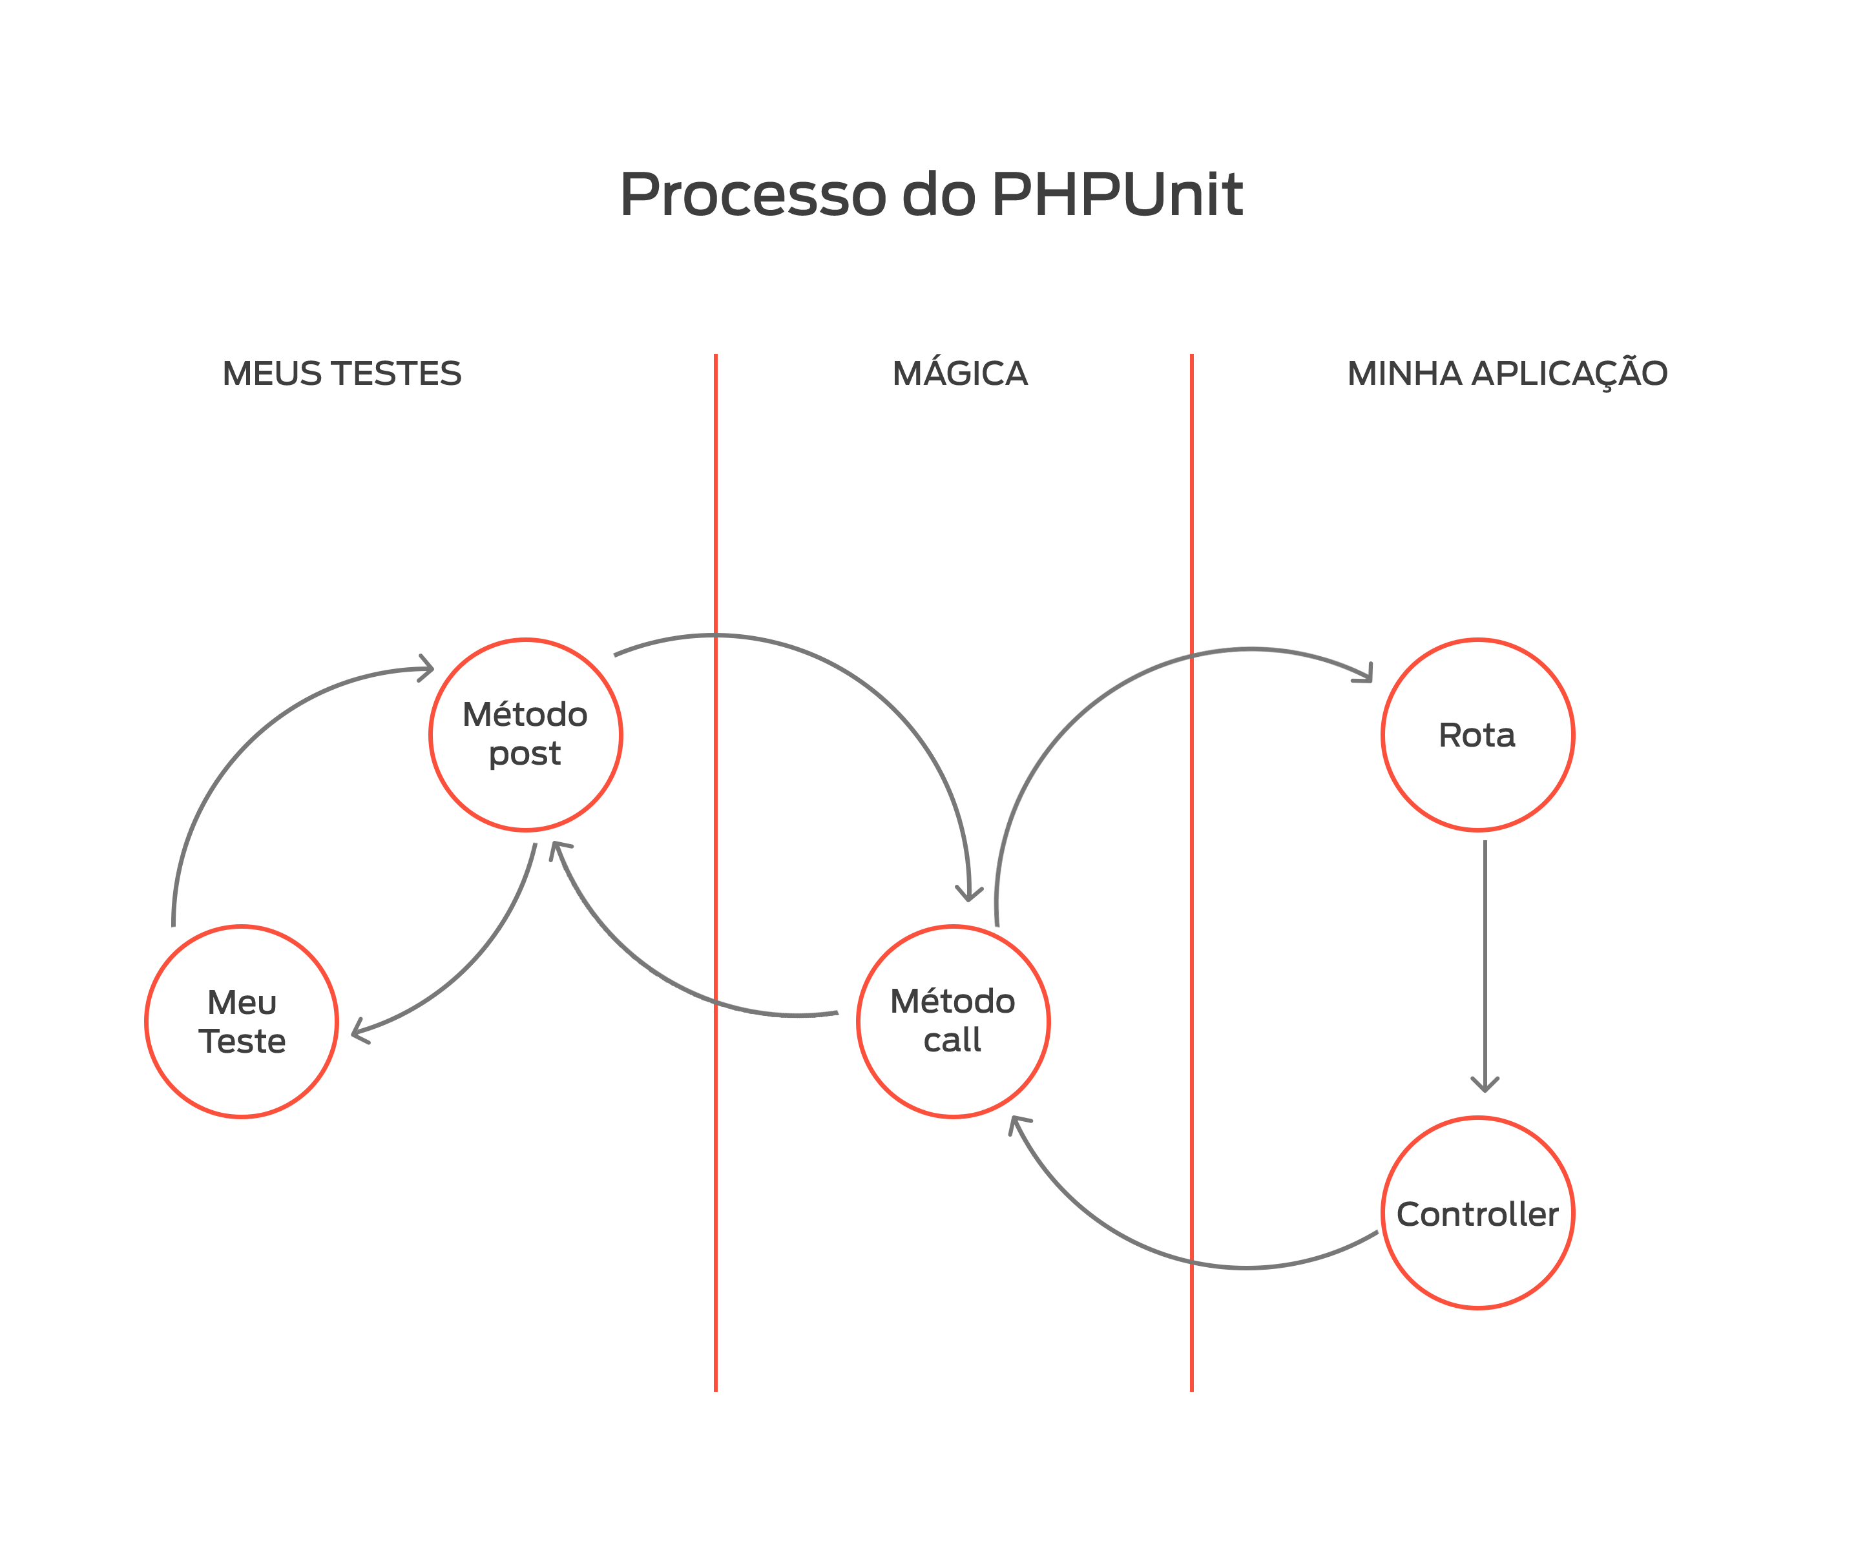

Slide 25
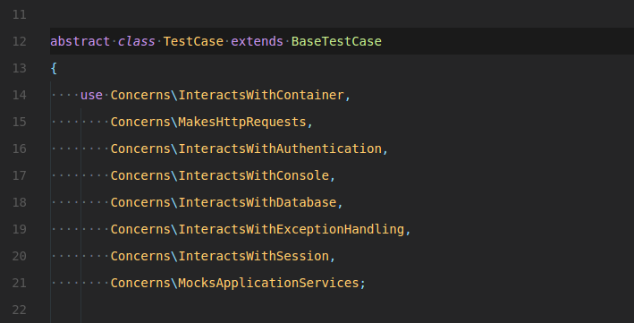

Slide 26
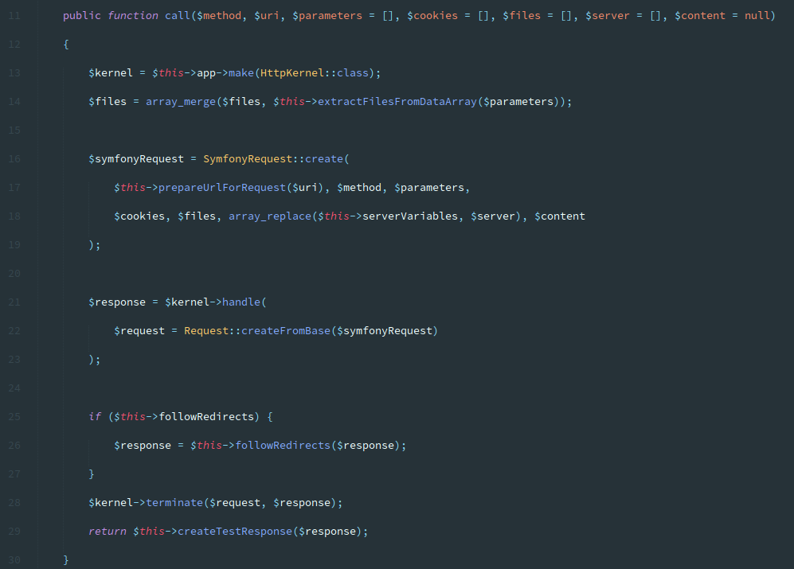

Slide 27
&
Mas e o coverage
do Dusk? :)
LEONARDO LEMOS
PHPUNIT & LARAVEL

Slide 28
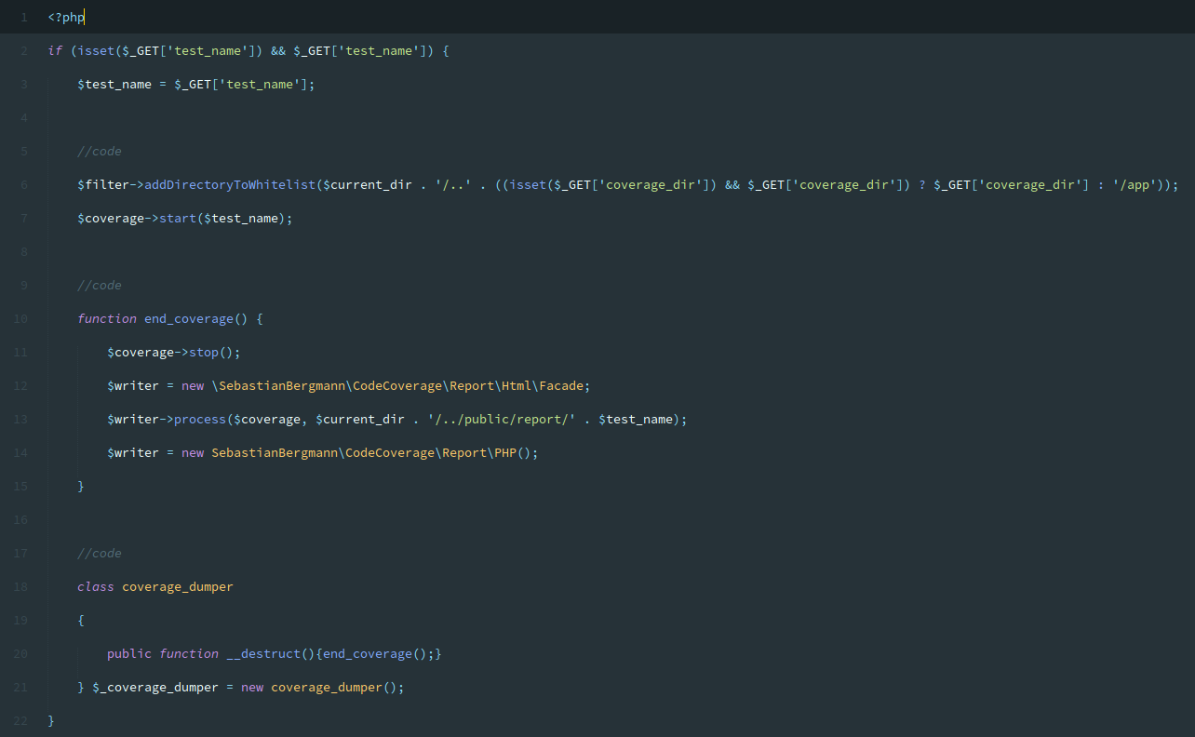

Slide 29
&
Exception Handling
LEONARDO LEMOS
PHPUNIT & LARAVEL

Slide 30
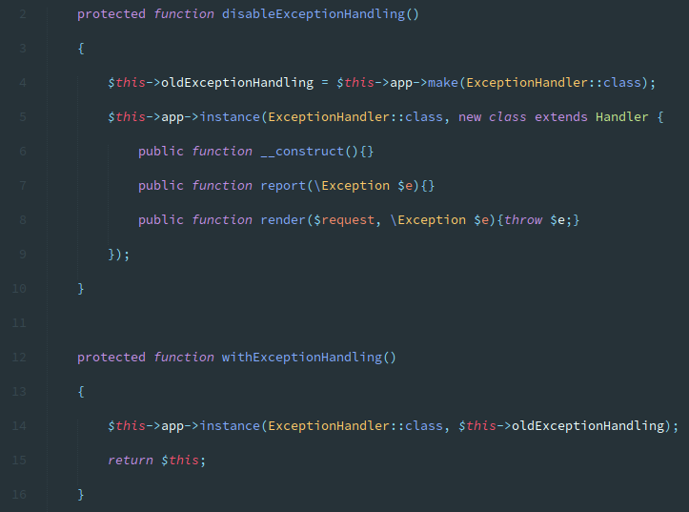

Slide 31
&
Middlewares
LEONARDO LEMOS
PHPUNIT & LARAVEL

Slide 32
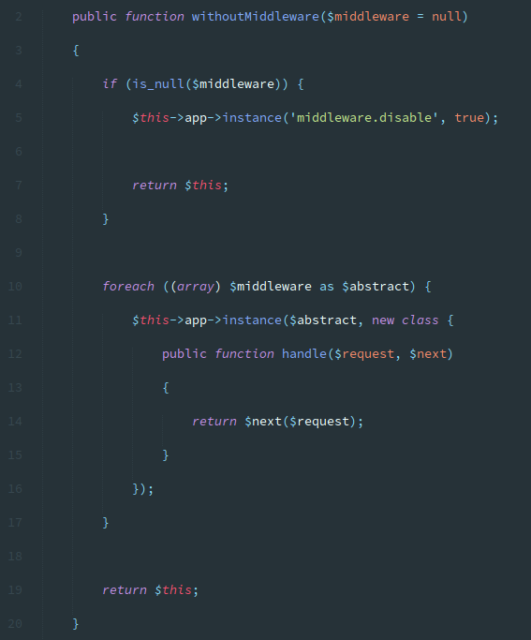

Slide 33
&
Migrations
LEONARDO LEMOS
PHPUNIT & LARAVEL

Slide 34
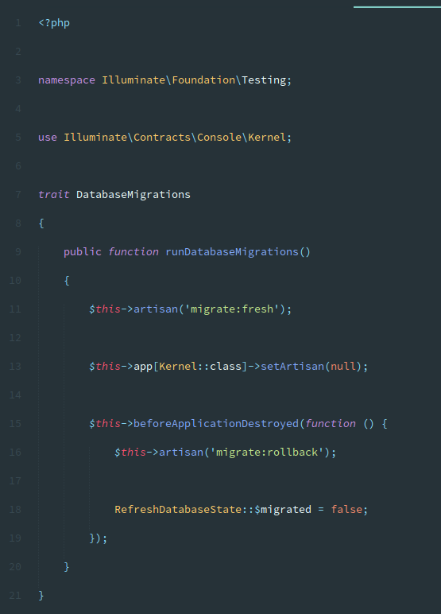

Slide 35
&
Mocks
LEONARDO LEMOS
PHPUNIT & LARAVEL

Slide 36
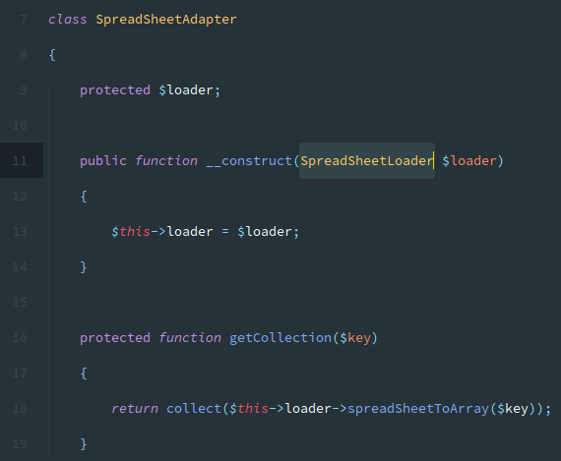

Slide 37
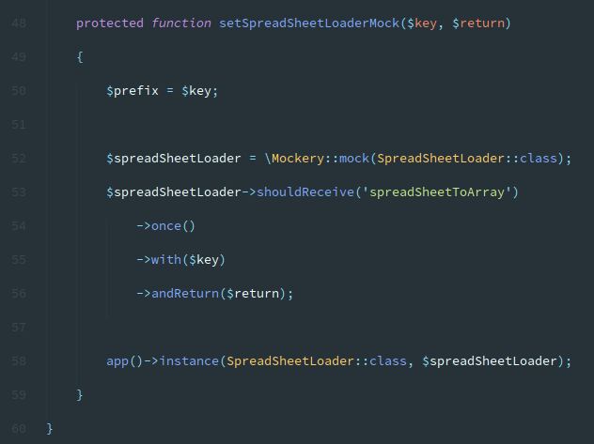

Slide 38

Obrigado

Slide 39





