Slide 1
Cambridge Charter School Internship Building a Turing Machine
Chad Spensky, Tim Greer, Jack Lepird, Stuart Baker
Feb 3 2015
Notes:
1
1

Slide 2
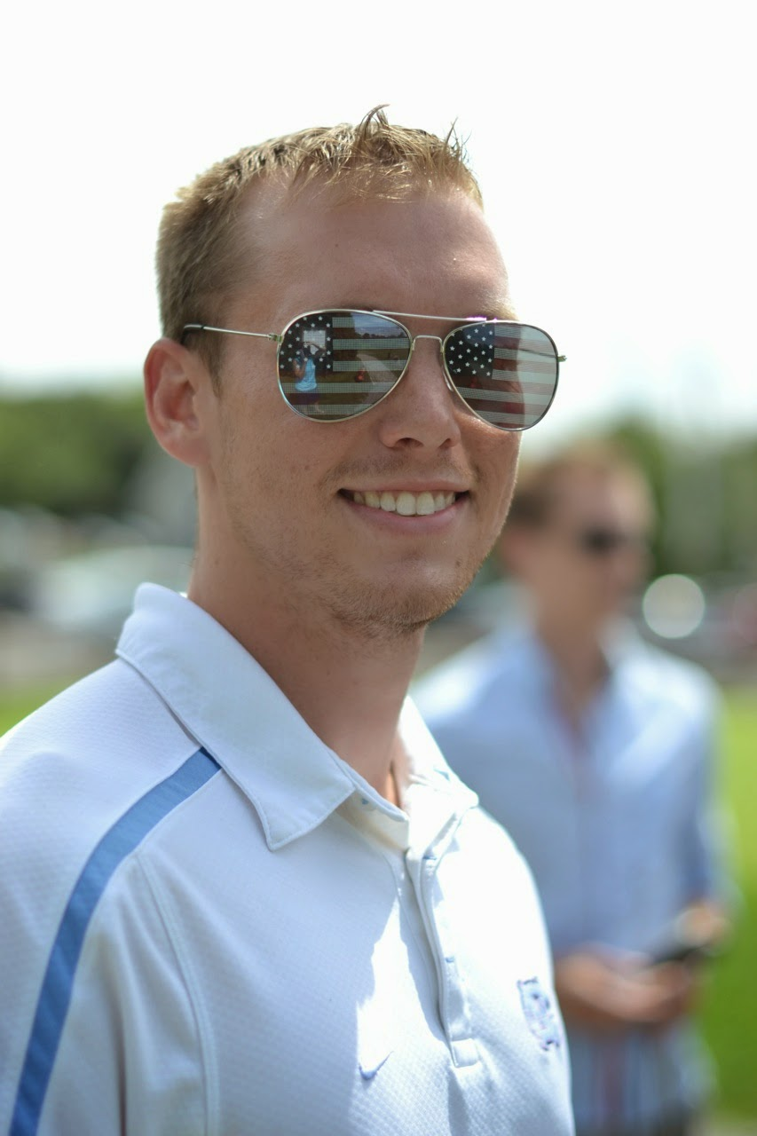
Who are we?
Chad Spensky
Area of Expertise: Computer Security
Education:
Bachelor’s Degree
Mathematics / Comp Sci. / Econ. @ PITT
Master’s Degree
Computer Security @ UNC-CH
Research Interests:
Authentication, Low-level Malware Analysis, Embedded Systems
Hobbies:
Snowboarding, Volleyball, Basketball, Inner Tube Water Polo, Traveling, Tinkering

Slide 3
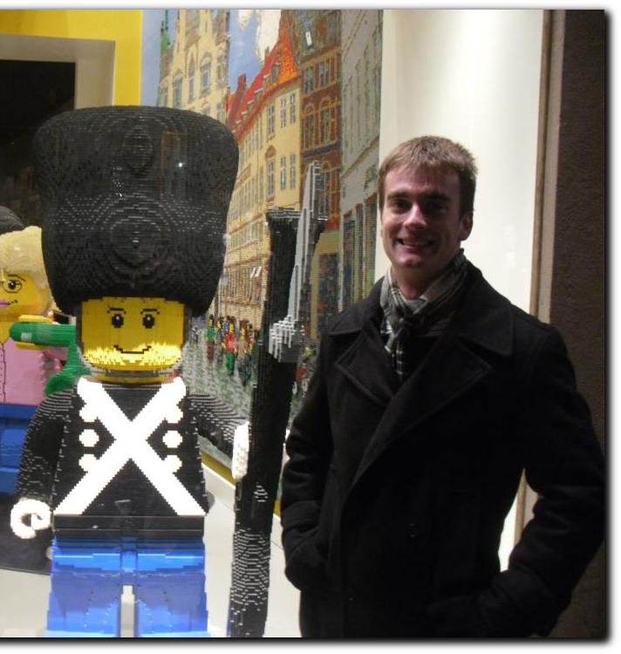
Who are we?
Jack Lepird
Areas of Expertise:
Machine Learning, Optimization, and Artificial Intelligence
Research Interest:
Next-Generation Aircraft Collision Avoidance Systems
Hobbies:
Travel, SCUBA, Golf

Slide 4
Who are we?
Tim Greer

Slide 5
Who are you?
What are your favorite subjects?
What is your favorite food/color/animal?
What do you do for fun?
What do you hope to get out of this internship?

Slide 6
Why are we here?
To Build a Turing Machine!

Slide 7
Why are we here?
A WHAT?! Machine?

Slide 8
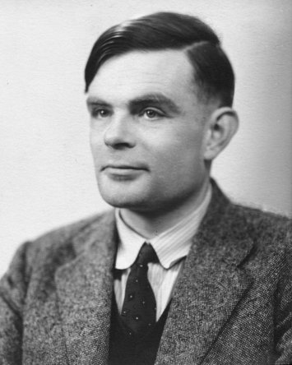
Alan Turing
One of the fathers of Computer Science

