Slide 1
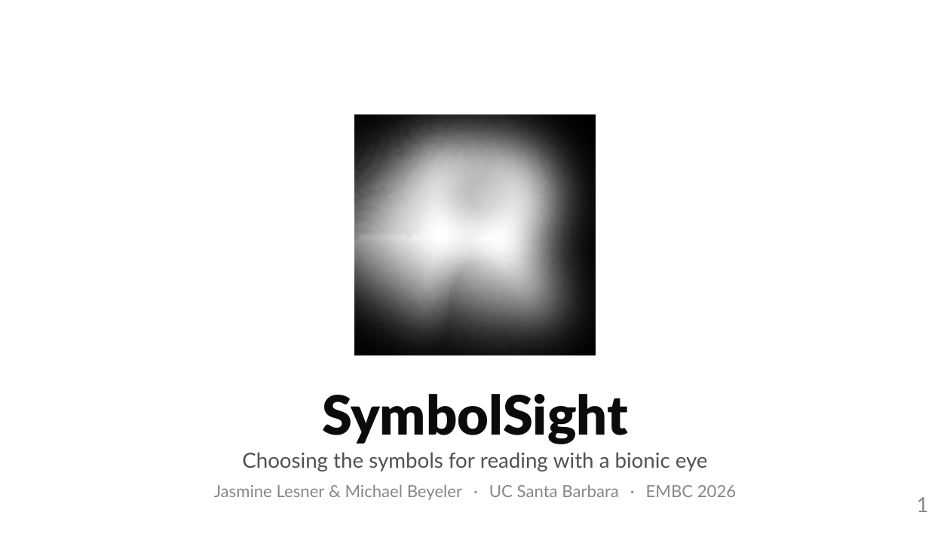
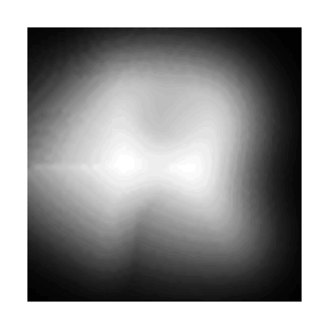
Notes:
[ANIMATION on this slide - plays in Slide Show mode]
"Good morning everyone!
That is the word 'read', one letter at a time, through a simulated retinal implant.
Let me name them for you as they go past. That is an R. That is an E. That is an A. And that is a D.
I know. They all look the same. That is the point.
My name is Jasmine Lesner, and this is joint work with Michael Beyeler at UC Santa Barbara.
The backstory: this started in Michael's graduate seminar on bionic vision. One evening I sat down and tried to read a paragraph through a simulated 16 by 16 implant, just to see what it was like.
I watched every letter blur into the next one until they were shapes that were neither of them.
And I got stuck on a question that turned into this whole project.
Why are we sending letters?"

Slide 2
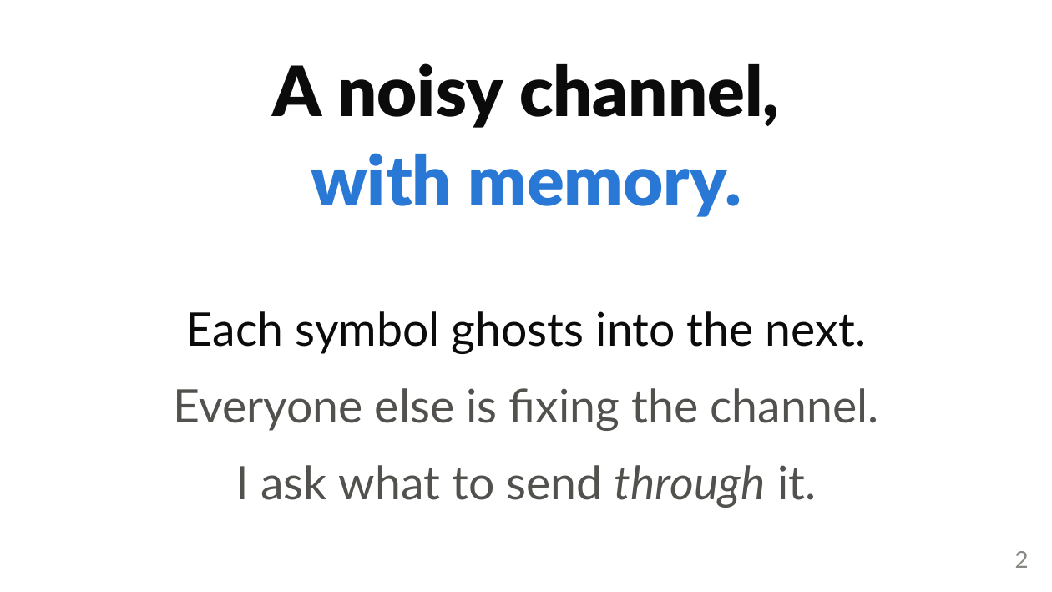
Notes:
"So here is the frame I want to use.
Reading through an implant is communication over a noisy channel. But it is a channel with memory, because each symbol is still fading when the next one arrives.
The four talks before mine this morning have all been about improving that channel. Better electrodes, current steering, sequential stimulation, measuring the cortical response directly.
That work matters, and I am not competing with it. I am asking the question that sits downstream of all of it.
Given a channel this bad, what should we send through it?
Btw: somebody did try a version of this in a real patient. Lauritzen 2012 fed Braille patterns straight into an Argus II and got 89 percent on single letters.
So a non-Latin code can work. But they picked one code, by hand, for one subject who already read Braille by touch.
Nobody has asked how to choose the code. That is the gap."

Slide 3
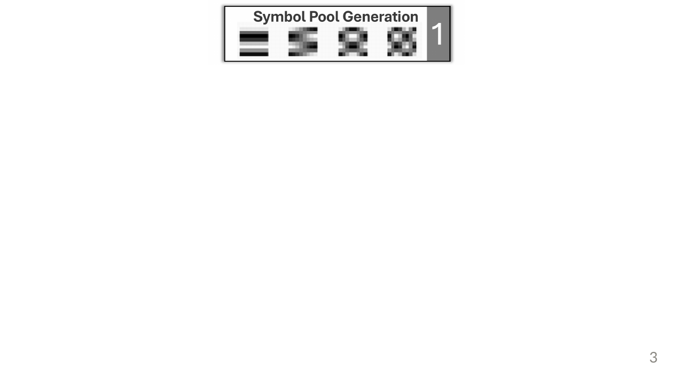
Notes:
[build 1 of 4]
"The method is four steps, and this is the only diagram I will show you today.
Step one. We build a pool of candidate glyphs. 146 of them.
Latin letters, Cyrillic, Arabic, Braille, and DCT patterns, which are just simple stripe and checker gratings."

Slide 4
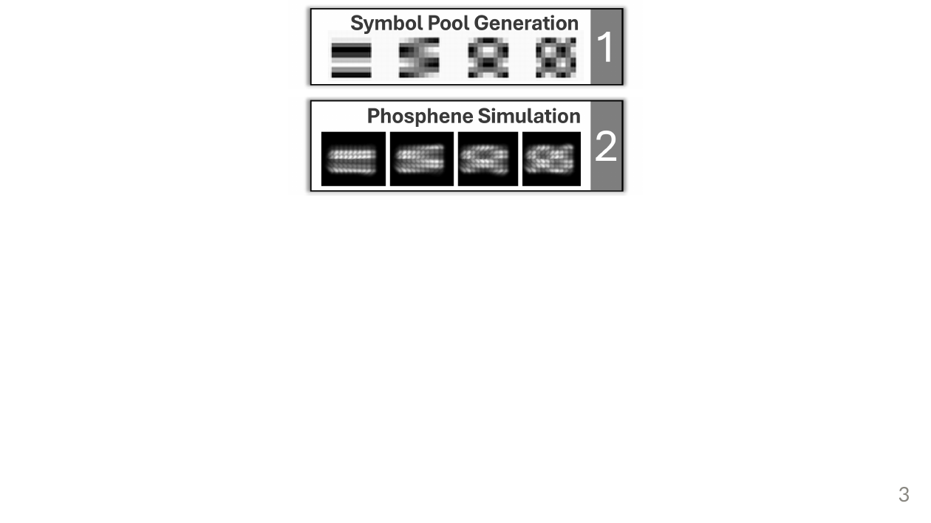
Notes:
[build 2 of 4]
"Step two. We push every glyph through a simulated retinal implant.
So now we see what each one actually looks like after the phosphene blur, and after the ghost of the previous symbol is layered on top of it."

Slide 5
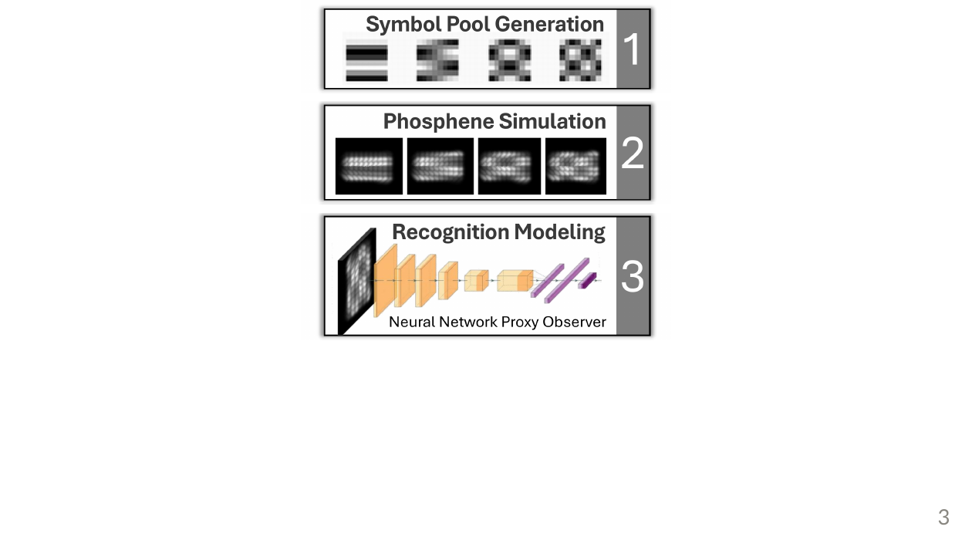
Notes:
[build 3 of 4]
"Step three. We show those degraded images to a neural network that acts as a stand-in observer, and we read off which pairs it confuses.
I want to be precise here, because this is the part I would push on if I were sitting where you are.
That network is not a model of a person. It is a fixed, reproducible yardstick for whether two symbols are still structurally different after the channel has had its way with them."

Slide 6
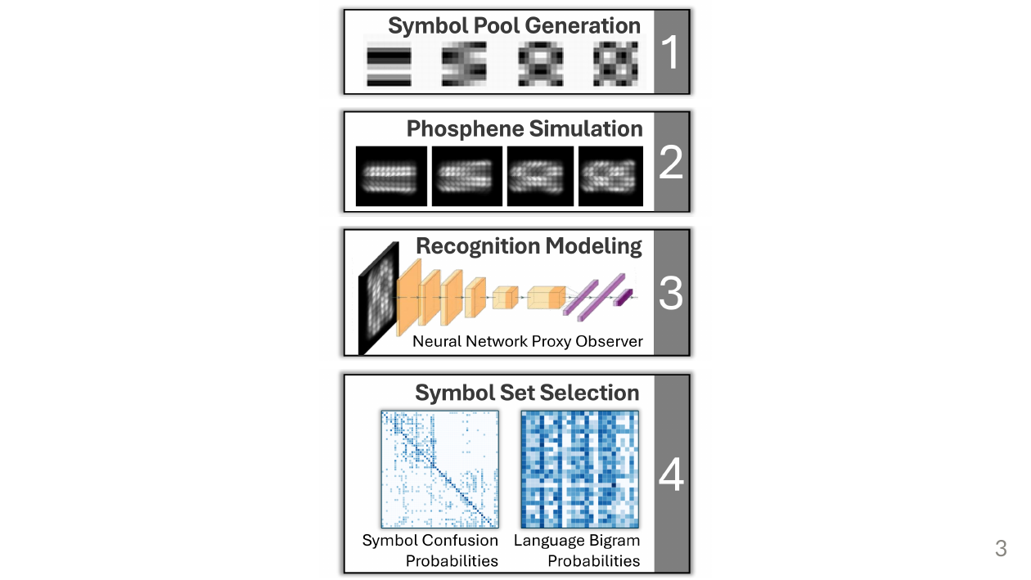
Notes:
[build 4 of 4]
"Step four. We take that confusion, weight it by how often each pair of letters actually occurs in the language, and we choose the assignment that keeps frequent neighbours apart.
And that last step, the weighting by language, turned out to matter more than I expected. I will come back to it at the end."

Slide 7
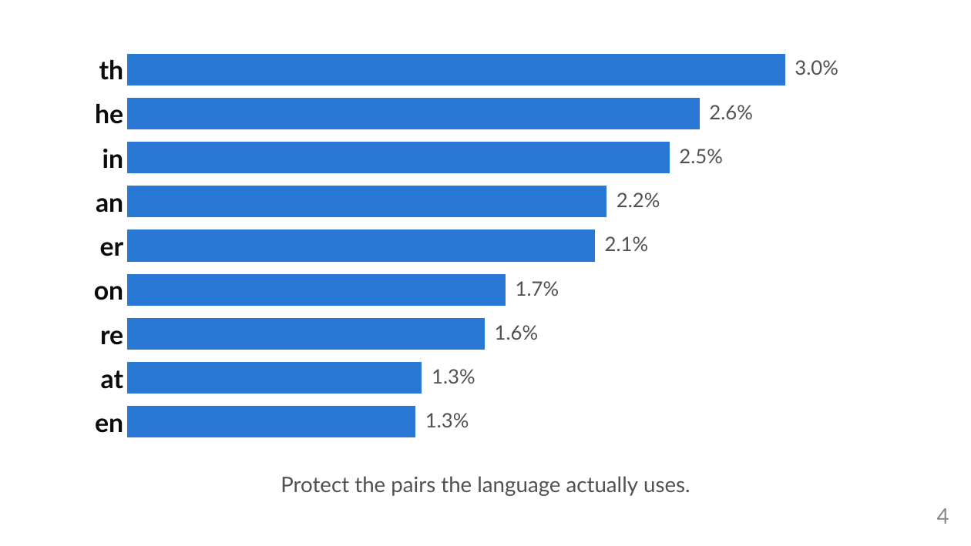
Notes:
"So why weight by the language?
Because errors are not equally costly.
This chart shows the most common letter pairs in English. T followed by H is about three percent of every letter transition you will ever read.
So if your symbols for T and H happen to collide, you pay that price on every single page. Q followed by Z, you basically never pay.
The optimiser spends its effort where the language spends its."

Slide 8
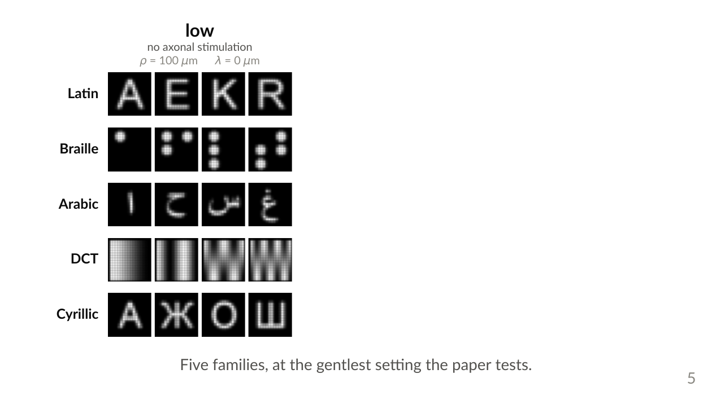
Notes:
[build 1 of 3]
"Quickly, so the rest of the talk makes sense. These are the five families the pool draws from.
Latin letters, Braille dot patterns, Arabic, DCT gratings, and Cyrillic.
And this is the gentlest setting the paper tests. 100 micron phosphenes, no axonal stimulation at all. Everything here is still readable."

Slide 9
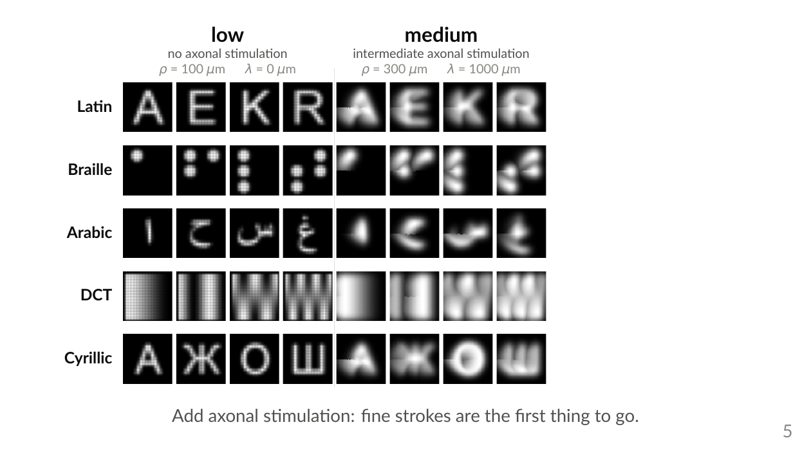
Notes:
[build 2 of 3]
"Now I turn on axonal stimulation, which is what makes a phosphene smear into a comet tail along the nerve fibre.
300 micron phosphenes, a 1000 micron streak.
Notice what goes first. The fine strokes. Look at the Arabic row, and look at those fine DCT gratings on the fourth row."

Slide 10
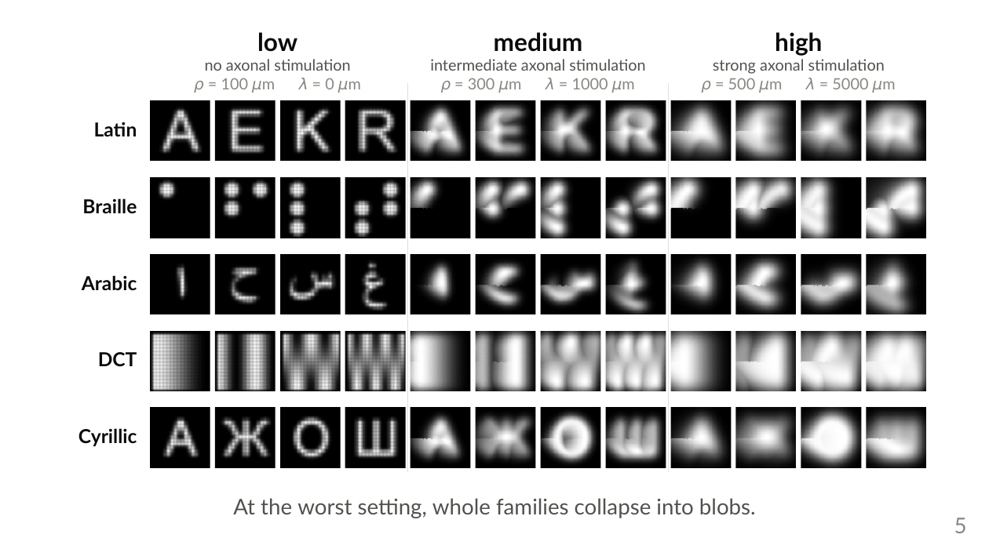
Notes:
[build 3 of 3]
"And this is the worst setting. 500 micron phosphenes, a 5000 micron streak.
Latin, Arabic and Cyrillic have all collapsed into centred blobs.
But look at the Braille row. Those dots are still separate objects.
Coarse and blocky survives. Remember that, it comes back."

Slide 11
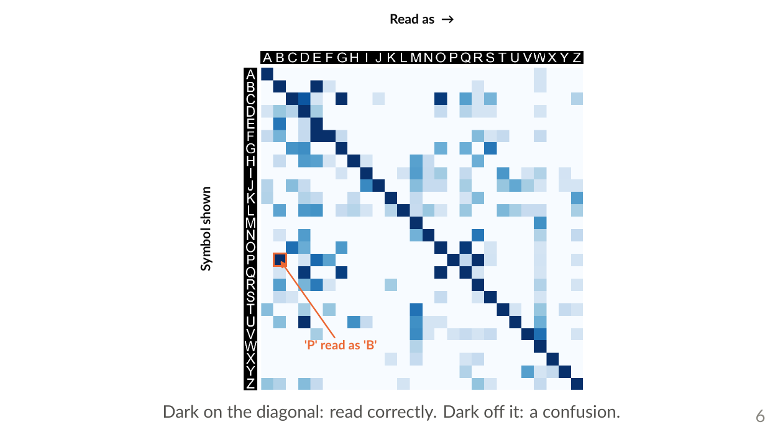
Notes:
"When I say the network tells us which pairs get confused, here is exactly what I mean, for just the 26 Latin letters.
Every row is the symbol we showed. Every column is what the network read it as.
The dark diagonal is the good case. It usually gets it right.
The dark cells OFF the diagonal are the confusions. Here is one, flagged in orange.
And this is fully reproducible. You can take this matrix and check my result yourself."

Slide 12
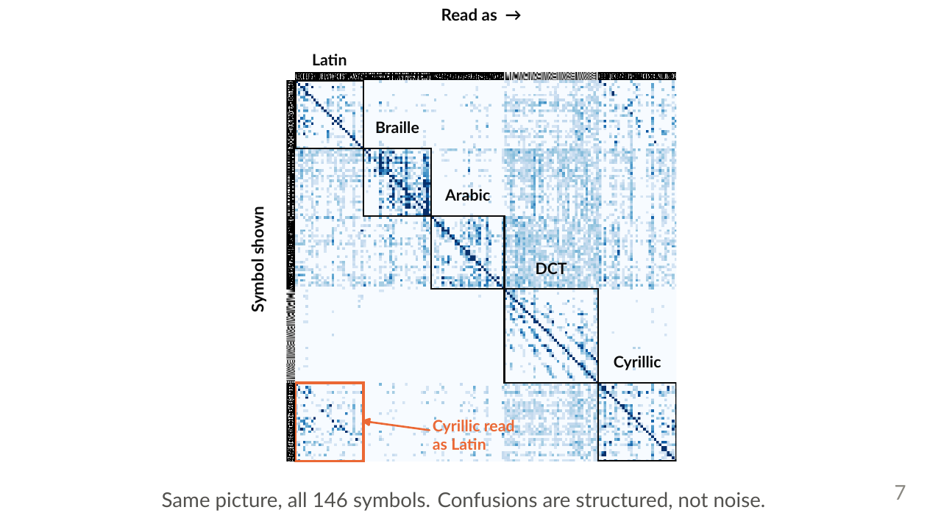
Notes:
"Now zoom out to all 146 symbols. Same picture, same colour scale.
Two things here.
First, notice the confusion is blocky. Symbols mostly get confused inside their own family. So the confusions are structured, not random noise, and structure is something you can optimise against.
Second, look at this corner. Cyrillic getting read as Latin, because those two alphabets share letterforms.
This is a map. And a map is something you can route around."

Slide 13
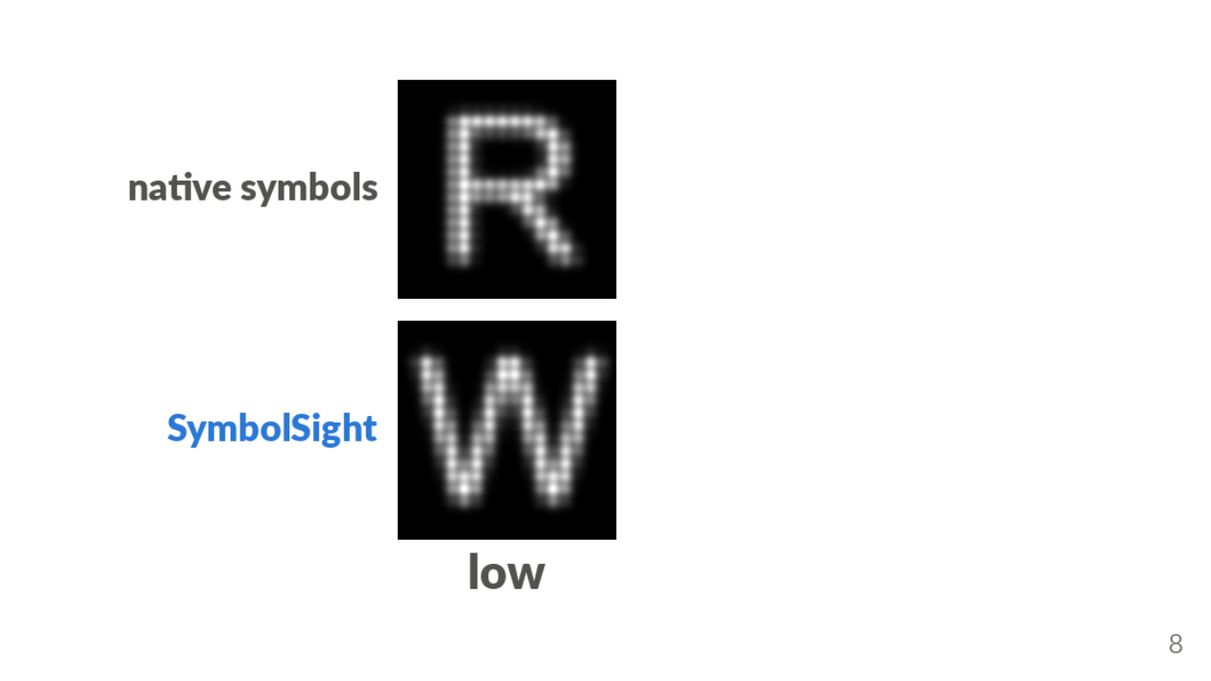
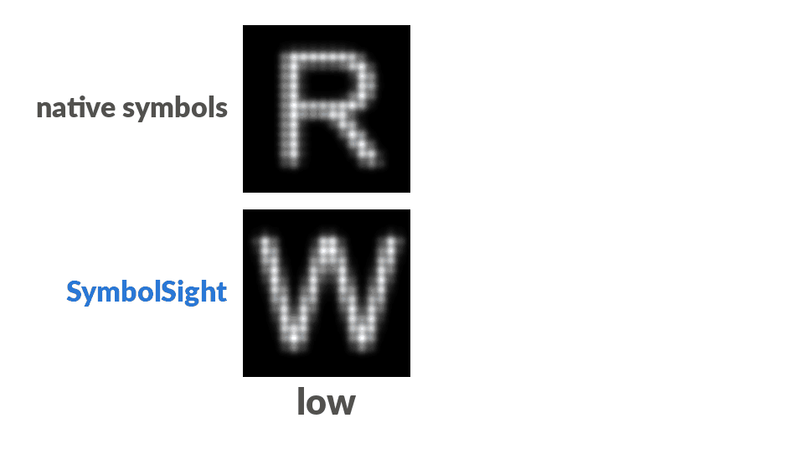
Notes:
[ANIMATION on this slide - plays in Slide Show mode]
[build 1 of 3]
"So now watch what that actually costs you.
The top row is the word 'read' in ordinary letters, going through the implant. The bottom row is the same word, same channel, spelled in the glyphs SymbolSight chose instead.
This is low distortion, and honestly, at this level both of them work. The letters are readable.
The chosen glyphs happen to be a W, a fine grating, a Cyrillic Yu, and a checkerboard."

Slide 14
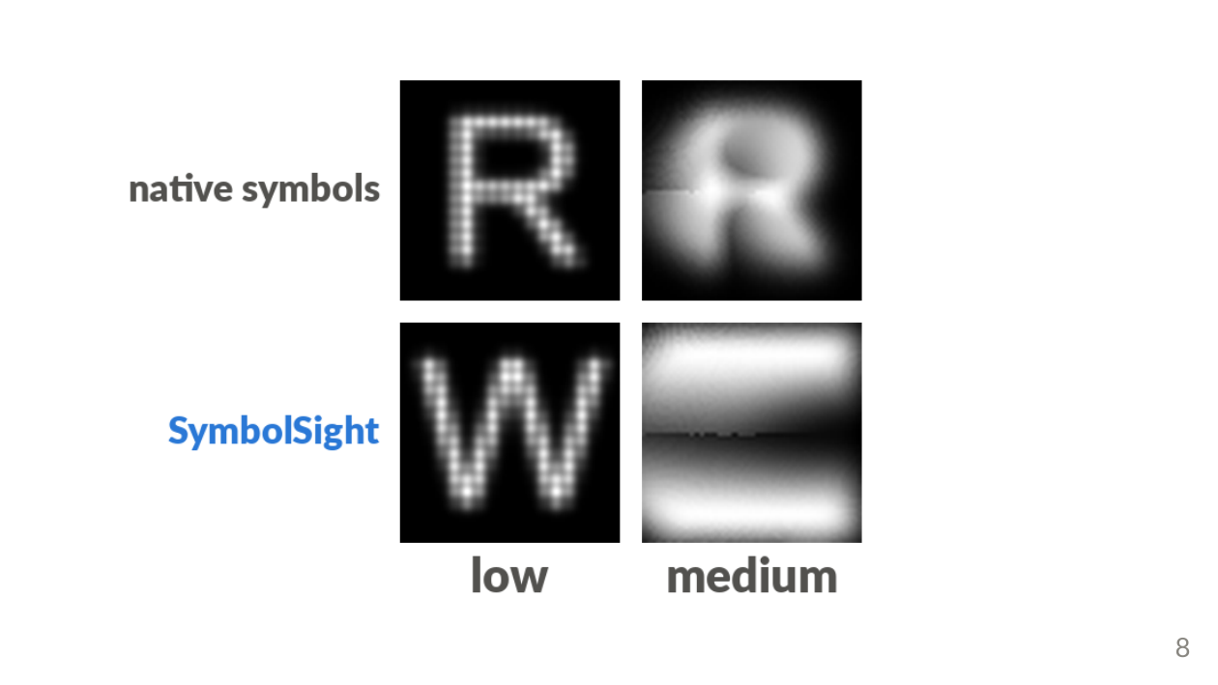
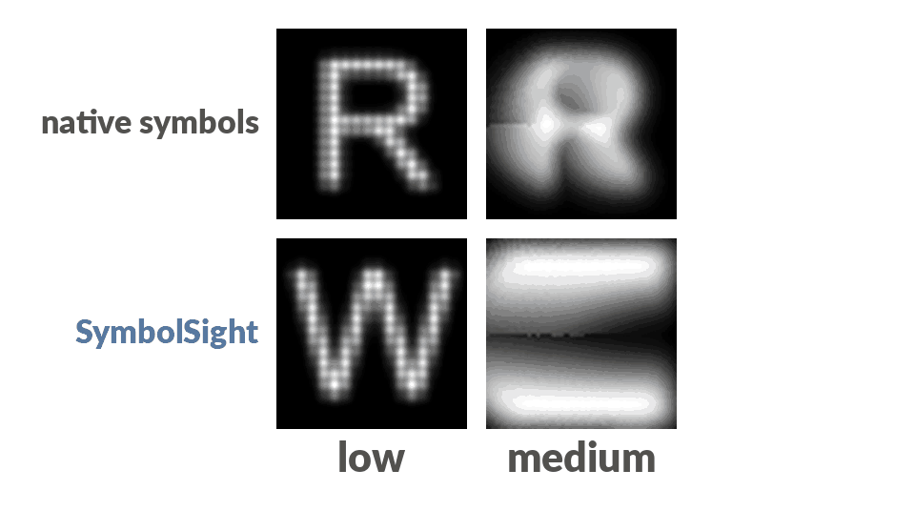
Notes:
[ANIMATION on this slide - plays in Slide Show mode]
[build 2 of 3]
"Now I add medium distortion.
Look at the top row. It is already going. The R and the E are melting toward the same shape.
And the bottom row has changed too, and this is the part I did not expect.
The optimiser has thrown away the fine gratings it was perfectly happy with a moment ago, and reached for coarser things instead."

Slide 15
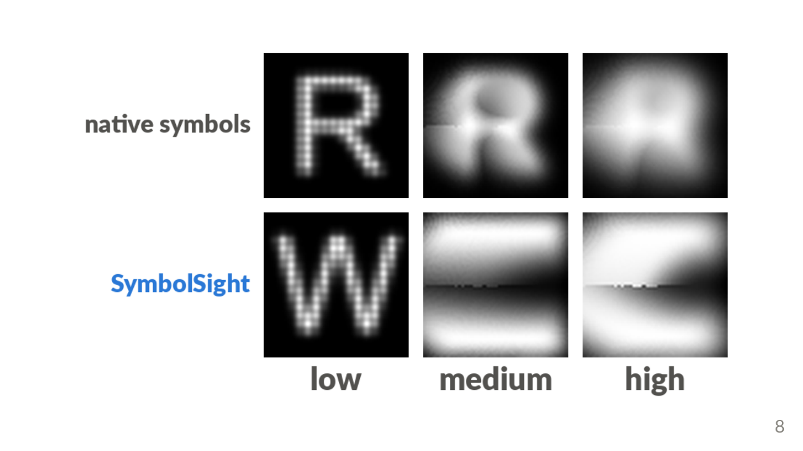
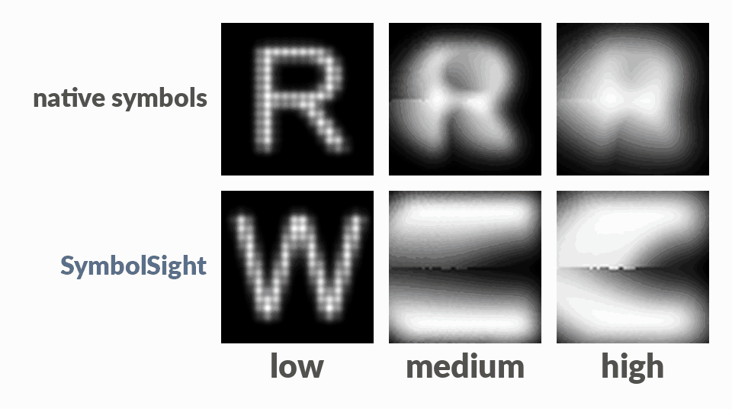
Notes:
[ANIMATION on this slide - plays in Slide Show mode]
[build 3 of 3]
"And high distortion.
Look at the top row. Four centred blobs. That is my first slide, happening on every letter.
Now look at the bottom row, and look at the SHAPE of the bright region. A band. A hook. A wedge. A wide smear.
They stay apart. And every one of them is coarse.
The optimiser is not being clever. It is being robust."

Slide 16
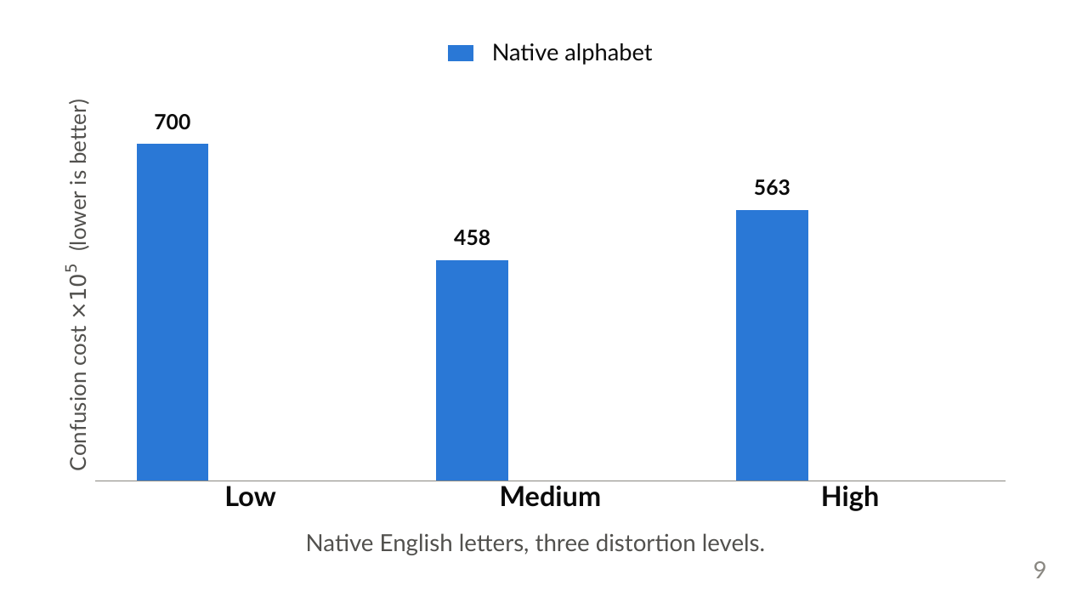
Notes:
[build 1 of 3]
"So let me put a number on it.
Blue is native English letters, at the three distortion levels. That is the baseline, and lower is better."

Slide 17
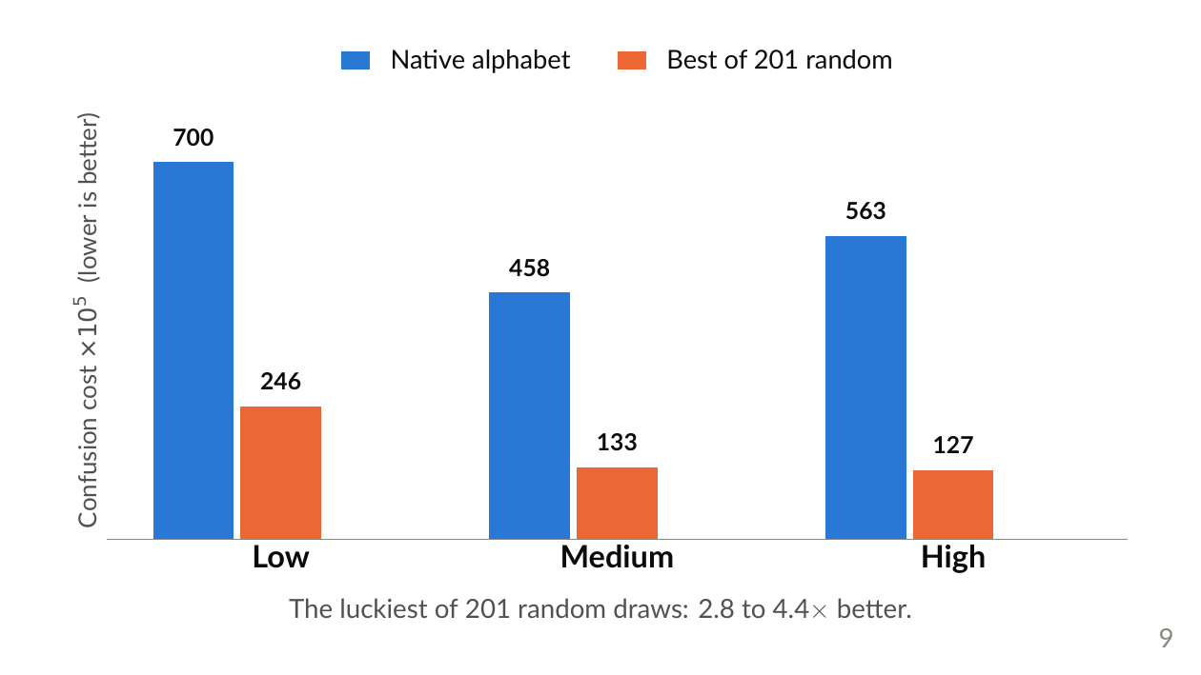
Notes:
[build 2 of 3]
"Orange is what you get by picking 26 symbols at random out of the pool, with no optimisation at all, and keeping the luckiest of 201 tries.
Even that lucky random draw beats the native alphabet, by about three to four times.
And I want to be honest about the word lucky: the average random draw is barely better than native. So heterogeneity on its own is not the answer.
But the fact that a lucky guess beats the alphabet at all tells you something uncomfortable. The Latin alphabet is a poor codebook for this channel. It was designed for high-resolution parallel reading on paper, not for this."

Slide 18
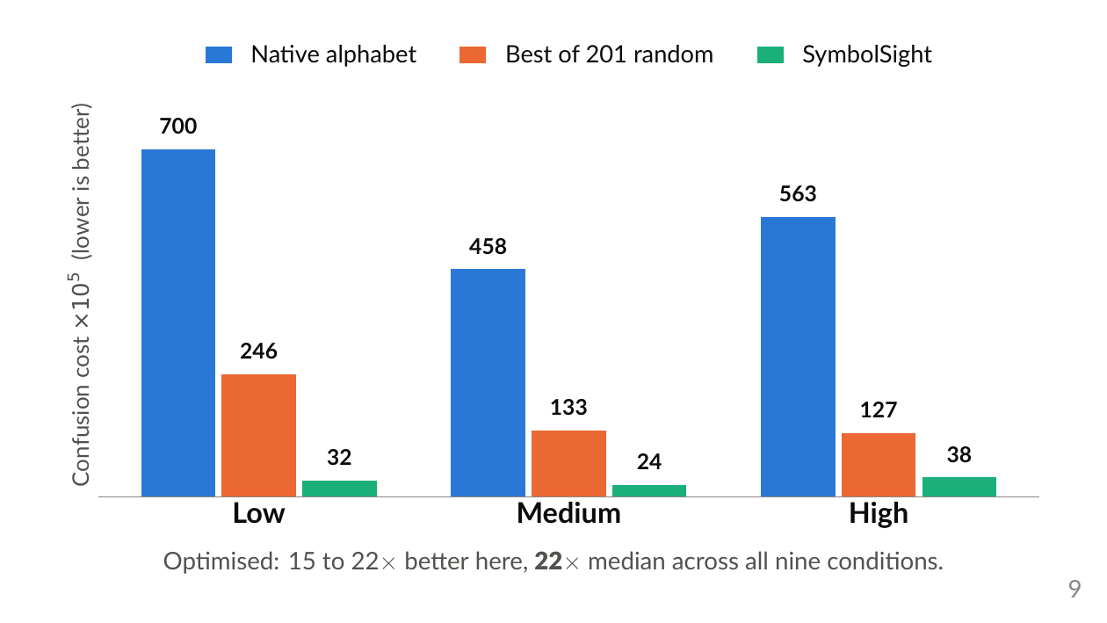
Notes:
[build 3 of 3]
"And green is SymbolSight.
Optimisation takes it much further. Fifteen to twenty-two times on this slide, and a median factor of 22 across all nine conditions.
So the search is doing the work, not the diversity. Hold onto that, it comes back at the end.
But I also want to be careful about what that 22 actually means. Which is my next slide."

Slide 19
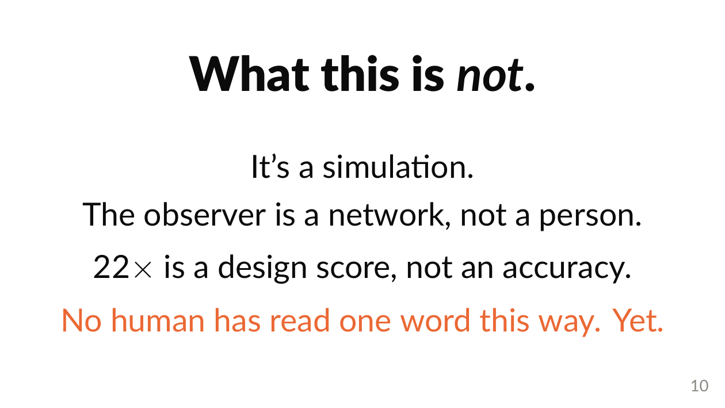
Notes:
"So let me tell you what this is NOT.
It is a simulation.
The observer is a neural network reading generic image features. A human who trained on these symbols for a few weeks could probably do better, so this is not an upper bound on anything.
The 22 is a design score for comparing codebooks. It is not a predicted reading accuracy, and I would ask you not to quote it as one.
And then the honest headline. No human being has ever read a single word this way.
What I have built is a filter. It turns an impossibly large design space into a short list worth testing on actual people."
RESTORE ONLY IF AHEAD OF SCHEDULE (~12s). Say it between the design-score line and the honest headline: "And simulated prosthetic vision with sighted observers is known to over-estimate performance. That is a real limitation, and it is exactly why every number here is a relative ranking under one fixed model, and not an absolute claim." This sentence is pre-cut by default so the closing handoff always has room. The point survives without it: the line above already says the 22 is not an accuracy, and backup B7 covers it in full if anyone asks (qa.md Q6).

Slide 20
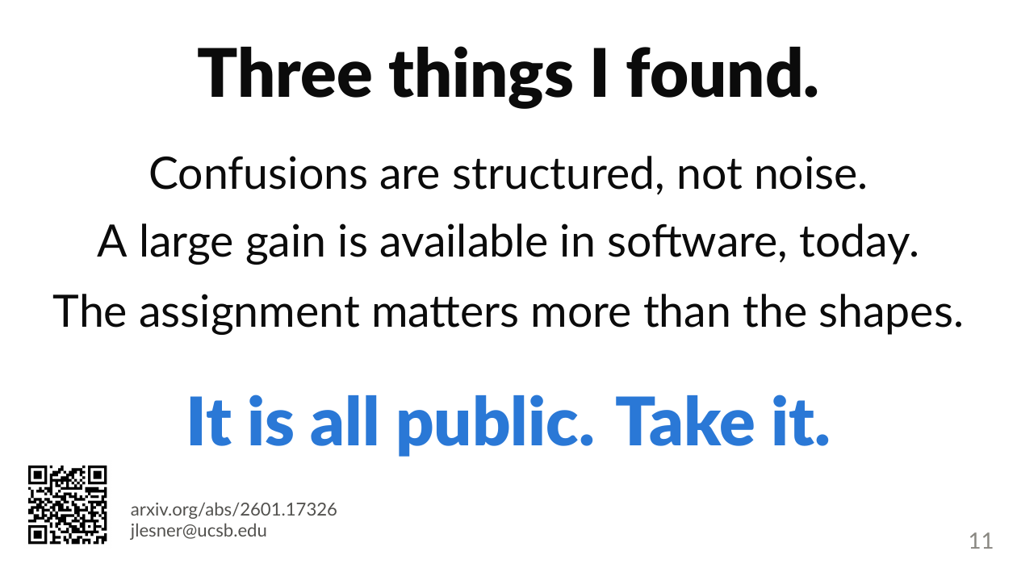
Notes:
"So, to summarise what I found.
One. The confusions are structured, not noise. That is the thing that makes them optimisable at all.
Two. A large gain, about 22 times on my metric, is available purely in software, on arrays that already exist.
Three. When I decomposed that gain, the language-aware assignment carried the larger share, not the distinctive shapes. The breakdown is in my backup slides if anyone wants it.
And then a personal note to close.
I did this as a solo project across a gap year. No funding, no course credit. I start a PhD in the fall, on a different problem, so this paper is where my part of it ends.
Which means I would much rather leave this with you than hold onto it.
Everything is public. The paper, the code, the confusion matrices, the whole symbol pool.
And there are two questions I could not answer, that some of you can.
If you see patients: does this confusion structure look anything like what your patients actually mix up? Because if it does not, my yardstick is wrong and I would like to know.
If you build the arrays: which of these glyphs could a real device actually put on the retina?
Come find me today, or email me, and I will hand over everything I know. Including the parts that did not work.
Thank you."

Slide 21
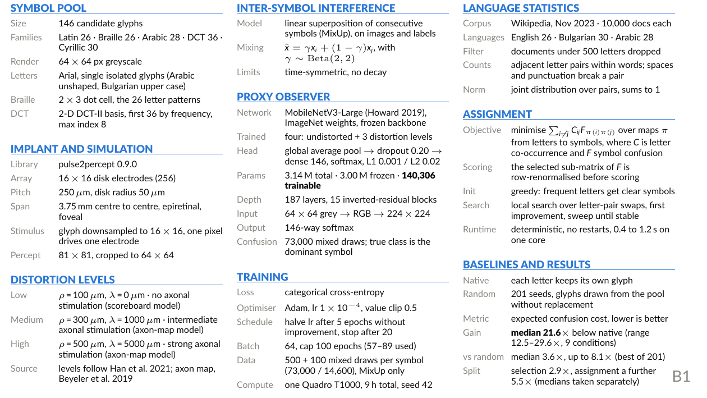
Notes:
SPEC SHEET. Your answer slide for any 'what exactly did you use' question.
Put it up and read from it; do not try to recite it.
Most-asked blocks: PROXY OBSERVER (140,306 trainable params on a frozen MobileNetV3-Large), IMPLANT (16x16 disk electrodes, 250um pitch, 3.75mm across), DISTORTION LEVELS (rho/lambda per level), ASSIGNMENT (greedy init + local search).
Say 'greedy plus local search', never 'Hungarian' (qa Q9).

Slide 22
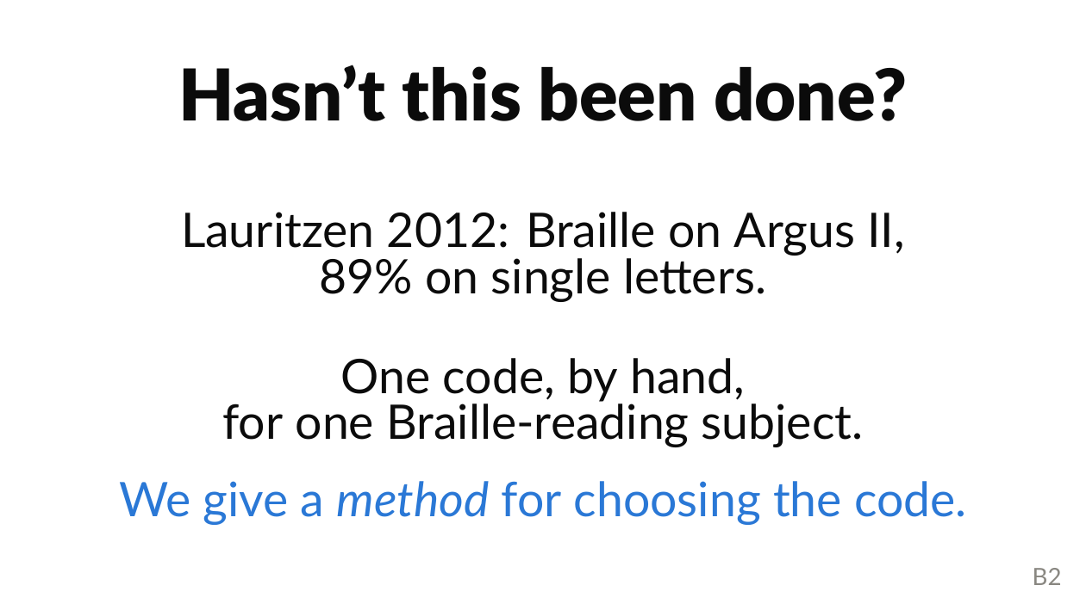
Notes:
Prior art / Lauritzen 2012 (qa Q1).
Braille via Argus II, 89% on single letters: one code, by hand, for one Braille-reading subject.
We give a METHOD for choosing the code. Defensible novelty is the combination: search over a large pool + an SPV confusion model + language bigrams.

Slide 23
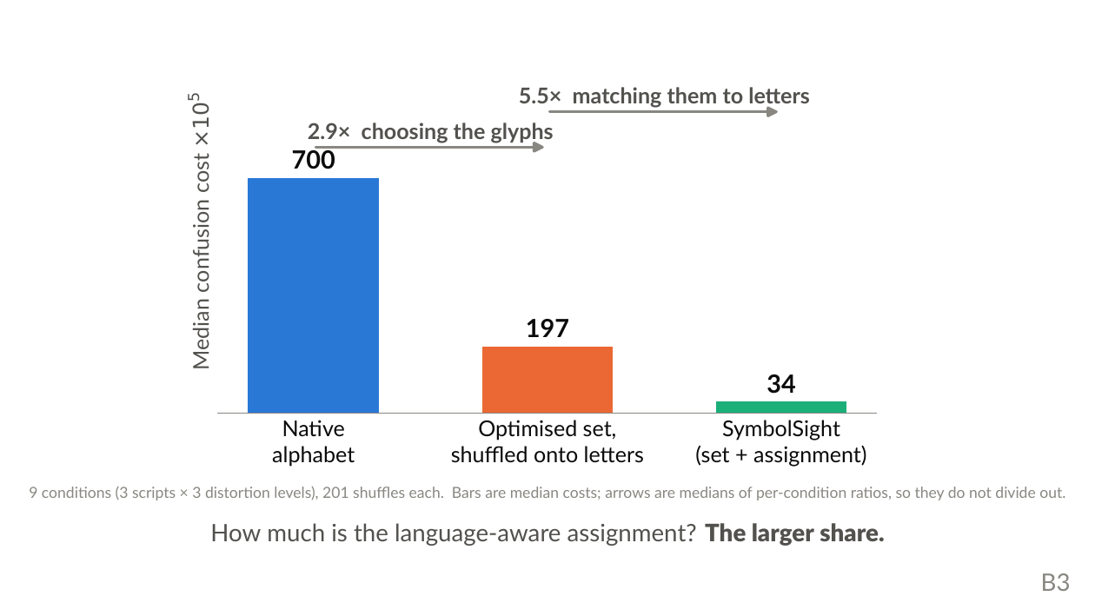
Notes:
Selection vs assignment ablation. THE ONE TO KNOW COLD.
If asked 'how much is the bigrams vs just distinctive shapes' (qa Q4): freezing the 26 chosen symbols and shuffling them onto letters keeps about 2.9x; the language-aware assignment adds about 5.5x more.
The assignment carries the LARGER share. This is also finding three on your closing slide.

Slide 24
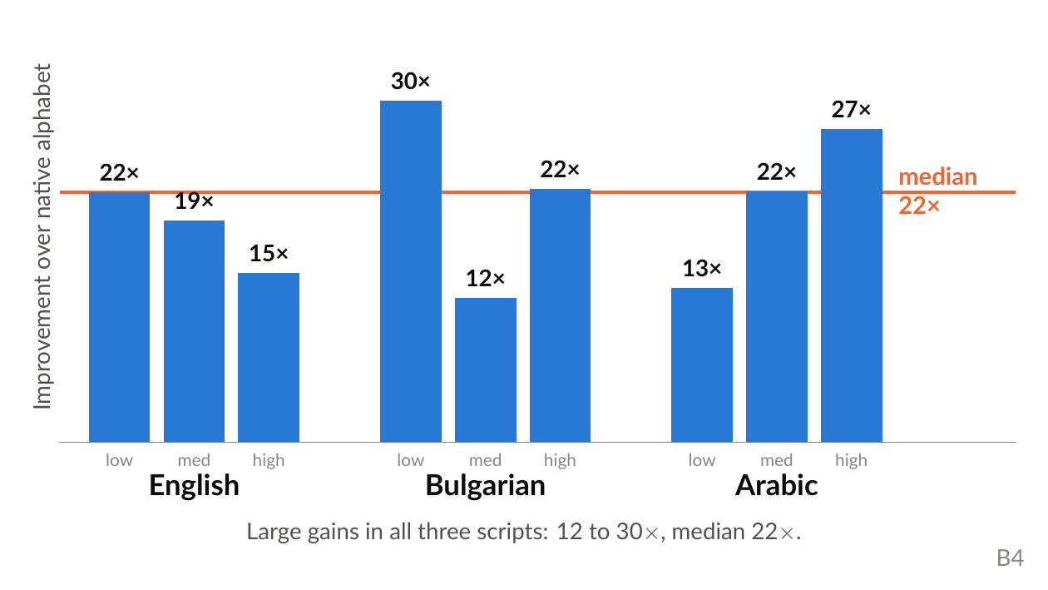
Notes:
Holds across scripts (Table II).
Median 22x, range 12.5-29.6x, across English, Bulgarian and Arabic. Not an artefact of one orthography.

Slide 25
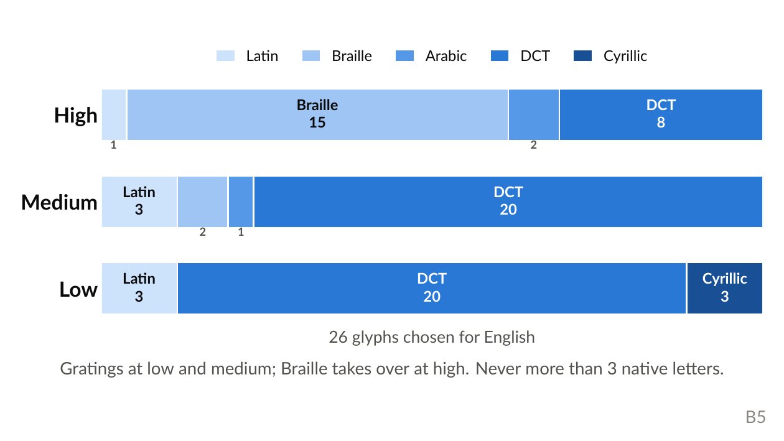
Notes:
Where the optimised glyphs come from.
As distortion rises the optimiser shifts from DCT gratings toward coarse Braille clusters; low-frequency content is what survives blur.
This is the evidence behind 'it is not being clever, it is being robust' on slide 8.

Slide 26
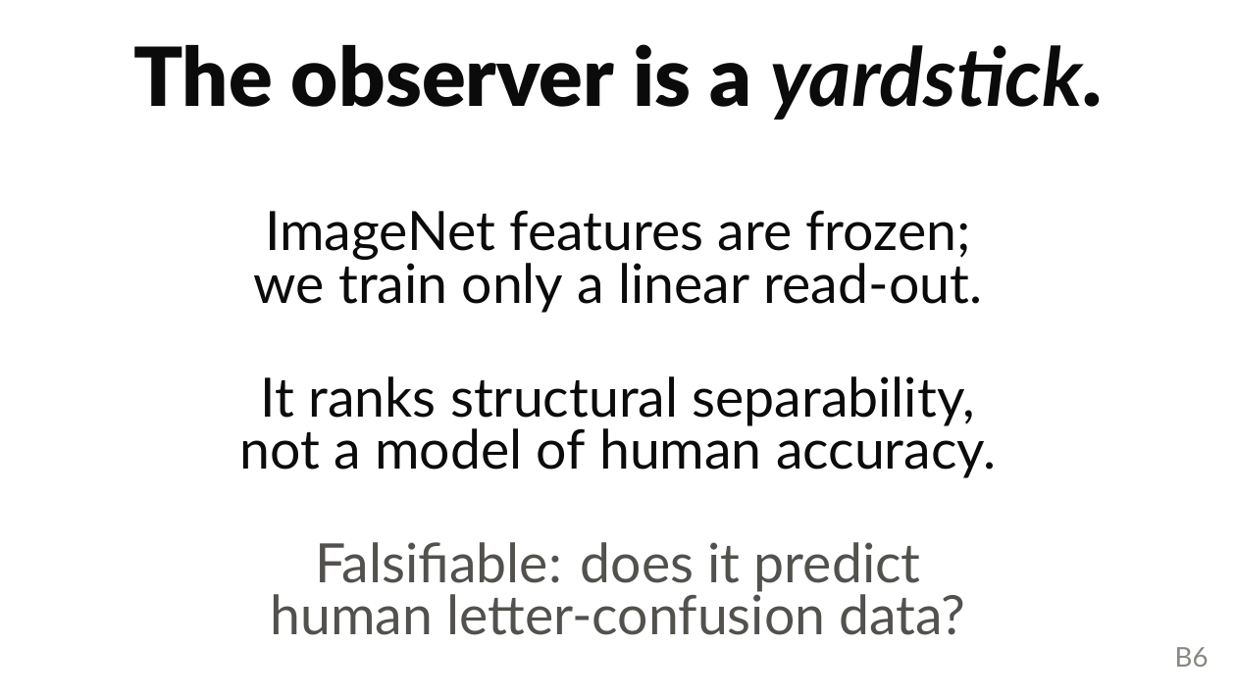
Notes:
The CNN proxy (qa Q5).
Frozen ImageNet features, linear read-out. A yardstick for structural separability, NOT a human-accuracy model.
Say 'fixed yardstick', never 'upper bound'. Falsifiable against published human letter-confusion data.

Slide 27
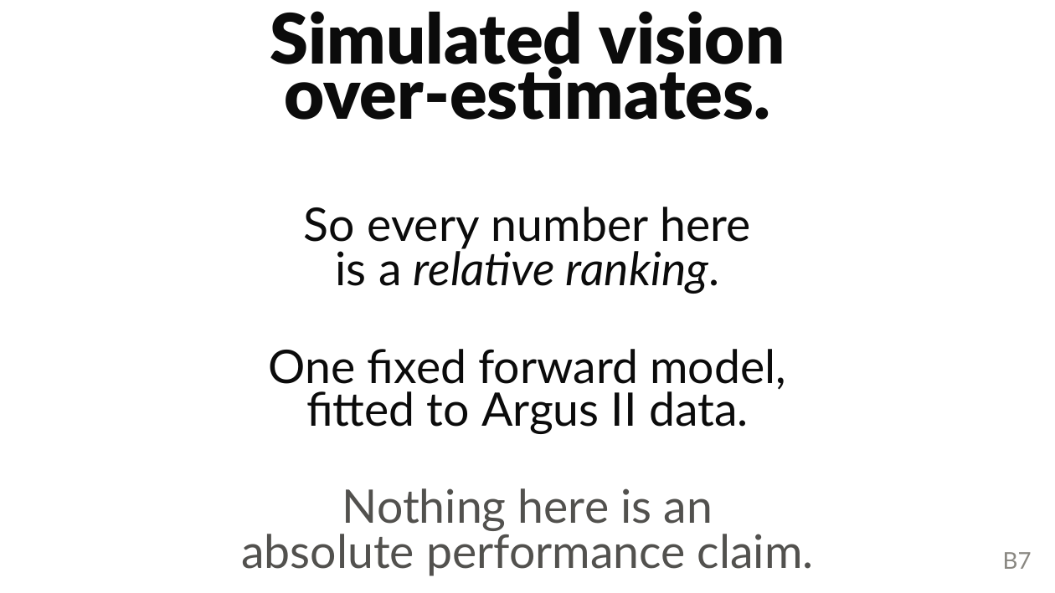
Notes:
SPV validity (qa Q6).
Concede fully: simulated vision with sighted observers over-estimates.
Every number here is a relative ranking under one fixed forward model.

Slide 28
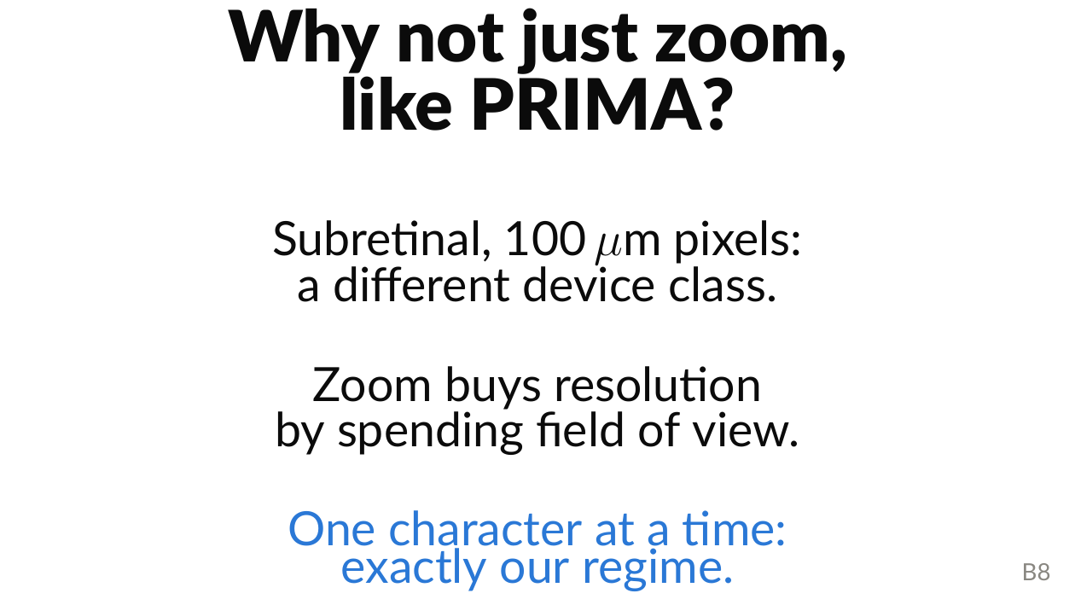
Notes:
PRIMA (qa Q13).
Different device class: subretinal, 100um pixels, and the axonal streaking that drives my model is an epiretinal phenomenon.
Zoom buys resolution by spending field of view, so at high zoom you read about one character at a time: exactly our regime. PRIMA is the motivating example, not the competitor.

