Slide 1
Reduction of an E-R Schema to Tables
A database which conforms to an E-R diagram can be represented by a collection of tables
For each (strong) entity set there is a table having as candidate key the key of the entity set
For relationship set there is a table having as columns the keys of the participating entities. The candidate key for the table is determined by the cardinality constraints among participating entities.
A weak entity set becomes a table that includes a column for the primary key of the identifying strong entity set
Inheritance to be discussed later …

Slide 2
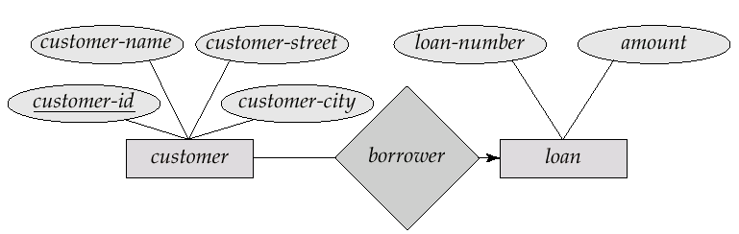
Basics: one table for each Entity set plus one for each Relationship
customer(customer-id, customer-name, customer-street, customer-city)
loan(loan-number, amount)
borrower(customer-id, loan-number)
The keys of the entities have become the keys of the entity tables.
The arrowhead from borrower to loan denotes that there is only one loan per customer: thus customer-id is the key for borrower,.

Slide 3
Combining Tables with the same key
customer(customer-id, customer-name, customer-street, customer-city)
loan(loan-number, amount)
borrower(customer-id, loan-number)
The first and last table can (&should) be combined since they have the same key.
customer(customer-id, customer-name, customer-street, customer-city, loan-number)

Slide 4
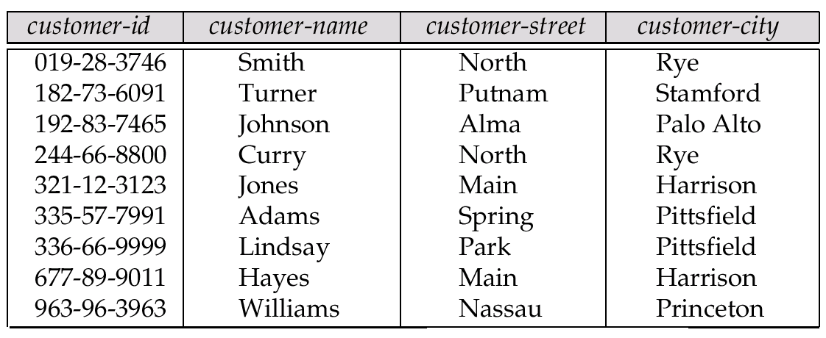
Representing Entity Sets as Tables
A strong entity set reduces to a table with the same attributes.
Key: Customer-id

Slide 5
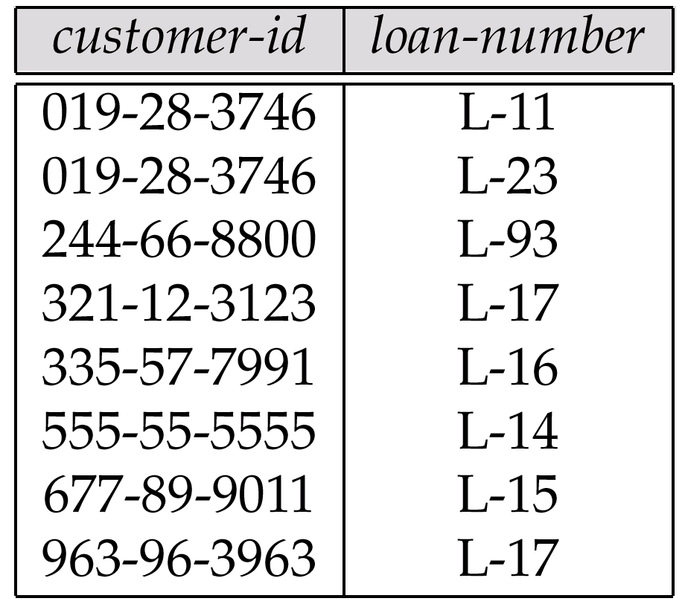
Representing Relationship Sets as Tables
A many-to-many relationship set is represented as a table with columns for the primary keys of the two participating entity sets, and any descriptive attributes of the relationship set.
E.g.: table for relationship set borrower: the arrow tells us that customer-id is a key

Slide 6
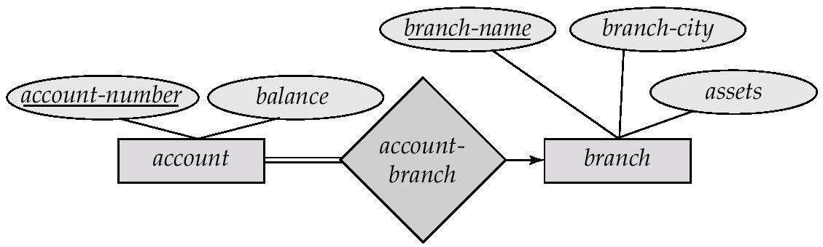
Minimize Table Count
Table with equivalent keys can be merged together---as in the 3NF design algorithm (to be discussed next week)
E.g.: Merge the tables account-branch with account
account(account-number, balance,branch-name)
branch(branch-name, branch-city, assets)

Slide 7
Composite and Multivalued Attributes
Previous rules hold for simple attributes
Composite attributes are flattened out by creating a separate attribute for each component attribute
E.g. given entity set customer with composite attribute name with component attributes first-name and last-name the table corresponding to the entity set has two attributes name.first-name and name.last-name

Slide 8
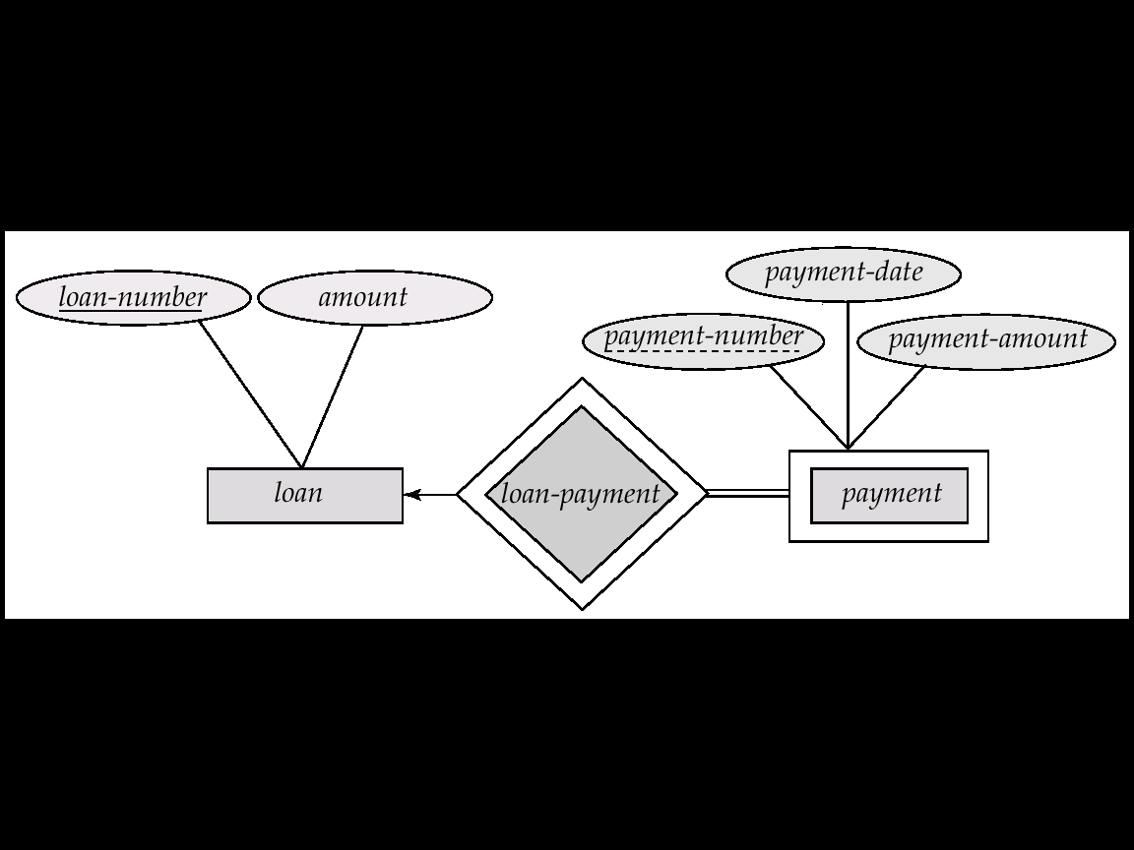
Representing Weak Entity Sets
A weak entity set becomes a table that includes a column for the primary key of the identifying strong entity set:
loan-number | Payment-number | Payment-date | Payment-amount
L-11 | 53 | 7/7/2001 | 120
L-14 | 53 | 8/1/2001 | 240
L-19 | . . . | . . . | . . .

Slide 9
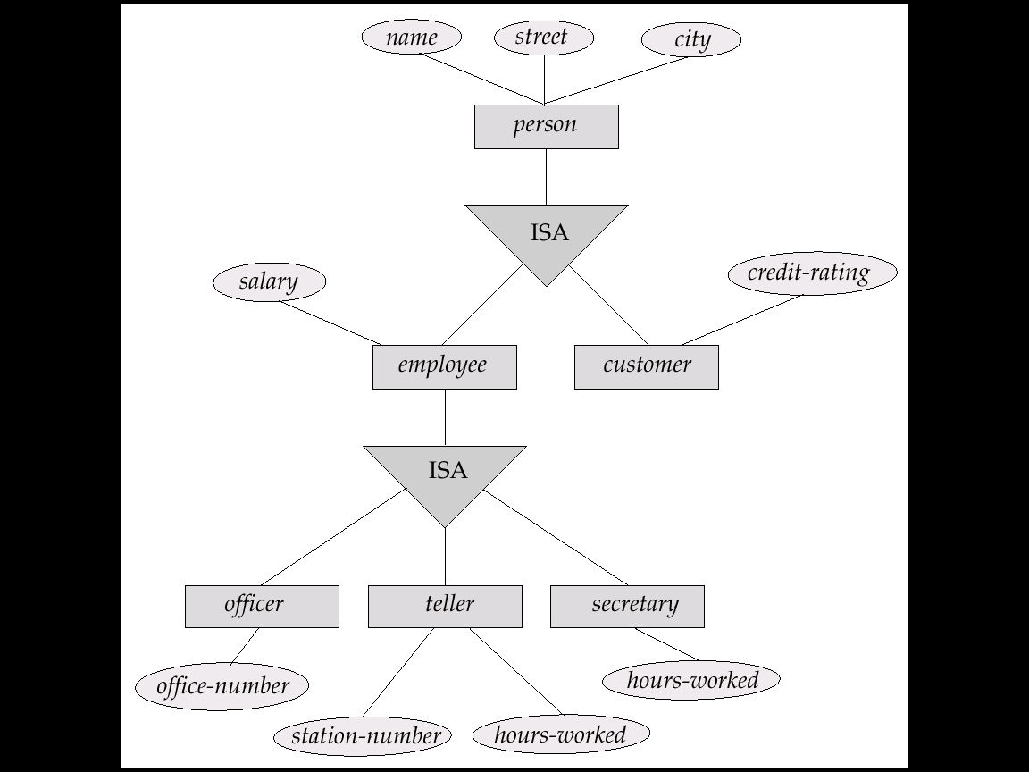
Representing Specialization as Tables
Method 1:
Form a table for the higher level entity
Form a table for each lower level entity set, include primary key of higher level entity set and local attributes
table table attributes person name, street, city customer name, credit-rating employee name, salary
Drawback: getting information about, employee city requires accessing two tables

Slide 10
Representing Specialization as Tables (cont.)
Method 2:
Form a table for each entity set with all local and inherited attributes table table attributes person name, street, city customer name, street, city, credit-rating employee name, street, city, salary If specialization is total, no need to create table for generalized entity (person)
Drawback: street and city may be stored redundantly for persons who are both customers and employees

Slide 11
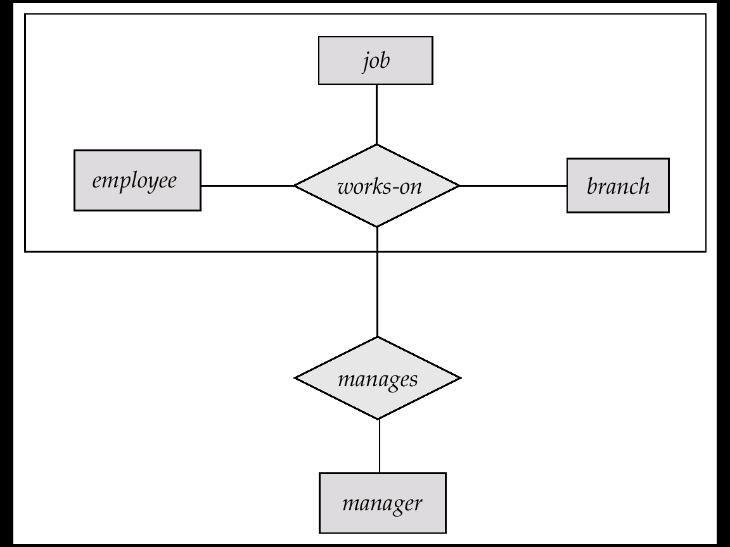
Aggregation: Mapping it into Relations
To represent aggregation, create a table containing
primary key of the aggregated relationship,
the primary key of the associated entity set
Any descriptive attributes
…. Check that this in fact BCNF

Slide 12
Relations Corresponding to Aggregation (Cont.)
E.g. to represent aggregation manages between relationship works-on and entity set manager, create a table manages(employee-id, branch-name, job, manager-name)
Table works-on is redundant if manages is BCNF. This is in fact the case if: employee-id, branch-name, job -> manager-name is the is the only FD

Slide 13
Given R(W): Check or Derive BCNF
All the FDs must be Elementary: i.e.
Their right side must contain only one attribute and this is not contained in the right side
Their left side must be minimal
For each left-side X check if this is a key by computing X+
If X+=W then X is a key. The FDs with this left side create no problem.
If X+ is a subset of W you must decompose into a pair with attributes X+ and X+ U (W - X+) U X.
Repeat until BCNF is reached.
BCNF is stricter than 3NF. In 3NF an elementary FD, X -> A, is OK if (i) X is a key or (ii) A is contained in some key!

Slide 14
Example: R(A, B, C, D, E, F)
Minimal right side Minimal Left Side
AB->C
B->C D
BC-> D
D->E F
E->F
F->E
AB->C
2a. B-> C
2b. B-> D
3. BC->D
4a. D->E
4b. D->F
5. E->F
6. F->E
AB->C
2a. B-> C
2b. B-> D
3. BC->D
4a. D->E
4b. D->F
5. E->F
6. F->E
After deriving the minimal left sides we check if they are keys: i.e., is B, D, E, F a key? Answer is no for all of them. So we can use any of them to decompose. With 6 we get F+= (F, E) thus we decompose into
(F, E) (A, B, C, D, E, F)

Slide 15
Example: R(A, B, C, D, E, F)
Minimal Left Side
1: (F, E) 2: (A, B, C, D, F)
Now, 1 is BCNF
for 2, Test 4b: D+ ={D, F} not a key, thus split into:
3: (D,F) 4: (A, B, C, D)
Now for 4, test 2b:
B+={B, C, D) not a key, split into:
5:(B, C, D), 6:(B, A)
1. out
2a. B-> C
2b. B-> D
3. out
4a. D->E
4b. D->F
5. E->F
6. F->E
So, our set of BCNF relations is: (F, E), (D, F), (B, C, D), (B, A)

