Slide 1
TRANSACTIONS
A sequence of SQL statements to be executed "together“ as a unit:
A money transfer transaction:
<e.g., Transfer $10k from Jane’s checking account to her saving account>
Reasons for Transactions:
T1: begin transaction
S1: UPDATE CAccount SET balance = balance - 10000
WHERE owner = ‘Jane'
S2: Update SAccount SET balance = balance + 10000
WHERE owner = 'Jane’
end transaction
Concurrency control. E.g., A concurrent T2 that prints the statements of customers in the bank is not allowed to fetch Jane’s records between S1 and S2.
Recovery from Crashes: Information in main memory is lost or compromised.
- System crashes after S1 but before S2. What now?
… But disk information is not lost and we can recover by undoing S1 or redoing S2.
But we do not know how far the transaction was executed

Slide 2
Chapter 16: Recovery System
Failure Classification
Storage Structure
Recovery and Atomicity
Log-Based Recovery

Slide 3
Classification of Failures
Transaction failure: (RB)
Logical errors: transaction cannot complete due to some internal error condition (e.g., violation of an integrity constraint).
System errors: the database system must terminate an active transaction due to an error condition (e.g., deadlock).
System crash: a power failure or other hardware or software failure causes the system to crash. (Recovery)
Fail-stop assumption: non-volatile storage contents are assumed to not be corrupted by system crash
Database systems have numerous integrity checks to prevent corruption of disk data
Disk failure: a head crash or similar disk failure destroys all or part of disk storage
Destruction is assumed to be detectable: disk drives use checksums to detect failures and then recover.

Slide 4
Recovery Algorithms
Recovery algorithms have two parts
Actions taken during normal transaction processing to ensure that enough information exists to recover from failures, and
Actions taken after a failure to recover the database contents to a state that ensures atomicity, consistency and durability

Slide 5
Storage Structure
Volatile storage:
does not survive system crashes
examples: main memory, cache memory
Nonvolatile storage:
survives system crashes
examples: disk, tape, flash memory, non-volatile (battery backed up) RAM
but may still fail, losing data
Stable storage:
a mythical form of storage that survives all failures
approximated by maintaining multiple copies on distinct nonvolatile media:
RAID Redundant Array of Independent Disks

Slide 6
Example of Data Access
buffer
Buffer Block A
input(A)
X
A
Buffer Block B
Y
B
output(B)
read(X)
write(Y)
x₂
x₁
y₁
work area
of T₁
work area
of T₂
memory
disk

Slide 7
Data Access
Physical blocks are those blocks residing on the disk.
Buffer blocks are the blocks residing temporarily in main memory.
Block movements between disk and main memory are initiated through the following two operations:
input(B) transfers the physical block B to main memory.
output(B) transfers the buffer block B to the disk, and replaces the appropriate physical block there.
We assume, for simplicity, that each data item fits in, and is stored inside, a single block.

Slide 8
Recovery and Atomicity
To ensure atomicity despite failures, we output to stable storage a log describing the modifications to be made to the database before we actually modify the database.
We study log-based recovery mechanisms in detail
We first present key concepts
And then present the actual recovery algorithm
Less used alternative: shadow-paging (brief details in book)

Slide 9
Log-Based Recovery
A log is kept on stable storage.
The log is a sequence of log records, and maintains a record of update activities on the database.
When transaction T_{i} starts, it registers itself by writing <T_{i} start> as a log record
Before T_{i} executes write(X), a log record <T_{i}, X, V₁, V₂> is written, where V₁ is the value of X before the write (the old value), and V₂ is the value to be written to X (the new value).
When T_{i} finishes it last statement, the log record <T_{i} commit> is written.
Two approaches using logs:
Deferred database modification
Immediate database modification

Slide 10
Immediate Database Modification
The immediate-modification scheme
Update log record of any update must be written and output to disk before the database items affected by those are written and output
Thus upon recovery the log has the story of what was changed on disk, making undo possible.
Once the log describing all the changes made on a certain block has been written to disk, the block is written back on disk, as soon as possible of course, but there is no strict time requirement (i.e., it could before or after transaction commit)
Order in which blocks are output can be different from the order in which they are written—and in fact UNIX does that.

Slide 11
Deferred Modification Scheme
The deferred-modification scheme: When transaction reaches commit point it
Writes the log to buffer and outputs this to disk, and
Outputs updated data blocks (in some order) ASAP
This simplifies some aspects of recovery, but transactions must use private buffer.
E.g., if we do not see a commit no page was written and we do not need an undo.

Slide 12
Transaction Commit
A transaction is said to have committed when its commit log record is output to stable storage
all previous log records of the transaction must have been output already
Writes performed by a transaction may still be in the buffer when the transaction commits, and may be output later

Slide 13
Immediate Database Modification Example
B_{C} output before T₁ commits
B_{A} output after T₀ commits
Log Write Output
<T₀ start>
<T₀, A, 1000, 950>
<T_{o}, B, 2000, 2050
A = 950
B = 2050
<T₀ commit> …the log
<T₁ start>
<T₁, C, 700, 600>
C = 600
B_{B} , B_{C}
<T₁ commit> …the log
B_{A}
Note: B_{X} denotes block containing X.

Slide 14
Undo and Redo Operations
Undo of a log record <T_{i}, X, V₁, V₂> writes the old value V₁ to X
undo(T_{i}) restores the value of all data items updated by T_{i} to their old values, going backwards from the last log record for T_{i}
when undo of a transaction is complete, a log record <T_{i} abort> is written out.
Redo of a log record <T_{i}, X, V₁, V₂> writes the new value V₂ to X
redo(T_{i}) sets the value of all data items updated by T_{i} to the new values, going forward from the first log record for T_{i}
No logging is done in this case

Slide 15
Undo and Redo on Recovering from Failure
When recovering after failure:
Transaction T_{i} needs to be undone if the log
contains the record <T_{i} start>,
but does not contain either the record <T_{i} commit> or <T_{i} abort>.
Transaction T_{i} needs to be redone if the log
contains the records <T_{i} start>
and contains the record <T_{i} commit> or <T_{i} abort>

Slide 16
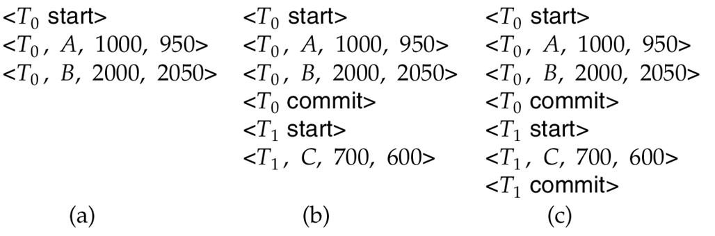
Immediate DB Modification
Below we show the log as it appears at three instances of time.
Recovery actions in each case above are:
undo (T₀):
redo (T₀) and undo (T₁)
redo (T₀) and redo (T₁)
Immediate modification: commit T is the first written for T
What about deferred modifications? Next slide.
TS(T_{i})

Slide 17
Deferred DB Modification
Below we show the log as it appears at three instances of time.
With deferred modification, nothing is written if there is no commit:
undo (T₀): nothing must be done because nothing was written
redo (T₀) and undo (T₁)
redo (T₀) and redo (T_{1}}
With deferred modification the writing does not start until “commit” is written on the log!
TS(T_{i})

Slide 18
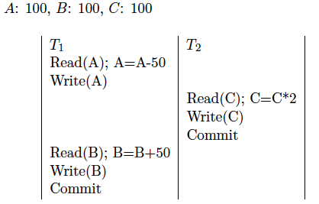
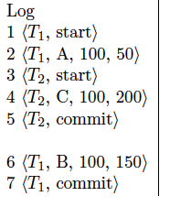
How can we recover if:
Q: What should DBMS do during recovery when it sees up to log record 4?
Or up to log record 5
Or up to log record 7

Slide 19
Checkpoints
Redoing/undoing all transactions recorded in the log can be very slow
processing the entire log is time-consuming if the system has run for a long time
we might unnecessarily redo transactions which have already output their updates to the database.
Streamline recovery procedure by periodically performing checkpointing
Output all log records currently residing in main memory onto stable storage.
Output all modified buffer blocks to the disk.
Write a log record < checkpoint L > onto stable storage where L is a list of all transactions active at the time of checkpoint.
All updates are stopped while doing checkpointing

Slide 20
Checkpoints (Cont.)
Scan backwards from end of log till the most recent <checkpoint L> record
Only transactions that are in L or started after the checkpoint need to be redone or undone
Transactions that committed or aborted before the checkpoint already have all their updates output to stable storage.
Some earlier part of the log may be needed for undo operations
Continue scanning backwards till a record <T_{i} start> is found for every transaction T_{i} in L.
Parts of log prior to earliest <T_{i} start> record above are not needed for recovery, and can be erased whenever desired.

Slide 21
Example of Checkpoints
T_{c}
T_{f}
T₁ can be ignored (updates already output to disk due to checkpoint)
T₂ and T₃ redone.
T₄ undone
T₁
T₂
T₃
T₄
checkpoint
system failure

Slide 22
Recovery Algorithm (After Crash)
Recovery from failure: Two phases
Redo phase: replay updates of all transactions, whether they committed, aborted, or are incomplete
Undo phase: undo all incomplete transactions
Redo phase:
Find last <checkpoint L> record, and set undo-list to L.
Scan forward from above <checkpoint L> record
Whenever a record <T_{i}, X_{j}, V₁, V₂> is found, redo it by writing V₂ to X_{j}
Whenever a log record <T_{i} start> is found, add T_{i} to undo-list
Whenever a log record <T_{i} commit> or <T_{i} abort> is found, remove T_{i} from undo-list

Slide 23
Recovery Algorithm (Cont.)
Undo phase:
Scan log backwards from end
Whenever a log record <T_{i}, X_{j}, V₁, V₂> is found where T_{i} is in undo-list perform same actions as for transaction rollback:
perform undo by writing V₁ to X_{j}.
write a log record <T_{i} , X_{j}, V₁>
Whenever a log record <T_{i} start> is found where T_{i} is in undo-list,
Write a log record <T_{i} abort>
Remove T_{i} from undo-list
Stop when undo-list is empty
i.e. <T_{i} start> has been found for every transaction in undo-list
After undo phase completes, normal transaction processing can resume.

Slide 24
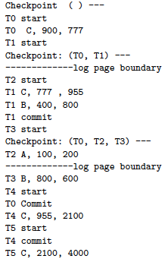
Q1: How many pages of the log will the system read for recovery (explain)? Q2. Which transactions will be undone and which will be redone? Q3. What are the values of { A, B} and {C} at the end of a successful recovery (explain the reason for your statement)?

Slide 25
Answers
Q1: How many pages of the log will the system read for recovery (explain)?
Walking back from the end, at the last checkpoint T0, T2 and T4 are still uncommitted. To find their start we must visit the first page.
Q2. Which transactions will be undone and which will be redone?
-Undone(no commit): T2, T3, T5 .
-Redone (commit after last checkpoint): T0, T4
- Ignored (commit before last checkpoint): T1
Q3. What are the values of { A, B} and { C} at the end of a successful recovery (explain the reason for your statement)?
A=100 because (T2 A, 100, 200) which was then undone;
B=800, because (T3 B, 800, 600) which was then undone;
C= 2100, because (T4 C, 955, 2100) was redone while (T5 C, 2100, 4000) was undone.

