Slide 1
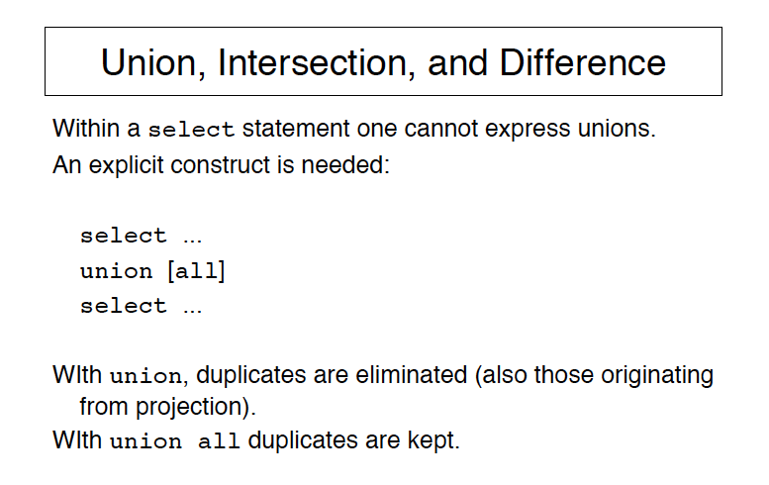

Slide 2
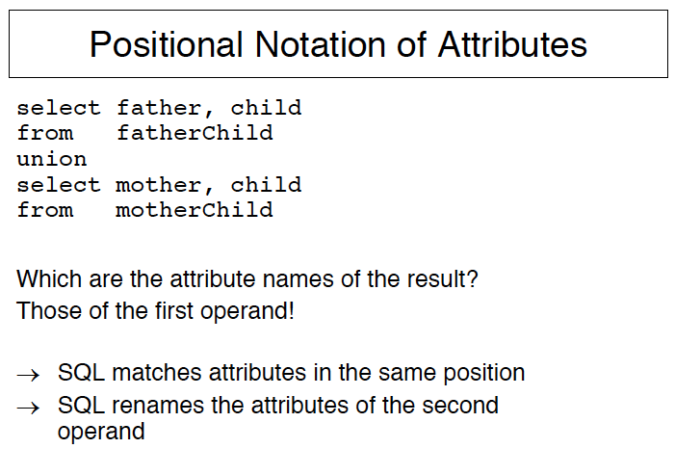
union all will keep duplicates

Slide 3
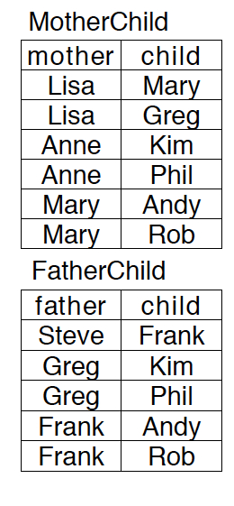
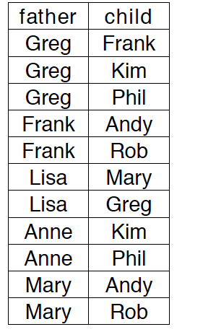


Slide 4
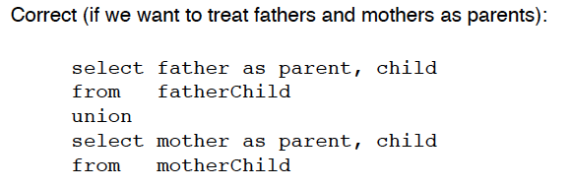
For set difference: Replace ‘union’ by ‘except’

Slide 5
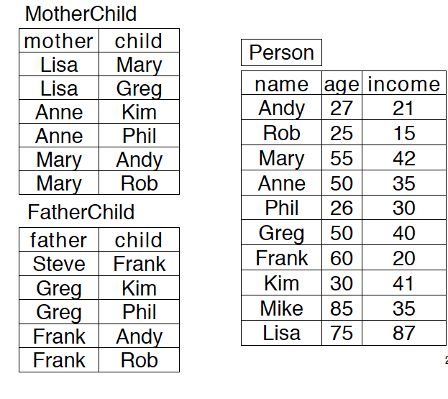
Set Difference: except
Find children who have a father but not a mother:
select child as childname from FatherChild except
select child from MotheChild

Slide 6
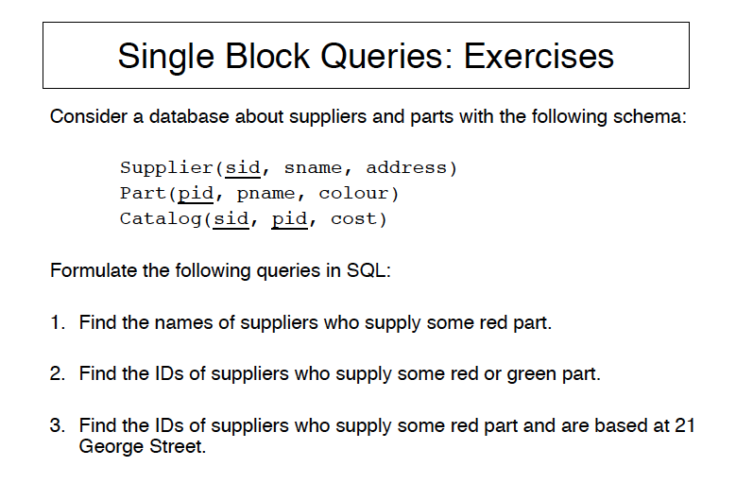
So far: single block queries—i.e. one select statement

Slide 7
SQL Queries from Hw1
Customer(customer-name, street, city)
Branch(branch-name, city) Account(customer-name, branch-name, account-number)
(c) Find the branches that do not have any accounts.
(d) Find the customer names who do not have any account in the ‘Region12’ branch.
(e) Find the customer names who have accounts in all the branches located in ‘Los Angeles’. You are not allowed to use the division operator directly for this question.
(f) Find the customer names who have only one account.

Slide 8
SQL Queries from Hw1
(f) Find the customer names who have only one account.
Account(customer-name, branch-name, account-number)
SELECT customer-name
FROM Account
GROUP BY customer-name
HAVING COUNT( DISTINCT account-number) =1

Slide 9
SQL Queries from Hw1
Customer(customer-name, street, city)
Branch(branch-name, city) Account(customer-name, branch-name, account-number)
(e) Find the customer names who have accounts in all the branches located in ‘Los Angeles’
First find how many branches in los angeles. The find how many branches in Los angeles have accounts for a given customer name. Then check that the two numbers are the same.
For this we need nested queries.

Slide 10
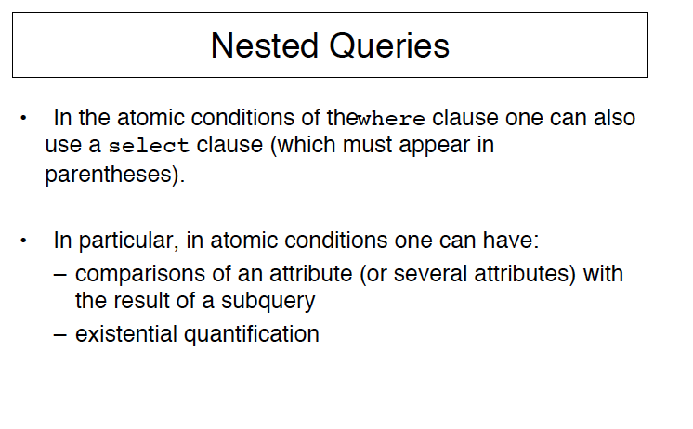

Slide 11
CS143: Database Systems
SQL Notes 2

Slide 12
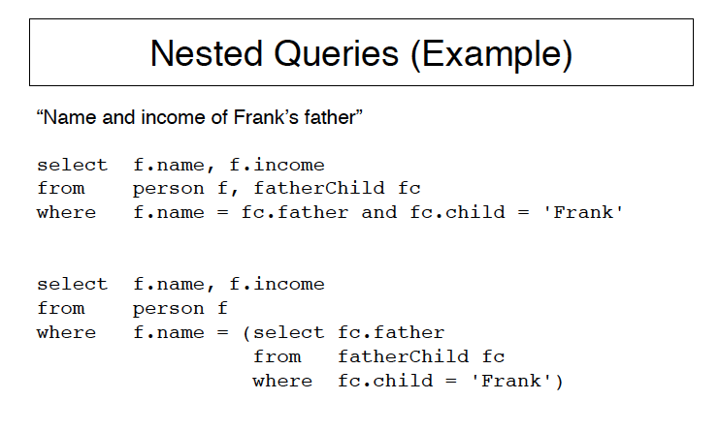
Instead of = (i.e., equal to any) we could have used IN (i.e. in the set)

Slide 13
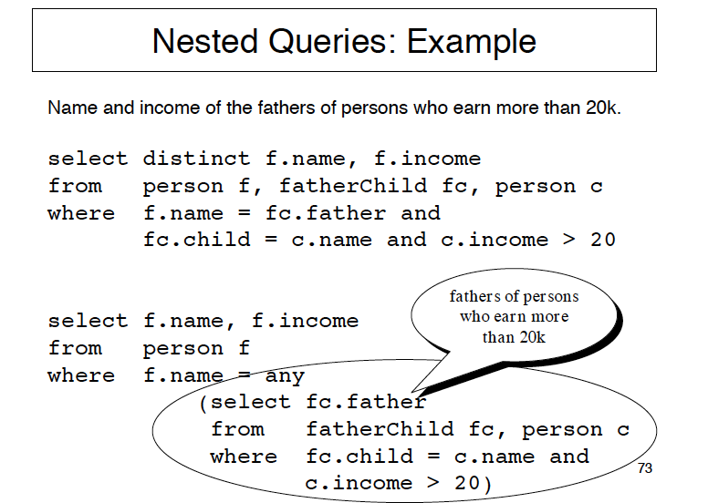

Slide 14
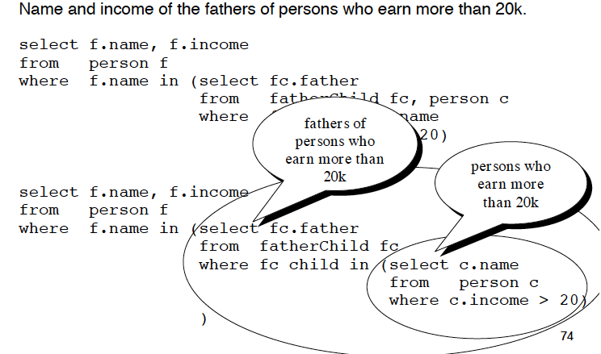

Slide 15
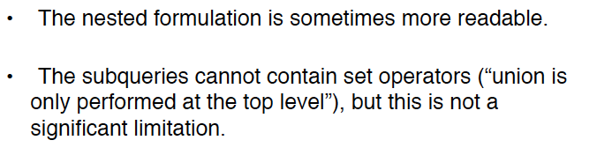

This only true if the optimizer is not smart.

Slide 16

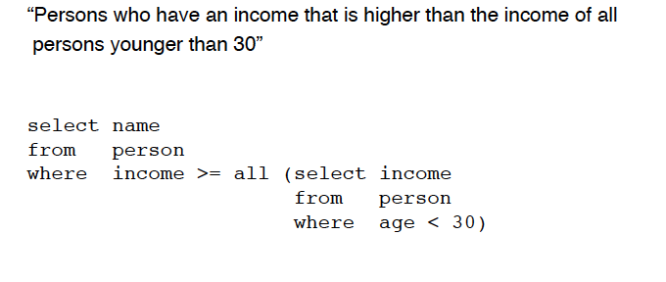

Slide 17
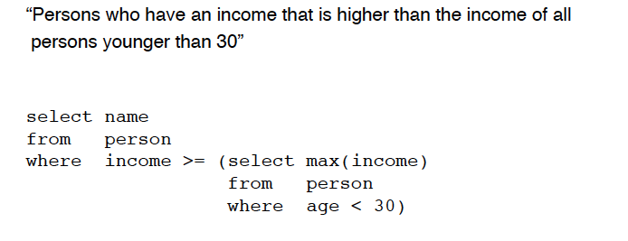
Equivalent formulation with max:
Any CHANGE W.R.T. THE PREVIOUS QUERY that used ALL?

Slide 18
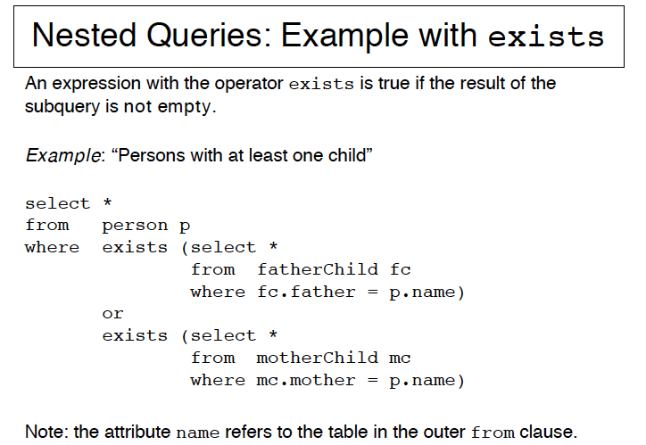

Slide 19
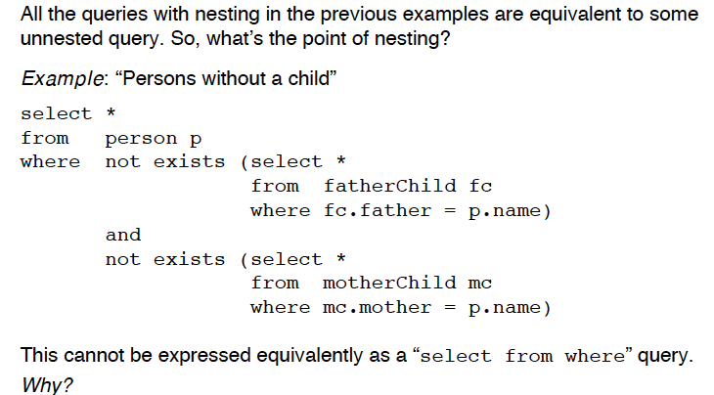

Slide 20
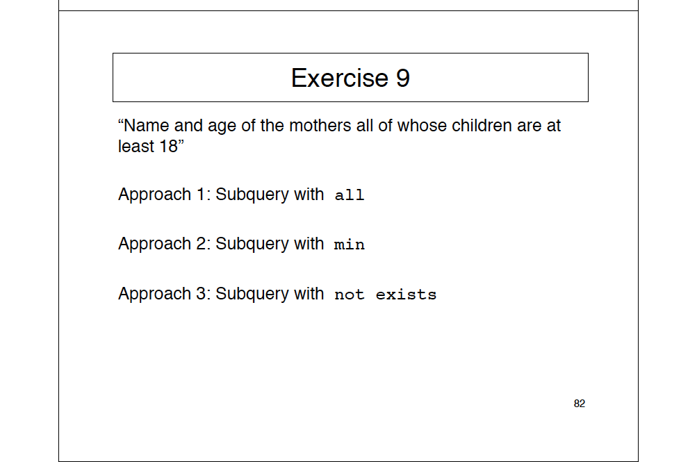

Slide 21
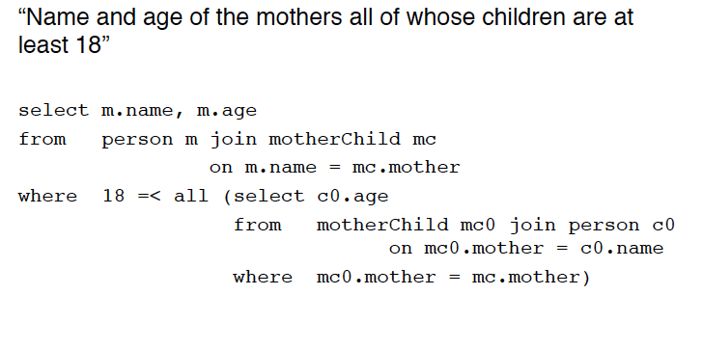
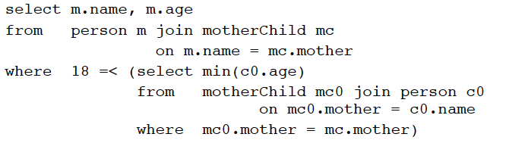

Slide 22

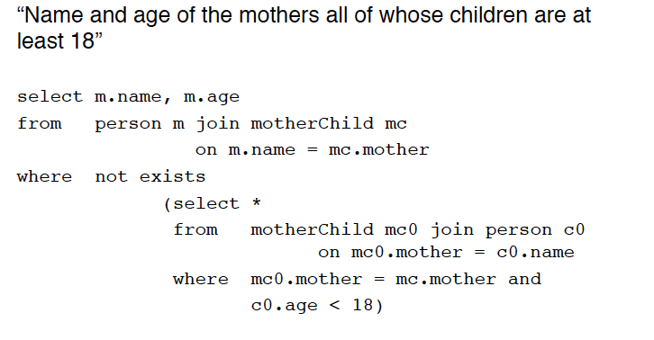
What about childless mothers? Note difference w.r.t. natural language.

Slide 23

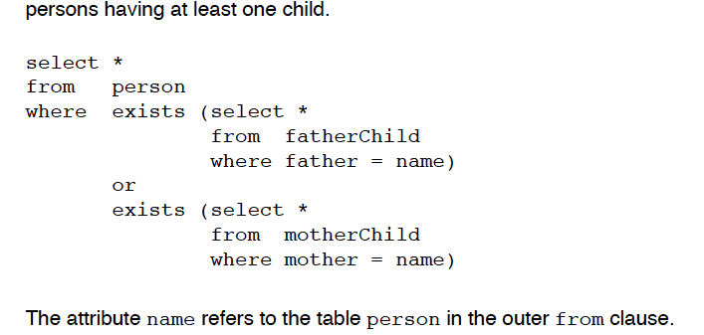

Slide 24
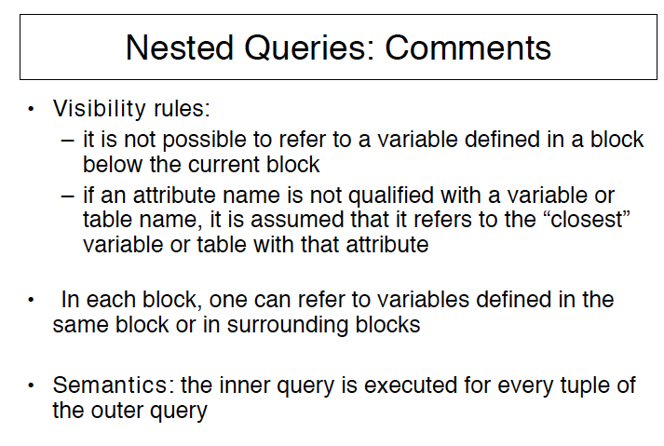
Inside----------

Slide 25
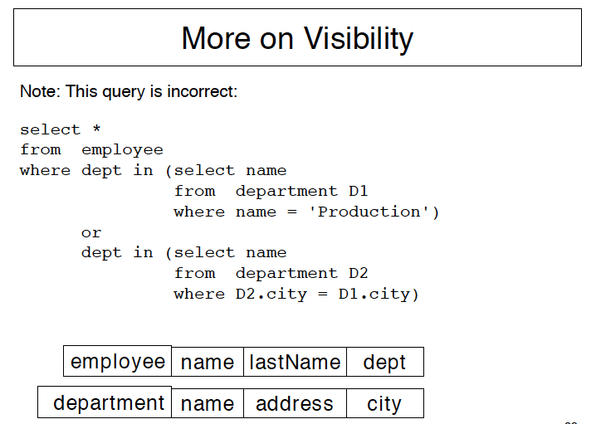

Slide 26
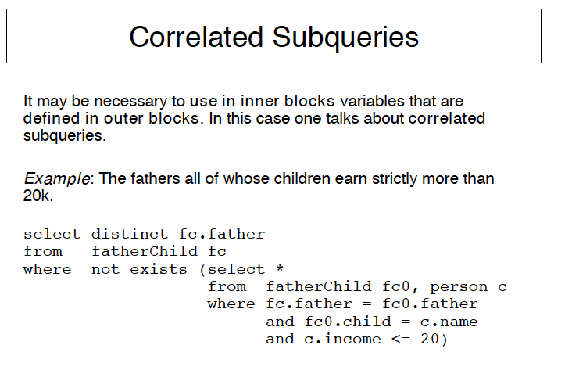

Slide 27
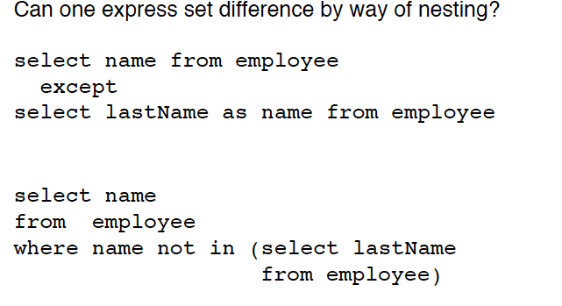
SET DIFF and NESTING
employee(name,lastname, dept)

Slide 28
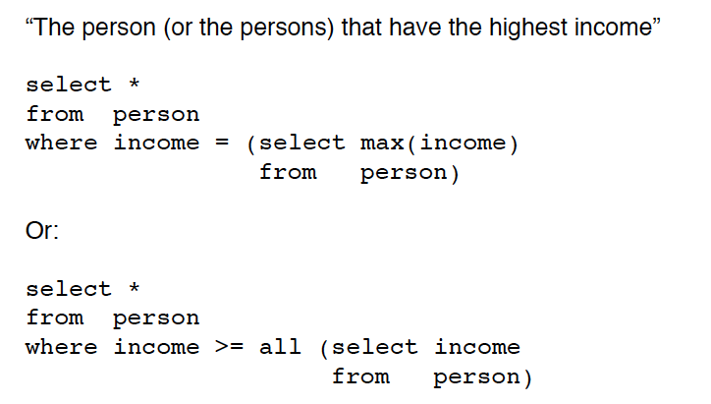

Slide 29
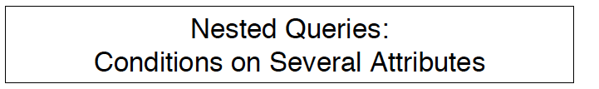
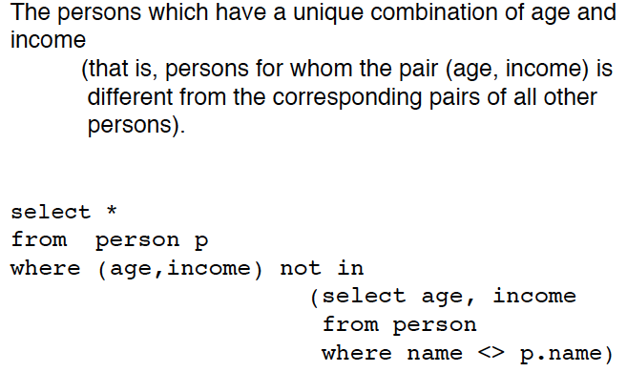

Slide 30
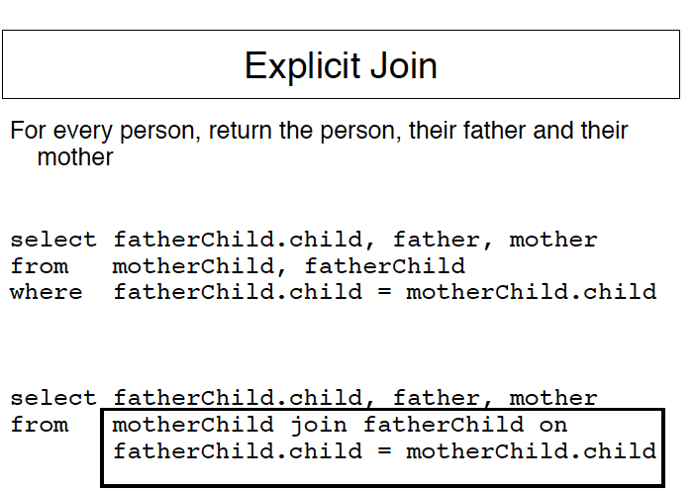

Slide 31
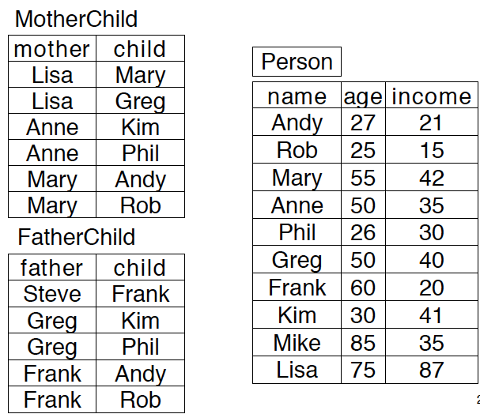

Slide 32
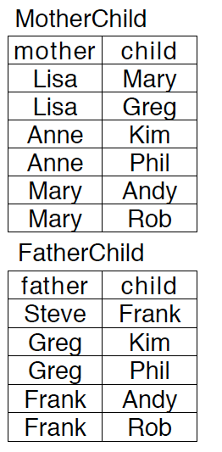
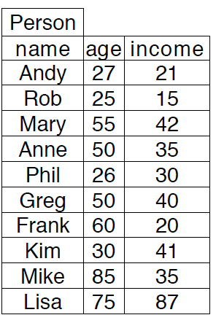

Slide 33
Joins and Information Preservation
Find the Mothers and Mothers of the same child
Unmatched values are lost from both left (i.e., motherChild)
and right (i.e., fatherChild)

Slide 34
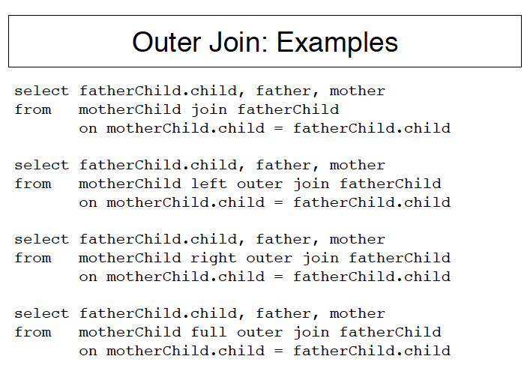
Unmatched values are lost from both left (i.e., motherChild) and right (i.e., fatherChild)
Values on the left are
preserved, since unmatched ones are padded with null values
Values on the right are
preserved, since unmatched ones are padded with null values
Values on both right and
Left are preserved, since unmatched ones are padded with null values

Slide 35
SQL Queries from Hw1
Customer(customer-name, street, city)
Branch(branch-name, city) Account(customer-name, branch-name, account-number)
(c) Find the branches that do not have any accounts.
SELECT customer-name
FROM Customer LEFT OUTERJOIN Account
ON Customer.customer-mame=Account.customer-name
WHERE ISNULL(account-number )

Slide 36
SQL Queries from Hw1
Customer(customer-name, street, city)
Branch(branch-name, city) Account(customer-name, branch-name, account-number)
(c) Find the branches that do not have any accounts.
SELECT customer-name
FROM Customer LEFT OUTERJOIN Account
ON Customer.customer-mame=Account.customer-name
HAVING COUNT(account-number )=0

