Slide 1
DB Transactions CS143 Notes
TRANSACTION: A sequence of SQL statements that are executed "together" as one unit:

Slide 2
Reasons for Transactions
Crashes
e.g. A money transfer transaction: Transfer $1M from Susan to Jane>
Begin Transaction
S1: UPDATE Account SET balance = balance - 1000000 WHERE owner = 'Susan'
S2: Update Account SET balance = balance + 1000000 WHERE owner = 'Jane‘
End Transaction
-- S1 and S2 are the actions composing the transaction. Completing one without the other is not acceptable.
-- Failure to complete might be due to a violation of integrity constraints or to the system crashing.

Slide 3
Crash Recovery Example
T1. A money transfer transaction: <eg, Transfer $1M from Susan to Jane>
S1: UPDATE Account SET balance = balance - 1000000
WHERE owner = 'Susan'
S2: Update Account SET balance = balance + 1000000
WHERE owner = 'Jane'
System crashes after S1 but before S2. What now?
- Basically, we can keep a log of the actions, and then undo S1.
So, we are back in the situation we were before T1 was executed.
Then, assuming that T1 was not the cause of the crash, T1 and other uncompleted transactions should be re-executed.

Slide 4
Reasons for Transactions (cont.)
2. Allowing concurrent execution of multiple transactions.
Thousand of transfers between accounts take place every second. Most of them can and should be executed concurrently
We must allow concurrent access from multiple clients.
In many cases we can allow parallel execution while avoiding any potential problems. E.g. multiple reads are OK.
But other kinds of actions could incur in conflicts and require a serial execution.
This is the concurrency control problem.

Slide 5
The ACID Properties for Transactions
Atomicity: "ALL-OR-NOTHING"
- Either ALL OR NONE of the operations in a transaction is executed.
- If the system crashes in the middle of a transaction, all changes by the transaction are "undone" during recovery.
Consistency: If the database is in a consistent state (all integrity constraints are satisfied) before a transaction, the database is in a consistent state after the transaction. (IC maintenance must also be completed)
Isolation: Even if multiple transactions are executed concurrently, The result is the same as executing them in some sequential order.
Each transaction is unaware of (is isolated from) other transaction running concurrently in the system. But of course, overload might result in some slow-down.
Durability If a transaction committed, all its changes remain permanently even after a system crash.

Slide 6
More on Crash recovery
But what does transaction completion mean?
Completion of computation in main memory means nothing, because that the system could crash soon after and ... everything will be lost.
Only secondary-store data are durable--we must focus on disk read/write.
SET means main-memory assignments, and write means disk writes:
T1. <Transfer $1M from Susan to Jane>
A1. read(balance) from Account WHERE owner = 'Susan'
A2. SET balance = balance - 1000000 %main memor
A3. write(balance) into Account WHERE owner = 'Susan‘
A4. read(balance) from Account WHERE owner = 'Jane'
A5. SET balance = balance + 1000000 %main memory
A6. write(balance) into Account WHERE owner = 'Jane‘
If we crash before A3, or after A6, nothing needs to be done.
If we crash after A3 and before A6 we have to undo A3.

Slide 7
Commit and RollBack the linchpins of Recovery
A transaction that has completed all its reads and writes will commit.
A transaction that cannot complete all its reads and writes must abort by executing a rollback command.
After commit a transaction cannot be rolled back.

Slide 8
Transaction in SQL
Explicit Control:
begin transaction
… transaction update statements …
end transaction
Implicit: in the absence of a begin/end transaction statement each SQL update statement is treated as a separate transaction.
AUTOCOMMIT mode OFF: the system obeys explicit commit and rollback in the program (they must be there).
Vendor-dependent primitives and defaults
Lower level of consistency

Slide 9
AUTOCOMMIT mode OFF
Transaction implicitly begins when any data in DB is read or written
All subsequent read/write is considered to be part of the same transaction
A transaction finishes when COMMIT or ROLLBACK statement is executed
COMMIT: All changes made by the transaction is stored permanently
ROLLBACK: Undo all changes made by the transaction (and not yet committed)
X X
---------------------------------------------------------------------------------------------
| | | | | | | |
INSERT1 DELETE SELECT COMMIT DELETE SELECT ROLLBACK INSERT
---------------------saved----------------- ---------------lost------------------

Slide 10
Setting Autocommit mode:
In DB2: UPDATE COMMAND OPTIONS USING c ON/OFF (default is on)
In Oracle: SET AUTOCOMMIT ON/OFF (default is off)
In JDBC: connection.setAutoCommit(true/false) (default is on)

Slide 11
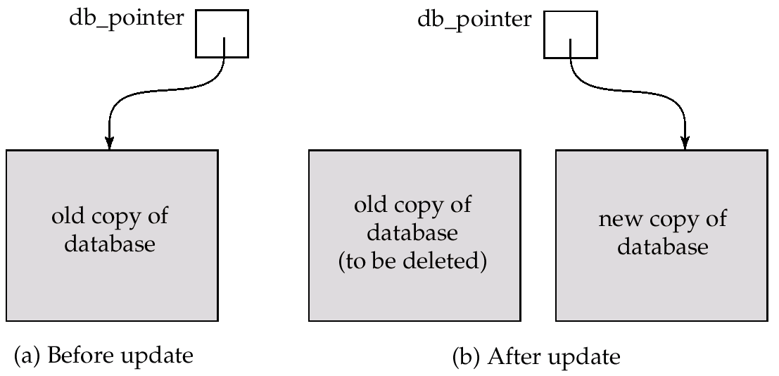
Commit/rollback a simpler method
The shadow-database scheme:
Assumes disks do not fail
Useful for text editors, but databases are too large and complex for this scheme to be efficiently executed (changes might not be local)

Slide 12
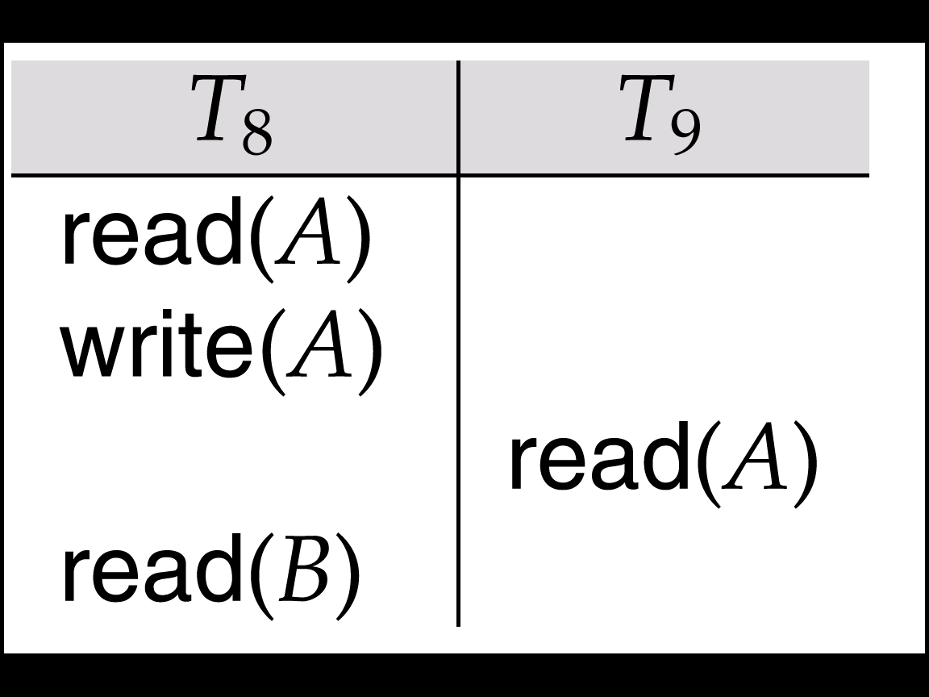
Dirty Reads: yet another recovery problem
The following schedule is not recoverable: if T₉ commits immediately after the its dirty read (i.e., a read from a trans not yet committed)
If T₈ should abort, T₉ could have shown to the user an inconsistent database state—then we may have to abort T₉ (cascading rollback).
A better solution is for the DBMS to use recoverable schedules.
Recoverable schedule — if a transaction Tj reads a data items written by a transaction Ti, then Ti must commit before Tj can commit, i.e. Tj must waitkeeping its resources until Ti commit .

Slide 13
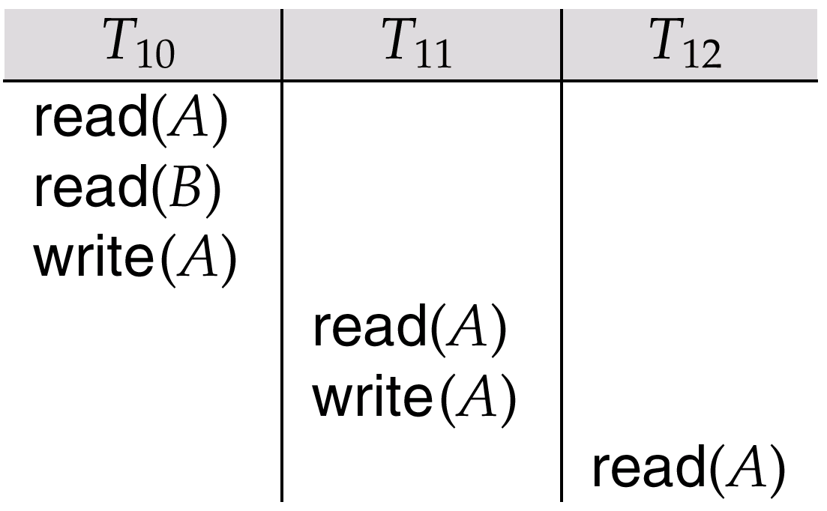
Recoverability (Cont.)
Cascading rollback – a single transaction failure leads to a series of transaction rollbacks. Consider the following schedule where none of the transactions has yet committed (so the schedule is recoverable)
If T₁₀ fails, T₁₁ and T₁₂ must also be rolled back.
Can lead to the undoing of a significant amount of work

Slide 14
More on Concurrent Execution
Concurrent access by multiple clients: We do not want to "lock out" the DBMS until one client finishes
In general, advantages of letting multiple transactions allowed run concurrently in the system are:
increased processor and disk utilization,
reduced average response time for transactions
But with concurrent executions transactions can interfere with each other, and produce results that could never have been produced if they were executed in a serial order.
An execution order that produces the same results as a serial one is called a serializable schedule
Examples:

Slide 15
Concurrency Example
Example1: Concurrently with T1 we execute T2 that simply reports the current balances in her accounts.
T1. <Transfer $1M from Susan saving account to her checking account>
A1. read(balance) from SAccount WHERE owner = 'Susan'
A2. SET balance = balance - 1000000 %main memory
A3. write(balance) into SAccount WHERE owner = 'Susan‘
A4. read(balance) from CAccount WHERE owner = ‘Susan'
A5. SET balance = balance + 1000000 %main memory
A6. write(balance) into CAccount WHERE owner = ‘Susan‘
T2: executed here: Susan’s $1,000,000 have been transferred from her
saving account to her checking account!

Slide 16
Concurrency Example
Example1: Concurrently with T1 we execute T2 that simply reports the current balances in her accounts.
T1. <Transfer $1M from Susan saving account to her checking account>
A1. read(balance) from SAccount WHERE owner = 'Susan'
A2. SET balance = balance - 1000000 %main memory
A3. write(balance) into SAccount WHERE owner = 'Susan‘
T2: executed here: Susan’s $1,000,000 disappeared… email is sent out
A4. read(balance) from CAccount WHERE owner = ‘Susan'
A5. SET balance = balance + 1000000 %main memory
A6. write(balance) into CAccount WHERE owner = ‘Susan‘

Slide 17
Concurrency Examples (cont.)
Example 2: <eg, Increase salary by $100 and then by $200>
T3: UPDATE Employee SET salary = salary + 1000
T4: UPDATE Employee SET salary = salary + 2000
Example 3: <eg, Increase salary by $100 and then by 20%>
T5: UPDATE Employee SET salary = salary + 1000
T6: UPDATE Employee SET salary = salary * 0.2
Example 3 has a concurrency problem. Example 2 does not---because addition commutes.
But, we do not want to with the semantics of the applications: we want serializability that is guarantees for every application semantics …
By reasoning only on the sequence order of read/write statements and nothing else

Slide 18
Serializable Schedules
We want to find schedule that are equivalent to serial schedules
Independent of their actual computations.
According to their disk read/write action
Conflict Serializability
This is achieved via various concurrency control schemes and protocols.

Slide 19
Schedules
Schedules – sequences that indicate the chronological order in which instructions of concurrent transactions are executed
Schedules are often recorded in logs.

Slide 20
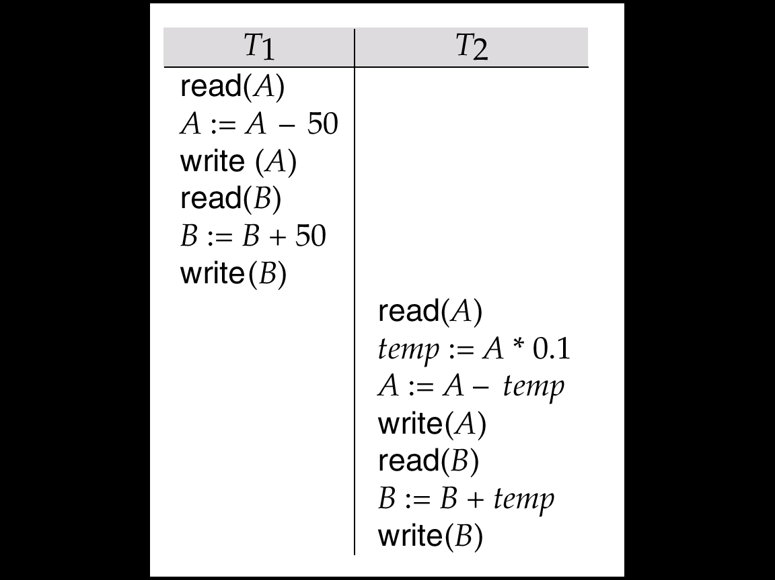
Example of a Serial Schedule
Let T₁ transfer $50 from A to B, and T₂ transfer 10% of the balance from A to B.
Start T1: A=100,
B= 0
End T1:
A=50,
B=50
End: A=45,
B= 55
If T2 before T1 A=40
B= 60

Slide 21
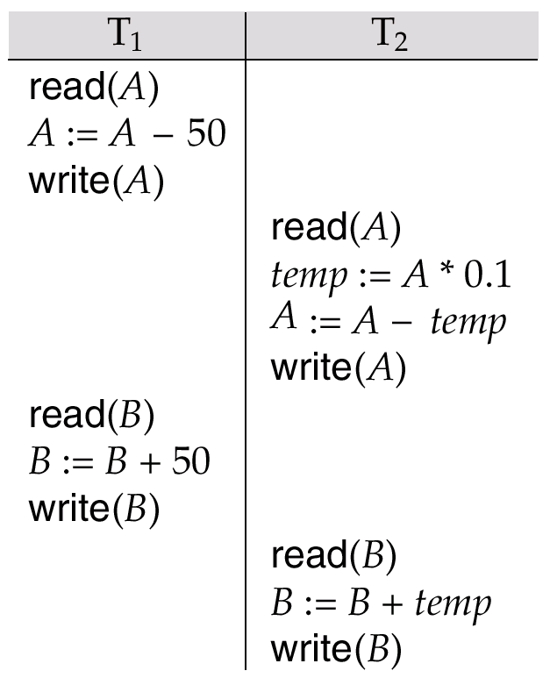
Example: Concurrent Schedule
T₁ and T₂ are the same as before but their schedule has changed into a concurrent one:
Initially: A=100
A=50
A=50
Temp=5
A=45
B=0
B=50
At the end: A= 45, B=55
B=55

Slide 22
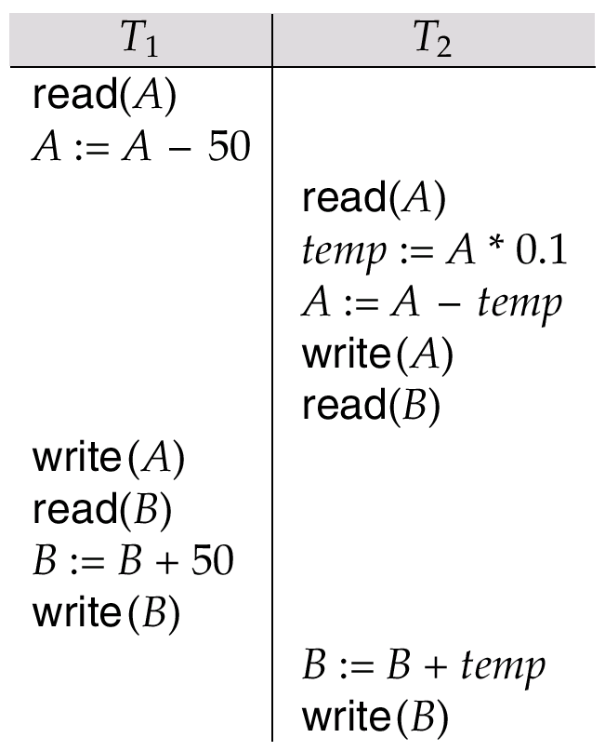
Example Schedules (Cont.)
The following concurrent schedule does not preserve the value of the the sum A + B.
Initially: A=100
A=150
B=0
A=100
temp=10
A= 90
B=0
A=50
B=0
B=50
At End: B=10,A= 50

Slide 23
Conflict Serializability
1: read(Q), and read(Q) do not conflict. 2: read(Q), and write(Q) from different transactions conflict. 3: write(Q), and write(Q) from different transactions conflict.
Conflict Graph for a set of transaction: A node for each transaction in the schedule. Then draw directed arcs between transactions whose action conflicts
Serializable Schedule: When its conflict graph has no directed cycles.

Slide 24
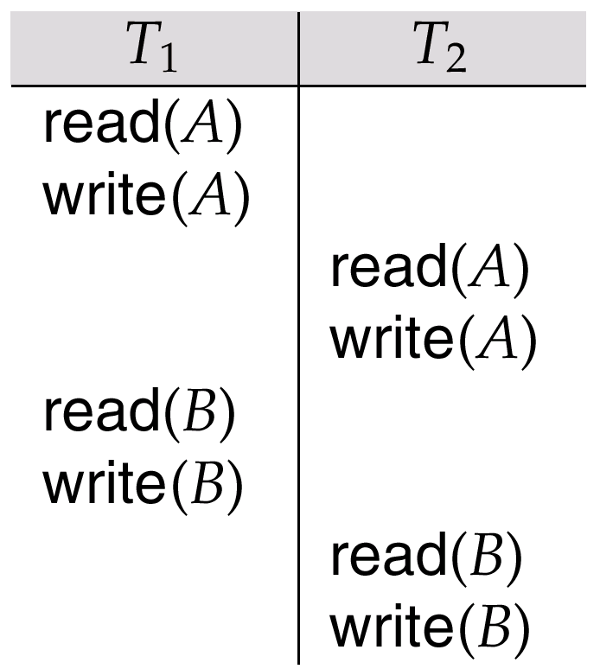
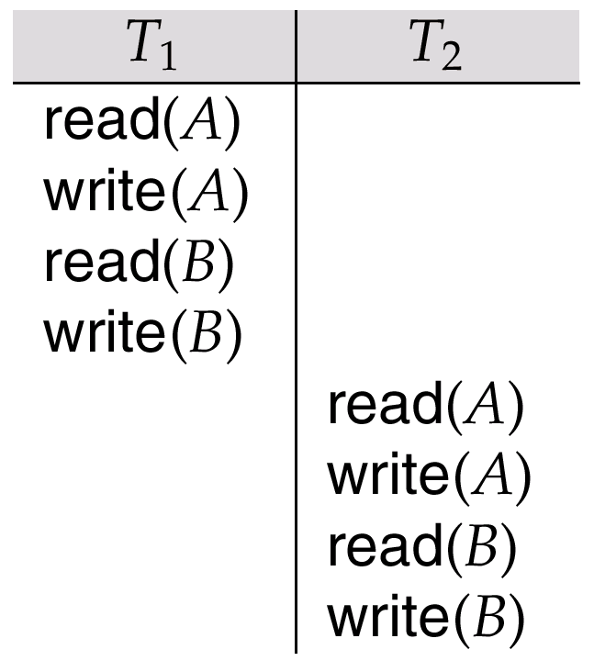
Conflict Serializability (Cont.)
by series of swaps of non-conflicting instructions, the schedule on the left can be transformed into the one on the right, which is a serial schedule where T₂ follows T₁.
Thus the Schedule is conflict-serializable.

Slide 25
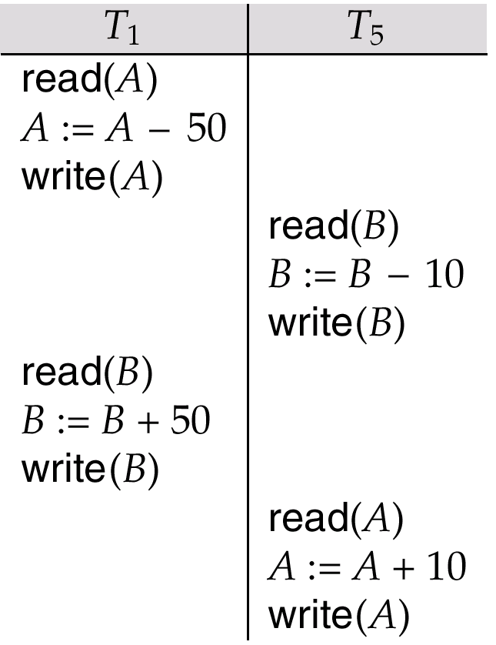
Sufficient vs. Necessary conditions
Schedule below produces same outcome as the serial schedule < T₁, T₅ >, yet is not conflict equivalent
Determining such equivalence requires analysis of operations other than read and write.

Slide 26
Example Schedule
T₅
T₁ T₂ T₃ T₄ read(X) read(Y) read(Z) read(V) read(W) read(W) read(Y) write(Y) write(Z) read(U) read(Y) write(Y) read(Z) write(Z)
read(U) write(U)

Slide 27
Example Schedule:
T₁ T₂ T₃ T₄ T₅ read(X) read(Y) read(Z) read(V) read(W) read(W) read(Y) write(Y) write(Z) read(U) read(Y) write(Y) read(Z) write(Z)
read(U) write(U)
T₁
T₂
Precedence Graph
T₄
T₃

Slide 28
Concurrency Control Protocols vs. Serializability Tests
Testing a schedule for serializability after it has executed is a little too late!
Goal – to develop concurrency control protocols that will assure serializability.
We will study two: a locking protocol and a timestamp-based protocol
Our serializability test understand why a concurrency control protocol is correct.

Slide 29
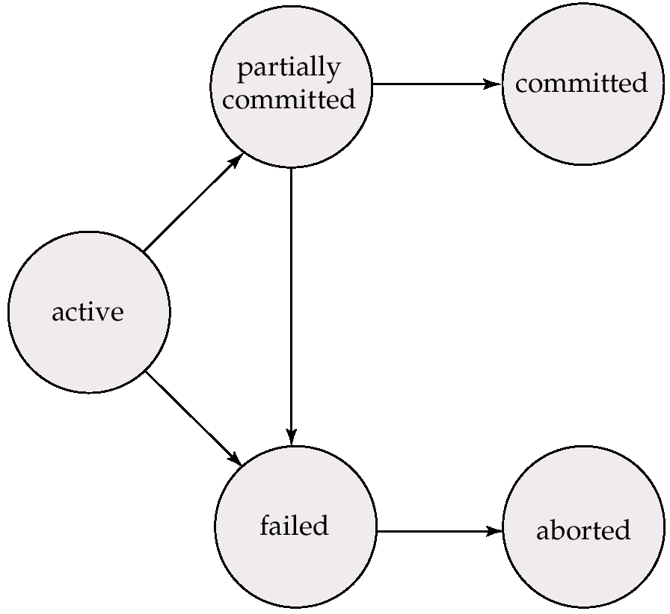
Enforcing Serializability Transaction States
Rollback!

Slide 30
Final Objective: the ACID Properties
Atomicity: "ALL-OR-NOTHING”
Either ALL OR NONE of the operations in a transaction is executed.
If the system crashes in the middle of a transaction, all changes by the transaction are "undone" during recovery.
Consistency: If the database is in a consistent state (all integrity constraints are satisfied) before a transaction, the database is in a consistent state after the transaction
Isolation: Even if multiple transactions are executed concurrently, The result is the same as executing them in some sequential order.
Each transaction is unaware of (is isolated from) other transaction running concurrently in the system. But of course, overload might result in some slow-down.
Durability If a transaction committed, all its changes remain permanently even after system crash

Slide 31
SQL: Relaxed Consistency Levels
Serializable — default
Repeatable read — only committed records to be read, repeated reads of same record must return same value. However, a transaction may not be serializable – it may find some records inserted by a transaction but not find others.
Read committed — only committed records can be read, but successive reads of record may return different (but committed) values.
Read uncommitted — even uncommitted records may be read.
Lower degrees of consistency useful for gathering approximate information about the database, e.g., statistics for query optimizer.
e.g. SET TRANSACTION READ ONLY, REPEATABLE READ

