Slide 1
UCLA CS143 Midterm Samples

Slide 2
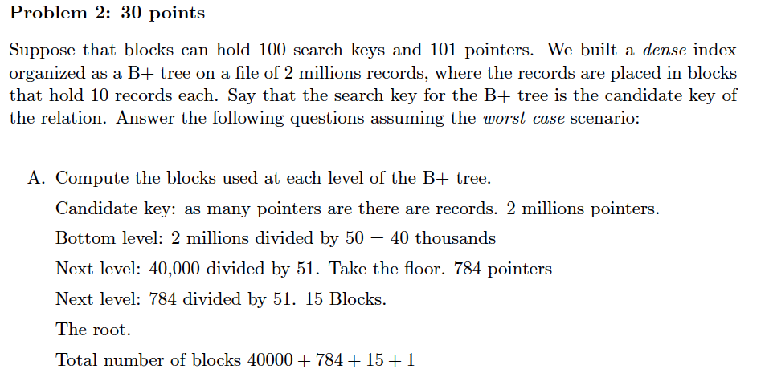
Two problems from Spring 2016
If this is was a sparse index we only need 200,000 pointers. At bottom level 4,000, next level 78. Finally, the root.

Slide 3
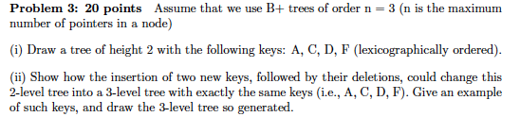
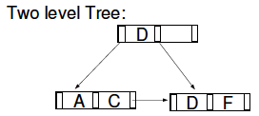
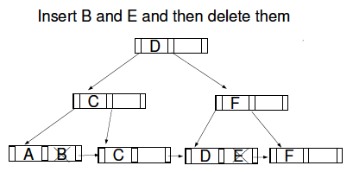
There are other correct answers.

Slide 4
Problems from Spring 2017

Slide 7
Aother acceptable interpretation: students who took classes in 2014 and never received a grade leq 3 in those classes.

