Slide 1
Lecture #13
Binary Tree Review
Binary Search Tree Node Deletion
Uses for Binary Search Trees
Huffman Encoding
Balanced Trees

Slide 2
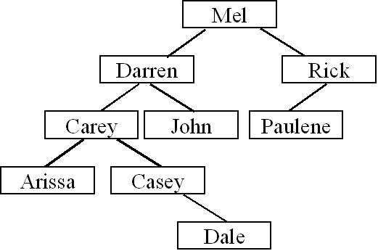
Binary Tree Review
void PostOrder(Node *cur)
{
if (cur == NULL) return;
PostOrder(cur->left); // Process nodes in left sub-tree.
PostOrder(cur-> right); // Process nodes in right sub-tree.
cout << cur->value; // Process the current node.
}
Question #1: What’s the post-order traversal for the following tree?
Question #2: Is the above tree a valid binary search tree?
Question #3: How about now?
Max

Slide 3

Binary Search Tree Insertion Review
Question #1: How would you go about inserting “Cathy”
Question #2: How would you go about inserting “Priyank”.
Notes:
Cathy would be Dale’s left child
Priyank would be Paulene’s right child

Slide 4
Deleting a Node from a Binary Search Tree
By simply moving an arbitrary node into Darren’s slot, we violate our Binary Search Tree ordering requirement!
Carey is NOT less than Arissa!
Next we’ll see how to do this properly….
Now, let’s learn how to delete an item from a BST.
It’s not as easy as you might think!
Let’s say we want to delete Darren from our tree…
NO!
Now how do I re-link the nodes back together?
X
Can I just move Arissa into Darren’s old slot?
Hmm.. It seems OK, but is our tree still a valid binary search tree?
Arissa

Slide 5
Deleting a Node from a Binary Search Tree
Here’s a high-level algorithm to delete a node from a Binary Search Tree:
Given a value V to delete from the tree:
Find the value V in the tree, with a slightly-modified BST search.
Use two pointers: a cur pointer & a parent pointer
If the node was found, delete it from the tree, making sure to preserve its ordering!
There are three cases, so be careful!

Slide 6
BST Deletion: Step #1
This algorithm is very similar to our traditional BST searching algorithm… Except it also has a parent pointer.
Step 1: Searching for value V
Every time we move down left or right, we advance the parent pointer as well!
Let’s delete Casey
When we’re done with our loop below, we want the parent pointer to point to the node just above the target node we want to delete.
parent = NULL
cur = root
While (cur != NULL)
If (V == cur->value) then we’re done.
If (V < cur->value)
parent = cur;
cur = cur->left;
C. Else if (V > cur->value)
parent = cur;
cur = cur->right;
Casey < Mel?
Casey < Darren?
Casey < Carey?
We’d want our parent pointer to point to Carey’s node.
parent
cur
parent
parent
cur
parent
cur
So if we were deleting Arissa…
cur
Now cur points at the node we want to delete, and parent points to the node above it!
parent
NULL

Slide 7
BST Deletion: Step #2
Once we’ve found our target node, we have to delete it. There are 3 cases.
Case 1:
Our node is a leaf.
Case 2:
Our node has one child
Case 3:
Our node has two children.
parent
cur
parent
cur
parent
cur

Slide 8
Step #2, Case #1 – Our Target Node is a Leaf
Let’s look at case #1 – it has two sub-cases!
Case 1, Sub-case #1: The target node is NOT the root node
Case 1:
Our node is a leaf.
ptr
Unlink the parent node from the target node (cur) by setting the parent’s appropriate link to NULL.
Then delete the target (cur) node.
In this case, our target node (cur) is our parent node’s right child…
So we’ll set parent->right to NULL to unlink the parent and cur.
parent
Our target node (cur) that we want to delete is NOT the root node!
cur
X

Slide 9
Step #2, Case #1 – Our Target Node is a Leaf
Let’s look at case #1 – it has two sub-cases!
Case 1, Sub-case #1: The target node is NOT the root node
Case 1:
Our node is a leaf.
ptr
Unlink the parent node from the target node (cur) by setting the parent’s appropriate link to NULL.
root
NULL
X
cur
Mel
Then delete the target (cur) node.
Case 1, Sub-case #2: The target node is the root node
parent
Our target node (cur) that we want to delete is the root node!
X
Set the root pointer to NULL.
cur
Then delete the target (cur) node.

Slide 10
Step #2, Case #2 – Our Target Node has One Child
Let’s look at case #2 now…
It also has two sub-cases!
Case 1, Sub-case #1: The target node is NOT the root node
Case 2:
Our node has one child
Relink the parent node to the target (cur) node’s only child.
parent
cur
X
Then delete the target (cur) node.
Our target node (cur) that we want to delete is NOT the root node!
only child

Slide 11
Step #2, Case #2 – Our Target Node has One Child
Let’s look at case #2 now…
It also has two sub-cases!
Case 1, Sub-case #1: The target node is NOT the root node
Case 2:
Our node has one child
Our target node (cur) that we want to delete is the root node!
Relink the parent node to the target (cur) node’s only child.
root
Then delete the target (cur) node.
cur
X
Mel
only child
Phil
Case 1, Sub-case #2: The target node is the root node
Nate
Sam
Relink the root pointer to the target (cur) node’s only child.
Then delete the target (cur) node.

Slide 12
Step #2, Case #3 – Our Target Node has Two Children
Let’s look at case #3 now. The hard one!
Case 3:
Our node has two children.
We need to find a replacement for our target node that still leaves the BST consistent.
We can’t just pick some arbitrary node and move it up into the vacated slot!
parent
For instance, what if we tried replacing Darren with Arissa?
cur
Arissa
Has two children!
Utoh! If we replace Darren with Arissa, our BST is no longer consistent!
Let’s move her up!
So, when deleting a node with two children, we have to be very careful!

Slide 13
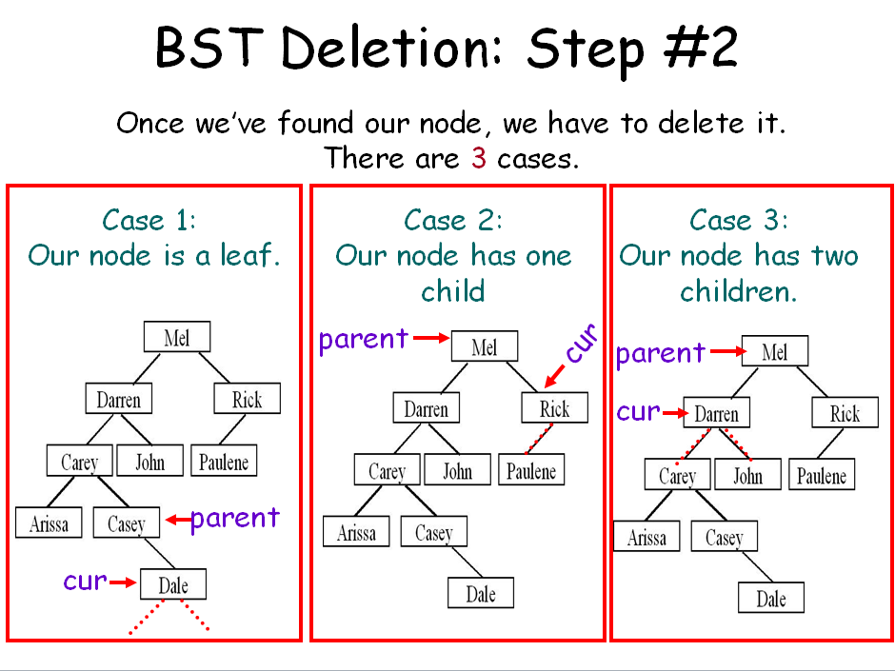
Step #2, Case #3 – Our Target Node has Two Children
…
Notice that our BST is still correct!
To delete a node like k that has two children….
We don’t actually delete the node itself!
k
Instead, we replace its value with one from another node!
These two values are the only suitable replacements for node k – so pick either one and copy it up.
These two values are the only suitable replacements for node k.
f
q
How? We want to replace k with either:
K’s left subtree’s largest-valued child
Notice that both of them are either a leaf or have just one child!
m
Or
2. K’s right subtree’s smallest-valued child
b
h
t
a
d
g
j
p
s
u
j
We use technique #1 or #2!
Why? Our replacement node is guaranteed to have either zero or one child!
c
e
n
So we pick one, copy its value up, then delete that node!
In this case, our node is a leaf, so we use Case 1.
For example, let’s use this node’s value.
Finally, we delete this node! How?

Slide 14
Step #2, Case #3 – Our Target Node has Two Children
…
Notice that our BST is still correct!
k
OK, now let’s try the other replacement node and see if it works!
f
q
And now let’s delete the replacement node… Which Case should we use?
m
b
h
m
t
In this case, our node has one child, so we use Case 2.
a
d
g
j
p
s
u
c
e
n

Slide 15
Step #2, Case #3 – Our Target Node has Two Children
…
Why is it guaranteed that our two replacement nodes have either zero or one child?
k
Well, we found the left subtree’s maximum value by going all the way to the right…
f
q
So by definition, it can’t have a right child!
b
h
m
t
No left child!
Either it has a left child or no children at all…
a
d
g
j
p
s
u
No right child!
The same holds true for the smallest value in our right subtree!
c
e
?
n
So this ensures we can use one of our simpler deletion algorithms for the replacement!
By definition, it can’t have a left child!

Slide 16
Deletion Exercise
Explain how you would go about deleting node k.
k
f
n
Explain how you would go about deleting node e.
b
h
l
p
Explain how you would go about deleting node i.
a
d
g
j
m
o
q
c
e
i
igloo
infer

Slide 17
Where are Binary Search Trees Used?
Remember the STL map?
#include <map>
using namespace std;
main()
{
map<string,float> stud2gpa;
stud2gpa[“Carey”] = 3.62;
stud2gpa[“David”] = 3.99;
stud2gpa[“Dalia”] = 4.0;
cout << stud2gpa[“David”];
}
stud2gpa
pRoot
NULL
ID
“Carey”
val
2.1
3.62
// BST insert!
left
NULL
right
NULL
ID
“David”
stud2gpa[“Carey”] = 2.1;
// BST search!
val
3.99
left
NULL
right
NULL
It uses a type of binary search tree to store the items!
ID
“Dalia”
val
4.0
left
right
NULL NULL

Slide 18
Where are Binary Search Trees Used?
The STL set also uses a type of BSTs!
#include <set>
using namespace std;
main()
{
}
The STL set and map use binary search trees (a special balanced kind) to enable fast searching.
// construct BST
Other STL containers like multiset and multimap also use binary search trees.
These containers can have duplicate mappings. (Unlike set and map)
set<int> a;
a.insert(2);
a.insert(3);
a.insert(4);
// insert into BST
a.insert(2);
int n;
n = a.size();
a.erase(2);
// delete from BST

Slide 19


Huffman Encoding: Applying Trees to Real-World Problems
Huffman Encoding is a data compression technique that can be used to compress and decompress files (e.g. like creating ZIP files).

Slide 20
Background
Before we actually cover Huffman Encoding, we need to learn a few things…
Remember the ASCII code?

Slide 21
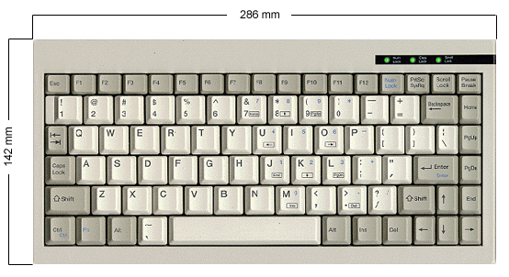

ASCII
Computers represent letters, punctuation and digit symbols using the ASCII code, storing each character as a number.
When you type a character on the keyboard, it’s converted into a number and stored in the computer’s memory!
50
65

Slide 22
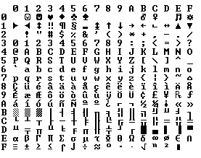
The ASCII Chart
48
0-15
16-31
32-47
48-63
64-79
80-95
96-111
112-127
65
97

Slide 23


Computer Memory and Files
So basically, characters are stored in the computer’s memory as numbers…
data
67
67
main()
{
char data[7] = “Carey”;
ofstream out(“file.dat”);
out << data;
out.close();
}
97
97
114
114
101
101
121
121
0
0
0
0
Similarly, when you write data out to a file, it’s stored as ASCII numbers too!

Slide 24
Bytes and Bits
Now, as you’ve probably heard, the computer actually stores all numbers as 1’s and 0’s (in binary) instead of decimal…
data
01000011
01000011
67
main()
{
char data[7] = “Carey”;
ofstream out(“file.dat”);
out << data;
out.close();
}
01100001
97
01110010
114
01100101
101
01111001
121
00000000
0
00000000
0
Each character is represented by 8 bits.
Each bit can have a value of either 0 or 1
(i.e. 1 = high voltage and 0 = low voltage)

Slide 25
Binary and Decimal
Every decimal number has an equivalent binary representation (they’re just two ways of representing the same thing)
Decimal Number
Binary Equivalent
0
00000000
1
00000001
2
00000010
3
00000011
4
00000100
…
…
255
11111111
So that’s binary…

Slide 26
Consider a Data File
Now lets consider a simple data file containing the data:
“I AM SAM MAM.”
As we’ve learned, this is actually stored as 13 numbers in our data file:
73 32 65 77 32 83 65 77 32 77 65 77 46
And in reality, its really stored in the computer as a set of 104 binary digits (bits):
01001001 00100000 01000001 01001101 00100000 01010011 01000001
01001101 00100000 01001101 01000001 01001101 00101110
(13 characters * 8 bits/character = 104 bits)

Slide 27
Data Compresion
So our original string “I AM SAM MAM.” requires 104 bits to store on our computer… OK.
01001001 00100000 01000001 01001101 00100000 01010011 01000001
01001101 00100000 01001101 01000001 01001101 00101110
The question is:
Can we somehow reduce the number of bits required to store our data?
And of course, the answer is YES!

Slide 28
Huffman Encoding
To compress a file “file.dat” with Huffman encoding, we use the following steps:
Compute the frequency of each character in file.dat.
Build a Huffman tree (a binary tree) based on these frequencies.
Use this binary tree to convert the original file’s contents to a more compressed form.
Save the converted (compressed) data to a file.

Slide 29
Huffman Encoding: Step #1
Step #1: Compute the frequency of each character in file.dat.
(i.e. compute a histogram)
FILE.DAT
S
M
M
I AM SAM MAM.
I
A
M
A
M
A
.
‘A’
‘I’
‘M’
‘S’
Space
Period
3
1
4
1
3
1

Slide 30
Huffman Encoding: Step #2
Step #2: Build a Huffman tree (a binary tree) based on these frequencies:
A. Create a binary tree leaf node for each entry in our table, but don’t insert any of these into a tree!
ch
B. While we have more than one node left:
1. Find the two nodes with lowest freqs.
2. Create a new parent node.
3. Link the parent to each of the children.
4. Set the parent’s total frequency equal to the sum of its children’s frequencies.
5. Place the new parent node in our grouping.
freq
2
1+1
left
right
‘A’
‘I’
‘M’
‘S’
Space
Period
3
1
4
1
3
1
ch
‘.’
ch
‘S’
ch
‘I’
ch
‘A’
ch
‘ ’
ch
‘M’
freq
1
freq
1
freq
1
freq
3
freq
3
freq
4
left
right
left
right
left
right
left
right
left
right
left
right
NULL
NULL
NULL
NULL
NULL
NULL
NULL
NULL
NULL
NULL
NULL
NULL

Slide 31
Huffman Encoding: Step #2
Step #2: Build a Huffman tree (a binary tree) based on these frequencies:
A. Create a binary tree leaf node for each entry in our table, but don’t insert any of these into a tree!
ch
B. While we have more than one node left:
1. Find the two nodes with lowest freqs.
2. Create a new parent node.
3. Link the parent to each of the children.
4. Set the parent’s total frequency equal to the sum of its children’s frequencies.
5. Place the new parent node in our grouping.
freq
2
left
right
ch
freq
3
ch
‘.’
ch
‘S’
left
right
freq
1
freq
1
left
right
left
right
NULL
NULL
NULL
NULL
ch
ch
‘I’
ch
‘A’
ch
‘ ’
ch
‘M’
freq
2
freq
1
freq
3
freq
3
freq
4
left
right
left
right
left
right
left
right
left
right
NULL
NULL
NULL
NULL
NULL
NULL
NULL
NULL
ch
‘.’
ch
‘S’
freq
1
freq
1
left
right
left
right
NULL
NULL
NULL
NULL

Slide 32
Huffman Encoding: Step #2
ch
freq
6
left
right
ch
freq
3
left
right
ch
ch
‘I’
ch
‘A’
ch
‘ ’
ch
‘M’
freq
2
freq
1
freq
3
freq
3
freq
4
left
right
left
right
left
right
left
right
left
right
NULL
NULL
NULL
NULL
NULL
NULL
NULL
NULL
ch
‘.’
ch
‘S’
freq
1
freq
1
left
right
left
right
NULL
NULL
NULL
NULL

Slide 33
Huffman Encoding: Step #2
ch
freq
13
left
right
ch
ch
freq
7
freq
6
left
right
left
right
ch
ch
‘A’
ch
‘ ’
ch
‘M’
freq
3
freq
3
freq
3
freq
4
left
right
left
right
left
right
left
right
NULL
NULL
NULL
NULL
NULL
NULL
ch
ch
‘I’
Ok. Now we have a single binary tree.
freq
2
freq
1
left
right
left
right
NULL
NULL
ch
‘.’
ch
‘S’
freq
1
freq
1
left
right
left
right
NULL
NULL
NULL
NULL

Slide 34
Huffman Encoding: Step #2
Step #2: Build a Huffman tree (a binary tree) based on these frequencies:
A. Create a binary tree leaf node for each entry in our table, but don’t insert any of these into a tree!
ch
B. Build a binary tree from the leaves.
freq
13
left
right
0
C. Now label each left edge with a “0” and
each right edge with a “1”
0
0
0
0
1
1
1
1
1
ch
ch
freq
7
freq
6
left
right
left
right
ch
ch
‘M’
ch
‘A’
ch
‘ ’
freq
3
freq
4
freq
3
freq
3
left
right
left
right
left
right
left
right
NULL
NULL
NULL
NULL
NULL
NULL
ch
ch
‘I’
freq
2
freq
1
left
right
left
right
NULL
NULL
ch
‘.’
ch
‘S’
freq
1
freq
1
left
right
left
right
NULL
NULL
NULL
NULL

Slide 35
Huffman Encoding: Step #2
Now we can determine the new bit-encoding for each character.
ch
freq
13
left
right
0
1
The bit encoding for a character is the path of 0’s and 1’s that you take from the root of the tree to the character of interest.
ch
ch
freq
7
freq
6
left
right
left
right
0
1
0
1
ch
ch
‘M’
ch
‘A’
ch
‘ ’
freq
3
freq
4
freq
3
freq
3
left
right
left
right
left
right
left
right
For example:
1
NULL
NULL
NULL
NULL
NULL
NULL
0
ch
ch
‘I’
S is encoded as 0001
freq
2
freq
1
left
right
left
right
A is encoded as 10
0
1
NULL
NULL
M is encoded as 01
ch
‘.’
ch
‘S’
Notice that characters that occurred more often in our message have shorter bit-encodings!
freq
1
freq
1
Etc…
left
right
left
right
NULL
NULL
NULL
NULL

Slide 36
Huffman Encoding: Step #3
Step #3: Use this binary tree to convert the original file’s contents to a more compressed form..
i.e. find the sequence of bits (1s and 0s) for each char in the message.
ch
freq
13
left
right
0
1
ch
ch
I AM SAM MAM.
freq
7
freq
6
left
right
left
right
0
1
0
1
001
11
10
01
11
0001
10
01
ch
ch
‘M’
ch
‘A’
ch
‘ ’
11
01
10
01
0000
freq
3
freq
4
freq
3
freq
3
left
right
left
right
left
right
left
right
1
NULL
NULL
NULL
NULL
NULL
NULL
0
ch
ch
‘I’
freq
2
freq
1
left
right
left
right
0
1
NULL
NULL
ch
‘.’
ch
‘S’
freq
1
freq
1
left
right
left
right
NULL
NULL
NULL
NULL

Slide 37
Huffman Encoding: Step #4
Step #4: Save the converted (compressed) data to a file.
001
11
10
01
11
0001
10
10
01
001
11
10
01
11
0001
01
11
01
0000
11
01
01
10
01
0000
10
compressed.dat
Notice that our new file is less than four bytes or 31 bits long!
Our original file is 13 bytes or 104 bits long!
originalfile.dat
01001001 00100000 01000001 01001101 00100000 01010011 01000001 01001101 00100000
01001101 01000001 01001101
00101110
We saved over 69%!

Slide 38
Ok… So I cheated a bit…
compressed.dat
If all we have is our 31 bits of data… its impossible to interpret the file!
Encoding:
‘A’ = “10”
‘ ‘ = “11”
‘M’ = “01”
‘I’ = “001”
‘.’ = “0000”
‘S’ = “0001”
Encoded Data:
001
11
10
01
11
0001
10
01
11
01
10
01
0000
Did 000 equal “I” or did 000 equal “Q”? Or was it 00 equals “A”?
So, we must add some additional data to the top of our compressed file to specify the encoding we used…
Now clearly this adds some overhead to our file…
But usually there’s a pretty big savings anyway!

Slide 39
Decoding…
Extract the encoding scheme from the compressed file.
Build a Huffman tree (a binary tree) based on the encodings.
Use this binary tree to convert the compressed file’s contents back to the original characters.
Save the converted (uncompressed) data to a file.
ch
compressed.dat
Output:
freq
ch
left
right
Encoding:
‘A’ = “10”
‘ ‘ = “11”
‘M’ = “01”
‘I’ = “001”
‘.’ = “0000”
‘S’ = “0001”
Encoded Data:
freq
I
_
A
M
_SAM_MAM.
0
left
right
1
0
NULL
1
ch
ch
ch
freq
freq
output.dat
left
right
ch
freq
left
right
left
right
freq
left
right
I AM SAM
MAM.
0
1
0
1
NULL
NULL
1
0
1
ch
ch
‘M’
ch
‘A’
ch
‘ ’
freq
ch
freq
freq
freq
‘M’
ch
‘A’
ch
‘ ‘
left
right
freq
left
right
left
right
left
right
NULL
freq
freq
left
right
NULL
NULL
NULL
NULL
NULL
0
1
left
right
left
right
NULL
NULL
NULL
NULL
NULL
NULL
001
11
10
ch
ch
‘I’
(When you hit a leaf node, output ch and then start again at the root!)
freq
(When you hit a leaf node, output ch and then start again at the root!)
01
11
0001
freq
left
right
left
right
10
01
11
01
0
1
NULL
NULL
10
01
0000
ch
‘.’
ch
‘S’
freq
freq
left
right
left
right
NULL
NULL
NULL
NULL

Slide 40
Balanced Search Trees
Question: What happens if we insert the following values into a binary search tree?
5, 10, 7, 9, 8, 20, 18, 17, 16, 15, 14, 13, 12, 11
Question: What is the approximate big-oh cost of searching for a value in this tree?

Slide 41
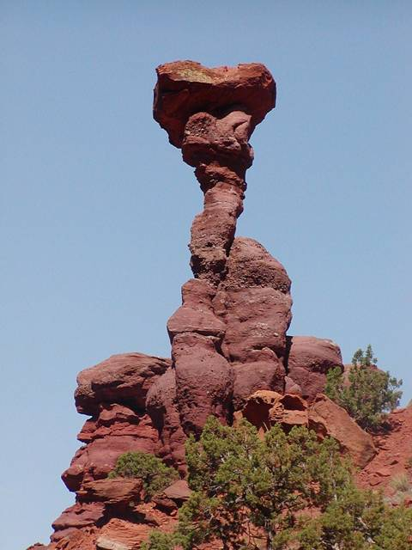
Balanced Search Trees
In real life, trees often end up looking just like our example, especially after repeated insertions and deletions.
It would be nice if we could come up with a tree ADT that always maintained an even height.
This would ensure that all insertions, searches and deletions would be O(log n).

Slide 42
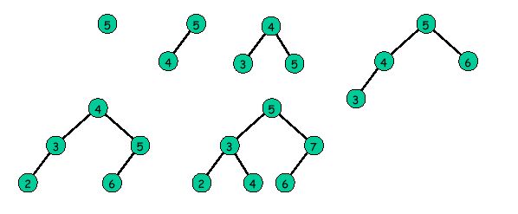
Balanced Search Trees
A binary tree is “perfectly balanced” if for each node, the number of nodes in its left and right subtrees differ by at most one.
Perfectly balanced search trees have a maximum height of log(n), but are difficult to maintain during insertion/deletion.

Slide 43
Balanced Search Trees
There are 3 popular approaches to building a balanced binary search tree :
AVL trees
2-3 trees
Red-black trees
Let’s learn about AVL trees!

Slide 44
AVL Trees
AVL tree: a BST in which the heights of the left and right sub-trees of each node differ at most by 1.
AVL Trees
Non-Legal AVL Trees

Slide 45
Implementing AVL Trees
To implement an AVL tree, each node has a new balance value:
0 if the node’s left and right subtrees have the same height
-1 if the node’s left subtree is 1 higher than the right
1 if the node’s right subtree is 1 higher than the left
value
5
Balance?
Balance?
What’s the balance?
bal
-1
What’s the balance?
-1
0
0
struct AVLNode
{
int value;
int balance;
AVLNode *left, *right;
};
NULL
NULL
value
3
value
19
Balance?
bal
bal
What’s the balance?
1
0
Balance?
0
NULL
NULL
NULL
NULL
value
4
bal
0
Balance?
When we insert a node we have to update all balance values from the new node to the root of the tree…
NULL
NULL

Slide 46
A Non-AVL Tree
0
-2
-2
-1
1
0
0
Notice: Even though the root node has a balance of zero, its sub-trees aren’t balanced!

Slide 47
Insertion into an AVL Tree (the simple case)
Case 1: After you insert the new node, all nodes in the tree still have balances of 0, -1 or 1.
Insert the new node normally (just like in a BST)
Then update the balances of all parent nodes, from the new leaf to the root.
If all of the balances are still 0, -1 or 1, DONE!
Balance values:
-1 = left higher
1 = right higher
0 = even height

Slide 48
Insertion into an AVL Tree (the simple case)
Insert the following values into an AVL tree, showing the balance factor of each node as you go: 4, 7, 2, 8, 6, 1
Val: 4
Bal: 0
Val: 4
Bal: 1
Val: 4
Bal: 0
Val: 4
Bal: 1
Val: 4
Bal: 1
Val: 4
Bal: 0
0
1
1
0
Val: 2
Bal: 0
Val: 2
Bal: 0
Val: 2
Bal: 0
Val: 2
Bal: 0
Val: 7
Bal: 0
Val: 7
Bal: 1
Val: 7
Bal: 0
Val: 7
Bal: 0
Val: 7
Bal: 0
-1
0
1
Val: 1
Bal: 0
Val: 6
Bal: 0
Val: 8
Bal: 0
Val: 6
Bal: 0
Val: 8
Bal: 0
Val: 8
Bal: 0
Balance values:
-1 = left higher
1 = right higher
0 = even height

Slide 49
Insertion into an AVL Tree (more complex case)
Case 2: When you insert a new node, it causes one or more balances to become less than -1 or greater than 1.
We must now “rebalance” the tree so all nodes still have a balance of –1, 0 or 1.
Let’s consider the case of inserting into the right subtree (left is similar)
There are two sub-cases to consider:
Single rotation
Double rotation

Slide 50
Case 2.1: Single Rotation
If we add a node to a subtree that causes any node in the AVL tree to go out of balance, then we rotate:
J
Bal=1
J
Bal=2
Bal=0
J
T
B
T
B
T
B
3
4
4
4
R
5
R
Z
Z
R
Z

Slide 51
Case 2.1: Single Rotation
So, what would our new tree look like if we add a value of 9?
Val: 4
Bal: 0
2
Val: 2
Bal: 0
Val: 7
Bal: 0
1
Val: 7
Bal: 0
0
Val: 6
Bal: 0
Val: 8
Bal: 0
1
Val: 4
Bal: 0
Val: 8
Bal: 0
0
1
Val: 9
Bal: 0
Val: 2
Bal: 0
Val: 6
Bal: 0
Val: 9
Bal: 0
The nodes 2 4 7 8 9, that comprise the ‘outside edge’ of the tree, have been rotated one node to the left.

Slide 52
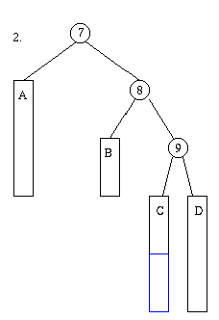
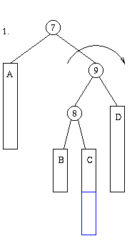
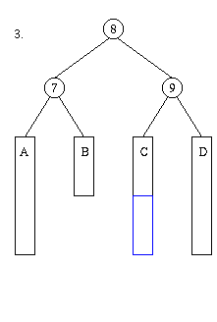
Case 2.1: Double Rotation
In some cases, when we add a node, it requires two rebalances.
But now, node 7 is still unbalanced!

