Slide 1
CS33 MT1 Review Session
Prepared by UPE for Professor Eggert’s CS33
Sign-in: https://goo.gl/forms/qbz3ic8ZygW2gsdD2

Slide 2
Bits and Bytes
Information on computers is stored in binary - 1’s and 0’s. CS33 teaches us about x86-64 which allows us to take advantage of 64 bits worth of information.
Most of the calculations we do will focus on ‘2’s complement’ wherein signed numbers can be represented as such with the MSB (most significant bit) representing what sign the number has. If its 1 then it is negative and ranges from -1 -> -(2^x) and the positive ranges from 0 -> (2^x) - 1, where x is the number of bits.
Negative numbers can be calculated by -c = ~c + 1. This however creates a case of -c = c for the most negative number. This can be handled in two ways by gcc - trapv (throw exception) and wrapv (compute modulo and wrap around = overflow).
Deal with Little Endian notation (MSB on the furthest to the left), but be aware of Big Endian (opposite).
Make sure to understand bitwise operations: ~, ^, |, &, <<, >>, ! and evaluate to a bit vector.
Logical operators involve comparators ||, && and evaluate to single bit.

Slide 3
More bits and bytes
I know overflow can be daunting, but overflow is simply the case when the MSB changes from 1 to zero or vice versa in 2’s complement. In C signed overflow does not wrap around but unsigned does. This causes signed overflow to perform undefined behavior.
Remember that each data type has a specific byte length and so the compiler will always align its address space to make the calculations faster - helpful to remember for Assembly. For example in some machines accessing odd memory address for an integer will slow down calculations because integers are aligned to multiples of 2.
Right shift is generally arithmetic (pads the end with whatever the MSB was) and Left shift is logical.
Right shift is equivalent to dividing by powers of 2 and left shifting is equivalent to multiplying by powers of 2.

Slide 4
Q Write a function to determine if the number is < 0
Write a C function using only bitwise operators, to determine if the number given is negative. If the number is positive return 1 else 0.
Hint: It can be done in one line!

Slide 5
A Write a function to determine if the number is < 0
int is_nonnegative(int x)
{
return !(x >> 31);
}
Well that was an easy one. Let’s try something a little harder!

Slide 6
Q Write a function sm2tc(int x)
Convert from sign magnitude to two’s complement using only bitwise operations. Note that we will be using Little Endian convention and the MSB represents the signed bit.
Reminder: Sign magnitude works such that one bit (the MSB) represents the sign of the number while the rest of the bits represent the magnitude of the number.

Slide 7
A Write a function sm2tc(int x)
int sm2tc(int x)
{
int is_negative = x >> 31; //This will tell us if x is negative or not
int mask = ~(~0 << 31); //Extract the signed bit. This mask does not overflow!
return ((is_negative) & (~(x & mask) + 1) | ((~is_negative) & x));
//If it’s not negative we return the same number, else we return 2’s
//complement
}

Slide 8
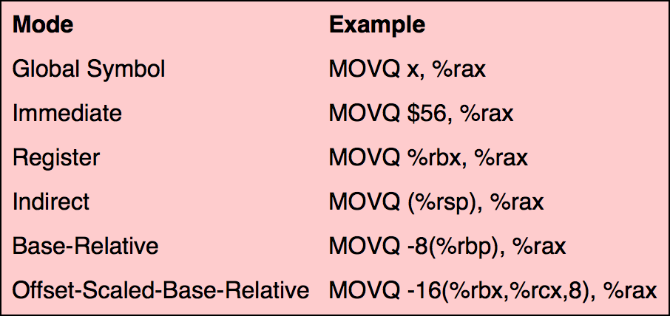
Dreadful Assembly!
Registers are small hardware based storage devices closest to the CPU that generally store addresses into physical memory.
X86-64 has for the most part 16 general purpose registers
%rbp (base pointer)
%rsp (stack pointer)
%rax (result register)
%rip (instruction pointer)
%rdi, %rsi, %rdx and %rcx (1st to 4th arguments)
Others
Note that x64 calling conventions differ from previous generations because now arguments are saved in registers! This is called the System V ABI in Linux (Google more if you’re a mad man).
When talking about assembly we focus on different types of modes of accessing data.

Slide 9
OMG more fun Assembly
When dealing with CS33 we will focus on AT&T x86-64 assembly such that in any instruction we have source, destination.
Some of the important instructions to be aware of are
mov - Move data from one location to another
add - Add data from registers or memory together
sub - Subtract
imul - Extended signed multiplication (concatenates two registers to store the value - low 64 bits in %rax and higher in %rdx)
idiv - Extended signed division (%rax will store quotient and %rdx stores remainder)

Slide 10
Memory Addressing Modes
Consider the following instruction:
movl $10, -8(%eax, %edx, 4)

Slide 11
Memory Addressing Modes
Consider the following instruction:
movl $10, -8(%eax, %edx, 4)
We're applying the movl instruction, which is responsible for moving (or copying) a value from one memory location to another.

Slide 12
Memory Addressing Modes
Consider the following instruction:
movl $10, -8(%eax, %edx, 4)
We're applying the movl instruction, which is responsible for moving (or copying) a value from one memory location to another.
We're moving the immediate value $10. We know that it's an immediate because it is prepended by a $ sign. An immediate is like a constant.

Slide 13
Memory Addressing Modes
Consider the following instruction:
movl $10, -8(%eax, %edx, 4)
We're applying the movl instruction, which is responsible for moving (or copying) a value from one memory location to another.
We're moving the immediate value $10. We know that it's an immediate because it is prepended by a $ sign. An immediate is like a constant.
We're moving the immediate into a memory location, MEM[REG[%eax]+4*REG[%edx]+(-8)]. We know that it's a memory location because of the parentheses!

Slide 14
Memory Addressing Modes
The general form is as follows:
D(Rb, Ri, S)
D is a constant displacement that is 1, 2, or 4 bytes long. What's the maximum displacement we can achieve?
Rb is the base register, which is any of the 16 integer registers.
Ri is the index register, which can be any register except for %rsp.
S is the scale. This can be 1, 2, 4, or 8. How many bits is this represented by?
This translates to MEM[REG[Rb]+S*REG[Ri]+D].

Slide 15
Memory Addressing Modes
Note that there are shorthands to this general form.
(Rb, Ri): MEM[REG[Rb]+Reg[Ri]] D(Rb, Ri): MEM[REG[Rb]+Reg[Ri]+D] (Rb, Ri, S): MEM[REG[Rb]+S*Reg[Ri]] (, Ri, S): MEM[S*Reg[Ri]]

Slide 16
leal Instruction
Let's consider the following instruction:
leal source, destination
leal, or load effective address, does exactly as its name suggests. The instruction takes a memory address expressed through the parameters (D, Rb, Ri, S) and, rather than returning the value at the address, returns the address itself.

Slide 17
Practice Question
Now, suppose we have:
leal D(Rb, Ri, S), %ebx
And that our variable, N, is in the register %eax. What values K*N can we produce with the leal instruction? (Where K is some integer.)

Slide 18
Practice Question
Now, suppose we have:
leal D(Rb, Ri, S), %ebx
And that our variable, N, is in the register %eax. What values K*N can we produce with the leal instruction? (Where K is some integer.)
If we use the form (, %eax, S) we can produce N, 2N, 4N, and 8N.

Slide 19
Practice Question
Now, suppose we have:
leal D(Rb, Ri, S), %ebx
And that our variable, N, is in the register %eax. What values K*N can we produce with the leal instruction? (Where K is some integer.)
If we use the form (, %eax, S) we can produce N, 2N, 4N, and 8N.
If we use the form (%eax, %eax, S), we can take advantage of the adding of the first parameter and produce 3N, 5N, and 9N.

Slide 20
Procedure Calls
Recall the usage of call and ret:
These instructions implement a subroutine call and return. The call instruction first pushes the current code location onto the hardware supported stack in memory (see the push instruction for details), and then performs an unconditional jump to the code location indicated by the label operand. Unlike the simple jump instructions, the call instruction saves the location to return to when the subroutine completes.

Slide 21
The call Instruction
If we break down the aforementioned definition, we have that the call instruction can be interpreted as follows:
call <label>: pushl %eip // Note: %eip points to the next // instruction to be executed. jmp <label>
In which case, the call instruction performs the desired functionality.

Slide 22
Practice Question
Suppose we have allocated memory locations 0xffff0000 through 0xffffffff for the stack, and we are worried that our x86 program might overflow the stack.
We decide to institute the ironclad rule that if a function ever attempts to grow the stack past the allocated bounds, the function immediately stops what it's doing and returns 0, thus shrinking the stack.
Explain the problems you see in implementing this rule.

Slide 23
Practice Question
Can it be done in C code?

Slide 24
Practice Question
Can it be done in C code?
NO!
Maintenance of the stack occurs in between lines of C code.
Example: Simply calling a function allocates space for the return address, the old %ebp, and possibly for the new stack frame.

Slide 25
Practice Question
Solution?

Slide 26
Practice Question
Solution?
Assembly!
subl 0x10, %esp

Slide 27
Practice Question
Solution?
Assembly!
movl %esp, %ebx
subl 0x10, %ebx
cmpl 0xFFFF0000, %ebx
jb <STACK EXCEEDED>
subl 0x10, %esp
subl 0x10, %esp

Slide 28
C to Assembly
int sum(int count) {
int i;
int sum = 0;
for (i = 0; i < count; ++i) {
sum += i;
}
return sum;
}

Slide 29
C to Assembly
1
2
3
4
5
6
7
8
9
10
11
12
13
14
15
16
17
18
sum:
pushl %ebp
movl %esp, %ebp
subl $16, %esp
movl $0, -8(%ebp)
movl $0, -4(%ebp)
jmp .L2
.L3:
movl -4(%ebp), %eax
addl %eax, -8(%ebp)
addl $1, -4(%ebp)
.L2:
movl -4(%ebp), %eax
cmpl 8(%ebp), %eax
jl .L3
movl -8(%ebp), %eax
leave
ret
int sum(int count) {
int i;
int sum = 0;
for (i = 0; i < count; ++i) {
sum += i;
}
return sum;
}

Slide 30
C to Assembly
1
2
3
4
5
6
7
8
9
10
11
12
13
14
15
16
17
18
sum:
pushl %ebp
movl %esp, %ebp
subl $16, %esp
movl $0, -8(%ebp)
movl $0, -4(%ebp)
jmp .L2
.L3:
movl -4(%ebp), %eax
addl %eax, -8(%ebp)
addl $1, -4(%ebp)
.L2:
movl -4(%ebp), %eax
cmpl 8(%ebp), %eax
jl .L3
movl -8(%ebp), %eax
leave
ret
A = 0
B = 0
eax = B
A += eax
B += 1
eax = B
compare eax with C
eax = A
int sum(int count) {
int i;
int sum = 0;
for (i = 0; i < count; ++i) {
sum += i;
}
return sum;
}

Slide 31
C to Assembly
1
2
3
4
5
6
7
8
9
10
11
12
13
14
15
16
17
18
sum:
pushl %ebp
movl %esp, %ebp
subl $16, %esp
movl $0, -8(%ebp)
movl $0, -4(%ebp)
jmp .L2
.L3:
movl -4(%ebp), %eax
addl %eax, -8(%ebp)
addl $1, -4(%ebp)
.L2:
movl -4(%ebp), %eax
cmpl 8(%ebp), %eax
jl .L3
movl -8(%ebp), %eax
leave
ret
save base pointer
ebp = esp
grow stack
A = 0
B = 0
jump to L2
eax = B
A += eax
B += 1
eax = B
compare eax with C
jump to L3 if eax < C
eax = A
reset base pointer
reset instruction pointer
int sum(int count) {
int i;
int sum = 0;
for (i = 0; i < count; ++i) {
sum += i;
}
return sum;
}

Slide 32
C to Assembly
1
2
3
4
5
6
7
8
9
10
11
12
13
14
15
16
17
18
sum:
pushl %ebp
movl %esp, %ebp
subl $16, %esp
movl $0, -8(%ebp)
movl $0, -4(%ebp)
jmp .L2
.L3:
movl -4(%ebp), %eax
addl %eax, -8(%ebp)
addl $1, -4(%ebp)
.L2:
movl -4(%ebp), %eax
cmpl 8(%ebp), %eax
jl .L3
movl -8(%ebp), %eax
leave
ret
save base pointer
ebp = esp
grow stack
A = 0
B = 0
jump to L2
eax = B
A += eax
B += 1
eax = B
compare eax with C
jump to L3 if eax < C
eax = A
reset base pointer
reset instruction pointer
sum = 0
i = 0
int sum(int count) {
int i;
int sum = 0;
for (i = 0; i < count; ++i) {
sum += i;
}
return sum;
}

Slide 33
C to Assembly
1
2
3
4
5
6
7
8
9
10
11
12
13
14
15
16
17
18
sum:
pushl %ebp
movl %esp, %ebp
subl $16, %esp
movl $0, -8(%ebp)
movl $0, -4(%ebp)
jmp .L2
.L3:
movl -4(%ebp), %eax
addl %eax, -8(%ebp)
addl $1, -4(%ebp)
.L2:
movl -4(%ebp), %eax
cmpl 8(%ebp), %eax
jl .L3
movl -8(%ebp), %eax
leave
ret
save base pointer
ebp = esp
grow stack
A = 0
B = 0
jump to L2
eax = B
A += eax
B += 1
eax = B
compare eax with C
jump to L3 if eax < C
eax = A
reset base pointer
reset instruction pointer
sum = 0
i = 0
i < count
int sum(int count) {
int i;
int sum = 0;
for (i = 0; i < count; ++i) {
sum += i;
}
return sum;
}

Slide 34
C to Assembly
1
2
3
4
5
6
7
8
9
10
11
12
13
14
15
16
17
18
sum:
pushl %ebp
movl %esp, %ebp
subl $16, %esp
movl $0, -8(%ebp)
movl $0, -4(%ebp)
jmp .L2
.L3:
movl -4(%ebp), %eax
addl %eax, -8(%ebp)
addl $1, -4(%ebp)
.L2:
movl -4(%ebp), %eax
cmpl 8(%ebp), %eax
jl .L3
movl -8(%ebp), %eax
leave
ret
save base pointer
ebp = esp
grow stack
A = 0
B = 0
jump to L2
eax = B
A += eax
B += 1
eax = B
compare eax with C
jump to L3 if eax < C
eax = A
reset base pointer
reset instruction pointer
sum = 0
i = 0
sum += i
++i
i < count
int sum(int count) {
int i;
int sum = 0;
for (i = 0; i < count; ++i) {
sum += i;
}
return sum;
}

Slide 35
C to Assembly
1
2
3
4
5
6
7
8
9
10
11
12
13
14
15
16
17
18
sum:
pushl %ebp
movl %esp, %ebp
subl $16, %esp
movl $0, -8(%ebp)
movl $0, -4(%ebp)
jmp .L2
.L3:
movl -4(%ebp), %eax
addl %eax, -8(%ebp)
addl $1, -4(%ebp)
.L2:
movl -4(%ebp), %eax
cmpl 8(%ebp), %eax
jl .L3
movl -8(%ebp), %eax
leave
ret
save base pointer
ebp = esp
grow stack
A = 0
B = 0
jump to L2
eax = B
A += eax
B += 1
eax = B
compare eax with C
jump to L3 if eax < C
eax = A
reset base pointer
reset instruction pointer
sum = 0
i = 0
sum += i
++i
i < count
return sum
int sum(int count) {
int i;
int sum = 0;
for (i = 0; i < count; ++i) {
sum += i;
}
return sum;
}

Slide 36
Assembly to C
sum:
pushl %ebp
movl %esp, %ebp
subl $16, %esp
movl $0, -8(%ebp)
movl $0, -4(%ebp)
jmp .L2
.L3:
movl -4(%ebp), %eax
addl %eax, -8(%ebp)
addl $1, -4(%ebp)
.L2:
movl -4(%ebp), %eax
cmpl 8(%ebp), %eax
jl .L3
movl -8(%ebp), %eax
leave
ret
Before:

Slide 37
Assembly to C
sum:
pushl %ebp
movl %esp, %ebp
subl $16, %esp
movl $0, -8(%ebp)
movl $0, -4(%ebp)
jmp .L2
.L3:
movl -4(%ebp), %eax
addl %eax, -8(%ebp)
movl -4(%ebp), %eax
addl $1, %eax
addl %eax, -8(%ebp)
addl $2, -4(%ebp)
.L2:
movl -4(%ebp), %eax
cmpl 8(%ebp), %eax
jl .L3
movl -8(%ebp), %eax
leave
ret
sum:
pushl %ebp
movl %esp, %ebp
subl $16, %esp
movl $0, -8(%ebp)
movl $0, -4(%ebp)
jmp .L2
.L3:
movl -4(%ebp), %eax
addl %eax, -8(%ebp)
addl $1, -4(%ebp)
.L2:
movl -4(%ebp), %eax
cmpl 8(%ebp), %eax
jl .L3
movl -8(%ebp), %eax
leave
ret
Before:
After:

Slide 38
Assembly to C
sum:
pushl %ebp
movl %esp, %ebp
subl $16, %esp
movl $0, -8(%ebp)
movl $0, -4(%ebp)
jmp .L2
.L3:
movl -4(%ebp), %eax
addl %eax, -8(%ebp)
movl -4(%ebp), %eax
addl $1, %eax
addl %eax, -8(%ebp)
addl $2, -4(%ebp)
.L2:
movl -4(%ebp), %eax
cmpl 8(%ebp), %eax
jl .L3
movl -8(%ebp), %eax
leave
ret
sum:
pushl %ebp
movl %esp, %ebp
subl $16, %esp
movl $0, -8(%ebp)
movl $0, -4(%ebp)
jmp .L2
.L3:
movl -4(%ebp), %eax
addl %eax, -8(%ebp)
addl $1, -4(%ebp)
.L2:
movl -4(%ebp), %eax
cmpl 8(%ebp), %eax
jl .L3
movl -8(%ebp), %eax
leave
ret
Before:
After:

Slide 39
Assembly to C
Before:
After:
.L3:
movl -4(%ebp), %eax
addl %eax, -8(%ebp)
movl -4(%ebp), %eax
addl $1, %eax
addl %eax, -8(%ebp)
addl $2, -4(%ebp)
.L3:
movl -4(%ebp), %eax
addl %eax, -8(%ebp)
addl $1, -4(%ebp)
temp = i
sum += temp
i++

Slide 40
Assembly to C
Before:
After:
.L3:
movl -4(%ebp), %eax
addl %eax, -8(%ebp)
movl -4(%ebp), %eax
addl $1, %eax
addl %eax, -8(%ebp)
addl $2, -4(%ebp)
.L3:
movl -4(%ebp), %eax
addl %eax, -8(%ebp)
addl $1, -4(%ebp)
temp = i
sum += temp
i++
sum += i
i++

Slide 41
Assembly to C
Before:
After:
.L3:
movl -4(%ebp), %eax
addl %eax, -8(%ebp)
movl -4(%ebp), %eax
addl $1, %eax
addl %eax, -8(%ebp)
addl $2, -4(%ebp)
.L3:
movl -4(%ebp), %eax
addl %eax, -8(%ebp)
addl $1, -4(%ebp)
temp = i
sum += temp
i++
sum += i
i++
temp = i
sum += temp
temp = i
++temp
sum += temp
i += 2

Slide 42
Assembly to C
Before:
After:
.L3:
movl -4(%ebp), %eax
addl %eax, -8(%ebp)
movl -4(%ebp), %eax
addl $1, %eax
addl %eax, -8(%ebp)
addl $2, -4(%ebp)
.L3:
movl -4(%ebp), %eax
addl %eax, -8(%ebp)
addl $1, -4(%ebp)
temp = i
sum += temp
i++
sum += i
i++
temp = i
sum += temp
temp = i
++temp
sum += temp
i += 2
sum += i
sum += i + 1
i += 2

Slide 43
Assembly to C
sum:
pushl %ebp
movl %esp, %ebp
subl $16, %esp
movl $0, -8(%ebp)
movl $0, -4(%ebp)
jmp .L2
.L3:
movl -4(%ebp), %eax
addl %eax, -8(%ebp)
movl -4(%ebp), %eax
addl $1, %eax
addl %eax, -8(%ebp)
addl $2, -4(%ebp)
.L2:
movl -4(%ebp), %eax
cmpl 8(%ebp), %eax
jl .L3
movl -8(%ebp), %eax
leave
ret
int sum(int count) {
int i;
int sum = 0;
for (i = 0; i < count; i += 2) {
sum += i;
sum += i + 1;
}
return sum;
}

Slide 44
Assembly to C
int sum(int count) {
int i;
int sum = 0;
for (i = 0; i < count; ++i) {
sum += i;
}
return sum;
}
int sum(int count) {
int i;
int sum = 0;
for (i = 0; i < count; i += 2) {
sum += i;
sum += i + 1;
}
return sum;
}
?
Notes:
Not equal! Faster (does less iterations) but not necessarily same output. Only same if count even.

Slide 45
Need more help?
UPE offers daily tutoring for all lower division classes!
Location: ACM/UPE Clubhouse (2763 BH)
Schedule: https://upe.seas.ucla.edu/tutoring/

Slide 46
Good luck!
Slides: https://goo.gl/ELg1HE
Facebook Event: https://goo.gl/cPEjcu
Sign in: https://goo.gl/forms/qbz3ic8ZygW2gsdD2
Good Link for understanding Assembly: https://www3.nd.edu/~dthain/courses/cse40243/fall2015/intel-intro.html
Any last quick questions? Come up and ask us! We’ll try our best.
Any last long questions? Post on the facebook event page!

Slide 47
Floating Point
IEEE Floating Point
[s][ e ][ f ]
32-bit ‘Single’
1 sign bit, 8 exponent bits, 23 fraction bits
64-bit ‘Double’
1 sign bit, 11 exponent bits, 52 fraction bits

Slide 48
Floating Point (cont.)
Normalized Numbers
When exponent in range 1 <= e <= 254
result = +- 2^{(e - 127)} * 1.f (in base 2)

Slide 49
Floating Point (cont.)
Denormalized “Tiny” Numbers
When e == 0
result = +- 2^{(e - 127)} * 0.f (in base 2)
Notes:
Bias!

Slide 50
Floating Point (cont.)
Infinity
e = 255, f = 0
Zero
s = 0 or 1, e = 0, f = 0
NaN
e = 255, f != 0
Anything a NaN touches turns into NaN (except boolean)
Comparing NaN to a number as boolean result = 0
(NaN == 4) // equals 0
(NaN == NaN) // also equals 0

Slide 51
Practice Question
Convert the following decimal number to a 32-bit IEEE
floating point representation:
d = -210.25

Slide 52
Practice Question
First, we need to convert 210.25 to binary. Let’s focus on the integer part first, then the decimal part after.

Slide 53
Practice Question
First, we need to convert 210.25 to binary. Let’s focus on the integer part first, then the decimal part after.
210 = 128+64+16+2, thus we have that 210 = 11010010

Slide 54
Practice Question
First, we need to convert 210.25 to binary. Let’s focus on the integer part first, then the decimal part after.
210 = 128+64+16+2, thus we have that 210 = 11010010
To convert the decimal part, we use the same strategy, except that we invert the values represented by the bits. So bit position 1 before the decimal represents ½, bit position 2 before the decimal represents ¼ and so on…

Slide 55
Practice Question
First, we need to convert 210.25 to binary. Let’s focus on the integer part first, then the decimal part after.
210 = 128+64+16+2, thus we have that 210 = 11010010
To convert the decimal part, we use the same strategy, except that we invert the values represented by the bits. So bit position 1 before the decimal represents ½, bit position 2 before the decimal represents ¼ and so on…
.25 = .01

Slide 56
Practice Question
So our final number is: 11010010.01

Slide 57
Practice Question
So our final number is: 11010010.01
The next step is to normalize. We only want one non-zero decimal place in the number. To do this, we must shift the decimal 7 positions to the left. This shift amount determines our unbiased exponent value.
This process leaves us with the number: 1.101001001

Slide 58
Practice Question
However, because of the rules used for conversion the first digit of any number will always be one, since we have normalized. Therefore, we do not need to represent this leading 1.

Slide 59
Practice Question
However, because of the rules used for conversion the first digit of any number will always be one, since we have normalized. Therefore, we do not need to represent this leading 1.
Thus, the number we will represent is 101001001
This is then padded with 0's to fill in the full 23 bits - leaving us with: 10100100100000000000000

Slide 60
Practice Question
However, because of the rules used for conversion the first digit of any number will always be one, since we have normalized. Therefore, we do not need to represent this leading 1.
Thus, the number we will represent is 101001001
This is then padded with 0's to fill in the full 23 bits - leaving us with: 10100100100000000000000
Side note: the sign bit is 1 since the original decimal number is negative.

Slide 61
Practice Question
The last remaining step is to bias our exponent. Recall that our exponent is the shift amount we used to normalize the number, which was 7.

Slide 62
Practice Question
The last remaining step is to bias our exponent. Recall that our exponent is the shift amount we used to normalize the number, which was 7.
To do this we take our exponent and add 127 (the maximum number you can express with 8 bits), which gives us 134.

Slide 63
Practice Question
The last remaining step is to bias our exponent. Recall that our exponent is the shift amount we used to normalize the number, which was 7.
To do this we take our exponent and add 127 (the maximum number you can express with 8 bits), which gives us 134.
Representing this in binary: 10000110

Slide 64
Practice Question
In total we have the following:
s = 1 (-)
e = 10000110 (7+127 = 134)
f = 10100100100000000000000 (210.25 after normalizing)

Slide 65
Practice Question
In total we have the following:
s = 1 (-)
e = 10000110 (7+127 = 134)
f = 10100100100000000000000 (210.25 after normalizing)
For a final expression of:
1 10000110 10100100100000000000000

Slide 66
Floating Point (cont.)
Problems
Overflow and underflow
Division by zero
Inexact
Invalid operand (square root of negative)
Tips
Half of all numbers between -1 and 1 in floating point
Write calculations to return results in that range
printf(“%.17g\n”, value)
Usually the best (lossless) printing of floating point value

Slide 67
Program Optimization
Measuring Performance
In a shell, use the ‘time’ command
$ time …
Ex: $ time sort large_file.txt
In C, use the function
clock_gettime(CLOCK.REALTIME, &ts)
// ts = ‘timespec’ struct containing:
// time_t s (seconds since 1970/1/1)
// long ns (nanoseconds since start of that second)

Slide 68
Program Optimization
Hoisting: doing more computation out of a loop
ListObject my_list;
for (i = 0; i < my_list.size(); ++i) {
//do something with my_list that doesn’t change its size
}
Compiler generally can’t know my_list.size() will stay the same

Slide 69
Program Optimization
Hoisting: doing more computation out of a loop
Compared to:
ListObject my_list;
int size = my_list.size();
for (i = 0; i < size; ++i) {
//do something with my_list that doesn’t change its size
}
Faster, because no repeated calls to my_list.size()!

Slide 70
Program Optimization
Loop Unrolling: doing more in the loop to reduce overhead
for (i = 0; i < 100; ++i) {
// Do something with i
}
vs
for (i = 0; i < 100; i += 2) {
// Do something with i
// Do something with i + 1
}

Slide 71
Instruction-level Parallelism
Breaking x86 instructions into lower instructions (µops) and executing these in parallel

Slide 72
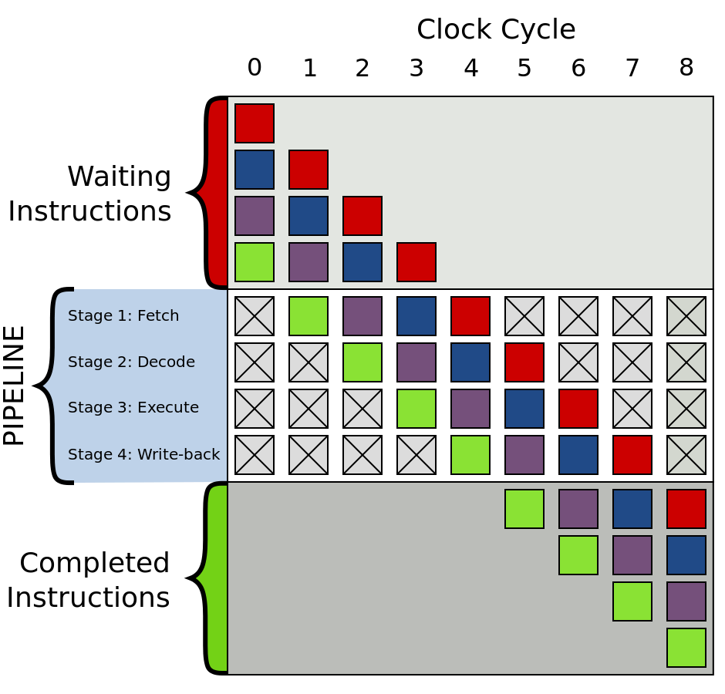
Instruction-level Parallelism
Pipelining / Superscalar Execution
Hardware translator turns a x86 instruction (like addl reg1, reg2) into the low level µops needed to perform this instruction
µops are then “pipelined” to be done in parallel
Problem?
Killed by conditional jumps
How can you know where you’ll jump next, i.e. which instruction will be done next?
Guess! Go with what usually happens, keep track, and don’t commit results if guessed incorrectly
Notes:
Example of conditional jump guessing:
Loop that executes 1 million times. It’s safe to guess it’ll loop around again.
The one instance it doesn’t loop around, we just don’t write the results of performing the loop’s instructions again.

Slide 73
Instruction-level Parallelism
Out of Order Execution

Slide 74
Instruction-level Parallelism
Out of Order Execution
In-Order Processor
Fetch the instruction
If inputs available, dispatch instruction to functional unit. If not, stall until available.
Instruction executed by functional unit
Functional unit writes results back to register file

Slide 75
Instruction-level Parallelism
Out of Order Execution
In-Order Processor
Fetch the instruction
If inputs available, dispatch instruction to functional unit. If not, stall until available.
Instruction executed by functional unit
Functional unit writes results back to register file
Out-of-Order Processor
Fetch the instruction
Dispatch instruction to instruction queue
Instruction waits in queue until inputs available. Allowed to leave queue before older instructions
When inputs available, instruction sent to functional unit and executed
Results queued
After older instructions have written their results, this instruction get to write its results

Slide 76
Instruction-level Parallelism
Out of Order Execution
Instruction Control Unit
Talks to Instruction Cache
Fetches instructions, gives to Execution Unit
Execution Unit
Is given µops to perform
Gives µops to hardware that can do it
Instruction either retired (commit its effect) or flushed (discarded)
Register renaming: using register other than named one to allow parallelism

Slide 77
Memory Hierarchy
The general principle behind caching is that for each level k, a smaller and faster device at k serves as a cache for a larger slower device at k+1.
For example, DRAM is a cache to the disk, and the L1 – L3 caches are caches to DRAM.
At the L1 cache, we often see a distinction between the L1 data and L1 instruction caches. The reasoning for this is twofold: first, as explored in ILP, we can fetch both the instruction and data in parallel. Secondly, it allows us to take advantage of ... locality!

Slide 78
Memory Hierarchy (cont.)
Cache blocks are generally stored in some format like: [set][valid][dirty][tag][-- data --]
The set and tag fields indicate the block of data being cached
We cache at a coarser granularity than single bytes
The distribution of bits to set and tag can heavily influence the likeliness that we're storing the right things in the cache. (Although, this goes down a discussion about associativity that isn't too important for this class!)
Notes:
A quick discussion about how caches are organized: how there are direct mapped caches (such that for each set, we have a single block of data) and fully associative caches (only one set). But it's honestly just a weird segway into a discussion about locality.

Slide 79
Memory Hierarchy (cont.)
Cache blocks are generally stored in some format like: [set][valid][dirty][tag][-- data --]
The set and tag fields indicate the block of data being cached
We cache at a coarser granularity than single bytes
The distribution of bits to set and tag can heavily influence the likeliness that we're storing the right things in the cache. (Although, this goes down a discussion about associativity that isn't too important for this class!)

Slide 80
Memory Hierarchy (cont.)
When we write programs, we want to take advantage of locality. This is usually expressed in two forms, spatial and temporal.
Spatial locality: accessing some data in some memory address probably means that you're going to be accessing data in nearby memory. Concretely, stride-1 reference patterns are good.
Temporal locality: you're probably going to be accessing data more than just once. So, repeated references to variables is great.

Slide 81
Thread Level Parallelism
What's the difference between a process and a thread? (This is a fairly common interview problem.)
Threads are more lightweight
Threads share a memory space, while process have their own memory spaces. That said, threads maintain their own registers.
We can use TLP to split a program, ideally an embarrassingly parallel program, into independent tasks.
Be careful about race conditions!

Slide 82
Synchronization
Semaphores allow us to enforce the number of threads that can enter a section of code. (They're essentially glorified counters!)
When the counter is nonzero, the door is open and the thread can pass.
When the counter is zero, the door is closed.
We rely on three primitives to control the value of the counter: sem_init, sem_wait, and sem_post.
Notes:
We can enforce protection for shared variables or critical sections with semaphores, which are basically locks that tell us how many threads can enter a section of code.
The semaphore is of type: sem_t and it is sort of a glorified counter or more conceptually, a door that allows/prevents entry into a section of code.
While the counter is non-zero, the door is open and thread can pass. When this happens, the counter decrements.
When the counter is zero, the door is closed. The thread must wait for the door to be open again (counter becomes non-zero) before it can pass.
sem_t sem;
P(&sem) – If sem is non-zero, return and decrement sem (the door is open, sem is allowed to pass). If sem is zero, wait until sem is non-zero, then decrement and return (the door is closed, wait for it to open).
V(&sem) – Increment sem by one. If sem was previously zero, the door was closed. Open the door and allow another thread in.
Say we have the following line of code:
<line of code>
...and we want to allow only two threads to be able to execute that line of code at any time.
sem_t sem = ... //initialize to 2 …
P(&sem);
<line of code>;
V(&sem);

Slide 83
Synchronization (cont.)
One way to look at the semaphore is to liken it to a doorman. The function that initializes the semaphore is the host, while the threads attempting to enter the critical section are the guests.
We begin with sem_init informing the the semaphore how many guests should be allowed;
The guests subsequently sem_wait until there is available capacity, which allows them to check in and enter the critical section; and
The guests check out using sem_post.

Slide 84
Synchronization (cont.)
The primitives are declared as follows:
int sem_init(sem_t *s, int pshared, unsigned int value);
int sem_wait(sem_t *s); // Waits until s > 0. When this happens, s
// is decremented and 0 is returned.
int sem_post(sem_t *s); // Increments s by one.

Slide 85
Q1
What are the purposes of having denormalized numbers?

Slide 86
Q1
What are the purposes of having denormalized numbers?
Represent even smaller numbers

Slide 87
Q1
Consider floating point with 4 fractional bits and 3 exponent bits (bias = 3)

Slide 88
Q1
Consider floating point with 4 fractional bits and 3 exponent bits (bias = 3)
Without denormalized numbers, smallest nonzero number:
0 001 0000 = V1 = 2¹⁻³ = 2⁻²
next smallest number:
0 001 0001 = V2 = 2⁻² + 2⁻⁶

Slide 89
Q1
Consider floating point with 4 fractional bits and 3 exponent bits (bias = 3)
Without denormalized numbers, smallest nonzero number:
0 001 0000 = V1 = 2¹⁻³ = 2⁻²
next smallest number:
0 001 0001 = V2 = 2⁻² + 2⁻⁶
Clearly V1 != V2, but if we did V2 - V1, we get 2⁻⁶ which is too small to represent and would get rounded down, meaning V2 - V1 = 0, but V2 != V1.

Slide 90
Q2
What’s the point of having a varying range between numbers?

Slide 91
Q2
As numbers increase, significance of smaller values decrease
Value of 1 relative to 10 is quite significant
Value of 1 relative to 10⁹ is insignificant

Slide 92
Q2
As numbers increase, significance of smaller values decrease
Value of 1 relative to 10 is quite significant
Value of 1 relative to 10⁹ is insignificant
Floating point allows representation of very large numbers by losing precision
Accomplished by each bit contributing a value that increases along with the exponent of the number

Slide 93
Q3
Under what circumstances will a compiler perform optimization?

Slide 94
Q3
Under what circumstances will a compiler perform optimization?
Only when the compiler is sure the behavior would be the same as the un-optimized case.

Slide 95
Q3
Under what circumstances will a compiler perform optimization?
Only when the compiler is sure the behavior would be the same as the un-optimized case.
Is this
*xp += *yp;
*xp += *yp;
the same as this?
*xp += 2 * (*yp);

Slide 96
Q3
Under what circumstances will a compiler perform optimization?
Only when the compiler is sure the behavior would be the same as the un-optimized case.
Is this
*xp += *yp; Not if xp == yp
*xp += *yp; Then the result is *xp += 3 * (*xp)
the same as this?
*xp += 2 * (*yp);

Slide 97
Q4
How can you tell if an optimization is useful in the long run?

Slide 98
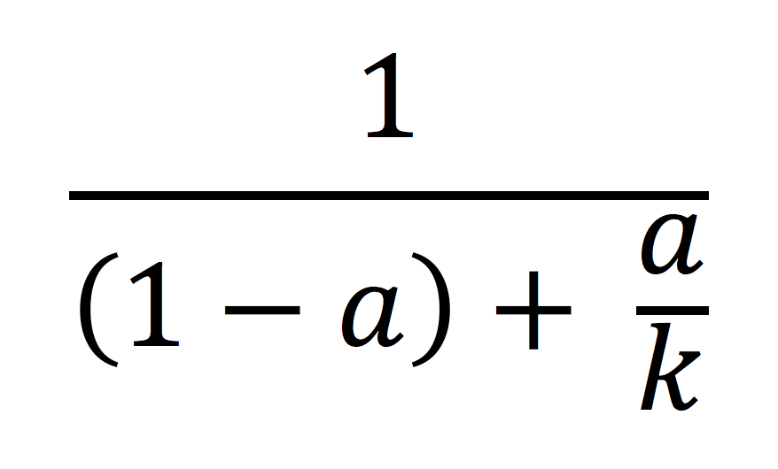
Q4
How can you tell if an optimization is useful in the long run?
Use Amdahl’s Law!
a = what fraction of your program is the hog
k = hog speedup factor
Speedup =

Slide 99
Q4
How can you tell if an optimization is useful in the long run?
Example:
Speedup half of your program (a = 0.5) to be twice as fast (k = 2)
Total speedup is only 1.33!

Slide 100
Q5
Suppose you want a thread T1 to wait until thread T2 finishes, and that T2 is detached. Explain how to arrange for this reliably, assuming the threads cooperate by executing code that you specify. Your code may invoke any of the pthread_* or sem_* primitives discussed in the book or in class. Explain any assumptions you make and any race conditions that you couldn't fix.

Slide 101
Q5
Suppose you want a thread T1 to wait until thread T2 finishes, and that T2 is detached. Explain how to arrange for this reliably, assuming the threads cooperate by executing code that you specify. Your code may invoke any of the pthread_* or sem_* primitives discussed in the book or in class. Explain any assumptions you make and any race conditions that you couldn't fix.
Can't we just use pthread_join? No, because T2 is detached! Instead, we need rely on semaphores (or more specifically, mutexes) to solve this problem. More specifically, we need to implement pthread_join using semaphores.
Notes:
Does anyone need help with how pthread_join works? On the board, we can do something on the three primitives, pthread_create, pthread_join, pthread_exit.

Slide 102
Q5
Here's an idea: what if we enforce an order on the execution of critical sections?
void t1 {
sem_wait(&mutex);
// Do work here ...
sem_post(&mutex);
}
Notes:
Suppose we have this t1. What will t2 look like?

Slide 103
Q5
Here's an idea: what if we enforce an order on the execution of critical sections?
void t2 {
// Do work here ...
sem_post(&mutex);
}
Notes:
And what should the mutex be initialized to?

Slide 104
Q5
sem_t mutex;
sem_init(&mutex,
0 /* pshared */,
0 /* value */);
void t1 {
sem_wait(&mutex);
// Do work here ...
sem_post(&mutex);
}
void t2 {
// Do work here ...
sem_post(&mutex);
}
In this solution, we take initialize mutex to zero such that t1's critical section is only "unlocked" after t2 completes its work. The race condition that we potentially encounter is that t1 can begin doing its work before t2 entirely terminates.

Slide 105
Q6
Discuss the tradeoffs between write-through and write-back write hit policies.

Slide 106
Q6
Under the write-through policy, for each write hit, write to the cache and also to the backing memory.
Memory and cached are always synchronized and consistent
However, we incur the penalty of writing to memory each time we write to cache, which negates the benefit of the cache for writes.

Slide 107
Q6
Under the write-back policy, for each write hit, write only to the cache but mark the cache block as dirty. We write back to memory upon eviction.
We benefit immensely from temporally localized programs!
Although we're guaranteed that we perform less or equally many writes as with the write-through policy, we run into the issue of unpredictability in our writes. For example, if we're developing a program for a nuclear plant, we might want to be sure of how long a write will take.
In the case that we have a program that performs many random reads, we may perform just as many writes but occupy extra space for the dirty bit.
Notes:
Follow-up question: suppose we wanted to implement write-back without a dirty bit. How might we be able to do this?

