Slide 1
Introduction to
Functional Dependencies (FDs) and Normal Form Schema Design
Cs143 Notes by Carlo Zaniolo

Slide 2
Functional Dependencies (FDs)
Given a relation R(W) where W is the attribute set and X and Y are subset of W, we say that
X -> Y (i.e., X functionally determines Y, or X functionally depend on Y), when
For any pair of tuples u1, u2 in R,
if u1[X] = u2[X], then u1[Y] = u2[Y]
I.e.: No two tuples in R can have the same X values but different Y values.

Slide 3
FDs and Keys
If X->W holds for R(W) then X is a superkey
X is a superkey for R iff for every attribute A of R, we have X->A.
A key X is a minimal superkey (i.e., no subset of X is a superkey)

Slide 4
FDs’ Properties
Reflexivity: If Y is a nonempty subset of X then X -> Y.
Augmentation: if X -> Y and X is a subset of Z, then Z->Y
Transitivity: X -> Y and Y->Z then X->Z
This is a sound and complete set of inference rules.
  Every other sound properties can be derived from these.
E.g. Additivity, Pseudotransitivity,
What is a sound (i.e. valid) property: one for which there is no counterexample is possible.

Slide 5
Transitive Closure
Transitive closure of a set of FDs G denoted G⁺: consists of the FDs in G plus those can be constructed with the previous rules
(Transitive) Closure of Attributes set X, denoted X⁺:
Start with X⁺ = X and repeat until no change in X⁺ If there is Y -> Z and Y is a subset of X⁺, add all attribute in Z to X⁺
Cover of G: any subset of G that has the same transitive cover as G
Computation of minimal cover for G. By successive elimination of redundant FDs. Result might not be unique.

Slide 6
Lossless Decomposition
Take a relation R(W) where W= X U Y U Z and replace it with:
R₁= π _{X U Y} R(W) and R₂= π _{X U Z} R(W)
Theorem: If X-> Y or X->Z then R(W) can be reconstructed as the natural join of these two projections.
By repeating this step (i.e., decomposing using FDs) we generate a set of relations whose natural join return the original table: a lossless decomposition (w.r.t content) … but constraints should be preserved too.

Slide 7
FDs After Projection
Take a relation R(W) where X-> Y. This FD also holds in R₁= π _{X U Y} R(W) and in every projection that contains both the attributes in X and Y.
X -> Y does not hold in R₂= π _{X U Z} R(W)
When we decompose into the a set of relations we will lose a few FDs: but we should be able to infer the lost ones by the formal properties of FDs. EG.
R(A, B, C) Has the following FDs. A->B, A->C, B->C
If we use the first FD to decompose into R(A,B), R(A, C) the third FD is lost. But
If we use the last FD to decompose into R(A,B), R(B, C) the third FD is loss. A->C is lost but A->B, B->C are kept: and A-> C is inferred from these two by transitivity.

Slide 8
Decomposition into BCNF
Given a relation R, we find its FDs
From these we find the keys,
And then we ask the question: is R BCNF?
If the answer is yes, we smile.
If the answer is no: we decompose the original relation into a set of BCNF tables
The decomposition algorithm is based on the notion of cover, which is based on the formal properties of FDs.

Slide 9
FD-Preserving Decomposition
But while lossless join preserves the information (as needed for queries) it does not preserve the FD constraints (needed to restrict updates)
Example: wrksin( E# , Dep, DLoc) with
(1) E#->Dep, (2) Dep->DLoc, (3) E#->Dloc
(2) Violates BCNF—decompose. Keys show some FDs:
w1( E# , Dep) w2(E# , DLoc) this is BCNF but (2) is lost
w1( E# , Dep) w3(Dep , DLoc) this is BCNF and (2) is not lost since (1) and (2) are preserved, so (3) is implied by transitivity

Slide 10
Decomposition Algorithm into BCNF
Starting with a given set of FDs G.
Step1. Put G into canonical form G’. i.e. G’ only contains FDs X->A where no X’->A holds for some proper subset X’ of X.
Step2. For every X->A in G’ compute X⁺ (to check that X is a key)
If X is not a key then decompose the relation using
X -> X⁺- X.
List the FDs in the projection and repeat this process until all relations are BCNF.
⁽Underscore the keys of the relations so produced)

Slide 11
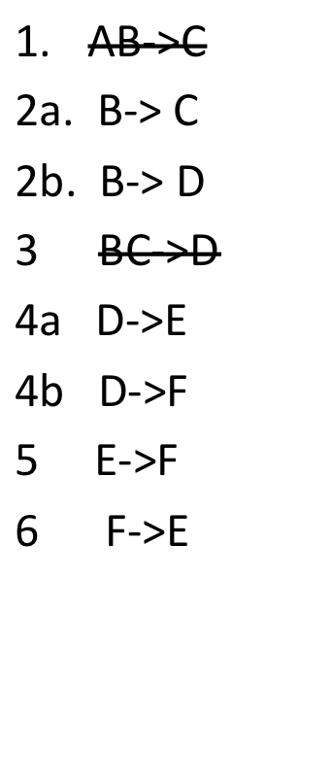
Example: R(A, B, C, D, E, F)
AB->C
B->C D
BC-> D
D->E F
E->F
F->E
AB->C
2a. B-> C
2b. B-> D
BC->D
4a D->E
4b D->F
5 E->F
6 F->E
Step1. Put G into canonical form G’. i.e. G’ only contains FDs X->A where no X’->A holds for some proper subset X’ of X.

Slide 12
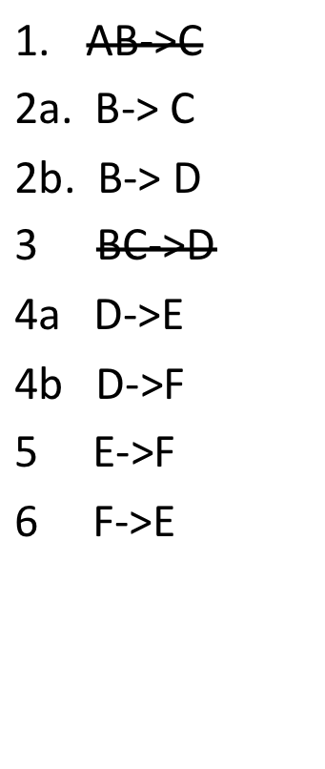
R(A, B, C, D, E, F) :Build BCNF Schema. Step 2
Starting with 2a:
Is B a key?
B+={B, C, D, E, F} …A missing
R1(B, C, D, E, F) R2(B,A)
R1(B, C, D, E, F) BCNF?
R2(B,A) BCNF?
Step2. For every X->A in G’ compute X⁺ (to check that X is a key)
If X is not a key then decompose the relation using X -> X⁺- X.

Slide 13
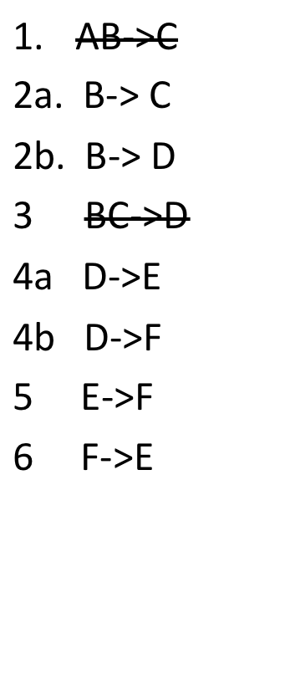
R(A, B, C, D, E, F) :Build BCNF Schema. Step 2
Starting with 2a:
Is B a key?
B+={B, C, D, E, F} …A missing
R1(B, C, D, E, F) R2(B,A) BCNF
R1(B, C, D, E, F) BCNF? Take 4a
D+={D, F, E), B, C are missing: decompose
R3(D, E, F) and R4(D, B, C) R4 Is BCNF
Take 5: E+={E, F}, D is missing decompose
R5(E, F), R6(D, F)
=
Our final BCNF consists of: R2, R4, R5, R6

Slide 14
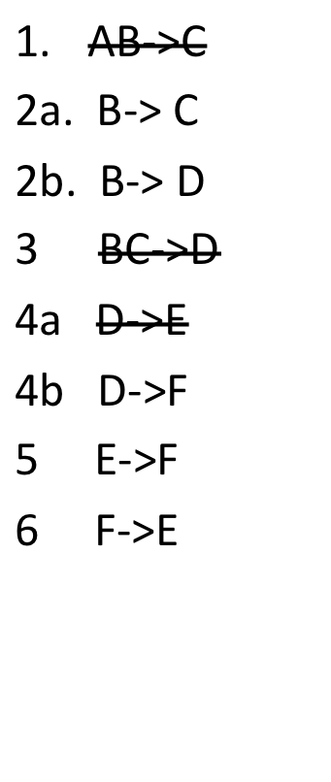
R(A, B, C, D, E, F) :Build BCNF Schema. Step 3
List the FDs in the projection and repeat this process until all relations are BCNF.
⁽Underscore the keys of the relations so produced)
R2(B,A), R4(D, B, C) R5(E, F), R6(D, F))
=
Are all the FDs preserved—i.e. derivable from those that in the decomposition are implied by the keys?
Answer: 2a, 2b by R4. 5,6 by R5, 4b by R6.
4a is missing but it is implied by 4a and 6

Slide 15
Schema Directly from ER Diagrams
One relation for each entity
One relation for each relationship connecting the keys of the entities at the end of diamonds
Combine the above if they have the same keys
Special cases for
  Weak entities and
  Inheritance.

Slide 16
Third Normal form: 3NF
Lossless join property is achieved always,
FD preservation is achieved in all cases but the rare case of Key Breaking dependencies
E.g. R(A, B, C) where AB->C and C->A. Two keys: AB and BC. C->A violates BCNF and the decomposition yields the decomposition into R(C, A) and R(C, B) where the constraint AB->C is lost.
So a dependency preserving decomposition into BCNF is not always feasible. To assure universal feasibility one needs to use Third Normal Form (3NF).
Definition: R is 3NF with respect to G: iff for every non-trivial X -> A, either
(i) X is a key or a superset of it, or
(ii) A is an attribute of some key (which will be broken if we decompose since A will go into one projection and the remaining key attributes into the other)

Slide 17
Schema Directly from ER Diagrams
One relation for each entity
One relation for each relationship connecting the keys of the entities at the end of diamonds
Combine the above if they have the same keys
Special cases for
  Weak entities and
  Inheritance.

Slide 18
BOYCE-CODD NORMAL FORM (BCNF)
Let a relation R be given and let G be the set of its FDs
Question: is this a good schema—no update anomalies?
According to Boyce and Codd: yes iff it is BCNF:
R is BCNF with respect to G:
iff for every non-trivial X -> Y, X is a key or a superkey
(X->Y trivial means that Y is a subset of X)

Slide 19
Update Anomalies
Due to Functional Dependencies
Actually with certain FD structures
Normal forms give simple rules that avoid these bad structures
Decomposition: a process whereby a relation is replaced by its projections eventually generating NF relations
The process is also driven by the FDs.

