Slide 1
UCLA ENG 111
Week 1 – Lecture Notes
McGraw-Hill/Irwin
Copyright © 2010 by the McGraw-Hill Companies, Inc. All rights reserved.

Slide 2
Key Concepts and Skills
Know the basic types of financial management decisions and the role of the Financial Manager
Know the financial implications of the various forms of business organization
Know the goal of financial management
Understand the conflicts of interest that can arise between owners and managers

Slide 3
Balance Sheet Model of the Firm
  Total Value of Assets:
  Total Firm Value to Investors:
Current Assets
Current Liabilities
Long-Term Debt
Fixed Assets
1 Tangible
2 Intangible
Shareholders’ Equity
Notes:
It is sometimes helpful to relate corporate decisions to individual circumstances. For example, consider discussing how individuals choose to buy cars or homes and how this decision would affect a personal balance sheet.

Slide 4
The Capital Budgeting Decision
Current Assets
Current Liabilities
Long-Term Debt
Fixed Assets
1 Tangible
2 Intangible
  What long-term investments should the firm choose?
Shareholders’ Equity

Slide 5
The Capital Structure Decision
Current Assets
Current Liabilities
Long-Term Debt
How should the firm raise funds for the selected investments?
Fixed Assets
1 Tangible
2 Intangible
Shareholders’ Equity

Slide 6
Short-Term Asset Management
Current Assets
Current Liabilities
Net Working Capital
Long-Term Debt
  How should short-term assets be managed and financed?
Fixed Assets
1 Tangible
2 Intangible
Shareholders’ Equity

Slide 7
1.1 What Is Corporate Finance?
Finance addresses the following three questions:
  What long-term investments should the firm choose? – CAPITAL BUDGETING
  How should the firm raise funds for the selected investments? – CAPITAL STRUCTURE
  How should short-term assets be managed and financed? – NET WORKING CAPITAL

Slide 8
Hypothetical Organization Chart
Board of Directors
Chairman of the Board and
Chief Executive Officer (CEO)
President and Chief
Operating Officer (COO)
Vice President and
Chief Financial Officer (CFO)
Treasurer
Controller
Cash Manager
Credit Manager
Tax Manager
Cost Accounting
Capital Expenditures
Financial Planning
Financial Accounting
Data Processing
Notes:
Controllers look INWARD, prepare financial statements, make predictions for the future.
Treasurers look OUTWARD of the company, try to get funds, create investor relations, issue stocks, bonds etc.
CEO – head of management
COO - head of day to day operations
CFO – Head of finances

Slide 9
1.2 The Corporate Firm
The corporate form of business is the standard method for solving the problems encountered in raising large amounts of cash.
However, businesses can take other forms.

Slide 10
Forms of Business Organization
The Sole Proprietorship
The Partnership
  General Partnership
  Limited Partnership
The Corporation
  Private
  Public
  Companies with more than $10 million in assets whose securities are held by more than 500 owners must file annual and other periodic reports. These reports are available to the public through the SEC's EDGAR database.
  More info: http://www.sec.gov/about/laws.shtml
Notes:
It may be beneficial to discuss S-Corporations and LLCs in the context of this slide.

Slide 11
A Comparison
Corporation
Partnership
Liquidity
Shares can be easily exchanged
Subject to substantial restrictions
Voting Rights
Usually each share gets one vote
General Partner is in charge; limited partners may have some voting rights
Taxation
Double
Partners pay taxes on distributions
Reinvestment and dividend payout
Broad latitude
All net cash flow is distributed to partners
Liability
Limited liability
General partners may have unlimited liability; limited partners enjoy limited liability
Continuity
Perpetual life
Limited life

Slide 12
Pros and cons of going public
PROS
Obtain money that does not have to be repaid
Increased visibility
Market valuation
CONS
Going public is costly
Management loses some of its freedom to act without board approval
Open to scrutiny
Public reporting
Company maybe taken over
Notes:
It may be beneficial to discuss S-Corporations and LLCs in the context of this slide.

Slide 13
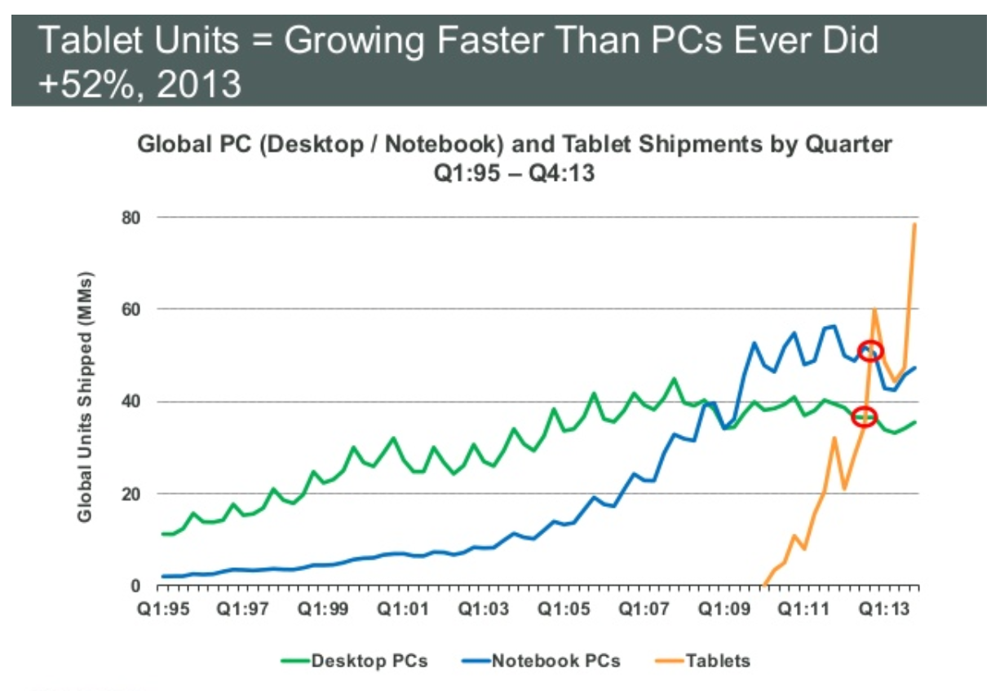
DELL

Slide 14
1.3 The Importance of Cash Flow
Firm issues securities (A)
Firm
Financial
markets
Invests
in assets
(B)
Retained
cash flows (F)
Cash flow
from firm (C)
Dividends and
debt payments (E)
Short-term debt
Long-term debt
Equity shares
Current assets
Fixed assets
Taxes (D)
The cash flows from the firm must exceed the cash flows from the financial markets.
Ultimately, the firm must be a cash generating activity.
Government
Notes:
It is important to remind students that net income is NOT cash flow.

Slide 15
The Financial Manager
The Financial Manager’s primary goal is to increase the value of the firm by:
Selecting value creating projects
Making smart financing decisions
Notes:
Note, these actions explicitly relate to the three questions addressed in slide 3.

Slide 16
1.4 The Goal of Financial Management
What is the correct goal?
  Maximize profit?
  Minimize costs?
  Maximize market share?
  Maximize shareholder wealth?

Slide 17
1.5 The Agency Problem
Agency relationship
  Principal hires an agent to represent his/her interest
  Stockholders (principals) hire managers (agents) to run the company
Agency problem
  Conflict of interest between principal and agent
Notes:
A common example of an agency relationship is a real estate broker – in particular if you break it down between a buyers agent and a sellers agent. A classic conflict of interest is when the agent is paid on commission, so they may be less willing to let the buyer know that a lower price might be accepted or they may elect to only show the buyer homes that are listed at the high end of the buyer’s price range.
Direct agency costs – the purchase of something for management that can’t be justified from a risk-return standpoint, monitoring costs.
Indirect agency costs – management’s tendency to forgo risky or expensive projects that could be justified from a risk-return standpoint.

Slide 18
Managing Managers
Managerial compensation
  Incentives can be used to align management and stockholder interests
  The incentives need to be structured carefully to make sure that they achieve their intended goal
Corporate control
  The threat of a takeover may result in better management
Notes:
Incentives – discuss how incentives must be carefully structured. For example, tying bonuses to profits might encourage management to pursue short-run profits and forego projects that require a large initial outlay. Stock options may work, but there may be an optimal level of insider ownership. Beyond that level, management may be in too much control and may not act in the best interest of all stockholders. The type of stock can also affect the effectiveness of the incentive.
Corporate control – ask the students why the threat of a takeover might make managers work towards the goals of stockholders.
Other groups also have a financial stake in the firm. They can provide a valuable monitoring tool, but they can also try to force the firm to do things that are not in the owners’ best interest.

Slide 19
Managerial Goals
Managerial goals may be different from shareholder goals
  Expensive perquisites
  Survival
  Independence
Increased growth and size are not necessarily equivalent to increased shareholder wealth

Slide 20
2.1 The Balance Sheet
An accountant’s snapshot of the firm’s accounting value at a specific point in time
The Balance Sheet Identity is:
Assets ≡ Liabilities + Stockholder’s Equity
Notes:
Note that Slides 4 through 7 from Chapter 1 could be reused here to emphasize the general structure of the balance sheet.
The left-hand side of the balance sheet lists the assets of the firm. Current assets are listed first because they are the most liquid. Fixed assets can include both tangible and intangible assets, and they are listed at the bottom because they generally are not very liquid. These are a direct result of management’s investment decisions. (Please emphasize that “investment decisions” are not limited to investments in financial assets.)
Note that the balance sheet does not list some very valuable assets, such as the people who work for the firm.
The liabilities and equity (or ownership) components of the firm are listed on the right-hand side. This indicates how the assets are paid for. Since the balance sheet has to balance, total equity = total assets – total liabilities. The portion of equity that can most easily fluctuate to create this balance is retained earnings. The right-hand side of the balance sheet is a direct result of management’s financing decisions.
Remember that shareholders’ equity consists of several components, and that total equity includes all of these components not just the “common stock” item. In particular, remind students that retained earnings belong to the shareholders.

Slide 21
U.S. Composite Corporation Balance Sheet
The assets are listed in order by the length of time it would normally take a firm with ongoing operations to convert them into cash.
According to GAAP, all assets should be recorded at cost and matching principle should be followed.
Balance Sheet includes only those assets that were subject to a transaction.
2010
2009
2010
2009
Current assets:
Current Liabilities:
Cash and equivalents
$140
$107
Accounts payable
$213
$197
Accounts receivable
294
270
Notes payable
50
53
Inventories
269
280
Accrued expenses
223
205
Other
58
50
Total current liabilities
$486
$455
Total current assets
$761
$707
Long-term liabilities:
Fixed assets:
Deferred taxes
$117
$104
Property, plant, and equipment
$1,423
$1,274
Long-term debt
471
458
Less accumulated depreciation
(550)
(460)
Total long-term liabilities
$588
$562
Net property, plant, and equipment
873
814
Intangible assets and other
245
221
Stockholder's equity:
Total fixed assets
$1,118
$1,035
Preferred stock
$39
$39
Common stock ($1 par value)
55
32
Capital surplus
347
327
Accumulated retained earnings
390
347
Less treasury stock
(26)
(20)
Total equity
$805
$725
Total assets
$1,879
$1,742
Total liabilities and stockholder's equity
$1,879
$1,742

Slide 22
U.S.C.C. Income Statement
The operations section of the income statement reports the firm’s revenues and expenses from principal operations.
Total operating revenues
$2,262
Cost of goods sold
1,655
Selling, general, and administrative expenses
327
Depreciation
90
Operating income
$190
Other income
29
Earnings before interest and taxes
$219
Interest expense
49
Pretax income
$170
Taxes
84
Current: $71
Deferred: $13
Net income
$86
Addition to retained earnings $43
Dividends: $43

Slide 23
Quick Quiz
What are the three basic questions Financial Managers must answer?
What are the three major forms of business organization?
What is the goal of financial management?
What are agency problems, and why do they exist within a corporation?

