Slide 1
ENG 111
Week 2 Online Lecture Notes
McGraw-Hill/Irwin
Copyright © 2010 by the McGraw-Hill Companies, Inc. All rights reserved.

Slide 2
2.1 The Balance Sheet
An accountant’s snapshot of the firm’s accounting value at a specific point in time
The Balance Sheet Identity is:
Assets ≡ Liabilities + Stockholder’s Equity
Notes:
Note that Slides 4 through 7 from Chapter 1 could be reused here to emphasize the general structure of the balance sheet.
The left-hand side of the balance sheet lists the assets of the firm. Current assets are listed first because they are the most liquid. Fixed assets can include both tangible and intangible assets, and they are listed at the bottom because they generally are not very liquid. These are a direct result of management’s investment decisions. (Please emphasize that “investment decisions” are not limited to investments in financial assets.)
Note that the balance sheet does not list some very valuable assets, such as the people who work for the firm.
The liabilities and equity (or ownership) components of the firm are listed on the right-hand side. This indicates how the assets are paid for. Since the balance sheet has to balance, total equity = total assets – total liabilities. The portion of equity that can most easily fluctuate to create this balance is retained earnings. The right-hand side of the balance sheet is a direct result of management’s financing decisions.
Remember that shareholders’ equity consists of several components, and that total equity includes all of these components not just the “common stock” item. In particular, remind students that retained earnings belong to the shareholders.

Slide 3
U.S. Composite Corporation Balance Sheet
The assets are listed in order by the length of time it would normally take a firm with ongoing operations to convert them into cash.
Clearly, cash is much more liquid than property, plant, and equipment.
2010
2009
2010
2009
Current assets:
Current Liabilities:
Cash and equivalents
$140
$107
Accounts payable
$213
$197
Accounts receivable
294
270
Notes payable
50
53
Inventories
269
280
Accrued expenses
223
205
Other
58
50
Total current liabilities
$486
$455
Total current assets
$761
$707
Long-term liabilities:
Fixed assets:
Deferred taxes
$117
$104
Property, plant, and equipment
$1,423
$1,274
Long-term debt
471
458
Less accumulated depreciation
(550)
(460)
Total long-term liabilities
$588
$562
Net property, plant, and equipment
873
814
Intangible assets and other
245
221
Stockholder's equity:
Total fixed assets
$1,118
$1,035
Preferred stock
$39
$39
Common stock ($1 par value)
55
32
Capital surplus
347
327
Accumulated retained earnings
390
347
Less treasury stock
(26)
(20)
Total equity
$805
$725
Total assets
$1,879
$1,742
Total liabilities and stockholder's equity
$1,879
$1,742

Slide 4
2.2 The Income Statement
Measures financial performance over a specific period of time
The accounting definition of income is:
Revenue – Expenses ≡ Income

Slide 5
U.S.C.C. Income Statement
The operations section of the income statement reports the firm’s revenues and expenses from principal operations.
Total operating revenues
$2,262
Cost of goods sold
1,655
Selling, general, and administrative expenses
327
Depreciation
90
Operating income
$190
Other income
29
Earnings before interest and taxes
$219
Interest expense
49
Pretax income
$170
Taxes
84
Current: $71
Deferred: $13
Net income
$86
Addition to retained earnings $43
Dividends: $43

Slide 6
U.S.C.C. Income Statement
The non-operating section of the income statement includes all financing costs, such as interest expense.
Total operating revenues
$2,262
Cost of goods sold
1,655
Selling, general, and administrative expenses
327
Depreciation
90
Operating income
$190
Other income
29
Earnings before interest and taxes
$219
Interest expense
49
Pretax income
$170
Taxes
84
Current: $71
Deferred: $13
Net income
$86
Addition to retained earnings: $43
Dividends: $43

Slide 7
U.S.C.C. Income Statement
Total operating revenues
$2,262
Cost of goods sold
1,655
Selling, general, and administrative expenses
327
Depreciation
90
Operating income
$190
Other income
29
Usually a separate section reports the amount of taxes levied on income.
Earnings before interest and taxes
$219
Interest expense
49
Pretax income
$170
Taxes
84
Current: $71
Deferred: $13
Net income
$86
Addition to retained earnings: $43
Dividends: $43

Slide 8
U.S.C.C. Income Statement
Total operating revenues
$2,262
Cost of goods sold
1,655
Selling, general, and administrative expenses
327
Depreciation
90
Operating income
$190
Other income
29
Earnings before interest and taxes
$219
Net income is the “bottom line.”
Interest expense
49
Pretax income
$170
Taxes
84
Current: $71
Deferred: $13
Net income
$86
Retained earnings: $43
Dividends: $43

Slide 9
Income Statement Analysis
There are three things to keep in mind when analyzing an income statement:
  Generally Accepted Accounting Principles (GAAP)
  Non-Cash Items
  Time and Costs

Slide 10
GAAP
The matching principle of GAAP dictates that revenues be matched with expenses.
Thus, income is reported when it is earned, even though no cash flow may have occurred.

Slide 11
Non-Cash Items
Depreciation is the most apparent. No firm ever writes a check for “depreciation.”
Another non-cash item is deferred taxes, which does not represent a cash flow.
Thus, net income is not cash.

Slide 12
Time and Costs
In the short-run, certain equipment, resources, and commitments of the firm are fixed, but the firm can vary such inputs as labor and raw materials.
In the long-run, all inputs of production (and hence costs) are variable.
Financial accountants do not distinguish between variable costs and fixed costs. Instead, accounting costs usually fit into a classification that distinguishes product costs from period costs.

Slide 13

2.3 Taxes
The one thing we can rely on with taxes is that they are always changing
Marginal vs. average tax rates
  Marginal – the percentage paid on the next dollar earned
  Average – the tax bill / taxable income
Other taxes
Notes:
Point out that taxes can be a very important component of the decision making process, but that what they learn about tax specifics now could change tomorrow. Consequently, it is important to keep up with the changing tax laws and to utilize specialists in the tax area when making decisions where taxes are involved.
www: Click on the web surfer icon to go to the IRS web site for the most up-to-date tax information.
It is important to point out that we are concerned with the taxes that we will pay if a decision is made. Consequently, the marginal tax rate is what we should use in our analysis.
Point out that the tax rates discussed in the book are just federal taxes. Many states and cities have income taxes as well, and those taxes should figure into any analysis that we conduct.

Slide 14
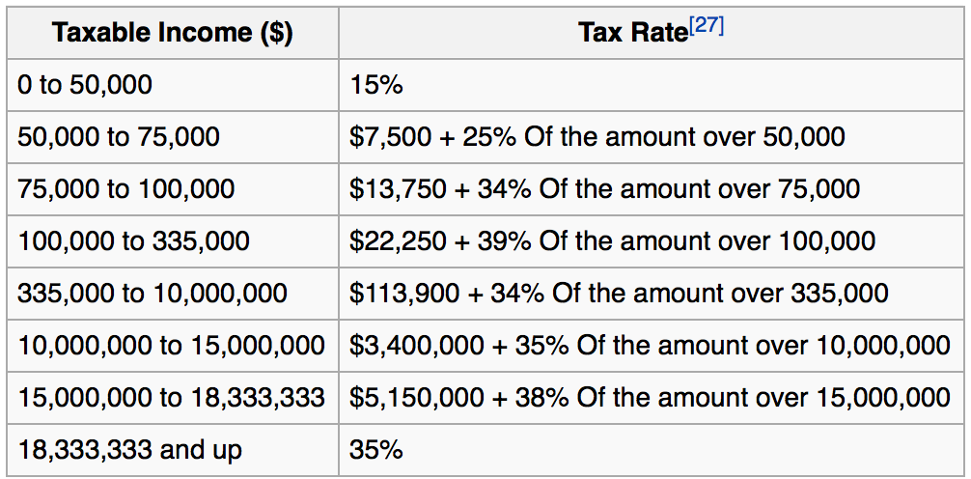
US Corporate Tax Rates

Slide 15
Marginal versus Average Rates
Suppose your firm earns $300,000 in taxable income.
  What is the firm’s tax liability?
  What is the average tax rate?
  What is the marginal tax rate?
If you are considering a project that will increase the firm’s taxable income by $1 million, what tax rate should you use in your analysis?
Notes:
Tax liability:
.15(50,000) + .25(75,000 – 50,000) + .34(100,000 – 75,000) + .39(300,000 – 100,000) = $100,250
Average rate: 100,250/ 300,000 = ..3341
Marginal rate comes from the table, and it is 34%
We should use the marginal rate with an expected additional $340,000 in taxes.

Slide 16
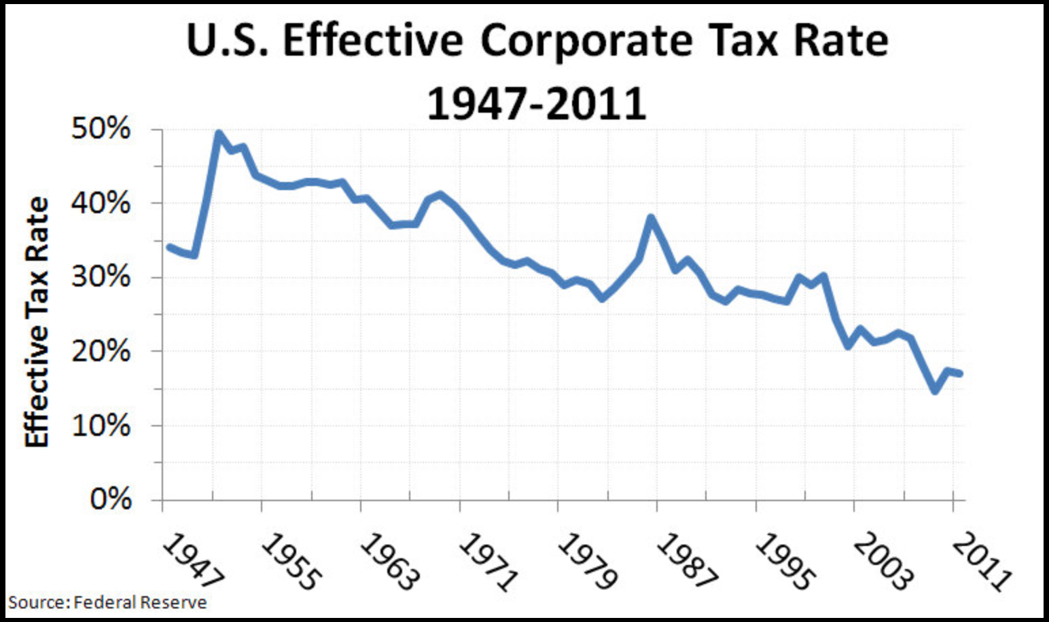
US effective rate is much lower than nominal tax rate.
Global companies have greater access to tax shelters.

Slide 17
2.4 Net Working Capital
Net Working Capital ≡
Current Assets – Current Liabilities
NWC usually grows with the firm

Slide 18
U.S.C.C. Balance Sheet
$252m = $707- $455
2010
2009
2010
2009
Current assets:
Current Liabilities:
Cash and equivalents
$140
$107
Accounts payable
$213
$197
Accounts receivable
294
270
Notes payable
50
53
Inventories
269
280
Accrued expenses
223
205
Other
58
50
Total current liabilities
$486
$455
Total current assets
$761
$707
Long-term liabilities:
Here we see NWC grow to $275 million in 2010 from $252 million in 2009.
Fixed assets:
Deferred taxes
$117
$104
Property, plant, and equipment
$1,423
$1,274
Long-term debt
471
458
Less accumulated depreciation
(550)
(460
Total long-term liabilities
$588
$562
Net property, plant, and equipment
873
814
Intangible assets and other
245
221
Stockholder's equity:
Total fixed assets
$1,118
$1,035
$23 million
Preferred stock
$39
$39
Common stock ($1 par value)
55
32
$275m = $761m- $486m
Capital surplus
347
327
This increase of $23 million is an investment of the firm.
Accumulated retained earnings
390
347
Less treasury stock
(26)
(20)
Total equity
$805
$725
Total assets
$1,879
$1,742
Total liabilities and stockholder's equity
$1,879
$1,742

Slide 19
2.5 Financial Cash Flow
In finance, the most important item that can be extracted from financial statements is the actual cash flow of the firm.
Since there is no magic in finance, it must be the case that the cash flow received from the firm’s assets must equal the cash flows to the firm’s creditors and stockholders.
CF(A)≡ CF(B) + CF(S)
Notes:
Remind students that this relation is just an application of the standard balance sheet identity.

Slide 20
U.S.C.C. Financial Cash Flow
Cash Flow of the Firm
Operating Cash Flow:
EBIT $219
Depreciation $90
Current Taxes -$71
OCF $238
Operating cash flow
$238
(Earnings before interest and taxes
plus depreciation minus taxes)
Capital spending
-173
(Acquisitions of fixed assets
minus sales of fixed assets)
Additions to net working capital
-23
Total
$42
Cash Flow of Investors in the Firm
Debt
$36
(Interest plus retirement of debt
minus long-term debt financing)
Equity
6
(Dividends plus repurchase of
equity minus new equity financing)
Total
$42

Slide 21
U.S.C.C. Financial Cash Flow
Cash Flow of the Firm
Operating cash flow
$238
(Earnings before interest and taxes
Capital Spending
Purchase of fixed assets $198
Sales of fixed assets -$25
Capital Spending $173
plus depreciation minus taxes)
Capital spending
-173
(Acquisitions of fixed assets
minus sales of fixed assets)
Additions to net working capital
-23
Total
$42
Cash Flow of Investors in the Firm
Debt
$36
(Interest plus retirement of debt
minus long-term debt financing)
Equity
6
(Dividends plus repurchase of
equity minus new equity financing)
Total
$42
Notes:
Note that capital spending can also be calculated as:
End NFA – Beg NFA + Depr
= $1,118 - $1,035 + $90 = $173

Slide 22
U.S.C.C. Financial Cash Flow
Cash Flow of the Firm
Operating cash flow
$238
(Earnings before interest and taxes
NWC grew from $275 million in 2010 from $252 million in 2009.
This increase of $23 million is the addition to NWC.
plus depreciation minus taxes)
Capital spending
-173
(Acquisitions of fixed assets
minus sales of fixed assets)
Additions to net working capital
-23
Total
$42
Cash Flow of Investors in the Firm
Debt
$36
(Interest plus retirement of debt
minus long-term debt financing)
Equity
6
(Dividends plus repurchase of
equity minus new equity financing)
Total
$42

Slide 23
U.S.C.C. Financial Cash Flow
Cash Flow of the Firm
Operating cash flow
$238
(Earnings before interest and taxes
plus depreciation minus taxes)
Capital spending
-173
(Acquisitions of fixed assets
minus sales of fixed assets)
Additions to net working capital
-23
Total
$42
Cash Flow of Investors in the Firm
Debt
$36
(Interest plus retirement of debt
minus long-term debt financing)
Equity
6
(Dividends plus repurchase of
equity minus new equity financing)
Total
$42

Slide 24
U.S.C.C. Financial Cash Flow
Cash Flow of the Firm
Operating cash flow
$238
(Earnings before interest and taxes
Cash Flow to Creditors
Interest $49
Retirement of debt 73
Debt service 122
Proceeds from new debt sales -86
Total $36
plus depreciation minus taxes)
Capital spending
-173
(Acquisitions of fixed assets
minus sales of fixed assets)
Additions to net working capital
-23
Total
$42
Cash Flow of Investors in the Firm
Debt
$36
(Interest plus retirement of debt
minus long-term debt financing)
Equity
6
(Dividends plus repurchase of
equity minus new equity financing)
Total
$42
Notes:
Cash flow to creditors can also be calculated as:
Interest paid – Net new borrowing = Interest paid – (End LT Debt – Beg LT Debt)
=$49 – ($471 - $458) = $36

Slide 25
U.S.C.C. Financial Cash Flow
Cash Flow of the Firm
Operating cash flow
$238
(Earnings before interest and taxes
Cash Flow to Stockholders
Dividends $43
Repurchase of stock 6
Cash to Stockholders 49
Proceeds from new stock issue -43
Total $6
plus depreciation minus taxes)
Capital spending
-173
(Acquisitions of fixed assets
minus sales of fixed assets)
Additions to net working capital
-23
Total
$42
Cash Flow of Investors in the Firm
Debt
$36
(Interest plus retirement of debt
minus long-term debt financing)
Equity
6
(Dividends plus repurchase of
equity minus new equity financing)
Total
$42

Slide 26
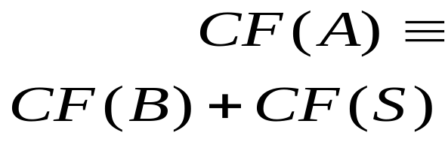
U.S.C.C. Financial Cash Flow
Cash Flow of the Firm
The cash flow received from the firm’s assets must equal the cash flows to the firm’s creditors and stockholders:
Operating cash flow
$238
(Earnings before interest and taxes
plus depreciation minus taxes)
Capital spending
-173
(Acquisitions of fixed assets
minus sales of fixed assets)
Additions to net working capital
-23
Total
$42
Cash Flow of Investors in the Firm
Debt
$36
(Interest plus retirement of debt
minus long-term debt financing)
Equity
6
(Dividends plus repurchase of
equity minus new equity financing)
Total
$42

Slide 27
2.7 Cash Flow Management
Earnings can be manipulated using subjective decisions required under GAAP
Total cash flow is more objective, but the underlying components may also be “managed”
  Moving cash flow from the investing section to the operating section may make the firm’s business appear more stable

Slide 28
Quick Quiz
What is the difference between book value and market value? Which should we use for decision making purposes?
What is the difference between accounting income and cash flow? Which do we need to use when making decisions?
What is the difference between average and marginal tax rates? Which should we use when making financial decisions?
How do we determine a firm’s cash flows? What are the equations, and where do we find the information?

Slide 29
Financial Ratios and Planning

Slide 30
Key Concepts and Skills
Know how to standardize financial statements for comparison purposes
Know how to compute and interpret important financial ratios
Be able to develop a financial plan using the percentage of sales approach
Understand how capital structure and dividend policies affect a firm’s ability to grow

Slide 31
3.1 Financial Statements Analysis
Common-Size Balance Sheets
  Compute all accounts as a percent of total assets
Common-Size Income Statements
  Compute all line items as a percent of sales
Standardized statements make it easier to compare financial information, particularly as the company grows.
They are also useful for comparing companies of different sizes, particularly within the same industry.

Slide 32
3.2 Ratio Analysis
Ratios also allow for better comparison through time or between companies.
As we look at each ratio, ask yourself:
  How is the ratio computed?
  What is the ratio trying to measure and why?
  What is the unit of measurement?
  What does the value indicate?
  How can we improve the company’s ratio?

Slide 33
Categories of Financial Ratios
Short-term solvency or liquidity ratios
Long-term solvency or financial leverage ratios
Asset management or turnover ratios
Profitability ratios
Market value ratios
Notes:
The ratios in the following slides will be computed using the 2010 information from the Balance Sheet (Table 3.1) and Income Statement (Table 3.4) given in the text.

Slide 34
Computing Liquidity Ratios
Current Ratio = CA / CL
  708 / 540 = 1.31 times
Quick Ratio = (CA – Inventory) / CL
  (708 - 422) / 540 = .53 times
Cash Ratio = Cash / CL
  98 / 540 = .18 times
What does having high short-term solvency ratios imply? Good or bad?
Notes:
The firm is able to cover current liabilities with it’s current assets by a factor of 1.3 to 1. The ratio should be compared to the industry – it’s possible that this industry has a substantial amount of cash flow and that they can meet their current liabilities out of cash flow instead of relying solely on the liquidation of current assets that are on the books.
The quick ratio is quite a bit lower than the current ratio, so inventory seems to be an important component of current assets.
This company carries a low cash balance. This may be an indication that they are aggressively investing in assets that will provide higher returns. We need to make sure that we have enough cash to meet our obligations, but too much cash reduces the return earned by the company.

Slide 35
Computing Leverage Ratios
Total Debt Ratio = (TA – TE) / TA
  (3588 - 2591) / 3588 = 28%
Debt/Equity = TD / TE
  (3588 – 2591) / 2591 = 38.5%
Equity Multiplier = TA / TE = 1 + D/E
  1 + .385 = 1.385
What does having high long-term solvency ratios imply? Good or bad?
Notes:
Note that these are often called solvency ratios.
TE = total equity, and TA = total assets. The numerator in the total debt ratio could also be found by adding all of the current and long-term liabilities.
The firm finances approximately 28% of its assets with debt.
Another way to compute the D/E ratio if you already have the total debt ratio:
D/E = Total debt ratio / (1 – total debt ratio) = .28 / .72 = .39
Note the rounding error as compared to the direct method applied in the slide.
The EM is one of the ratios that is used in the Du Pont Identity as a measure of the firm’s financial leverage.

Slide 36
Computing Coverage Ratios
Times Interest Earned = EBIT / Interest
  691 / 141 = 4.9 times
Cash Coverage = (EBIT + Depreciation + Amortization) / Interest
  (691 + 276) / 141 = 6.9 times
Notes:
Remember that depreciation (and amortization) is a non-cash deduction. A better indication of a firm’s ability to meet interest payments may be to add back the depreciation and amortization to get an estimate of cash flow before taxes.
You can also calculate a type of inverse value as follows:
Interest Bearing Debt / EBITDA = (196 + 457) / 967 = .68
Values less than one are indicative of a stable position.

Slide 37
Computing Inventory Ratios
Inventory Turnover = Cost of Goods Sold / Inventory
  1344 / 422 = 3.2 times
Days’ Sales in Inventory = 365 / Inventory Turnover
  365 / 3.2 = 114 days
What would make you under or overestimate these values?
  Remedy?
Notes:
Inventory turnover can be computed using either ending inventory or average inventory when you have both beginning and ending figures. It is important to be consistent with whatever benchmark you are using to analyze the company’s strengths or weaknesses.
It is also important to consider seasonality in sales. If the balance sheet is prepared at a time when there is a large inventory build-up to meet seasonal demand, then the inventory turnover will be understated and you might believe that the company is not performing as well as it is. On the other hand, if the balance sheet is prepared when inventory has been drawn down due to seasonal sales, then the inventory turnover would be overstated and the company may appear to be doing better than it really is. Averages using annual data may not fix this problem. If a company has seasonal sales, you may want to look at quarterly averages to get a better indication of turnover.

Slide 38
Computing Receivables Ratios
Receivables Turnover = Sales / Accounts Receivable
  2311 / 188 = 12.3 times
Days’ Sales in Receivables = 365 / Receivables Turnover
  365 / 12.3 = 30 days
What would make you under or overestimate these values?
  Remedy?
Notes:
Technically, the sales figure should be credit sales. This is often difficult to determine from the income statements provided in annual reports. If you use total sales instead of credit sales, you will overstate your turnover level. You need to recognize this bias when credit sales are unavailable, particularly if a large portion of the sales are cash sales.
As with inventory turnover, you can use either ending receivables or an average of beginning and ending.
You also run into the same seasonal issues as discussed with inventory.
Probably the best benchmark for days’ sales in receivables is the company’s credit terms. If the company offers a discount (1/10 net 30), then you would like to see days’ sales in receivables less than 30. If the company does not offer a discount (net 30), then you would like to see days’ sales in receivables close to the net terms. If days’ sales in receivables is substantially larger than the net terms, then you first need to look for biases, such as seasonality in sales. If this does not provide an explanation for the difference, then the company may need to take another look at its credit policy (who it grants credit to and its collection procedures).

Slide 39
Computing Total Asset Turnover
Total Asset Turnover = Sales / Total Assets
  2311 / 3588 = .64 times
  It is not unusual for TAT < 1, especially if a firm has a large amount of fixed assets.
  What can be good and bad about a high TAT?
Notes:
Having a TAT of less than one is not a problem for most firms. Fixed assets are expensive and are meant to provide sales over a long period of time. This is why the matching principle indicates that they should be depreciated instead of immediately expensed.
This is one of the ratios that will be used in the Du Pont identity.

Slide 40
Computing Profitability Measures
Profit Margin = Net Income / Sales
  363 / 2311 = 15.7%
Return on Assets (ROA) = Net Income / Total Assets
  363 / 3588 = 10.1%
Return on Equity (ROE) = Net Income / Total Equity
  363 / 2591 = 14.0%
Notes:
You can also compute the gross profit margin and the operating profit margin.
GPM = (Sales – COGS) / Sales
OPM = EBIT / Sales
Profit margin is one of the components of the Du Pont identity and is a measure of operating efficiency. It measures how well the firm controls the costs required to generate the revenues. It tells how much the firm earns for every dollar in sales. In the example, the firm earns almost $0.16 for each dollar in sales.
Note that the ROA and ROE are returns on accounting numbers. As such, they are not directly comparable with returns found in the marketplace. ROA is sometimes referred to as ROI (return on investment). As with many of the ratios, there are variations in how they can be computed. The most important thing is to make sure that you are computing them the same way as the benchmark you are using.
ROE will always be higher than ROA as long as the firm has debt (and ROA is positive). The greater the leverage, the larger the difference will be. ROE is often used as a measure of how well management is attaining the goal of owner wealth maximization. The Du Pont identity is used to identify factors that affect the ROE.

Slide 41
Computing Market Value Measures
Market Capitalization = $88 per share x 33 million shares = 2904 million
PE Ratio = Price per share / Earnings per share
  88 / 11 = 8 times
Notes:
See Table 3.6, as well as the instructor’s manual (chapter 3 appendix), for a summary list of financial ratios.

Slide 42

Using Financial Statements
Ratios are not very helpful by themselves: they need to be compared to something
Time-Trend Analysis
  Used to see how the firm’s performance is changing through time
Peer Group Analysis
  Compare to similar companies or within industries
  SIC and NAICS codes
  Cross price elasticities
Notes:
SIC codes have been used many years to identify industries and allow for comparison with industry average ratios. The SIC codes are limited, however, and have not kept pace with a rapidly changing environment. Consequently, the North American Industry Classification System was introduced in 1997 to alleviate some of the problems with SIC codes.
Click on the web surfer to go the NAICS home page. It provides information on the change to the NAICS and conversion between SIC and NAICS codes.

Slide 43
3.3 The Du Pont Identity
ROE = NI / TE
Multiply by 1 and then rearrange:
  ROE = (NI / TE) (TA / TA)
  ROE = (NI / TA) (TA / TE) = ROA * EM
Multiply by 1 again and then rearrange:
  ROE = (NI / TA) (TA / TE) (Sales / Sales)
  ROE = (NI / Sales) (Sales / TA) (TA / TE)
  ROE = PM * TAT * EM

Slide 44
Using the Du Pont Identity
ROE = PM * TAT * EM
  Profit margin is a measure of the firm’s operating efficiency – how well it controls costs.
  Total asset turnover is a measure of the firm’s asset use efficiency – how well it manages its assets.
  Equity multiplier is a measure of the firm’s financial leverage.
  How can you improve ROE? What happens if EM goes up?
Notes:
Improving our operating efficiency or our asset use efficiency will improve our return on equity. If the TAT is low compared to our benchmark, then we can break it down into more detail by looking at inventory turnover and receivables turnover. If those areas are strong, then we can look at fixed asset turnover and cash management.
We can also improve our ROE by increasing our leverage – up to a point. Debt affects a lot of other factors, including profit margin, so we have to be a little careful here. We want to make sure we have enough debt to utilize our interest tax credit effectively, but we don’t want to overdo it.

Slide 45
Calculating the Du Pont Identity
ROA = 10.1% and EM = 1.39
  ROE = 10.1% * 1.385 = 14.0%
PM = 15.7% and TAT = 0.64
  ROE = 15.7% * 0.64 * 1.385 = 14.0%

Slide 46
Potential Problems
There is no underlying theory, so there is no way to know which ratios are most relevant.
Benchmarking is difficult for diversified firms.
Globalization and international competition makes comparison more difficult because of differences in accounting regulations.
Firms use varying accounting procedures.
Firms have different fiscal years.
Extraordinary, or one-time, events

Slide 47
Quick Quiz
How do you standardize balance sheets and income statements?
Why is standardization useful?
What are the major categories of financial ratios?
How do you compute the ratios within each category?
What are some of the problems associated with financial statement analysis?

