Slide 1
ENG 111
Week 3 Lecture Notes
McGraw-Hill/Irwin
Copyright © 2010 by the McGraw-Hill Companies, Inc. All rights reserved.

Slide 2
3.4 Financial Models
Investment in new assets – determined by capital budgeting decisions
Degree of financial leverage – determined by capital structure decisions
Cash paid to shareholders – determined by dividend policy decisions
Liquidity requirements – determined by net working capital decisions

Slide 3
Financial Planning Ingredients
Economic Assumptions – explicit assumptions about the coming economic environment
Sales Forecast – many cash flows depend directly on the level of sales (often estimate sales growth rate)
Pro Forma Statements – setting up the plan as projected (pro forma) financial statements allows for consistency and ease of interpretation
Asset Requirements – the additional assets that will be required to meet sales projections
Financial Requirements – the amount of financing needed to pay for the required assets
Plug Variable – determined by management decisions about what type of financing will be used (makes the balance sheet balance)

Slide 4
Percent of Sales Approach
Some items vary directly with sales, others do not.
Income Statement
Costs may vary directly with sales - if this is the case, then the profit margin is constant
Depreciation and interest expense may not vary directly with sales – if this is the case, then the profit margin is not constant
Dividends are a management decision and generally do not vary directly with sales – this affects additions to retained earnings

Slide 5
Percent of Sales Approach
Balance Sheet
Initially assume all assets, including fixed, vary directly with sales.
Accounts payable also normally vary directly with sales.
Notes payable, long-term debt, and equity generally do not vary with sales because they depend on management decisions about capital structure.
The change in the retained earnings portion of equity will come from the dividend decision.
External Financing Needed (EFN)
The difference between the forecasted increase in assets and the forecasted increase in liabilities and equity.

Slide 6
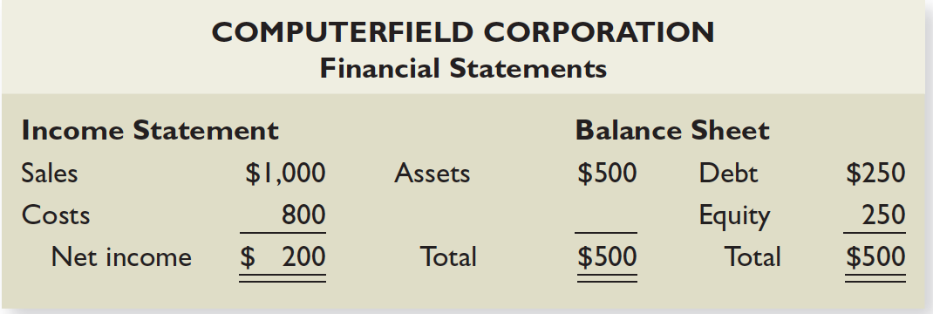
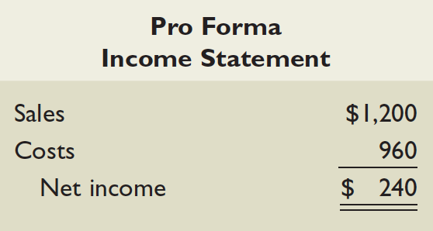
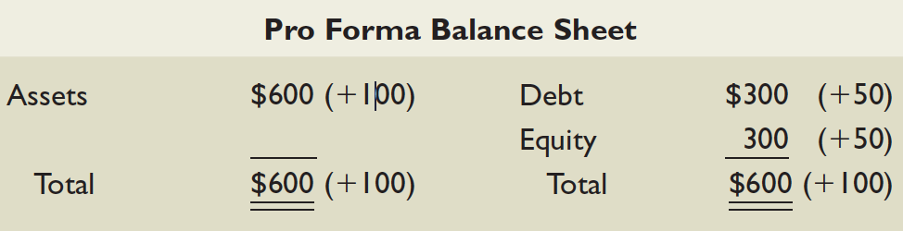
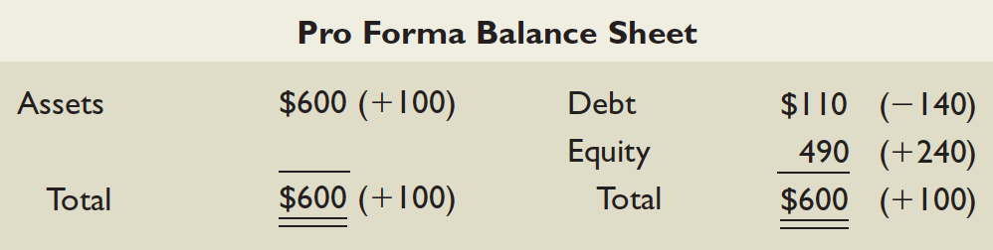
A Simple Financial Planning Example

Slide 7
A Simple Financial Planning Example

Slide 8
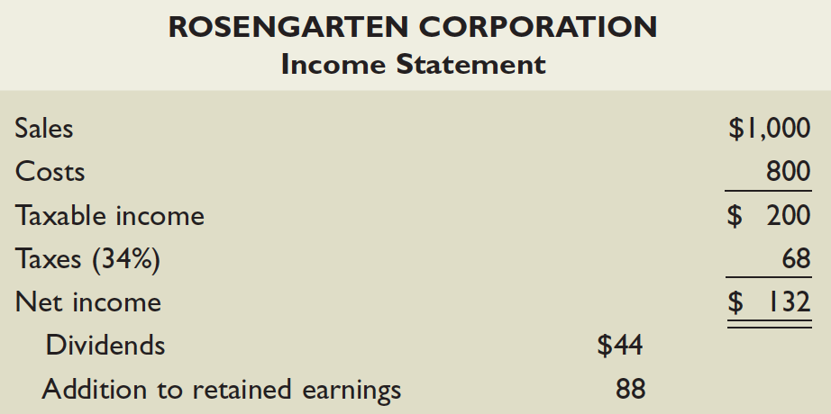
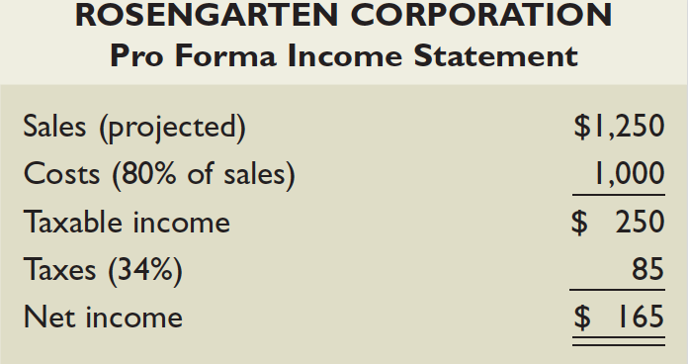
Another Financial Planning Example

Slide 9
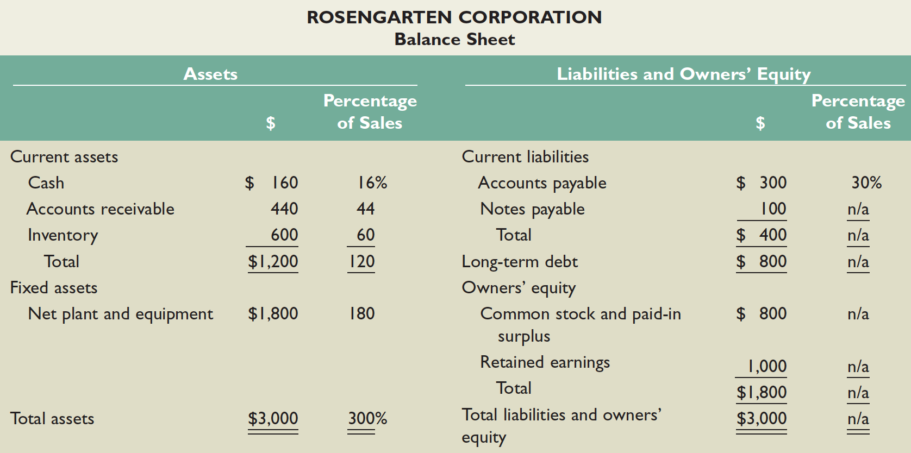
Another Financial Planning Example - continued

Slide 10
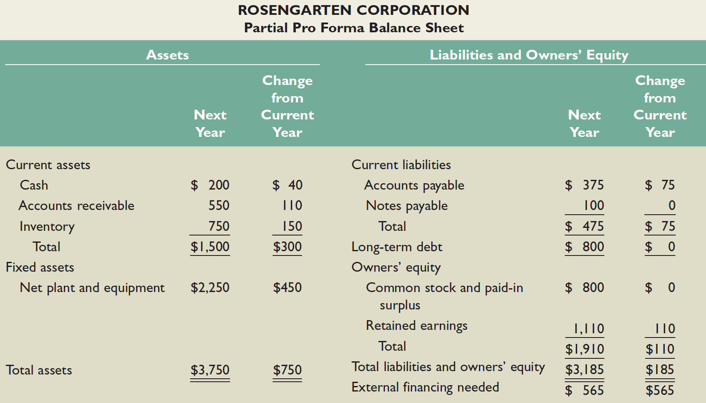
Another Financial Planning Example – continued 1st step in balancing the Balance Sheet

Slide 11
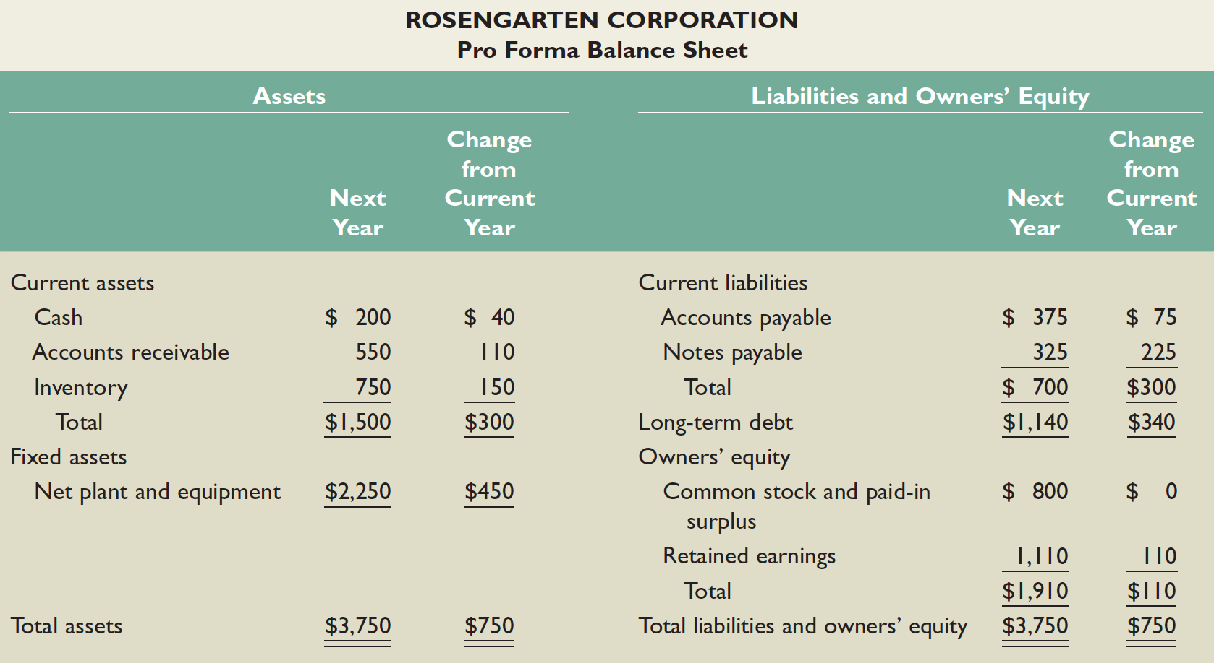
Another Financial Planning Example – continued Bal. Sheet balanced – assumption: NWC stays the same

Slide 12
Percent of Sales and EFN
External Financing Needed (EFN) can also be calculated as:
Notes:
The first term measures the increase in assets, which is based on the capital intensity ratio. The second and third terms capture the increase in liabilities and equity, respectively.

Slide 13
3.5 External Financing and Growth
At low growth levels, internal financing (retained earnings) may exceed the required investment in assets.
As the growth rate increases, the internal financing will not be enough, and the firm will have to go to the capital markets for financing.
Examining the relationship between growth and external financing required is a useful tool in financial planning.

Slide 14
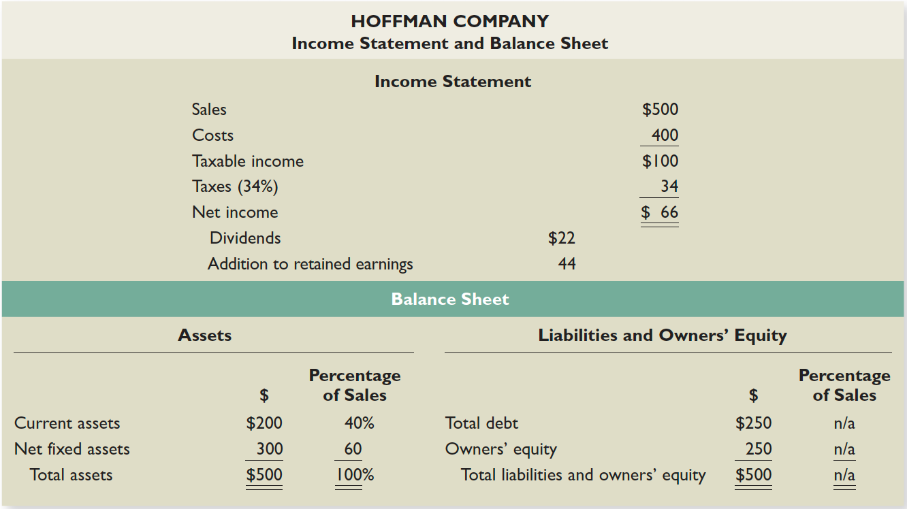

Slide 15
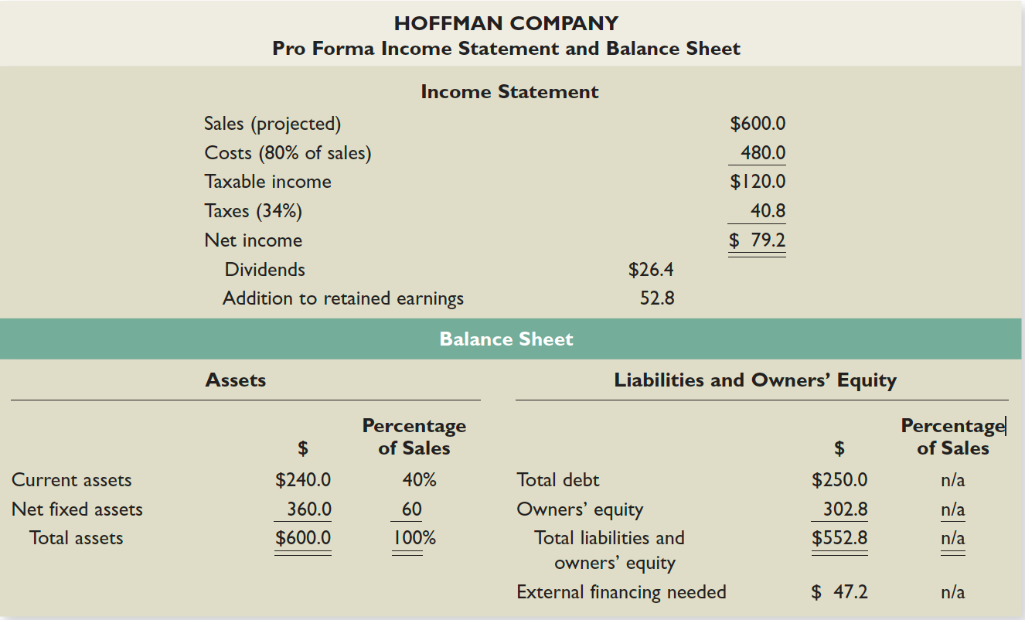

Slide 16
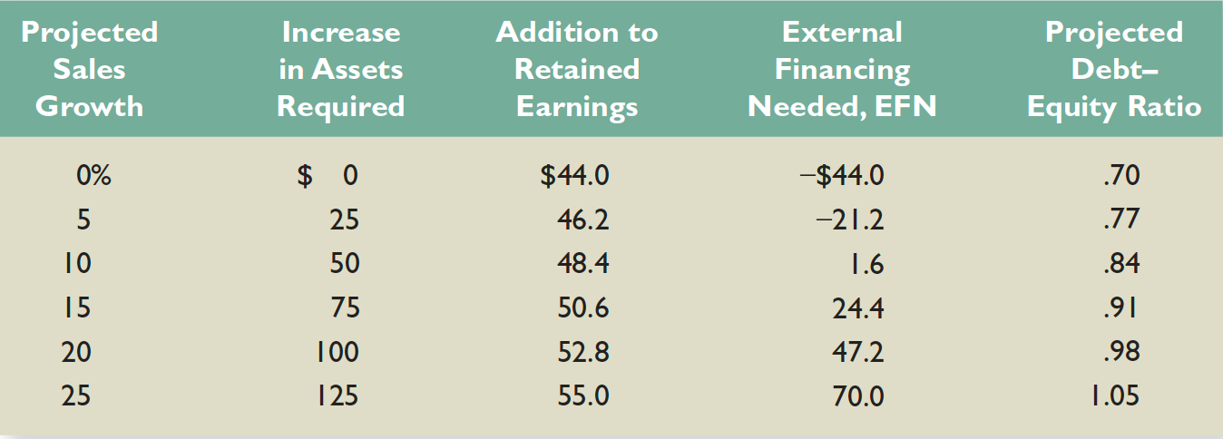

Slide 17
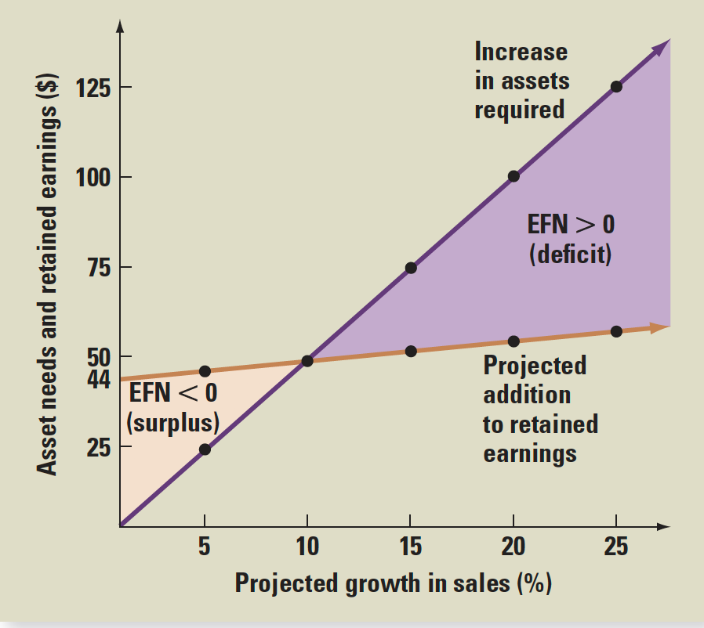

Slide 18
The Internal Growth Rate
The internal growth rate tells us how much the firm can grow assets using retained earnings as the only source of financing.
Using the information from the Hoffman Co.
ROA = 66 / 500 = .132
b = 44/ 66 = .667
Notes:
The information for these calculations is given in Table 3.13. This firm could grow assets at 9.65% without raising additional external capital.
Relying solely on internally generated funds will increase equity (retained earnings are part of equity) and assets without an increase in debt. Consequently, the firm’s leverage will decrease over time. If there is an optimal amount of leverage, as we will discuss in later chapters, then the firm may want to borrow to maintain that optimal level of leverage. This idea leads us to the sustainable growth rate.

Slide 19
The Sustainable Growth Rate
The sustainable growth rate tells us how much the firm can grow by using internally generated funds and issuing debt to maintain a constant debt ratio.
Using the Hoffman Co.
ROE = 66 / 250 = .264
b = .667
Notes:
Note that no new equity is issued.
The sustainable growth rate is substantially higher than the internal growth rate. This is because we are allowing the company to issue debt as well as use internal funds.
Commonly, sustainable growth is calculated as only the numerator of our formula (ROE * b), but this assumes we calculate ROE based on beginning, rather than ending, equity.

Slide 20
Relationship between growth rate and EFN
Δ in (Assets-SponLiab)
Δ in (Assets-SponLiab)
and Δ in RE
Δ in RE
g
EFN<0 surplus
EFN>0 deficit
Two things to note:
Note that Δ in (Assets-SponLiab) starts at the origin. If the company does not grow (g=0%) there is no need to increase assets or change spontaneous liabilities. (Per year, sales will take place as before, existing assets will be used and depreciation amount, which is taken off as cost, can be used to replace the depreciating asset. Δ in RE starts at a positive value. Note that if the company does not grow, it will still have revenue, albeit as before. Hence, if company had positive profit and kept some of it as RE, without anygrowth, the same amount of revenue and Δ in RE will be obtained.
There is a differential in the slopes of two lines which allows a unique intersection and the existence of IGR. The Slope of the white line is equal to Δ in Assets-SponLiab per percentage growth rate. The slope of the yellow line is equal to Δ in RE per percentage growth rate. Since assets are expected to be used over time, it is reasonable to expect the sales to be smaller and profit and addition to RE even smaller than assets.

Slide 21
Determinants of Growth
Profit margin – operating efficiency
Total asset turnover – asset use efficiency
Financial leverage – choice of optimal debt ratio
Dividend policy – choice of how much to pay to shareholders versus reinvesting in the firm
Notes:
The first three components come from the ROE and the Du Pont identity.
It is important to note at this point that growth is not the goal of a firm in and of itself. Growth is only important so long as it continues to maximize shareholder value.

Slide 22
3.6 Some Caveats
Financial planning models do not indicate which financial polices are the best.
Models are simplifications of reality, and the world can change in unexpected ways.
Without some sort of plan, the firm may find itself adrift in a sea of change without a rudder for guidance.

