Slide 1
Advent of Code 2021

Slide 2
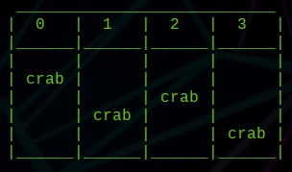
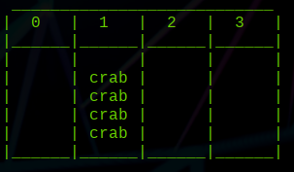
Day 7 – Part 1
Problem description: https://adventofcode.com/2021/day/7
A “swarm” of crabs arranged with various non-negative integer horizontal positions (ex: 0, 7, 3)
The crabs can move and they burn fuel proportional to the distance traveled (1 unit of fuel to move 1 unit of distance)
Task: move all crabs to the same horizontal position while minimizing the total amount of fuel spent. Submit the sum of the fuel spent by all crabs.

Slide 3
Day 7 – Part 1
Proposed consolidation point:
Crab horizontal position:
Fuel function for single crab:
Fuel function for all crabs:

Slide 4
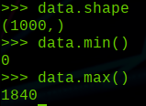
Day 7 – Part 1:
Brute Force Technique
For every horizontal position y between the minimum and maximum crab positions
  For every crab x
    Add abs(y – x) to the sum
  Return the minimum fuel cost.
Is brute force feasible?
  1841 iterations of the outer loop
  1000 iterations of the inner loop
Yes brute force is trivial

Slide 5
Day 7 – Part 1
The End.

Slide 6
Day 7 – Part 1
JK

Slide 7
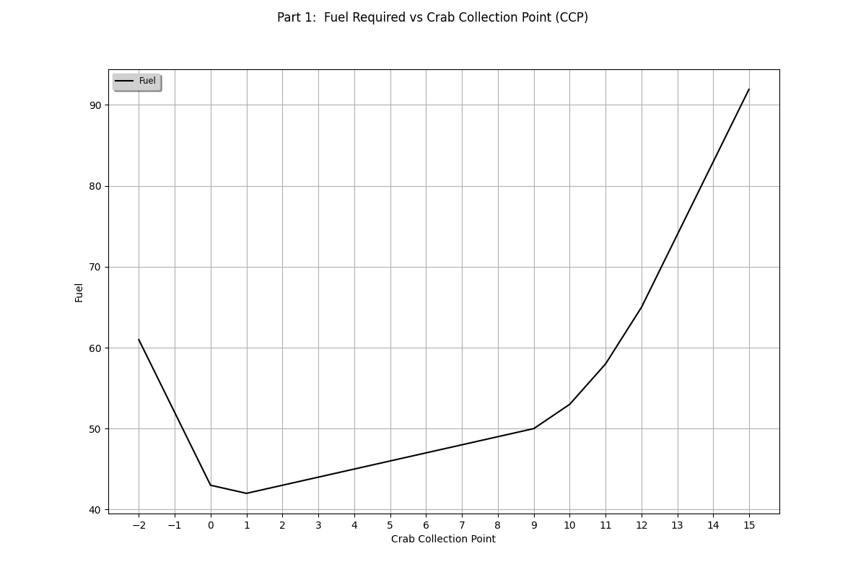
Day 7 – Part 1
Crab positions:
[0, 0, 0, 0, 1, 9, 10, 11, 12]
It’s a convex function, which means it’s easy to minimize

Slide 8
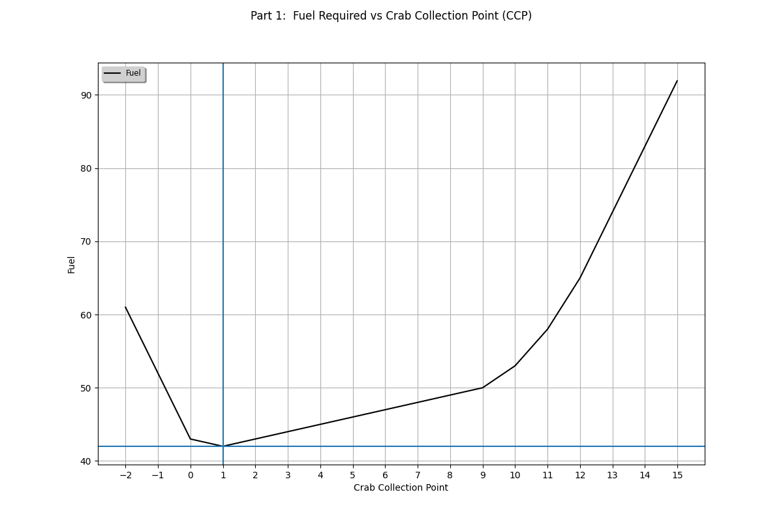
Day 7 – Part 1
Crab positions:
[0, 0, 0, 0, 1, 9, 10, 11, 12]
Minimum fuel cost occurs when the slope of the fuel function is zero*.
*for this function, the slope is technically not defined at this point

Slide 9
Day 7 – Part 1:
Math
In the basic form, the function is only piece-wise differentiable and undefined at 0
By rearranging, the fuel function derivative is minimized when then number of crabs to the right of y is equal to the number of crabs to the left of y
This central location is the median.

Slide 10
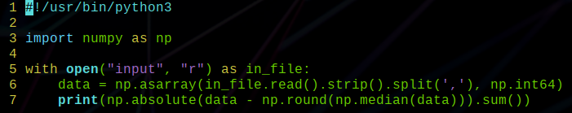
Day 7 – Part 1:
Implementation

Slide 11

Day 7 – Part 2
The same crab layout and objective as before, but with a different fuel function.
Crab Fuel Function
Distance | Total Fuel
1 | 1
2 | 3
3 | 6
4 | 10
5 | 15
6 | 21

Slide 12
Day 7 – Part 2
The individual crab fuel function is the sum of every number between 1 and the distance traveled.
Can be calculated directly:
Overall crab fuel function:

Slide 13
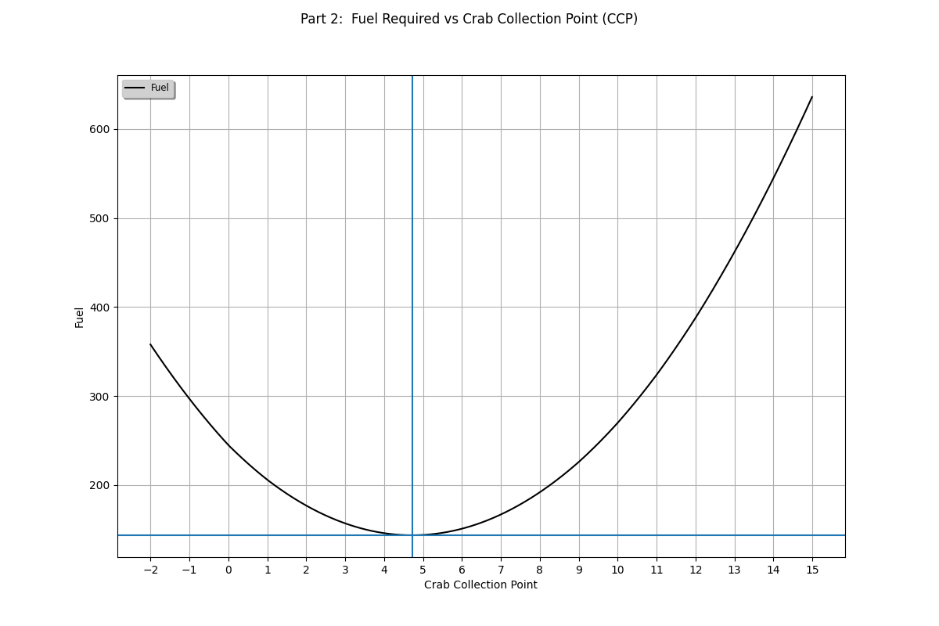
Day 7 – Part 2
Crab positions:
[0, 0, 0, 0, 1, 9, 10, 11, 12]
Minimum fuel cost occurs when the slope of the fuel function is zero.

Slide 14
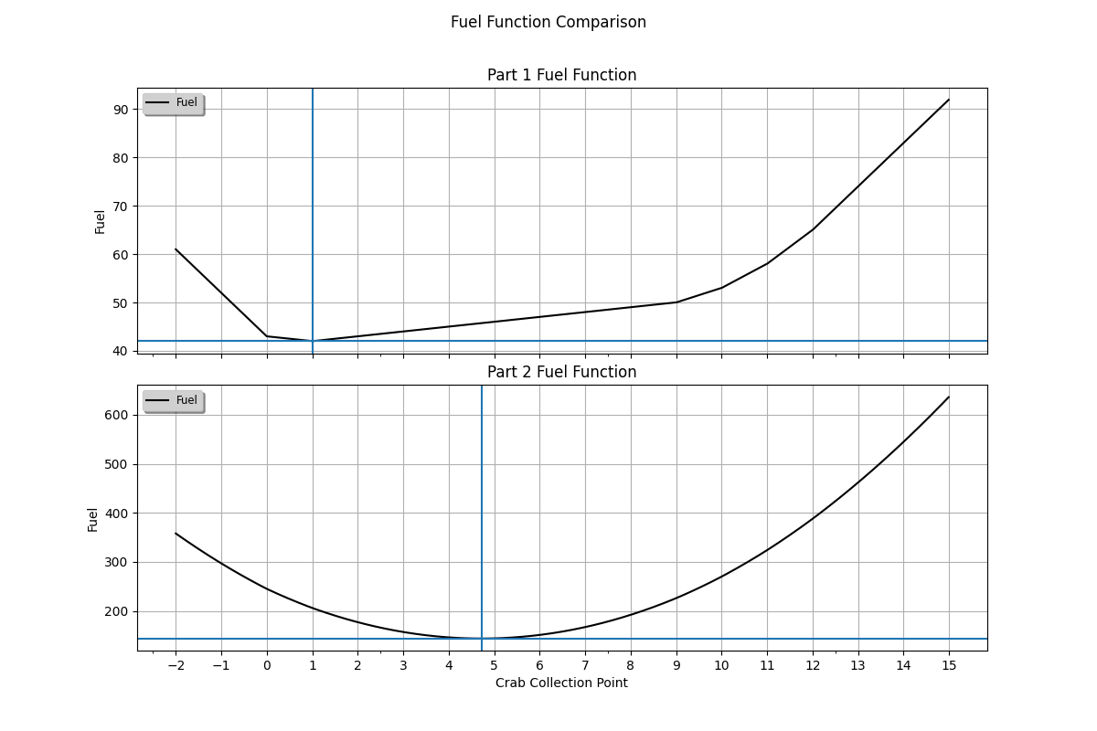
Day 7 – Part 2
Crab positions:
[0, 0, 0, 0, 1, 9, 10, 11, 12]
The optimal crab collection point is dependent on the fuel function.

Slide 15
Day 7 – Part 2

Slide 16
Day 7 – Part 2

Slide 17
Day 7 – Part 2

Slide 18
Day 7 – Part 2

Slide 19
Day 7 – Part 2
What is this?
What is the min/max of this expression?

Slide 20
Day 7 – Part 2
Average of all
crab positions
Min: -N
Max: N

Slide 21
Day 7 – Part 2
Average of all
crab positions

Slide 22
Day 7 – Part 2
Average of all
crab positions
** for a continuous (ie. non-integer)
input space, this would be
a continuous range [-0.5, 0.5]

Slide 23
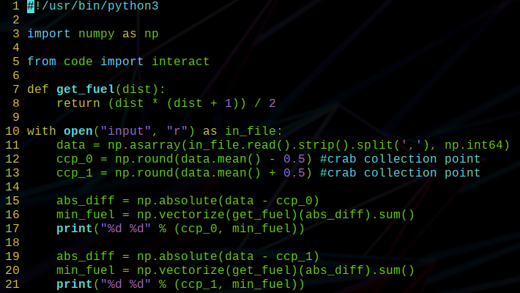
Day 7 – Part 2:
Implementation

Slide 24
Day 19
Problem description: https://adventofcode.com/2021/day/19
~35 sensors
~25 beacons per sensor
Beacon positions relative to the sensor are known, but the orientation of the beacons may be reflected and rotated about any axis any number of times
Adjacent sensors share 12 beacons
Tasks:
  task 1: find the number of unique beacons
  task 2: find the maximum manhattan distance between sensor centers
Determining the correct orientation of each sensor will essentially solve both tasks

Slide 25
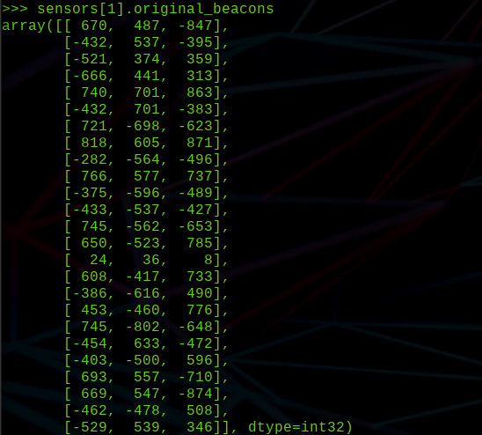
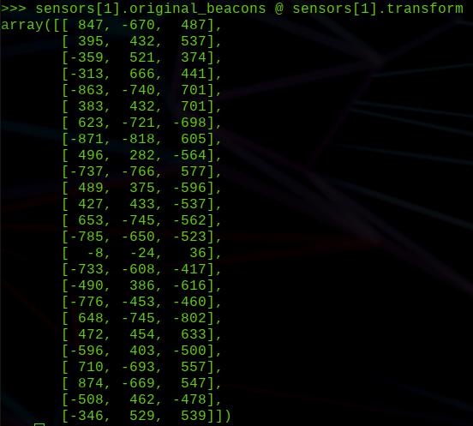
Day 19
original orientation
true orientation

Slide 26
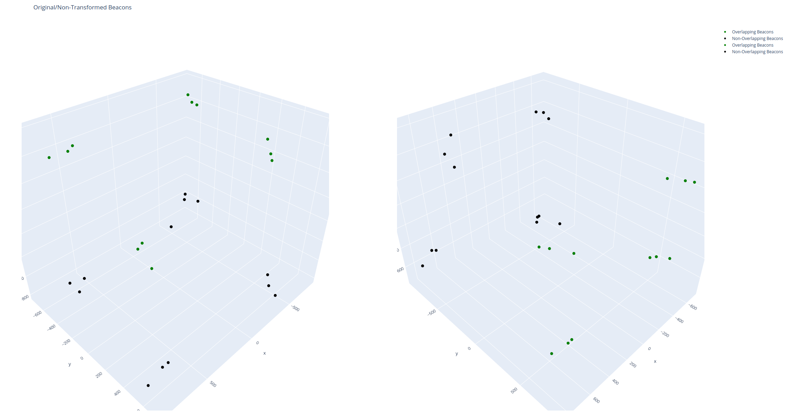
Day 19
root
sensor
adjacent
sensor
(non-oriented)

Slide 27
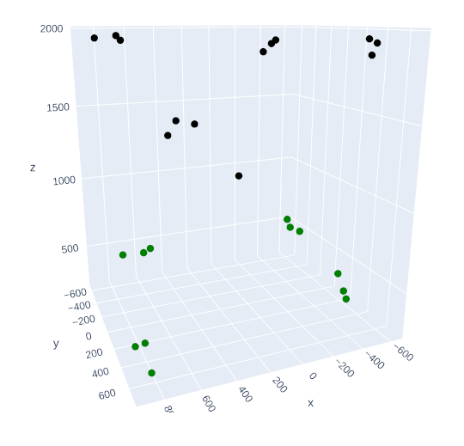
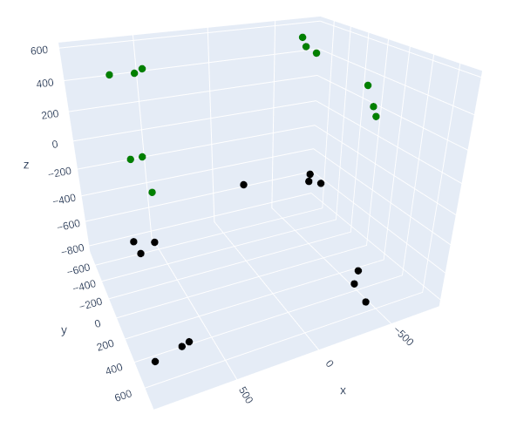
Day 19
root
sensor
adjacent
sensor
(oriented)

Slide 28
Day 19
General approach:
  The root node is oriented correctly
  Calculate inter-beacon pairwise distances for each sensor
  While unoriented sensors remain:
    From an oriented sensor s1, consider an unoriented sensor s2
    If 12 matching inter-beacon distances:
      While s2 not oriented:
        Rotate/reflect s2 beacons using one of 24 projection matrices
        For each pair of overlapping beacons b1, b2
          s2 center = b1 – b2
          If s2 center is equal for all overlapping pairs of beacons, s2 is oriented

Slide 29
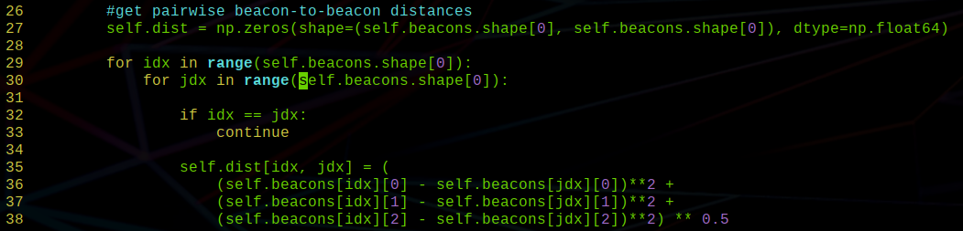
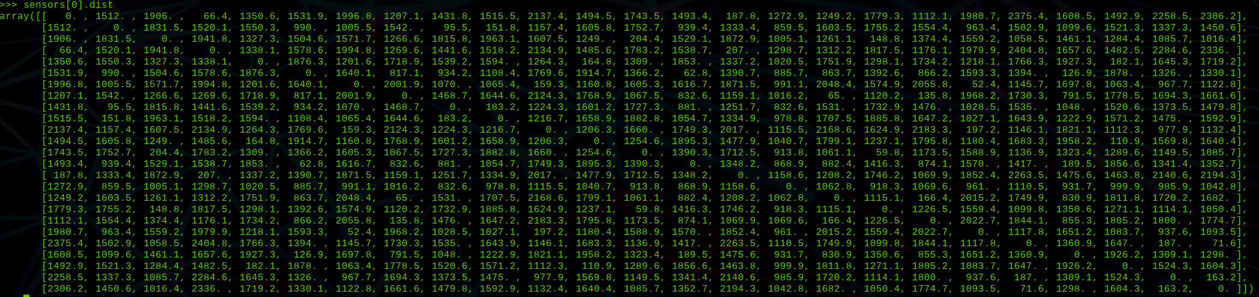
Day 19
Generate inter-beacon pairwise distances for each sensor:

Slide 30
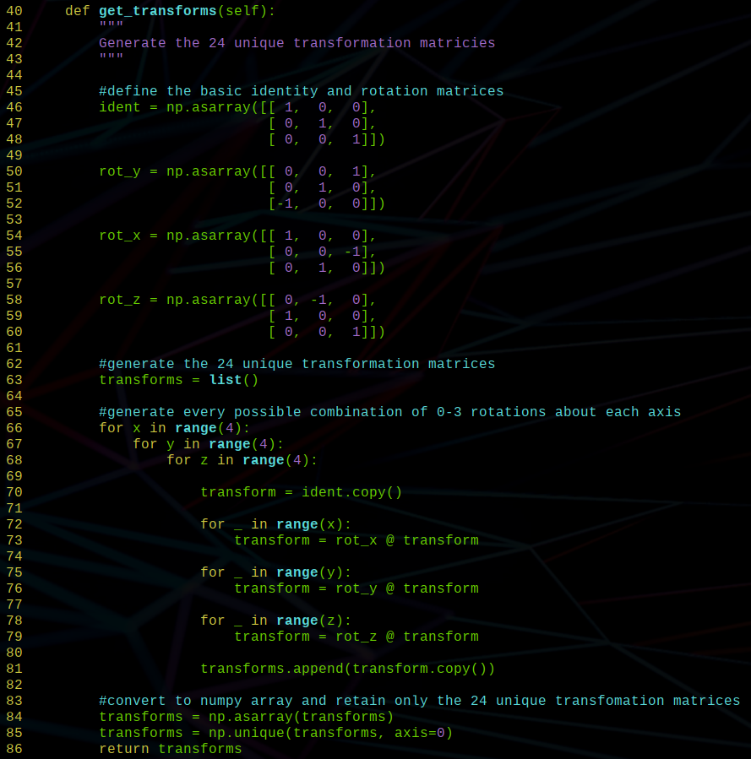
Day 19
Generate projection matrices:

Slide 31
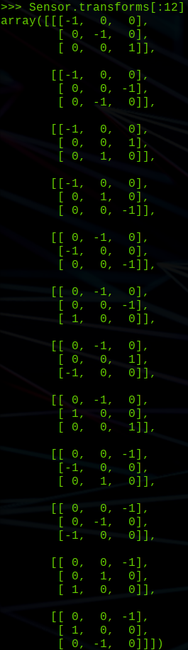
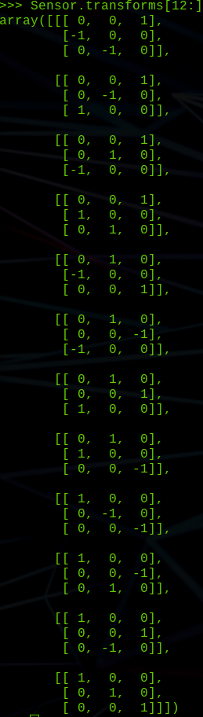
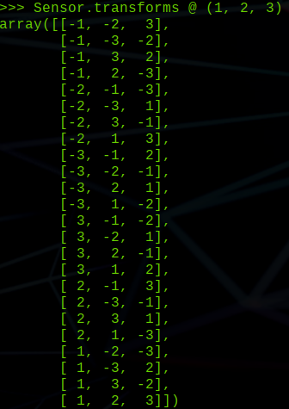
Day 19
Projection matrix usage:
1 vector transformed by 10 different matrices
Projection matrix examples:

Slide 32
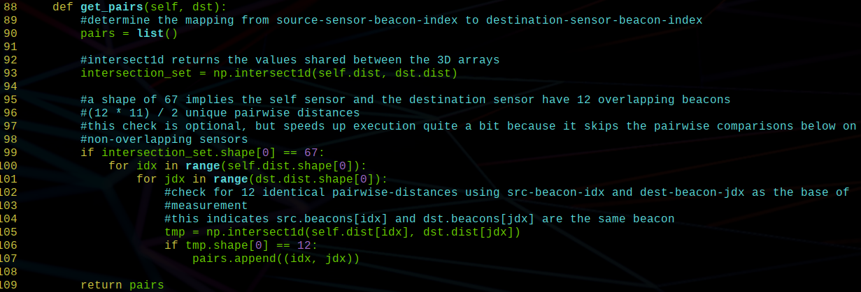
Day 19
Find overlapping beacons based on pairwise inter-beacon distances:

Slide 33
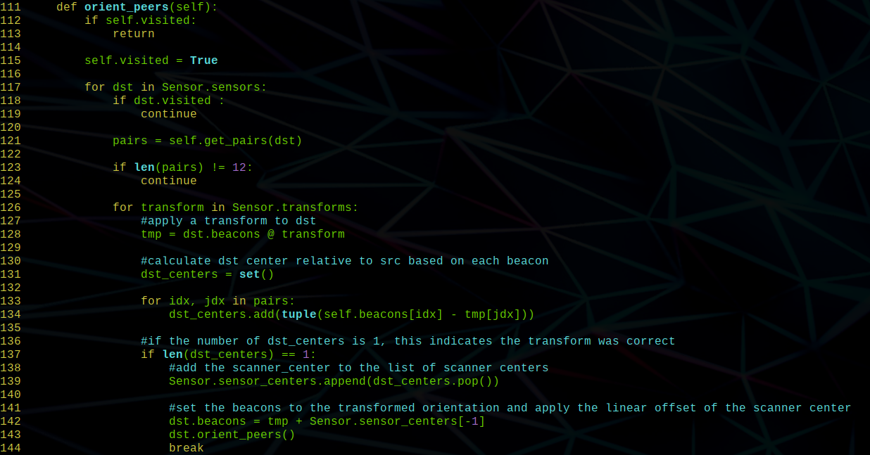
Day 19
Core logic of brute forcing the transforms and traversing the graph.

Slide 34
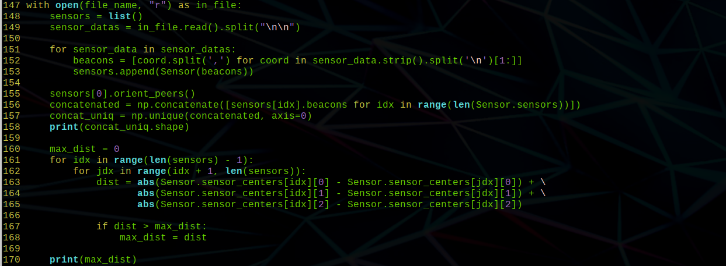
Day 19
Final logic to determine the number of unique beacons (part 1), and the maximal manhattan distance between sensor centers.

Slide 35
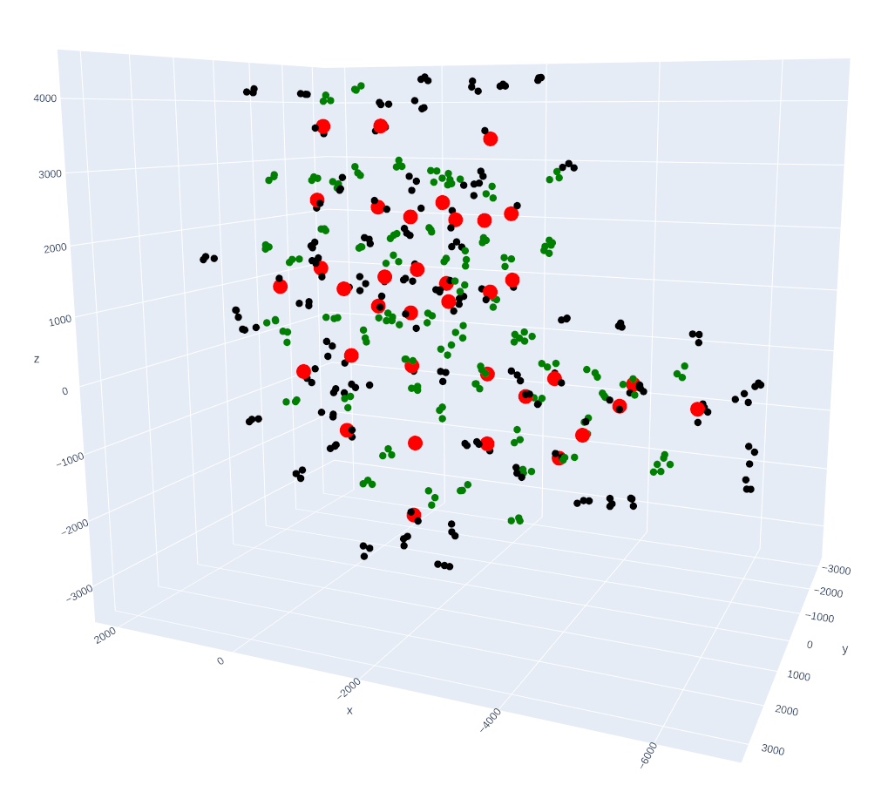
Day 19
Visualization of oriented and arranged sensors/beacons.

