Slide 1
Ludo
SWE 681 Programming Project
Alireza Sadeghi

Slide 2
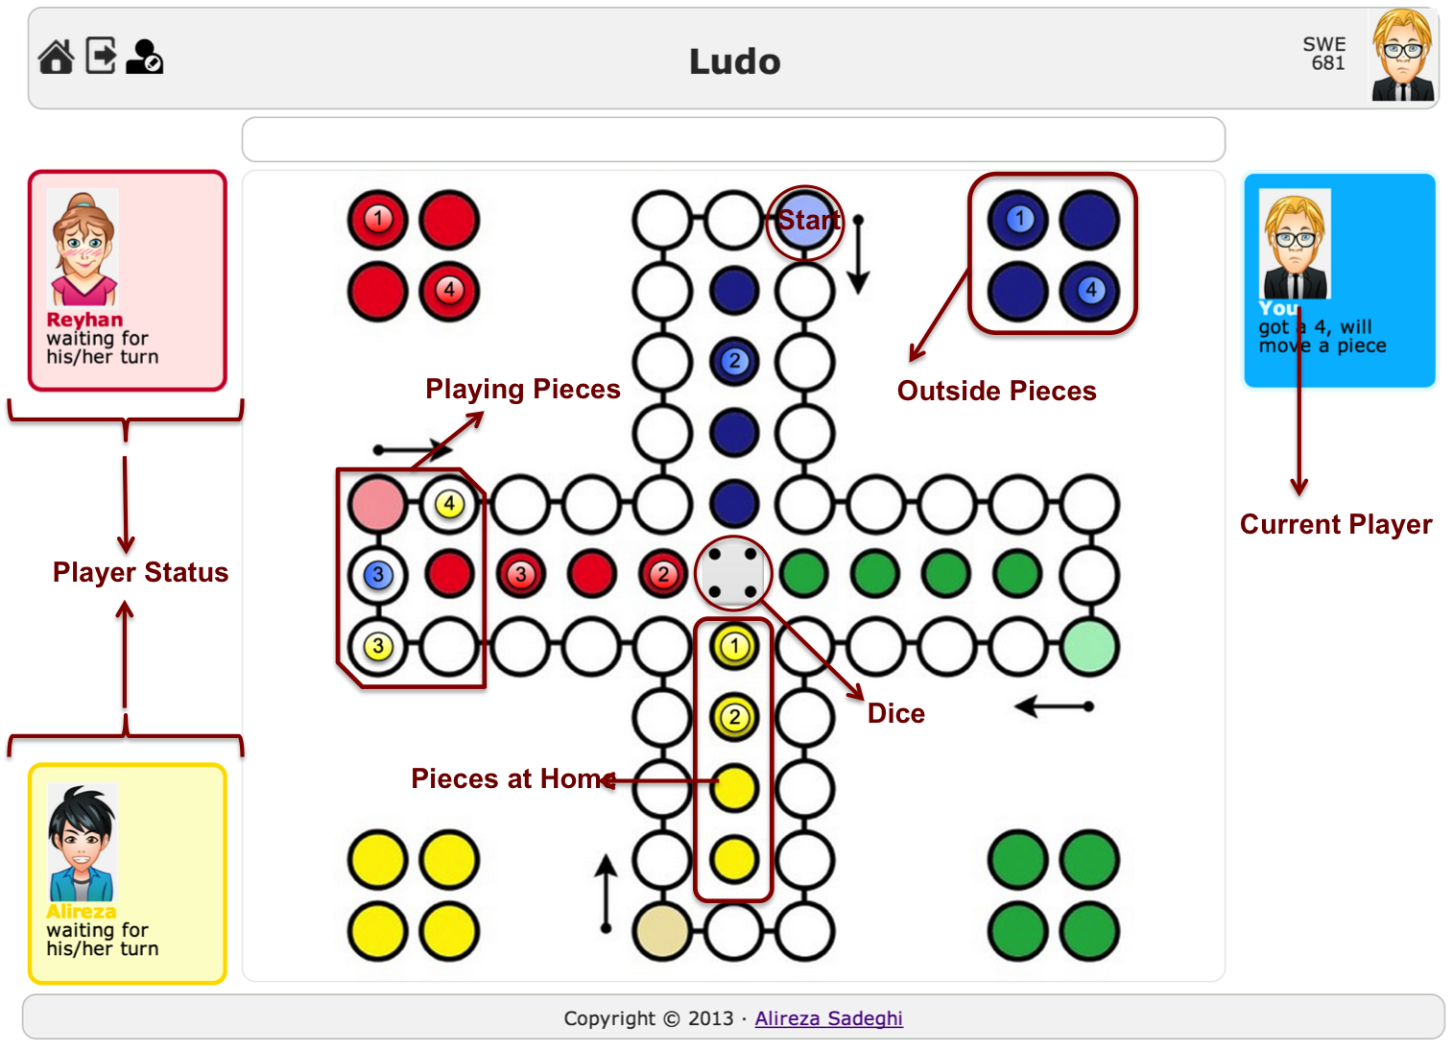
Ludo
A version of Ludo, named “Mensch ärgere dich nicht”

Slide 3
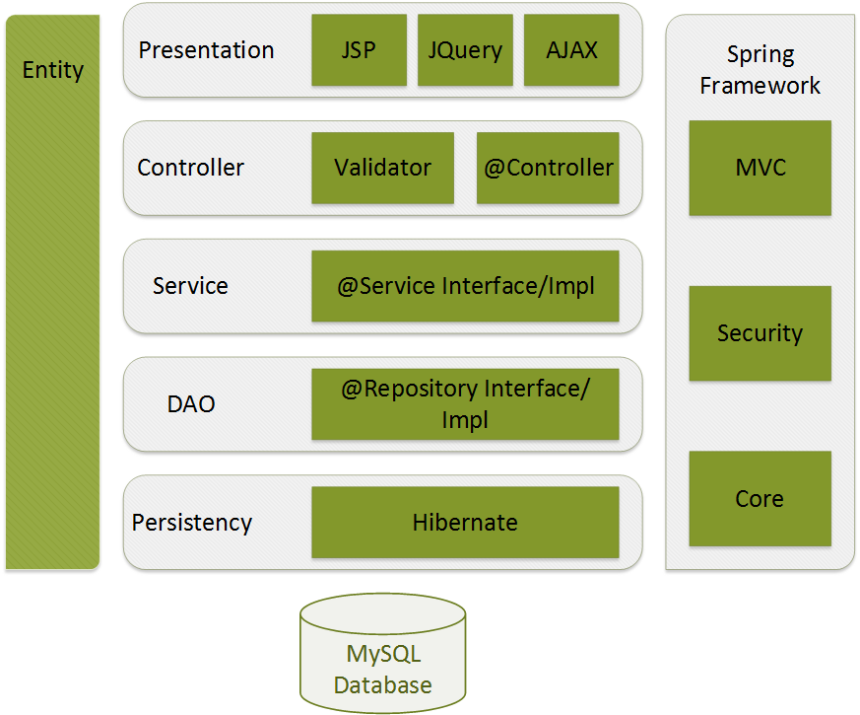
High-level Architecture
Spring ver. 3.2
Hibernate ver. 4.1

Slide 4
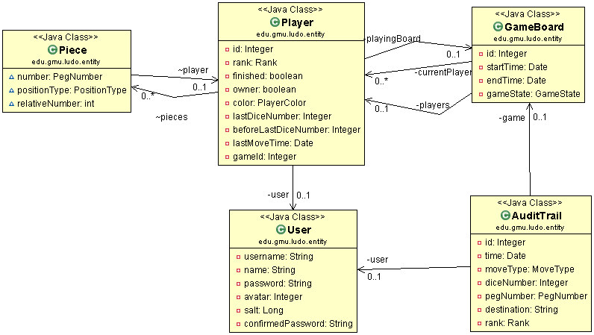
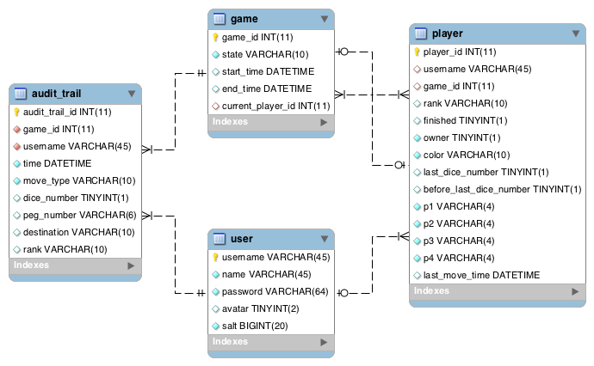
Entities

Slide 5
Security Requirements

Slide 6
Authentication/Authorization
Least privilege principle
All requests (/**) required AuthN
Except: login and sign up
<security:http use-expressions='true' auto-config="true">
<security:intercept-url pattern="/login.htm" access="permitAll" requires-channel="https" />
<security:intercept-url pattern="/addUser.htm" access="permitAll" requires-channel="https”/>
<security:intercept-url pattern="/**" access="isAuthenticated()" requires-channel="https" />
<security:form-login login-page="/login.htm" authentication-failure-url="/login.htm?login_error=1” default-target-url="/index.htm" always-use-default-target="true" authentication-failure-handler-ref="authenticationFailureHandler"/>
<security:logout logout-url="/j_spring_security_logout" delete-cookies="JSESSIONID"
invalidate-session="true" />
</security:http>

Slide 7
Authentication/Authorization
Confidentiality
http channel is redirected to https
User session is invalidated after logout
<security:http use-expressions='true' auto-config="true">
<security:intercept-url pattern="/login.htm" access="permitAll" requires-channel="https" />
<security:intercept-url pattern="/addUser.htm" access="permitAll" requires-channel="https”/>
<security:intercept-url pattern="/**" access="isAuthenticated()" requires-channel="https" />
<security:form-login login-page="/login.htm" authentication-failure-url="/login.htm?login_error=1” default-target-url="/index.htm" always-use-default-target="true" authentication-failure-handler-ref="authenticationFailureHandler"/>
<security:logout logout-url="/j_spring_security_logout" delete-cookies="JSESSIONID"
invalidate-session="true" />
</security:http>

Slide 8
Authentication/Authorization
Password Protection
Salted Hash with PRNG
SHA-256
public void encodePassword(ShaPasswordEncoder passwordEncoder) {
this.salt = new SecureRandom().nextLong();
this.password = passwordEncoder.encodePassword(password, salt);
}
<bean id="authenticationProvider" class="edu.gmu.ludo.service.impl.LoginServiceProviderImpl">
<constructor-arg ref="userDetailsService" />
<property name="userDetailsService" ref="userDetailsService" />
<property name="passwordEncoder" ref="passwordEncoder" />
<property name="saltSource”>
<bean class="org.springframework.security.authentication.dao.ReflectionSaltSource">
<property name="userPropertyToUse" value="salt" />
</bean>
</property>
</bean>
<bean class="org.springframework.security.authentication.encoding.ShaPasswordEncoder" id="passwordEncoder">
<constructor-arg value="256" />
<property name="iterations" value="1000" />
</bean>

Slide 9
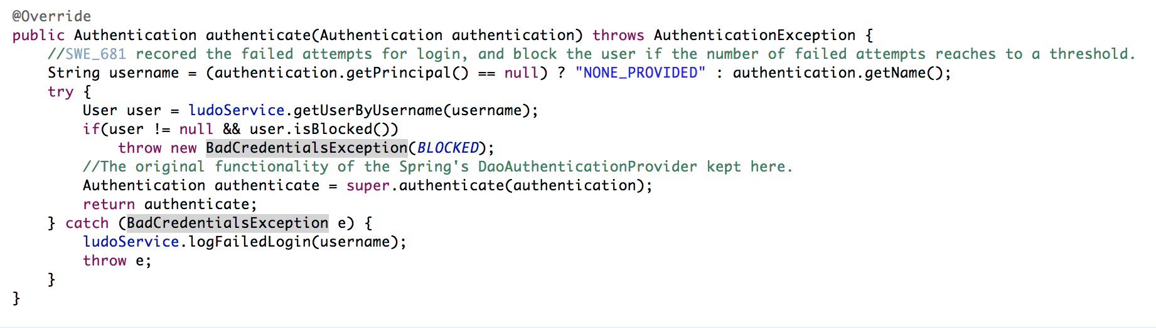
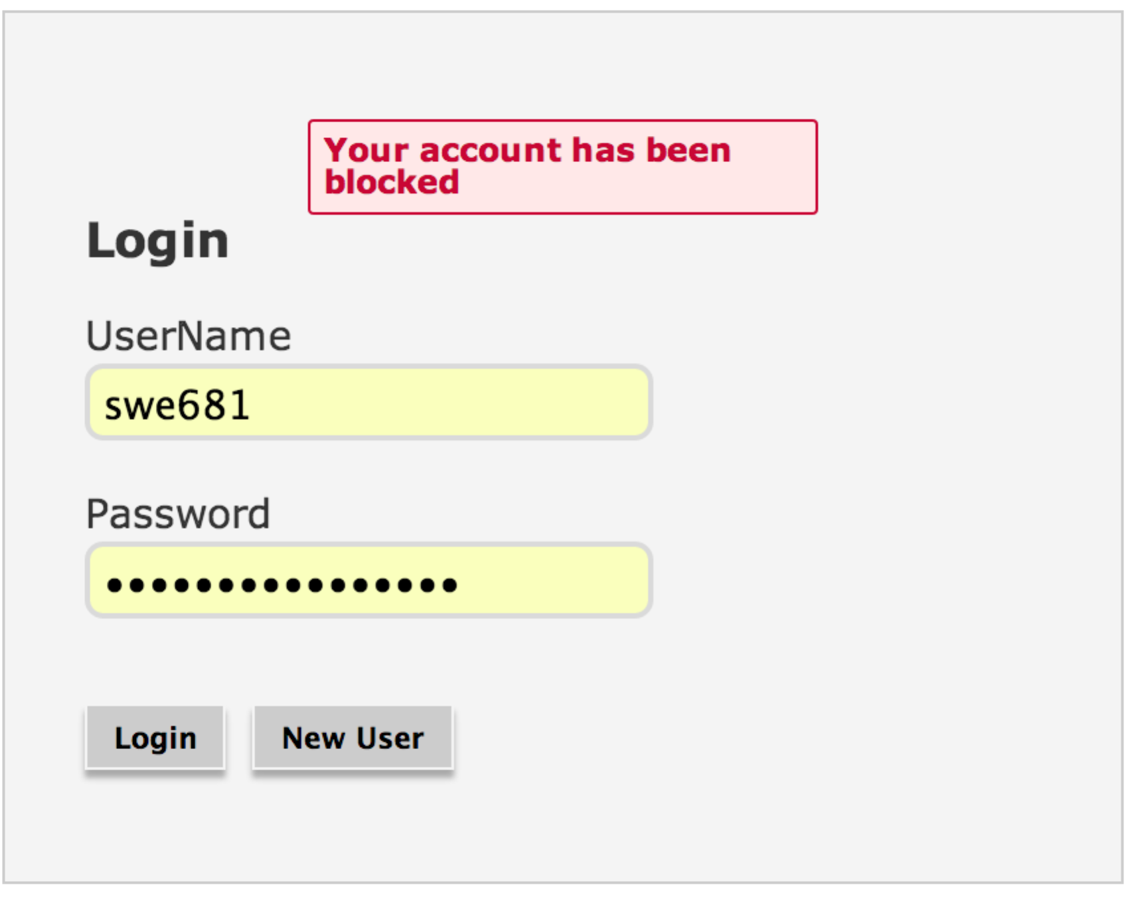
Authentication/Authorization
Failed login attempts are logged
The user’s account is blocked after MAX_FAILURE attempts.
Spring’s default AuthenticationFailureHandler and AuthenticationProvider methods are wrapped.

Slide 10
User Input Validation (syntactic)
Spring validation mechanism
Every user-filled object annotated with @Valid tag in controller beans
Server-side (non-bypassability)
Whitelist checking
@RequestMapping(value="/addUser.htm",method=RequestMethod.POST)
public String saveUser(Model model, @ModelAttribute @Valid User user, BindingResult result) {
if (result.hasErrors()) {
return "gameManager/addUser";
}
...
...
if (!user.getUsername().matches("^([a-zA-Z_0-9]){5,}$"))
errors.put("username", "user.username.invalid");

Slide 11
User Input Validation (Semantics)
Validity of the request is checked based on the current state of the game and the players. E.g.:
If an unauthorized player (who is not in the game) tries to join an started game
If a player tries to play out of his/her turn.
If a player tries to play an invalid move.
If a player who has left or won tries to make a move
…

Slide 12
Database issues
Database config file is encrypted
AES algorithm
Only SELECT, INSERT and UPDATE rights are granted to database user.
Least privilege principle
Counter SQL Injection
Hibernate Parameterized Query.
jdbc.driver=com.mysql.jdbc.Driver
jdbc.url=jdbc:mysql://localhost:3306/ludo
jdbc.user=swe681
jdbc.password=hoByACD7P0+8Dk6xGXM6hg==
String hql = "SELECT DISTINCT game FROM GameBoard game WHERE game.gameState = :state";
return getCurrentSession().createQuery(hql).setString("state", state.name()).list();

Slide 13
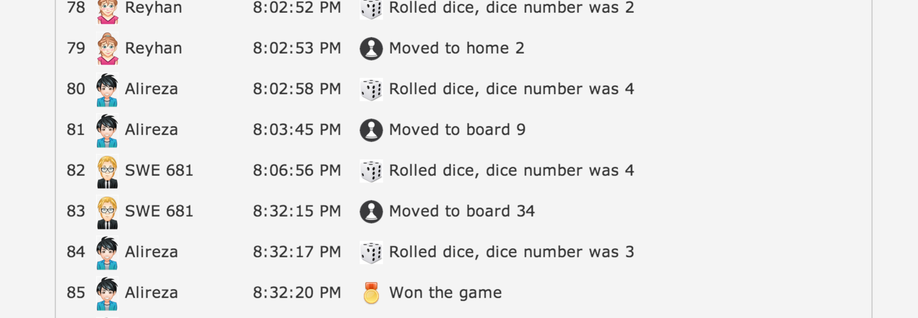
Other Requirements
Integrity
Audit trail of every game moves are stored.
Availability
If a user does not play for MAX_INACTIVE_TIME he/she will be automatically expelled from the game.
Error Information sent to the user is limited
Tomcat’s default error pages are customized.
<error-page>
<error-code>400</error-code>
<location>/error.html</location>
</error-page>
...
<error-page>
<exception-type>java.lang.Exception</exception-type>
<location>/error.html</location>
</error-page>

Slide 14
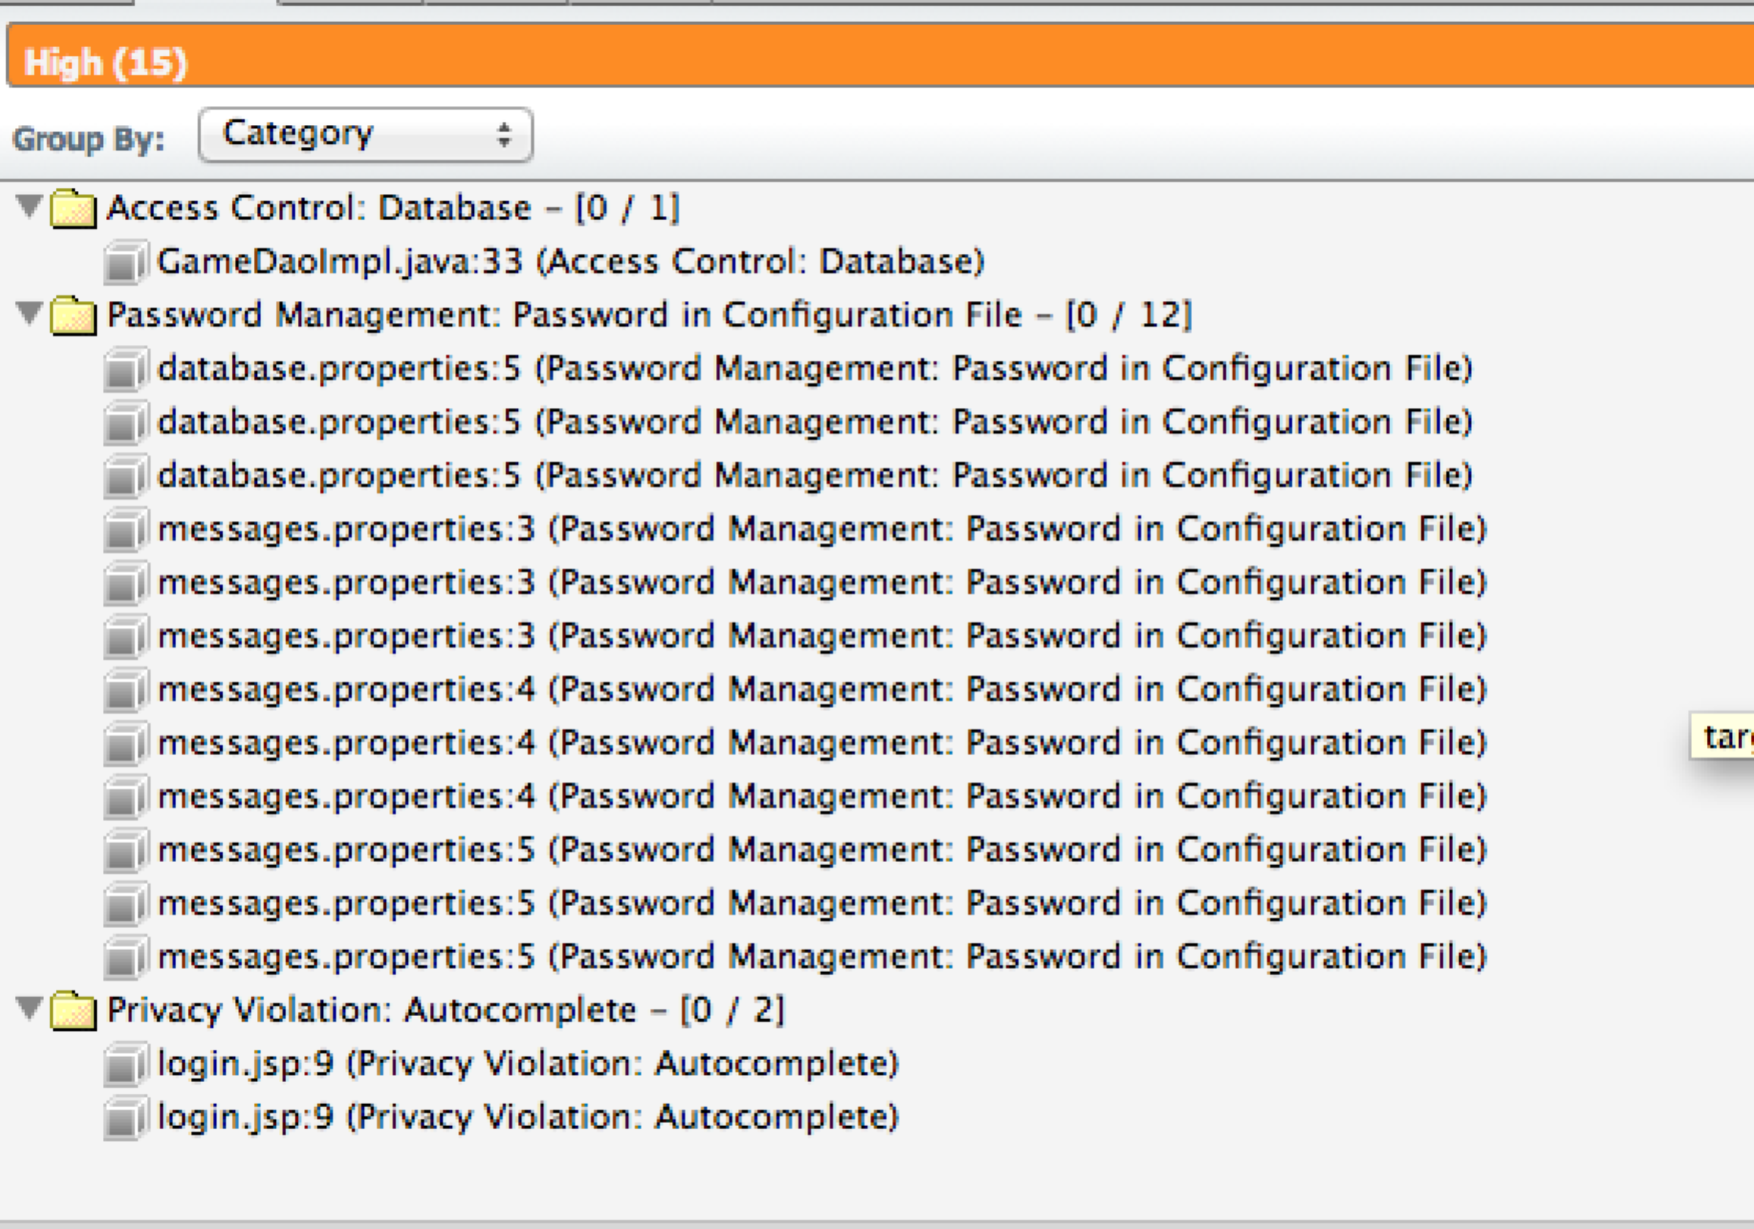
Static Analysis
Fortify
0 critical, 3 High and 0 medium issues.
Results has False Positives

Slide 15
Live Demo…

