Slide 1
notes

Slide 2
Logiciels
IDE : Vscode, Jetbrains, Emacs, vi, etc…
SCM : Git, SVN, Clearcase, Continuus, CVS, Mercurial
Browser : Chrome, Firefox, Edge, Safari, Opera
Node : nvm, nvm-windows

Slide 3
Vscode extensions
Prettier
Git Graph
Javascript Console Utils (whtouche)
Error Lens
Angular Language Service
Typescript Class Organizer
ESLint
Javascript ES6 code snippet
Surround

Slide 4
git
git init
git config --global user.name "Jean-Louis GUENEGO"
git config --global user.email jlguenego@gmail.com

Slide 5
npm
npm init
npm init -y
npm install express
npm install -g rimraf
npm ci
npm install -D typescript
npm exec = npx

Slide 6
HTTP
HTTP Request
client
server
HTTP Response
POST /sdfgsdf/sdfgsdf?s=34&&&&;;;::: HTTP/2.0
X-Mon-Truc: asdfasdfewewe
ererer: aeqwer
ffff: sfsdfsdf
Content-Length: 12
Content-Type: text/plain
qwerqwerqwer
HTTP/1.1 200 OK
X-Mon-Truc: asdfasdfewewe
ererer: aeqwer
ffff: sfsdfsdf
Content-Length: 12
Content-Type: text/html
Hello World!

Slide 7
Javascript histoire
1998
ES2
1995
Netscape
Javascript
1997
ECMAScript
2009
ES5
2015
ES6
1999
ES3
ES2015
ES2016
…
ES2023
ESNext
2007
v8
2012
Typescript
import/export
const/let
() => {}
class, extends, etc.
typage fort
interface, type, etc.
2009
Node
CommonJS
require
module.exports

Slide 8
Google chrome extension
Json Formatter
Angular DevTool

Slide 9
Angular
npm init @angular@latest
npx ng g m layout -m app
npx ng g c layout/xxx --export

Slide 10
AppRouting
App
Browser
App

Slide 11

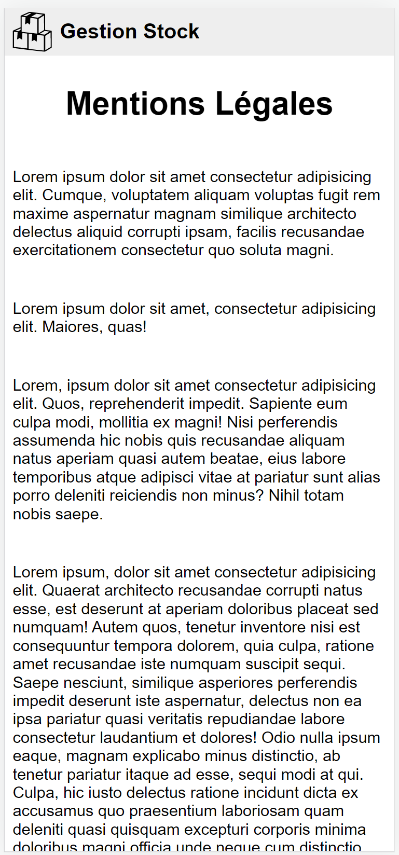

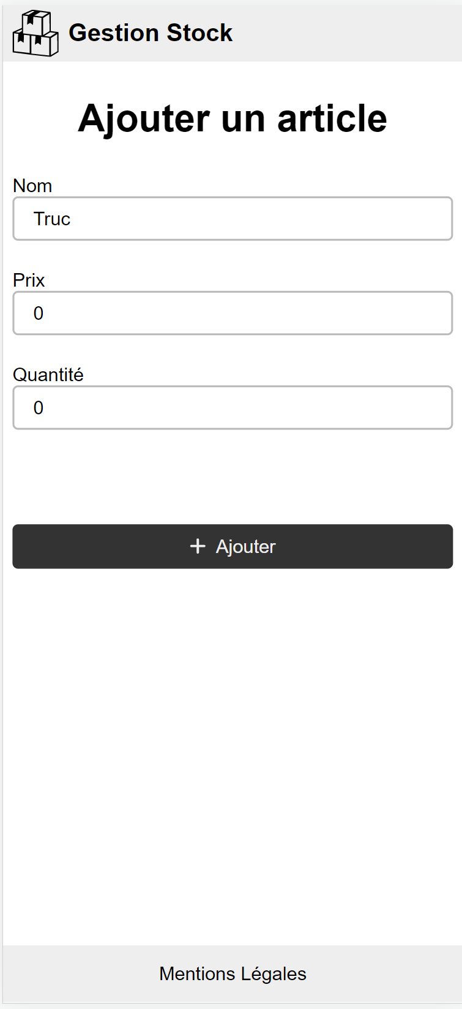
/
/legal
/stock
/stock/add

Slide 12
AppRouting
App
Layout
Browser
App
Header
Body
Footer

Slide 13
AppRouting
App
Step2
Layout
Browser
App
Step4
Header
./routes
Home
Body
Step3
Step1
Footer
Legal

Slide 14
Artefact angular
Modules : @NgModules, paquet de directive pipe et composant
Composant : @Component, intelligent visuel et communiquant
Directive : @Directive, intelligent, communiquant, emprunte un visuel
Pipe : @Pipe
Service : @Injectable

Slide 15
webographie
https://css-tricks.com/snippets/css/a-guide-to-flexbox/

Slide 16
AppRouting
App
Step2
Layout
Browser
Common
App
Step4
Header
./routes
Body
Home
StockRouting
Step3
Step1
Stock
Footer
Legal
Stock
Add

Slide 17
Lazy loading
Home
Stock

Slide 18
Observable
a
a
a
next
next
next
complete
a
a
a
next
next
next
error
a
a
next
next

Slide 19
interval
0
1
2
3
1
2
3
4
0
1
2
3
4

Slide 20
Heuristic refactoring
Eviter d'imbriquer : préférer enchainer, verticaliser
Fonction qui prend du temps a executer ? Alors utiliser Observable (rxjs)
of(undefined).pipe(…).subscribe()
Eviter les pointeurs null

Slide 21
switchMap
0
1
2

Slide 22
mergeMap
0
1
2

Slide 23
switchMap dans beaucoup de cas
0
0

Slide 24
etat1
etat2
action

Slide 25
AppRouting
App
Step2
Layout
Browser
Common
App
Step4
Header
./routes
Body
Home
StockRouting
Step3
Step1
Stock
Footer
Legal
Widget
Stock
AsyncButton
Add

Slide 26
CORS
ng serve
http://localhost:4200
Client
CORS
back
http://localhost:3000

Slide 27
ng serve
ng build
ng lint
ng test
ng e2e

Slide 28
ng test
compile
tous les test passent
couverture totale
test fonctionnel

Slide 29
Heuristique de test unitaire
Observable ? fakeAsync + tick() + tick(2000), flush()
Jasmine spy = SpyOn(object, 'method'). spy.and.returnValue()
HttpTestingController (simuler les requetes)
Savoir acceder au template d'un composant :
fixture.nativeElement.querySelector
fixture.componentInstance (composant lui meme)

