Slide 1
Notes

Slide 2
Logiciels
IDE : VSCode, JetBrains
NodeJS (node, npm, npx) : nvm-windows
SCM : git, svn, mercury, clearcase, etc.
Browser : Chrome, Safari, Firefox, Edge

Slide 3
git
git init

Slide 4
node.exe
node <script>

Slide 5
npm
npm install -g <module-node>
npm init [name]
npm init
npm init -y
npm install <module-node>
npm install -D <module-node>
npm run <script>

Slide 6
npx
npx <executable-dans-.bin>
npx <module-node>

Slide 7
Webographie
https://www.conventionalcommits.org/en/v1.0.0/
https://semver.org/

Slide 8
VSCode extensions
Git Graph
Error Lens
Javascript Console Utils
Prettier
Angular Language Service
Eslint
SonarLint
Typescript Class Organizer

Slide 9
HTTP
HTTP Request
Client
Server
HTTP Response
POST /qqq/a?sss HTTP/2.0
asdfasd: asdfasdf
cccc: asdfasdf
Content-Length: 12
qqqwwweeeddd
HTTP/1.1 201 Created
asdfasd: asdfasdf
Content-Type: text/octet-stream
Content-Length: 12
Hello World!

Slide 10
Typescript
xxx.ts
xxx.js

Slide 11
1995
Javascript
Netscape
1998
ES2
2015
ES6
1999
ES3
2009
ES5
1997
ECMAScript
tc39
2007
Chrome
v8
2012
Typescript
class, extends
import/export
let/const
ES2015
ES2016
…
ES2023
ESNext
NodeJS
CommonJS=require, module.exports

Slide 12
Artefacts
Modules (@NgModules)
Composant (@Component)
Directive (@Directive)
Pipe (@Pipe)
Service (@Injectable)

Slide 13

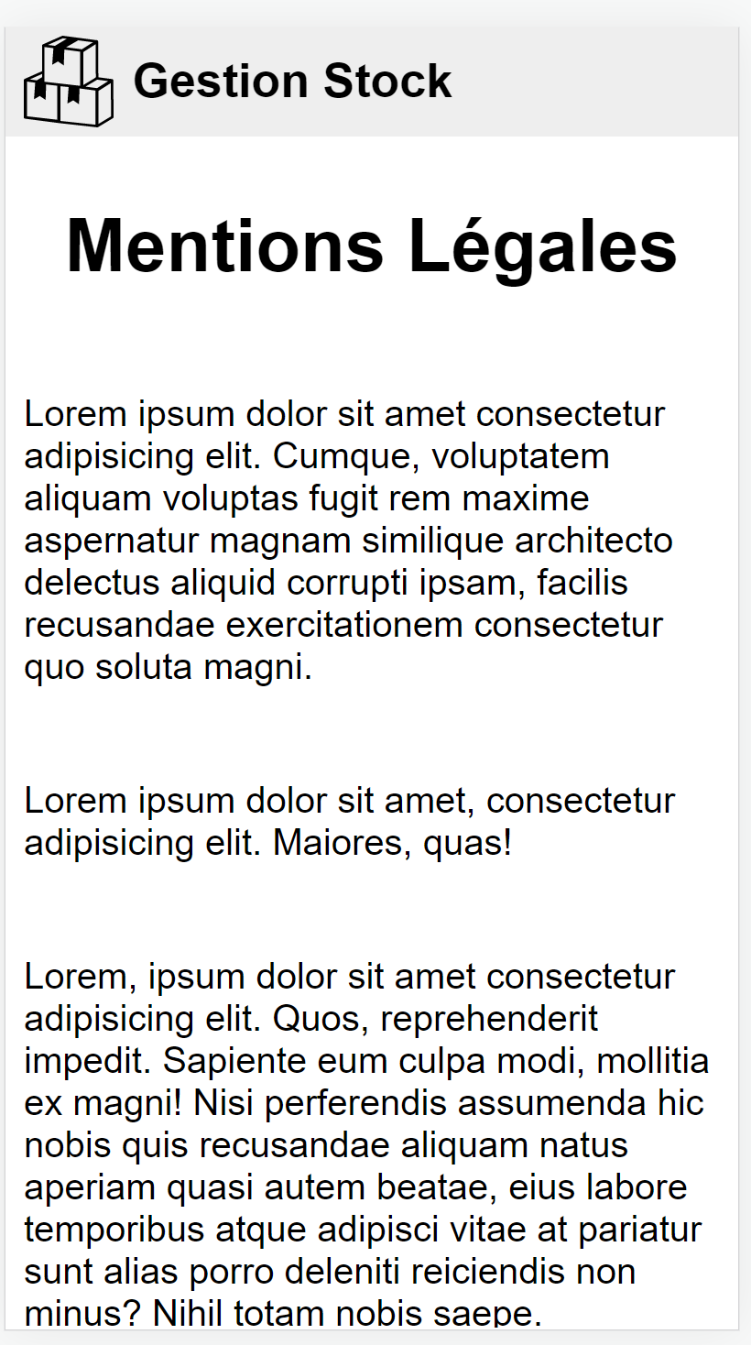
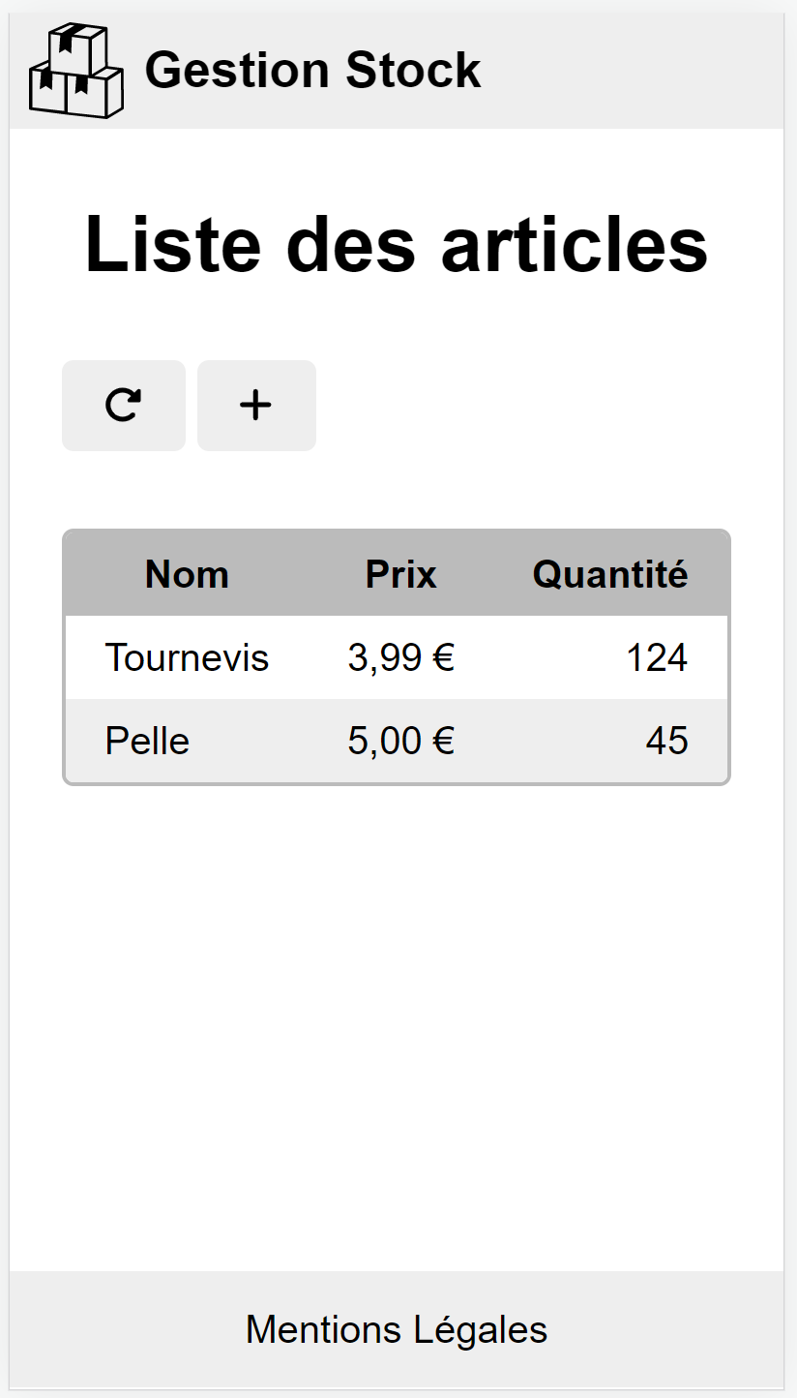
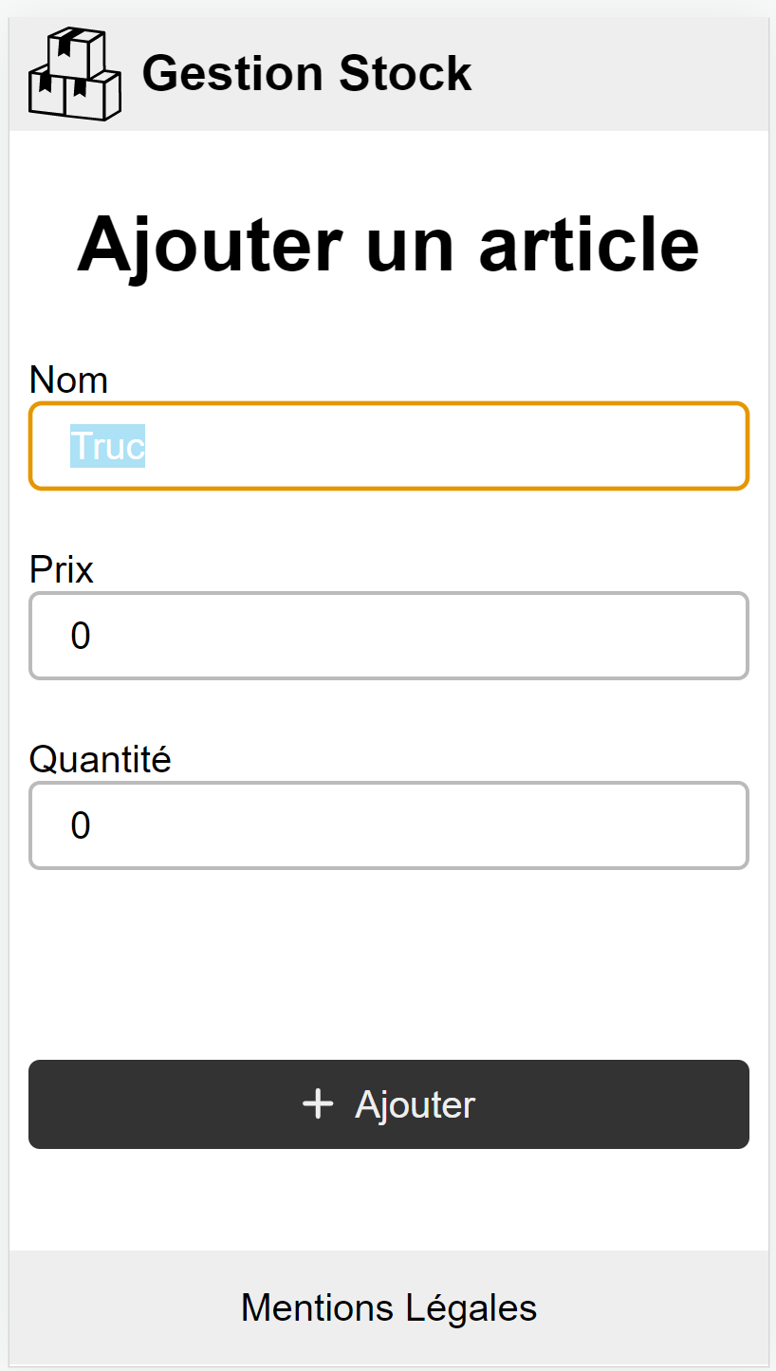
/
/legal
/stock
/stock/add

Slide 14
Browser
App
AppRouting
App

Slide 15
Common
Browser
App
AppRouting
Layout
App
Header
Body
Footer

Slide 16
Router
App
AppRouting
Step2
Layout
App
Step4
Header
routes/
Bodyk
Home
Step3
Step1
Footer
Legal
Step4

Slide 17
Router
App
AppRouting
Step2
Layout
App
Step4
Header
routes/
Bodyk
Home
Step3
Step1
Stock
StockRouting
Footer
Widgets
Legal
Step4
Stock
AsyncIconButton
Add

Slide 18
Lazy loading

Slide 19
Observable
x
a
e
y
next(x)
obs.subscribe()
complete
2
1
9
5
error(err)
2
1
9

Slide 20
of(23)
23
complete

Slide 21
o1.pipe(switchMap(() => o2))
o1
o2
o2
o2

Slide 22
o1.pipe(mergeMap(() => o2))
o1
o2
o2
o2

Slide 23
CORS
http://localhost:4200
Client
CORS
http://localhost:3000

Slide 24
CI
ng serve
ng lint
ng test

Slide 25
les tests doivent compiler
les tests doivent passer
les tests doivent avoir une couverture minimum du code.
les tests doivent refléter le métier

Slide 26
ta prod
nginx
chrome
xxx

