Slide 1
Notes

Slide 2
logiciels
SCM: git
IDE: vscode, jetbrains, eclipse
navigateur: chrome, edge, safari, firefox
node: volta, nvm, node 18

Slide 3
1998
ES2
1995
Netscape
Javascript
1997
ECMAScript
1999
ES3
2009
ES5
2012
typescript
import/export
let/const
2015
ES6
2007
v8
2009
node
CommonJS

Slide 4
npm
npm init -y
npm install <lib>
npm install <lib> -D
npm install

Slide 5
git
git init
git config --global user.name "Jean-Louis GUENEGO"
git config --global user.email jlguenego@gmail.com

Slide 6
Vscode extensions
Prettier
Javascript Console Util (whtouche)
Error Lens
Git Graph
Javascript (ES6) Code Snippet
Angular Language Service
ESLint
Template String Converter
Typescript Class Organizer
Surround : (try catch)

Slide 7

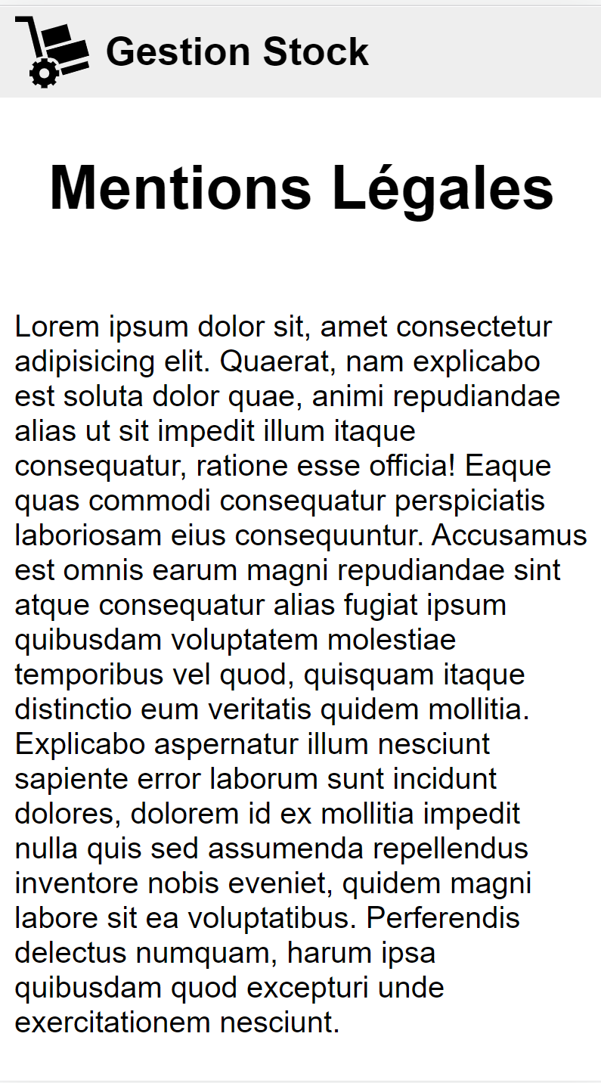
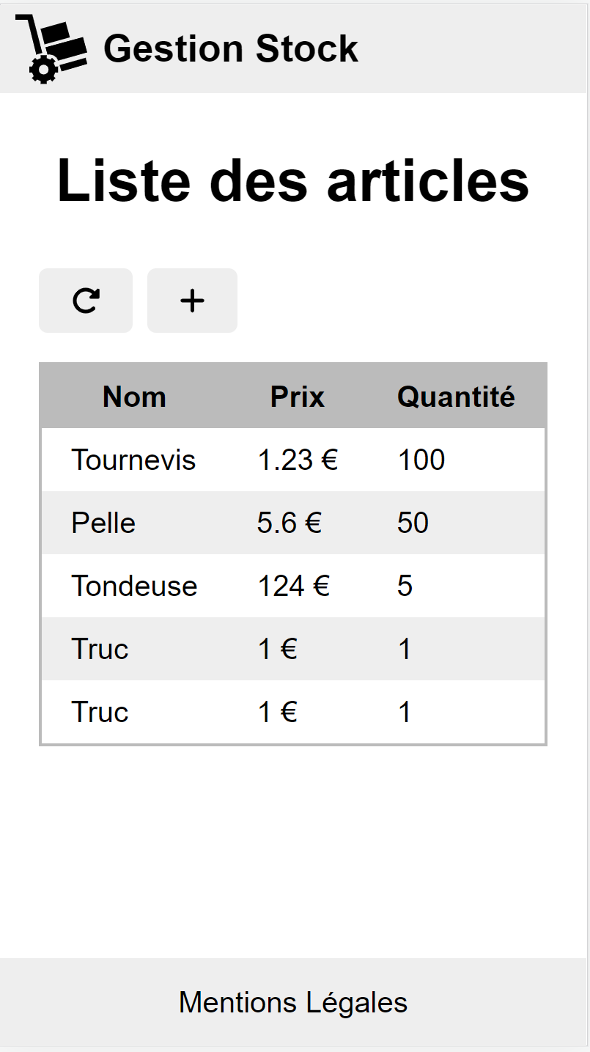
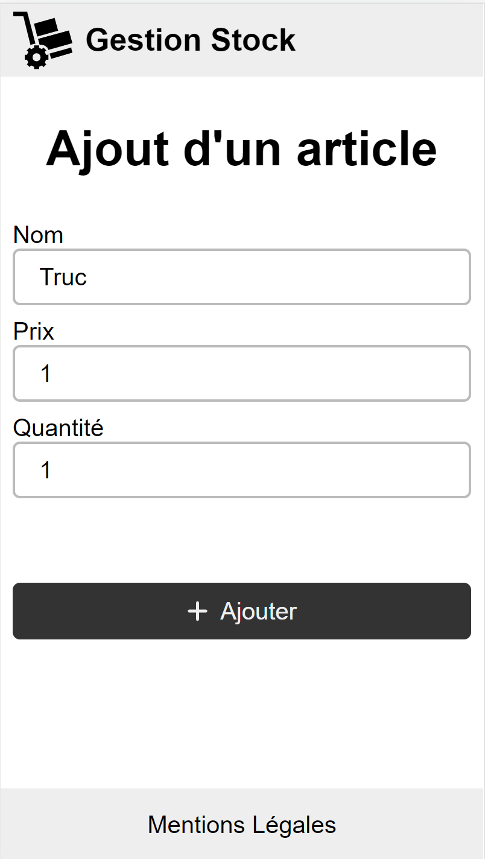

Slide 8
Artefacts
Modules angular : @NgModule
composants, directives, pipes
injecteur
Composant : @Component
Visuel, Intelligent, Communicatif
Directive : @Directive
Pipe : @Pipe
Service : @Injectable

Slide 9
Browser
App
AppRouting
App

Slide 10
Browser
App
AppRouting
Layout
App
Header
Body
Footer

Slide 11
Commande ng
ng g m layout -m app

Slide 12
Browser
App
AppRouting
Step2
Layout
App
./routes
Step4
Header
Home
Step1
Body
Legal
Step3
Footer
Step4

Slide 13
Browser
App
AppRouting
Step2
Layout
App
./routes
Step4
Header
Home
StockRouting
Step1
Body
Legal
Stock
Step3
widget
Footer
Stock
Step4
autofocus
Add
AsyncBtn

Slide 14
CPU
Carte reseau

Slide 15
observables
o1
o2
o2
next
next
next
obs.subscribe()
complete
o1
o2
o2
next
next
next
error
obs.subscribe()
const obs = new Observable((subscriber) => {…})

Slide 16
observables
o1
next
const subscription = obs.subscribe()
subscription.unsubcribe()
const obs = new Observable((subscriber) => {…})

Slide 17
a
b
c
complete
…
0
1
2
…
1
2
3
…
0
1
2
3

Slide 18
localhost:4200
dev
client
CORS
back
localhost:3000

Slide 19
localhost:4200
dev
client
CORS
back
localhost:3000

Slide 20
ng serve
ng build
ng lint
ng test
ng e2e

Slide 21
4 niveaux de tests unitaires
Tests compile
Test pass
Couverture de test a 100%
Les tests sont fonctionnelles

Slide 22
SwitchMap

Slide 23
MergeMap

