Slide 1
notes

Slide 2
logiciels
IDE : Vscode, jetbrains (webstorm, phpstorm, etc.)
Browser: Google Chrome, Microsoft Edge, Safari, Firefox
NodeJS: volta, nodejs
SCM : git, svn, cvs, tfs, clearcase, continuus, mercurial

Slide 3
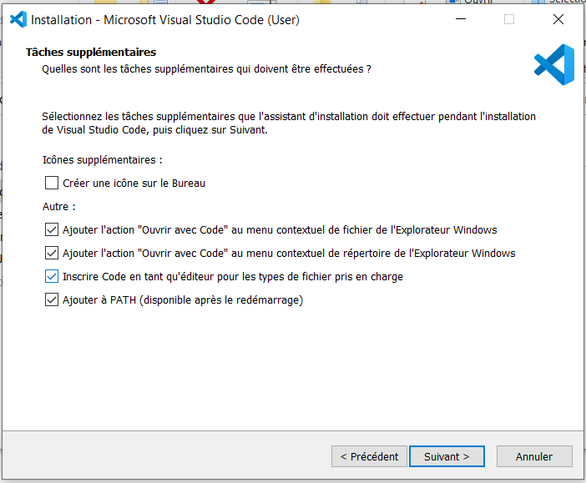
Vscode install
A cocher

Slide 4
Histoire JS
1998
ES2
2009
ES5
1995
Netscape
Javascript
1997
ECMAScript
1999
ES3
2015
ES6
2007
Chrome
v8
ES2015
ES2016
...
ES2023
ESNext
2009
nodeJS
commonJS
2012
Typescript
const/let
import/export

Slide 5
git
git init
git config --global user.name "Jean-Louis GUENEGO"
git config --global user.email jlguenego@gmail.com

Slide 6
vscode extensions
Git Graph
Prettier
Javascript Console Utils
Error Lens
Angular Language Service

Slide 7
node
node.exe
npm
npx

Slide 8
npm
npm init
npm i express
npm i
npm ci
npm i typescript -D

Slide 9
HTTP
HTTP Request
client
server
HTTP Response
POST /toto/titi.html?xx HTTP/3.0
Content-Type: text/plain
sdfdsf: yyyy
aaaaa: dfgdfgdf
gdfgfdgfdg: dfgdfgdf
Content-Length: 12
azerazerazer
HTTP/1.1 201 Created
Content-Type: application/json
sdfdsf: yyyy
aaaaa: dfgdfgdf
gdfgfdgfdg: dfgdfgdf
Content-Length: 12
[1,2,"toto"]

Slide 10
AppRouting
App
Browser
App

Slide 11
artefacts
Module @NgModule
Component @Component
Directive @Directive
Pipe @Pipe
Service

Slide 12
AppRouting
App
Browser
Layout
App
Header
Body
Footer

Slide 13
AppRouting
Router
step2
App
Browser
Layout
App
step4
Header
./routes
step3
Body
Home
Footer
step1
Legal

Slide 14
AppRouting
Router
step2
App
Browser
Layout
App
step4
Header
./routes
step3
Body
StockRouting
Home
Footer
step1
Legal
Stock
Stock
Add

