Slide 1
notes

Slide 2
logiciels
IDE : Vscode, jetbrains (webstorm, phpstorm, etc.)
Browser: Google Chrome, Microsoft Edge, Safari, Firefox
NodeJS: volta, nodejs
SCM : git, svn, cvs, tfs, clearcase, continuus, mercurial

Slide 3
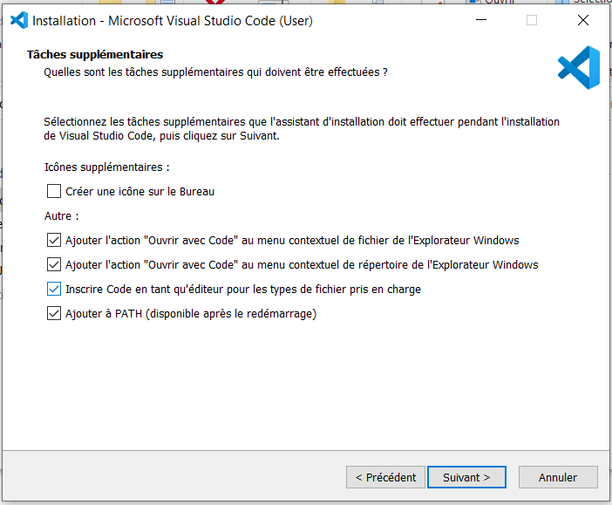
Vscode install
A cocher

Slide 4
Histoire JS
1998
ES2
2009
ES5
1995
Netscape
Javascript
1997
ECMAScript
1999
ES3
2015
ES6
2007
Chrome
v8
ES2015
ES2016
...
ES2023
ESNext
2009
nodeJS
commonJS
2012
Typescript
const/let
import/export

Slide 5
git
git init
git config --global user.name "Jean-Louis GUENEGO"
git config --global user.email jlguenego@gmail.com

Slide 6
vscode extensions
Git Graph
Prettier
Javascript Console Utils
Error Lens
Angular Language Service
Javascript (ES6) Snippet
TypeScript Class Organizer

Slide 7
node
node.exe
npm
npx

Slide 8
npm
npm init
npm i express
npm i
npm ci
npm i typescript -D

Slide 9
HTTP
HTTP Request
client
server
HTTP Response
POST /toto/titi.html?xx HTTP/3.0
Content-Type: text/plain
sdfdsf: yyyy
aaaaa: dfgdfgdf
gdfgfdgfdg: dfgdfgdf
Content-Length: 12
azerazerazer
HTTP/1.1 201 Created
Content-Type: application/json
sdfdsf: yyyy
aaaaa: dfgdfgdf
gdfgfdgfdg: dfgdfgdf
Content-Length: 12
[1,2,"toto"]

Slide 10
AppRouting
App
Browser
App

Slide 11
artefacts
Module @NgModule
Component @Component
Directive @Directive
Pipe @Pipe
Service

Slide 12
AppRouting
App
Browser
Layout
App
Header
Body
Footer

Slide 13
AppRouting
Router
step2
App
Browser
Layout
App
step4
Header
./routes
step3
Body
Home
Footer
step1
Legal

Slide 14
AppRouting
Router
step2
App
Browser
Layout
App
step4
Header
./routes
step3
Body
StockRouting
Home
Footer
step1
Legal
Stock
Stock
Add

Slide 15
lazy loading
Home
Stock
main.js
stock.js

Slide 16
observable
const o = new Observable(subscriber => {
})
o.subscribe()
complete
error
o.subscribe()
const s = o.subscribe()
s.unsubscribe()

Slide 17
CPU
Ext
ext
CPU
RAM

Slide 18
webographie
https://rxmarbles.com/#map
https://rxjs.dev/
https://refactoring.guru/refactoring
"css flex game", "css grid game", "ux lois github"

Slide 19
CORS
localhost:4200
ng serve
client
CORS
localhost:3000
back end

Slide 20
Proxy
localhost:4200
ng serve
client
localhost:3000
back end

Slide 21
CI
ng serve
ng build
ng lint
ng test
ng e2e

Slide 22
test
all tests compile
all tests pass
all tests cover
all tests functional

