Slide 1
notes

Slide 2
git
git init

Slide 3
Webographie
https://semver.org/
https://github.com/tc39/proposals/blob/main/finished-proposals.md

Slide 4
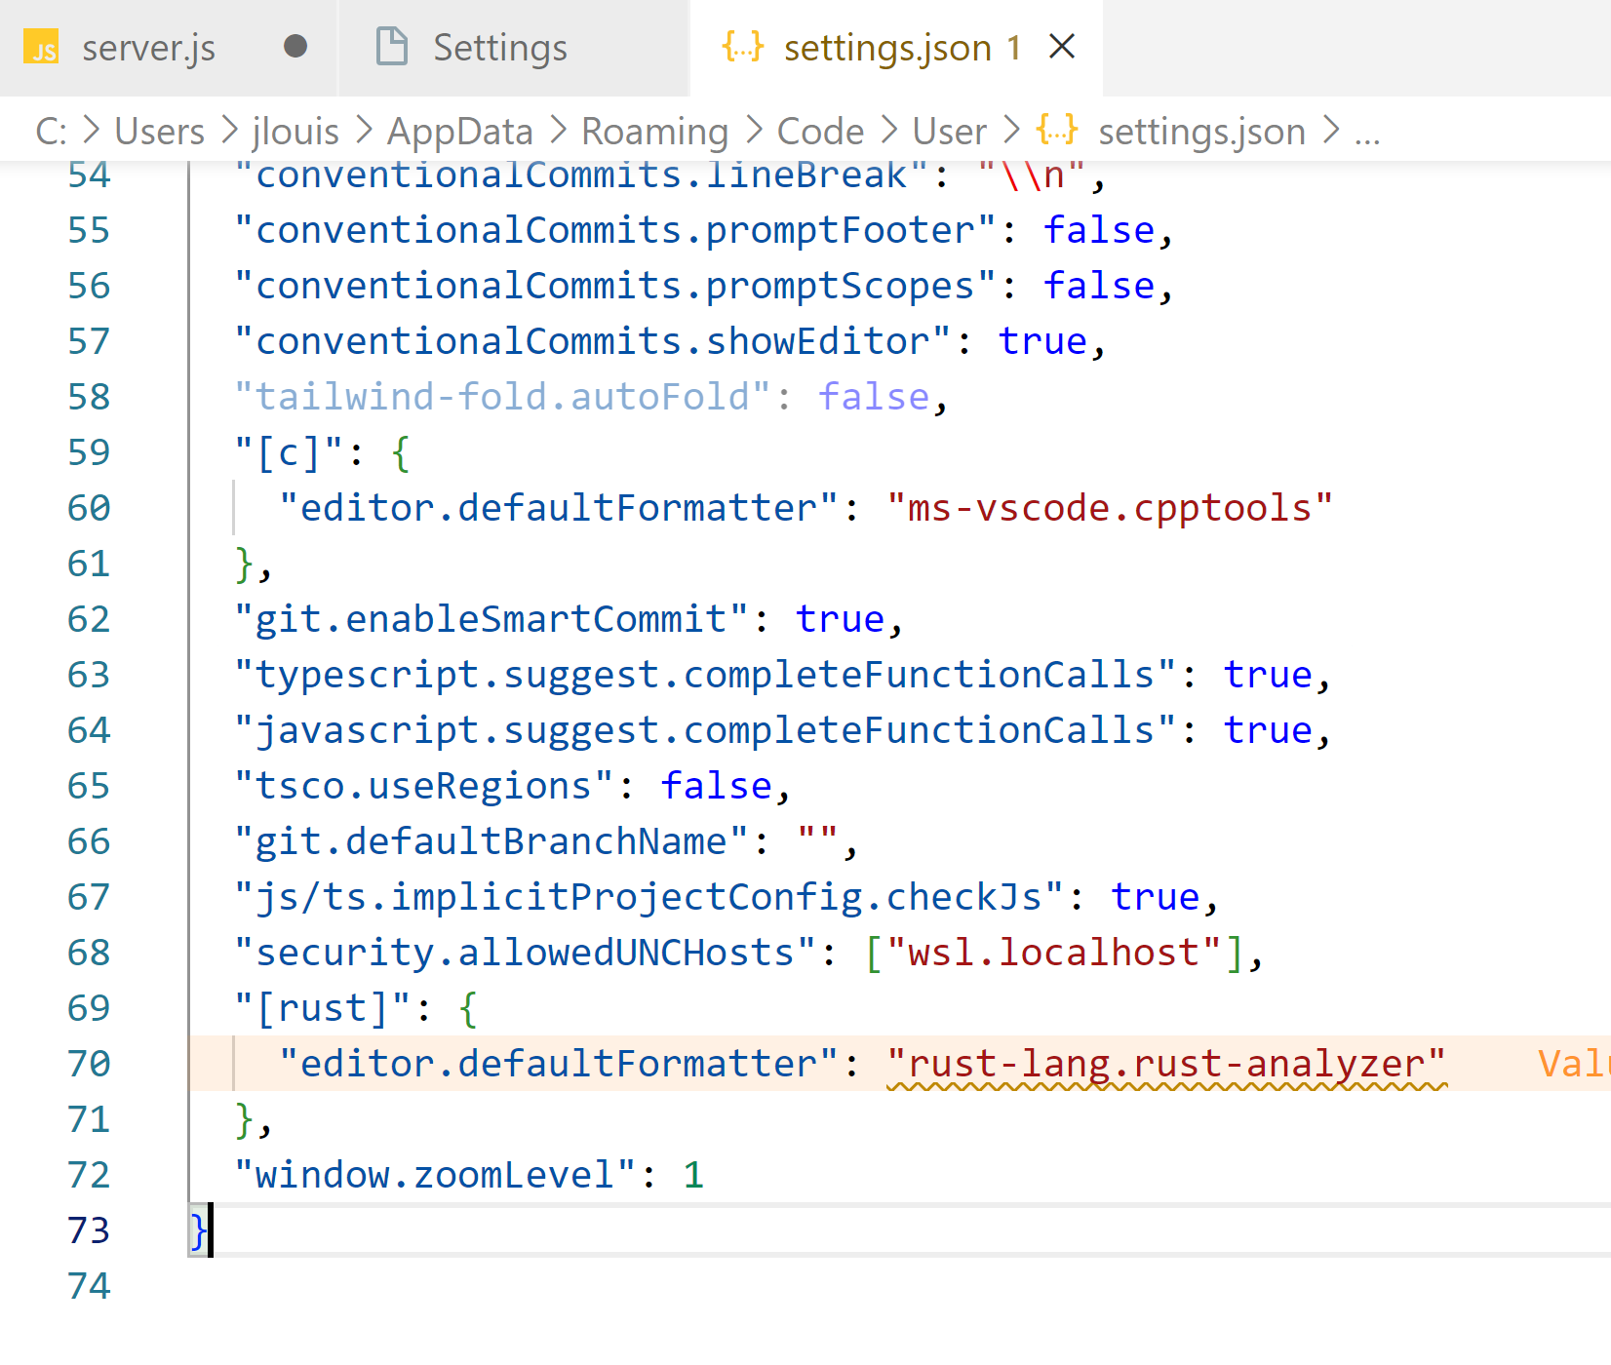
javascript config vscode
console.log()

Slide 5
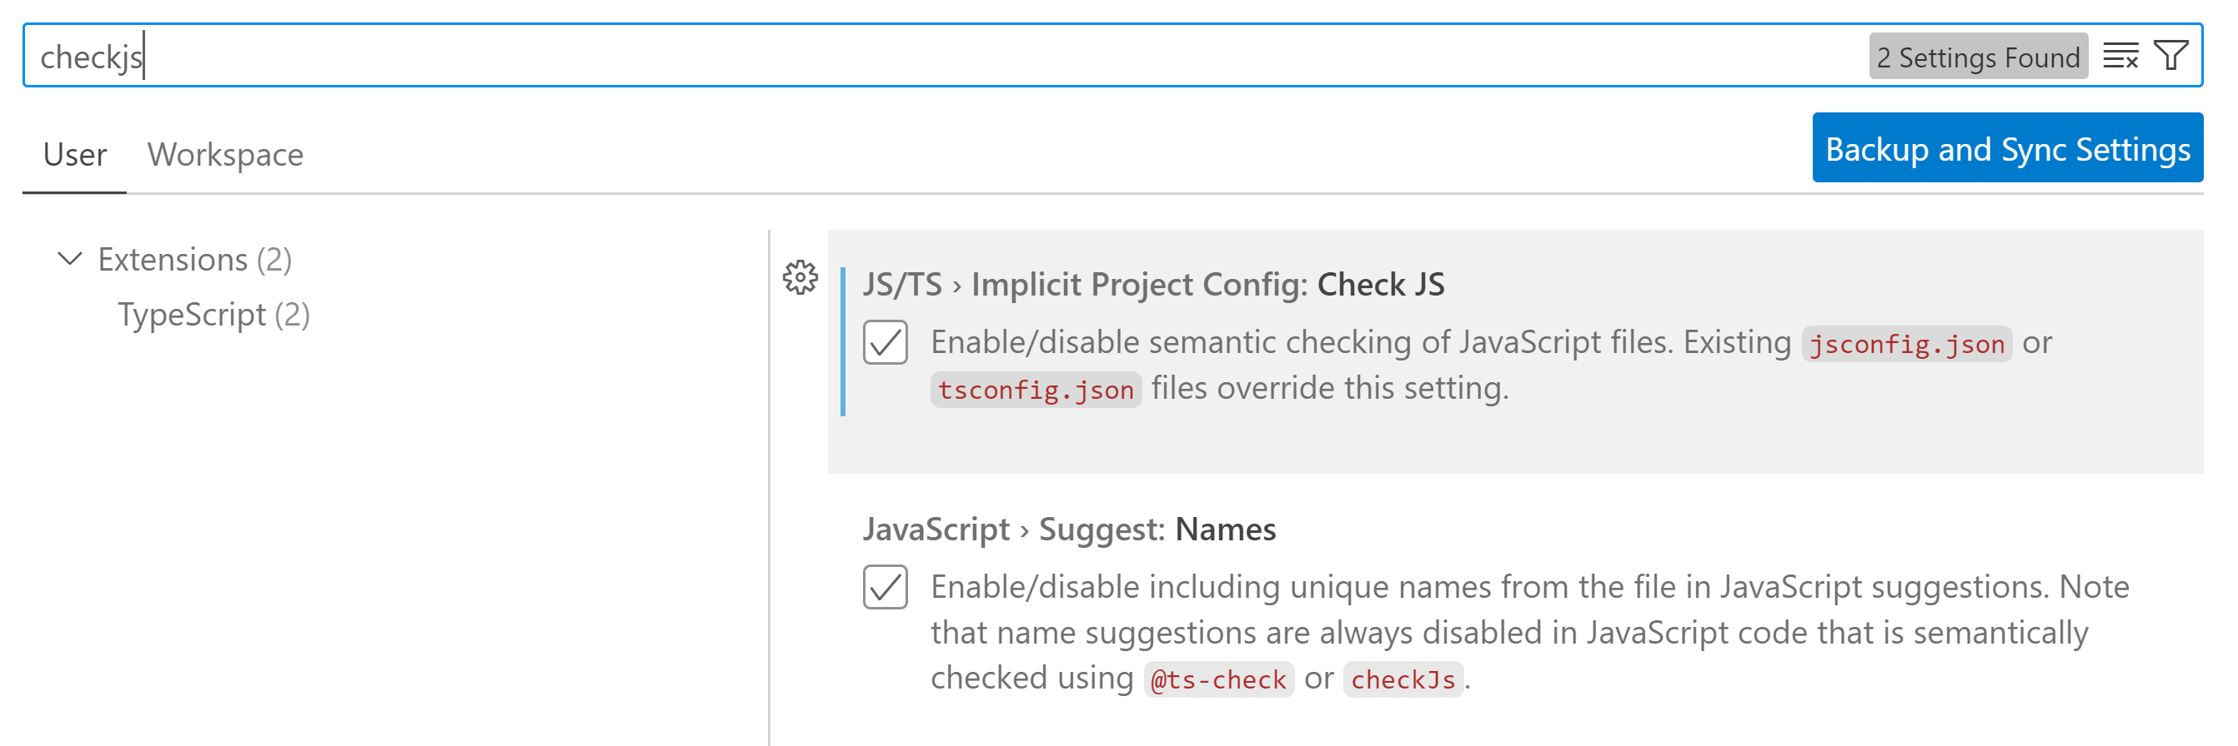
javascript checkjs

Slide 6
Vscode
JavaScript (ES6) code snippets
Javascript console utils (whtouche)
Prettier
Git Graph
Material Icon Theme
Thunder Client
SVG
Angular Language Service
Template String Converter
TypeScript Class Organizer

Slide 7
npm
npm init
npm init -y
npm install <librairie>
npm install
npm install -g rimraf

Slide 8
Historique de JS
1998
ES2
1999
ES3
2009
ES5
2015
ES6
ES2015
1995
Netscape
Javascript
1997
ECMAScript
2012
Typescript
const/let
import/export
class, extends
() => {}
typage expl.
2009
Nodejs
import x from y
export x
ESM
const x = require('x')
module.exports = x
CommonJS

Slide 9
HTTP
client
HTTP request
server
HTTP response
HTTP Request
POST /asdfasdf/werwer/ddfdf?asdfasdf HTTP/2.0
X-Ma-Joli-Entete: qqq@#$
qwerqwerqwre: sdfsdfsd
dfdfdfdf: asdfasd
Host: www.toto.com:5656
werwerwer: sdfsdfsdf
Content-Length: 13
Content-Type: application/json
{''toto'': 123}
HTTP Response
HTTP/1.1 200 OK
Date: Wed 12 Jan 12:34 GMT
X-Powered-by: express
ererer: sdfsdfsdf
Content-Length: 2
Content-Type: text/plain
Access-Control-Allow-Origin: *
ok

Slide 10
architecture composant

Slide 11
composant
composant
visuel
intelligent
communicant

Slide 12
App
Layout
Header
Body
Footer

Slide 13
5 artefacts
Composant : @Component
Directive : @Directive
Pipe : @Pipe
Module : @NgModule
Service : @Injectable

Slide 14
CPU
CtrlDD

Slide 15
modules
module node : repertoire qui contient un fichier package.json
module typescript : fichier qui contient au moins une instruction import ou export
module EcmaScript : (ES Module) fichier qui contient au moins une instruction import ou export

Slide 16
observable
cycle de vie :
definir
lancer
fin de vie (interruption, fini en erreur ou en succes)

Slide 17
definition
const obs = new Observable((subscriber) => {…})

Slide 18
lancer
const subscription = obs.subscribe()
next
next
next
complete
next
next
next
error
subscription.unsubscribe()
next
next

Slide 19
0
1
2
…
startWith(-1)
-1
0
1
2
…
map(x => x + 1)
0
1
2
3
…
take(3)
1
2
…
0

Slide 20
CORS
localhost:4200
ng serve
client
localhost:3000
CORS
express

Slide 21
Proxy
localhost:4200
ng serve
client
localhost:3000
express

Slide 22
Proxy
localhost:4200
server frontal
client
localhost:3000
express

