Slide 1
Notes formation angular

Slide 2
Logiciels à installer
IDE : Vscode, Jetbrain
Browser : Chrome, Edge, Firefox, Safari
NodeJS : node, npm, npx
SCM : Git, SVN, CVS, Mercurial, Continuus, Clearcase

Slide 3
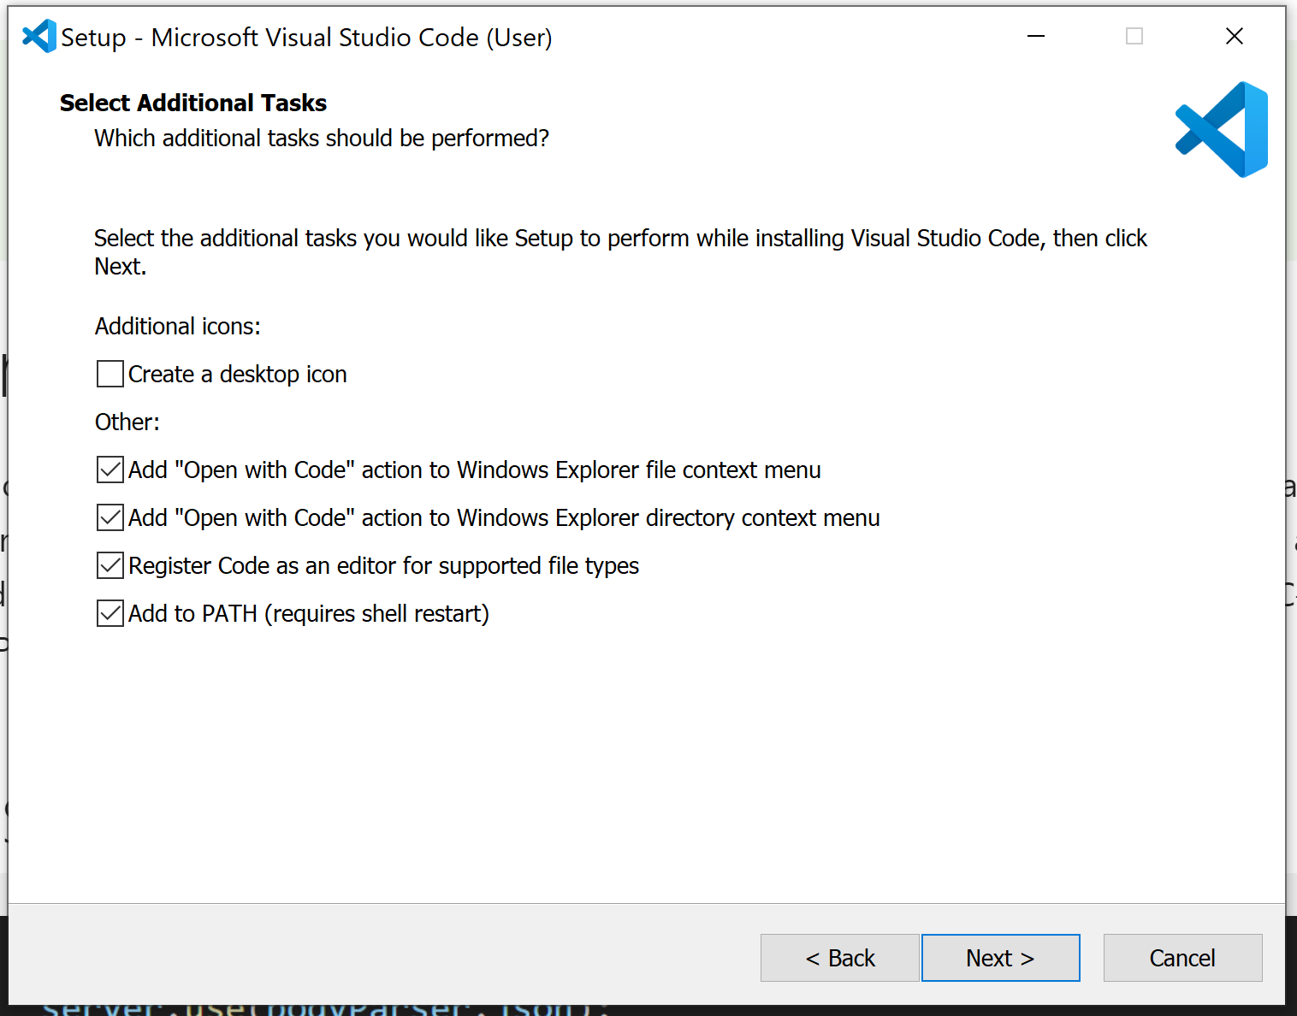
Cocher les case "open with code"

Slide 4

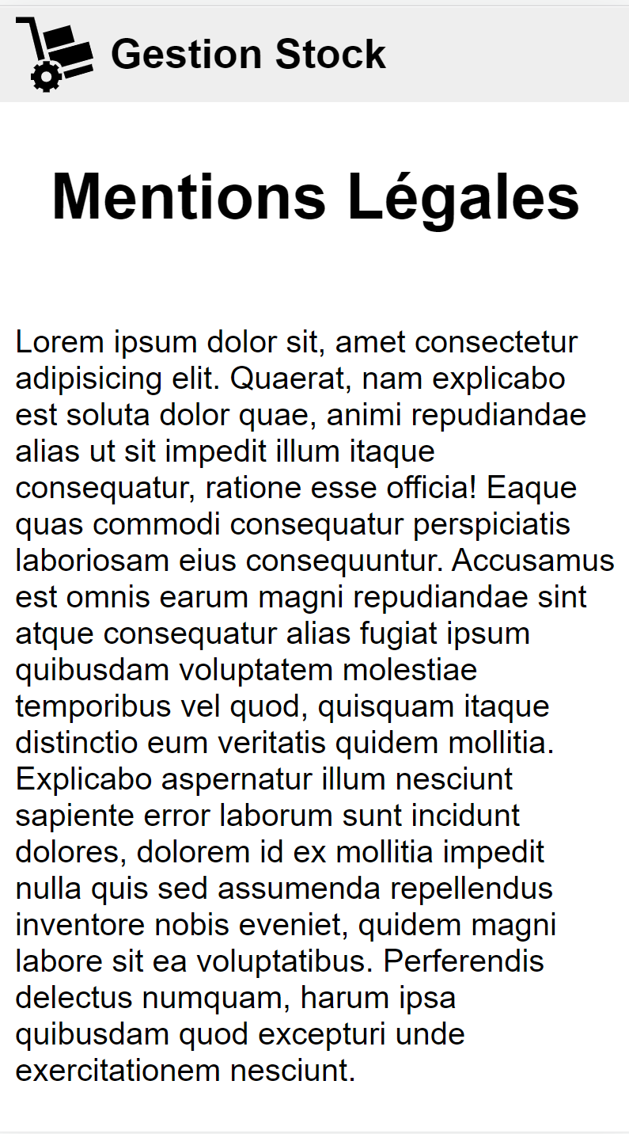
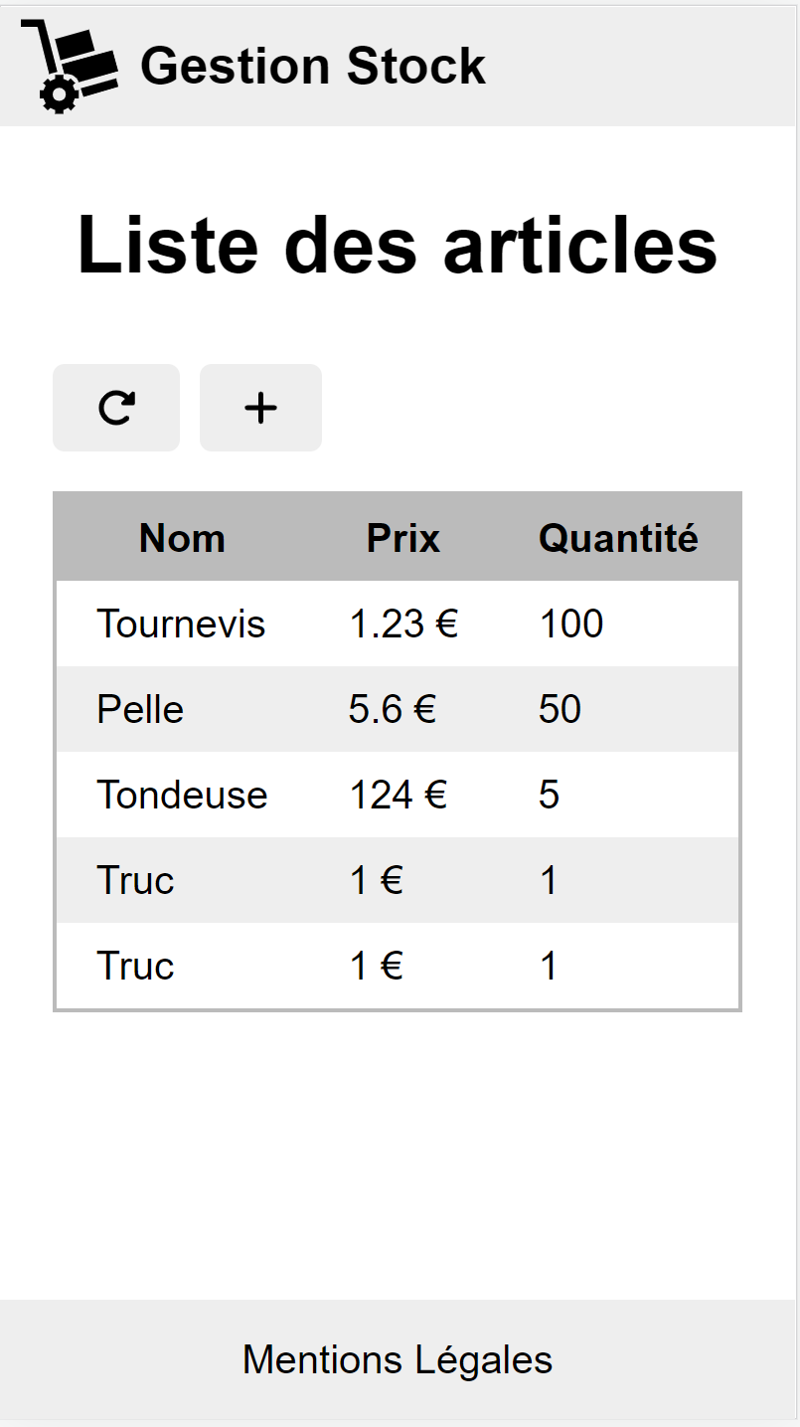
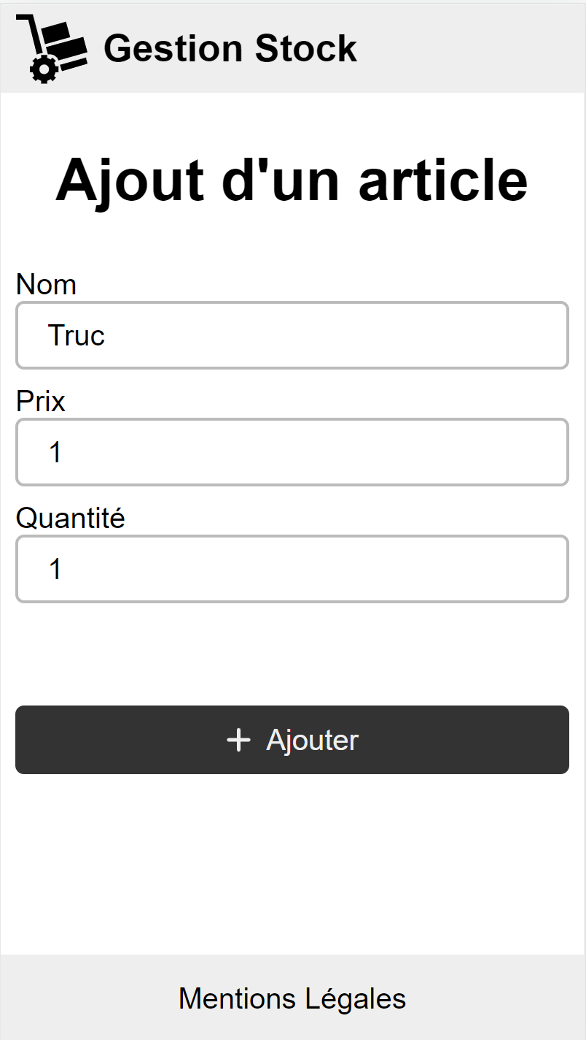
/
/stock
/stock/add
/legal

Slide 5
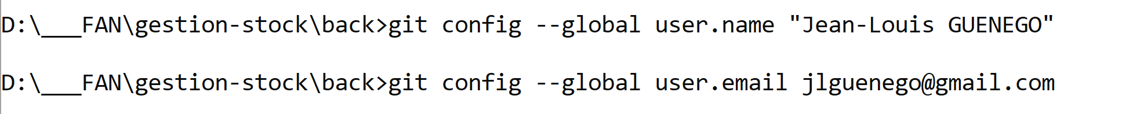
git
git init

Slide 6
Vscode extensions
Javascript console utils (whtouche)
Intellicode … (microsoft)
Prettier
Git Graph

Slide 7
npm
npm init -y
npm install <librairie>
npm install -D <librairie-de-dev>

Slide 8
HTTP
HTTP Request
Client
Server
HTTP Response
POST /aaa/bbb/cc?qwerqwererwer HTTP/3.0
sdfsdfsdf: asdfasdfasdf
dfdfdfdf: asdfasdfeee
zzzzz: asdfasdfasdf
Content-Length: 2
Content-Type: application/json
{}
HTTP/1.1 201 Created
sdfsdfsdf: asdfasdfasdf
dfdfdfdf: asdfasdfeee
zzzzz: asdfasdfasdf
Content-Length: 13
Content-Type: application/json
{''hello'':123}

Slide 9
Histoire JS
1998
ES2
1995
Netscape
Javascript
1997
ECMAScript
1999
ES3
2009
ES5
2011
ES5.1
'use strict'
2015
ES6
ES2015
2016
ES7
ES2016
jQuery
q
ES2016
ES2017
ES2018
…
ES2023
ESNext
XMLHttpRequest
AngularJS
fetch

Slide 10
myApp
app
layout
layoutHeader
layoutBody
layoutFooter

Slide 11
Webographie
https://caniuse.com/
https://css-tricks.com/snippets/css/a-guide-to-flexbox/
https://flexboxfroggy.com/
http://es6-features.org/
https://angularjs.org/

Slide 12
to do list
Rajouter qq icones
Retrouver liste article depuis back-end
Selectionner un article, bouton supprimer si au moins 1 selectionne
Programmer le bouton refresh
Programmer le bouton supprimer
Traiter un formulaire
Soumettre le formulaire :
ajoute l'article dans le back-end
redirige la page vers la /stock

Slide 13
home.html
stock.html

Slide 14
programmation asynchrone
htmlfini
click
hover
CPU
DD
DD
CPU
RAM

Slide 15
CORS
localhost:9000
webpack dev server
Client
CORS
localhost:3000
back-end

Slide 16
Extension chrome (edge)
JSON Formatter

