Slide 1
Liste des choses a installer
VSCode
Node
Git
Tortoisegit

Slide 2
Gestion stock
Mkdir gestion-stock
Cd gestion-stock
Git init
Mkdir back
Cd back
Npm init
Npm install express

Slide 3
Architecture HTTP
Client HTTP
Requete HTTP
Server HTTP
Reponse HTTP
1ere ligne
POST / HTTP/2.0
Content-Length: 23
Cle2: Valeur2
Asdfasdfasdfasf
asdfasdfasdf
HTTP/1.1 200 OK
Content-Length: 12
Content-Type: text/plain
Hello World!
Header
Body
http://localhost:3000/toto/titi

Slide 4
Extensions VSCODE
Git Graph
Prettier
Angular Language Service
Javascript console utils (whtouche)

Slide 5
VSCODE config
Configurer Prettier pour le formattage
Format on Save.

Slide 6
Package.json
Dependancies
DevDependancies (uniquement les logiciels qui servent pendant le développement mais pas en production)

Slide 7
Javascript historique
ES4 aux oubliettes
1998
ES2
1995
Netscape
Javascript
1997
ECMAScript v1
TC39
2009
ES5
2015
ES6
ES2015
2016
ES7
ES2016
2012
Typescript v1
ESNext
1999
ES3
2008
Chrome
V8

Slide 8
import
Notation CommonJS : const x = require(‘y’);
Notation ES2015 : import x from ‘y’;

Slide 9
Javascript et asynchrone
Int fd = fopen(« toto.txt », chmod);
…
Fopen(« toto.txt », chmod, () => {…})

Slide 10
Install en global
Npm install –g truc

Slide 11
Install d’un nouveau projet Angular
Npm I –g @angular/cli
Ng new <directory>
Cd <directory>
Ng serve

Slide 12
Angular : 5 artefacts
Composant
Modules
Composants
Directives
Services
Pipes
Visuelle
Intelligent
HTML/CSS
.ts

Slide 13
Cycle de developpement
Ng build --prod
Ng serve
Ng lint
Ng test
Ng e2e

Slide 14
Angular au debut d’un projet
Browser
App
AppRouting
App

Slide 15
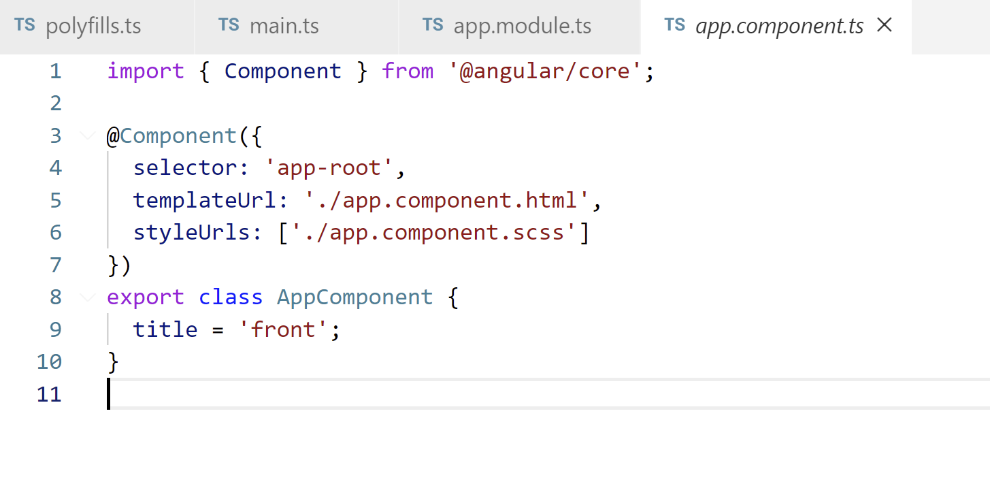
Metadata
decoration

Slide 16
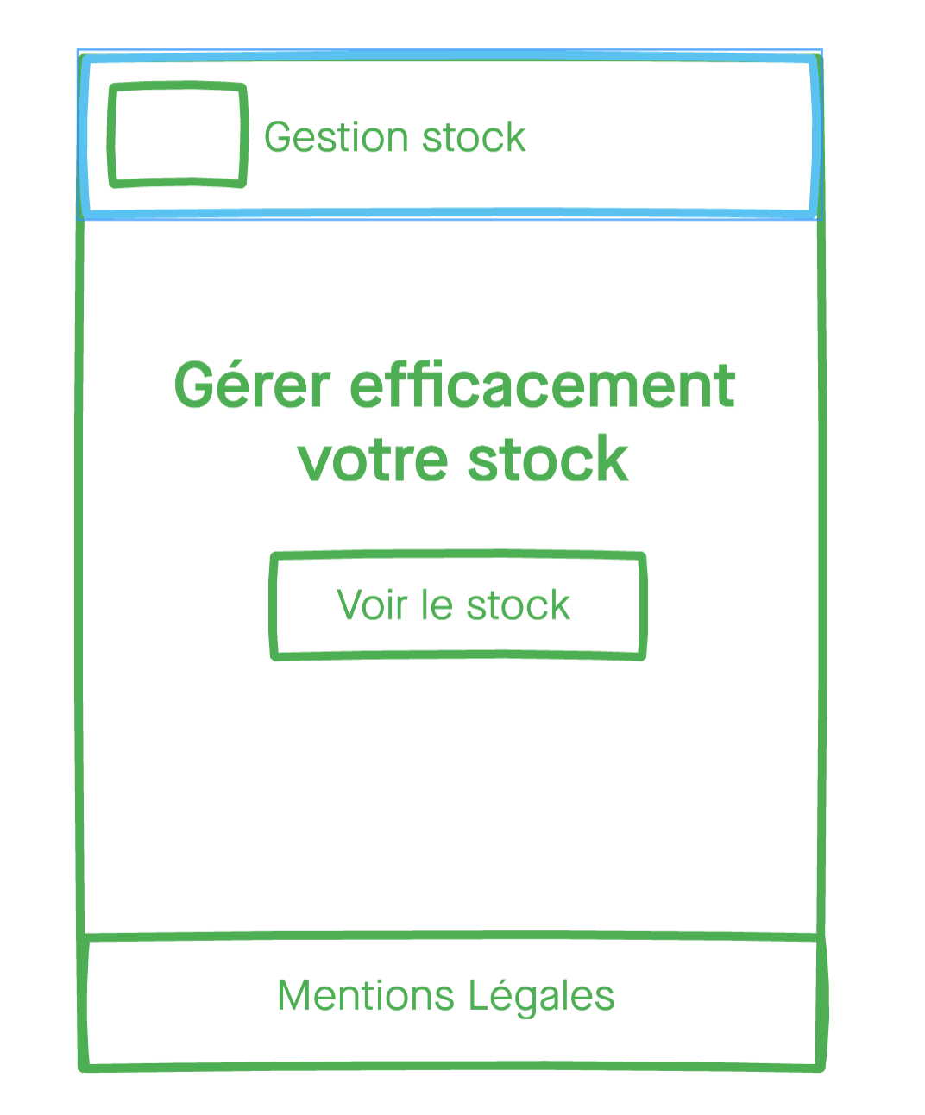
App
Layout
App
Header
Body
Footer

Slide 17
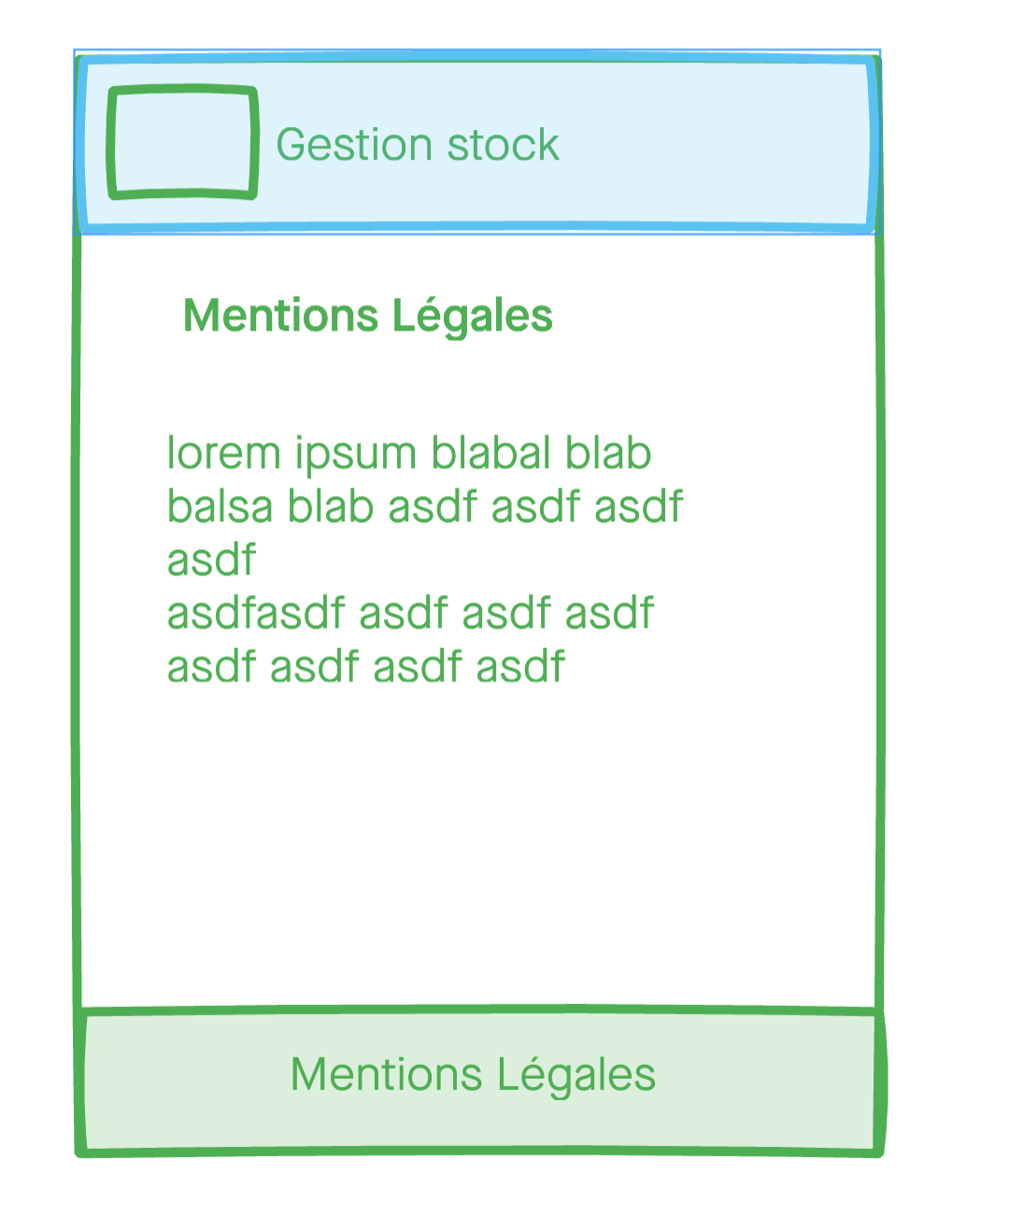
AppRouting
1
Router
3
App
Layout
App
StockRouting
ReactiveForm
./routes
Header
Footer
Body
Stock
Home
1
2
Legal
Ellipsis
Stock
Add
Widget
Autofocus

Slide 18
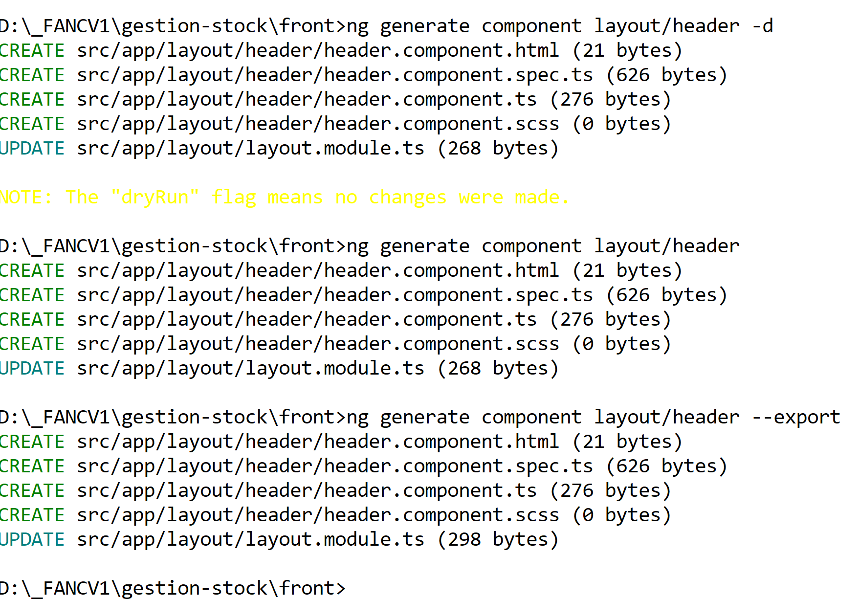

Slide 19
Routing
Creation des composants de routes (Home, Legal)
Regler les routes dans AppRouting
App-body: ajouter router-outlet
Les liens avec routerLink

Slide 20
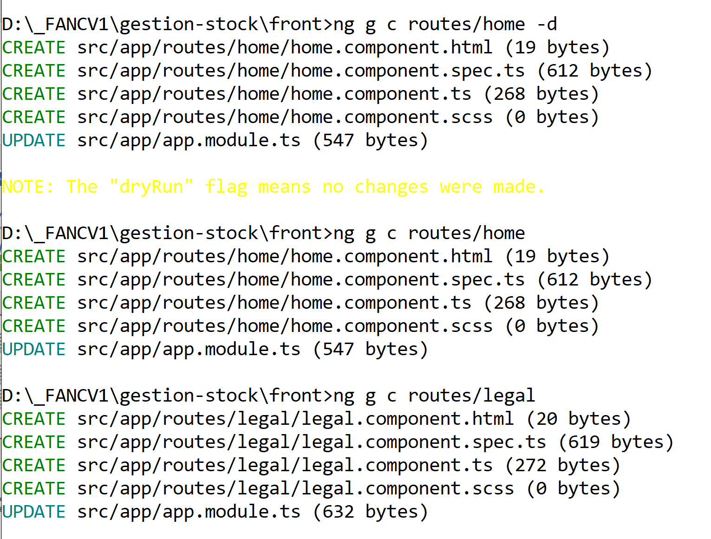
Routing generate

Slide 21
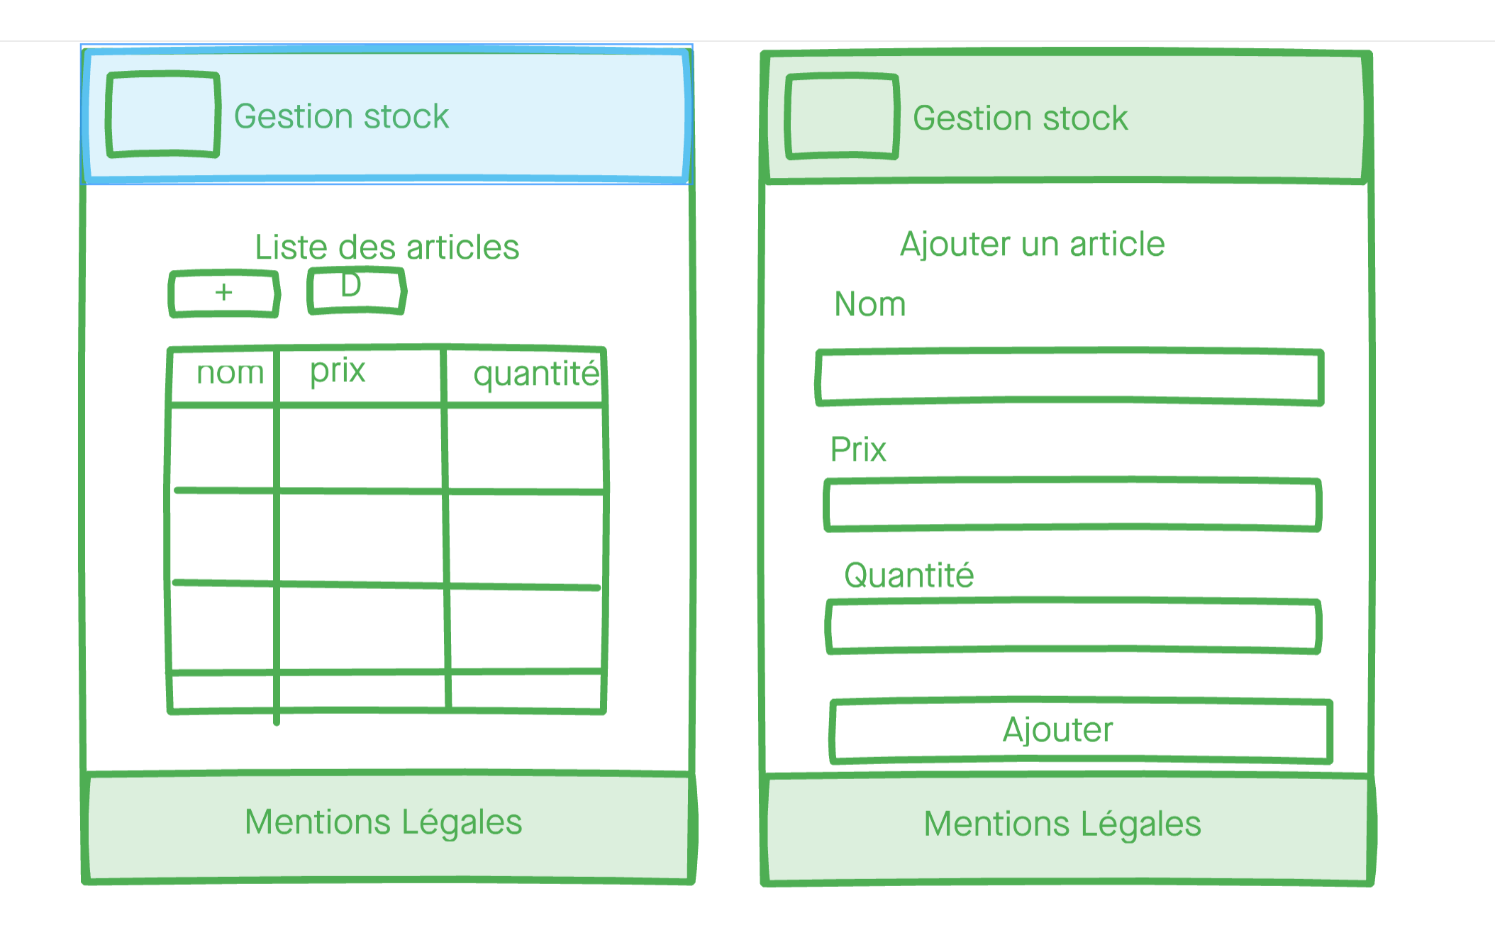
Maquette

Slide 22
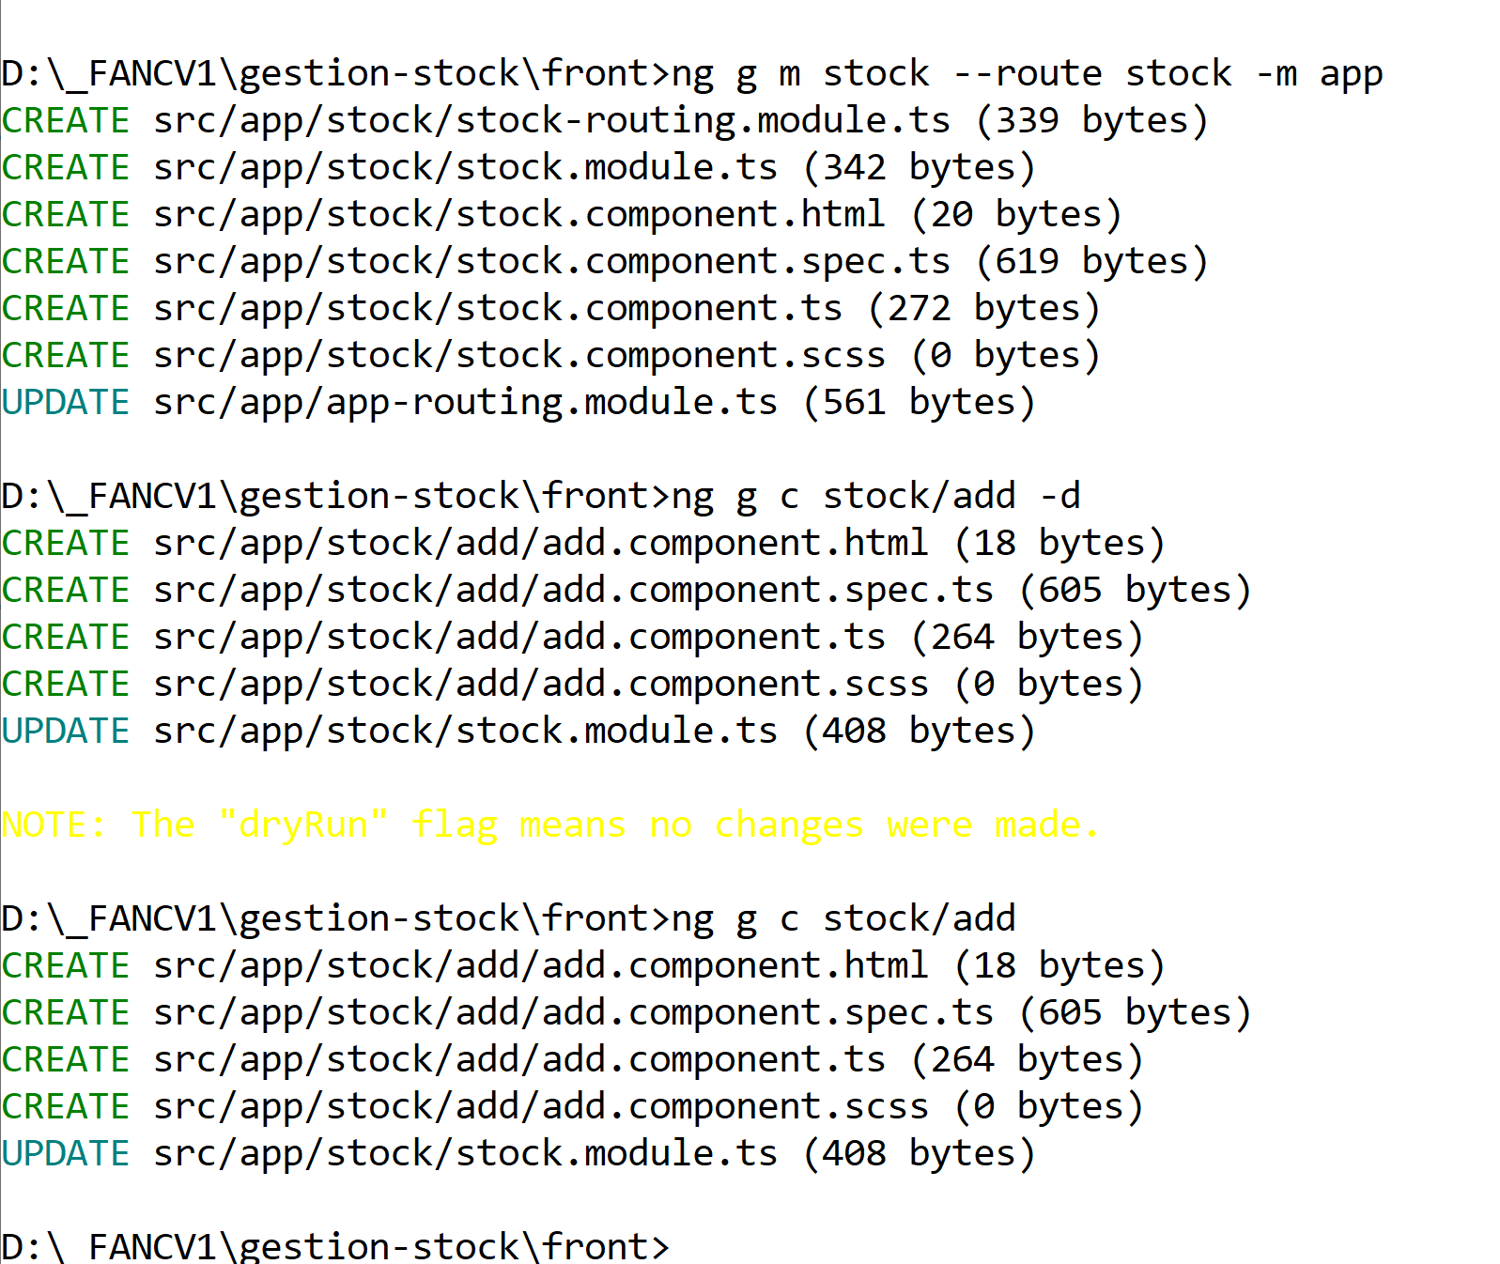
Lazy routing

Slide 23
Bibliographie
Suzan weinschenk « les 100 choses… »
http://color.hotglue.me/color_pdf.head.139811657448&download=1

Slide 24
TODO list 3eme jour
HTTP (relation avec back-end)
CORS
Injection d’un service
Directive (en ecrire une)
Pipe (en ecrire un)
Ng test
Ng e2e
Ng build --prod

Slide 25
Ng serve (localhost:4202)
Client HTTP
CORS
Localhost:3000
Articles
Autoriser CORS

Slide 26
Ng serve (localhost:4202)
Scenario Proxyconf
Client HTTP
Localhost:3000
Articles

Slide 27
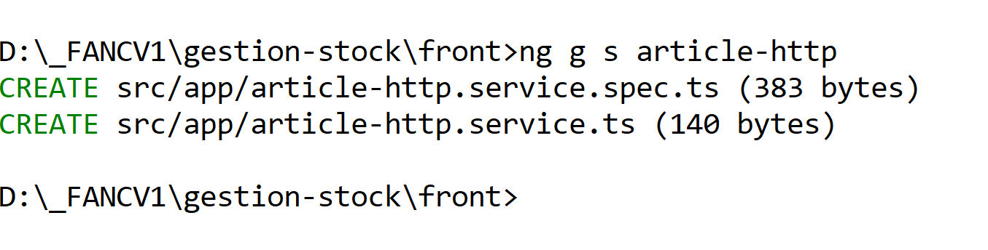
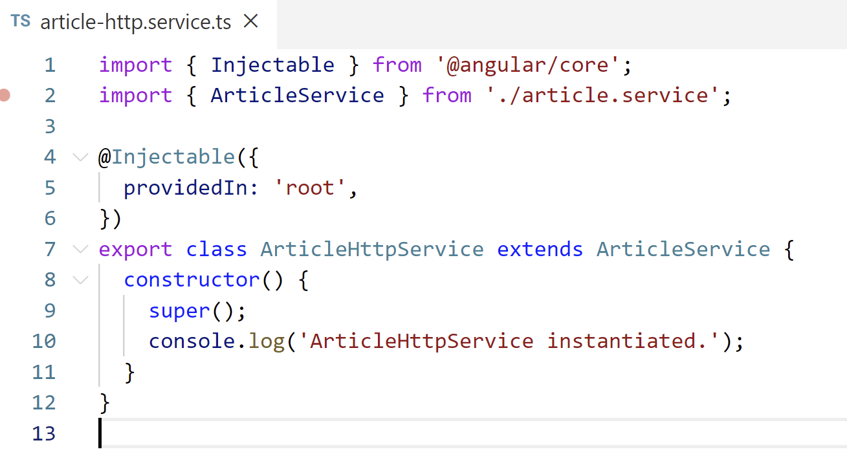
Creation d’un service enveloppant HTTPClient
Heritage

Slide 28
Observables
23
12
45
next
next
next
complete
23
12
45
error
next
next
next

Slide 29
HttpClient
{…}
next
complete
{…}
error

Slide 30
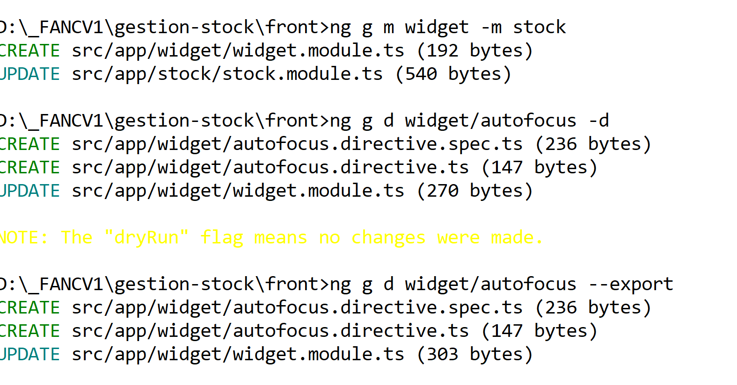
Directive

Slide 31
Ng test
1er phase : avoir des tests qui marchent (pas d’erreur)
Ng test retourne 0 failures.
2ème phase : avoir des tests qui couvrent un maximum de code.
3ème phase : avoir des tests qui satisfont le métier.

Slide 32
Ng e2e avec proxy
https://stackoverflow.com/questions/45733761/webdriver-manager-not-working-behind-proxy
npx webdriver-manager update --proxy=http://someproxy:8080 --ignore_ssl
ng e2e webdriver-update=false

