Slide 1
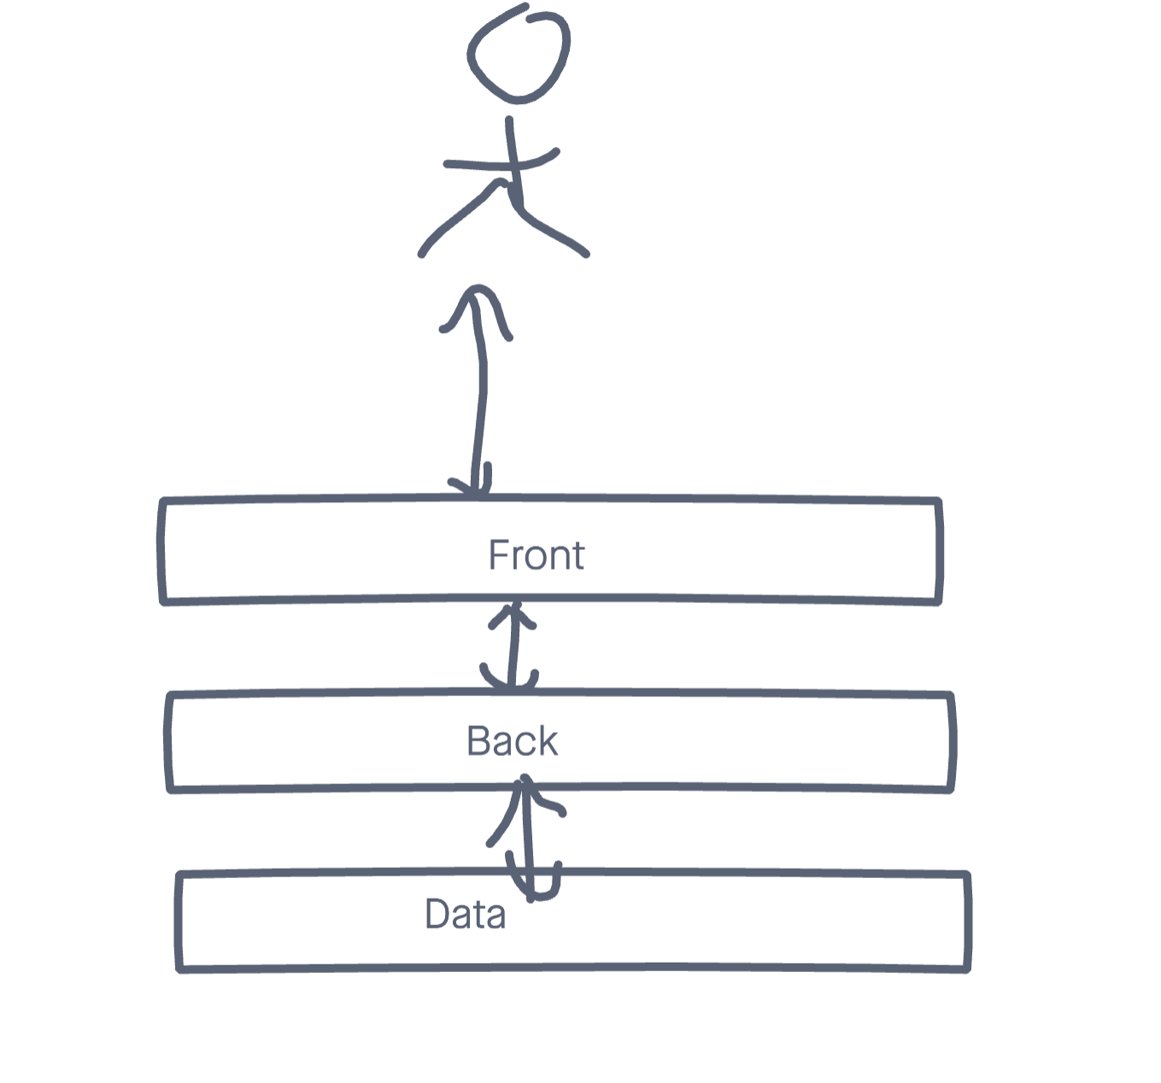

Slide 2
Extension VSCode
Git graph
Prettier
Javascript ES6 Code Snippet
Document This
Javascript console utils (whtouche)
ESLint

Slide 3
Chrome extension
JSON Formatter

Slide 4
Client
HTTP Request
Server
HTTP Response
Commande
POST /asdfasf/asdfasd HTTP/2.0
Toto-Titi: 123
Titi-Tata: « asdfasdf »
Content-Type: application/json
Content-Length: 45
{name: Dupont, firstname: Marcel, etc.}
HTTP/1.1 201 Created
Toto-Titi: 123
Titi-Tata: « asdfasdf »
Content-Type: application/json
Content-Length: 67
{id: 234ef45, name: Dupont, firstname: Marcel, etc.}
Header
Body

Slide 6
1995
Javascript
Netscape
1997
ECMAScript
ES1
1998
ES2
2009
ES5
2017
ES2017
1999
ES3
2015
ES6
ES2015
2016
ES2016
2021
ES2021
ES12
Const
Let
Class
Import
Etc.
ESNext
2008
V8
Chrome
2009
NodeJS
2012
Typescript v1
const x = require(‘x’)
Notation CommonJS
Import x from ‘x’;
Notation ES6

Slide 7
Commandes
Mkdir back
Cd back
Git init
Git config –global user.name “nom prenom”
Git config –global user.email mail@mail.com
Npm init –y
Npm install <module>
Npm install <module> -D
Npm run start:dev

Slide 8
Architecture de type REST
/articles
GET : Retrieve All (pagination, ordering, filtering) (200)
PATCH : Mettre a jour en bulk (204)
DELETE : Remove All (204)
POST : Ajouter un nouvel article (code retour 201)
/articles/1234
GET : Retrieve article de reference 1234 (200)
PUT : Remplacer un article par un autre article (204)
PATCH : Modifier un article (plus performant) (204)
DELETE : Effacer un article (204)

Slide 9
Programmation asynchrone et evenementiel
load
click
hover
C.Reseau
RAM
CPU

Slide 10
Ouverture de fichier
CPU
Controleur DD
CPU
Controleur DD

Slide 11
Cas d’express
Get /api/articles
Demarrage server.ts
Callback app.listen
POST /api/articles

Slide 12
Sync.js

Slide 13
Async.js

Slide 14
Promise
Succes (appel de resolve)
Error (appel de reject)
Exemple : Demarrage du server express (start())
resolve()
app.listen
Reject(err)

Slide 15
IIFE : Immediately Invoked Function Expression
(() => {…})();

Slide 16
Les tests
Build
Developpement
Lint
Test unitaire
Test E2E
Nodemon
eslint
mocha
Mocha,
Pupeeter,
protactor
Etc.
pm2

Slide 17
Google GTS
Faciliter la configuration de projet

Slide 18
Module debug
MSDOS
set DEBUG=njs:*
BASH
export DEBUG=“njs:*”

Slide 19
Mise en production
Prerequis :
OS (linux/windows/mac)
Nodejs
Git
Acces internet
URL Mongo
Pm2
Configuration de pm2

Slide 20
pm2
pm2 start <script>
pm2 stop all
pm2 start all
pm2 logs
pm2 save
pm2 startup

Slide 21
Webographie
Refactoring: https://refactoring.guru/
ES6 : http://es6-features.org/
CanIUse : https://caniuse.com/
CSS Flex : https://css-tricks.com/snippets/css/a-guide-to-flexbox/
CSS Froggy : https://flexboxfroggy.com/#fr

