Slide 1
notes
formation nodejs

Slide 2
Logiciels
NodeJS : node LTS
Versioning de nodejs : nvm, volta
IDE : Visual Studio Code, Jetbrains (IntelliJ ultimate, PHPStorm, WebStorm, etc.)
Base de donnees : MongoDB
SCM : Git, SVN, Mercury, CVS, Clearcase
Navigateur : Chrome, Firefox, Safari, Opera, Edge, Brave

Slide 3
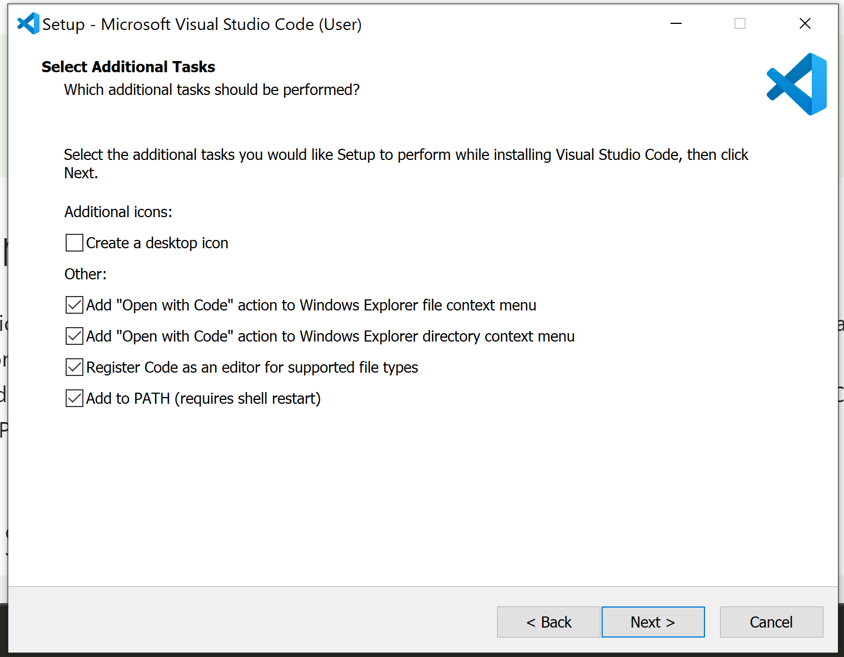
vscode install

Slide 4
Webographie
https://caniuse.com/
https://docs.npmjs.com/cli/v6/using-npm/semver
https://semver.org/
https://nodejs.org/en

Slide 5
Vscode extensions
Prettier
Javascript Console Utils (whtouche)
Git Graph
Error Lens
Intellicode * (microsoft)
Thunder Client
String Template Converter
CodeMetrics
Javascript (ES6) code snippet
Material Icon Theme (philip kief)
Document This
ESLint

Slide 6
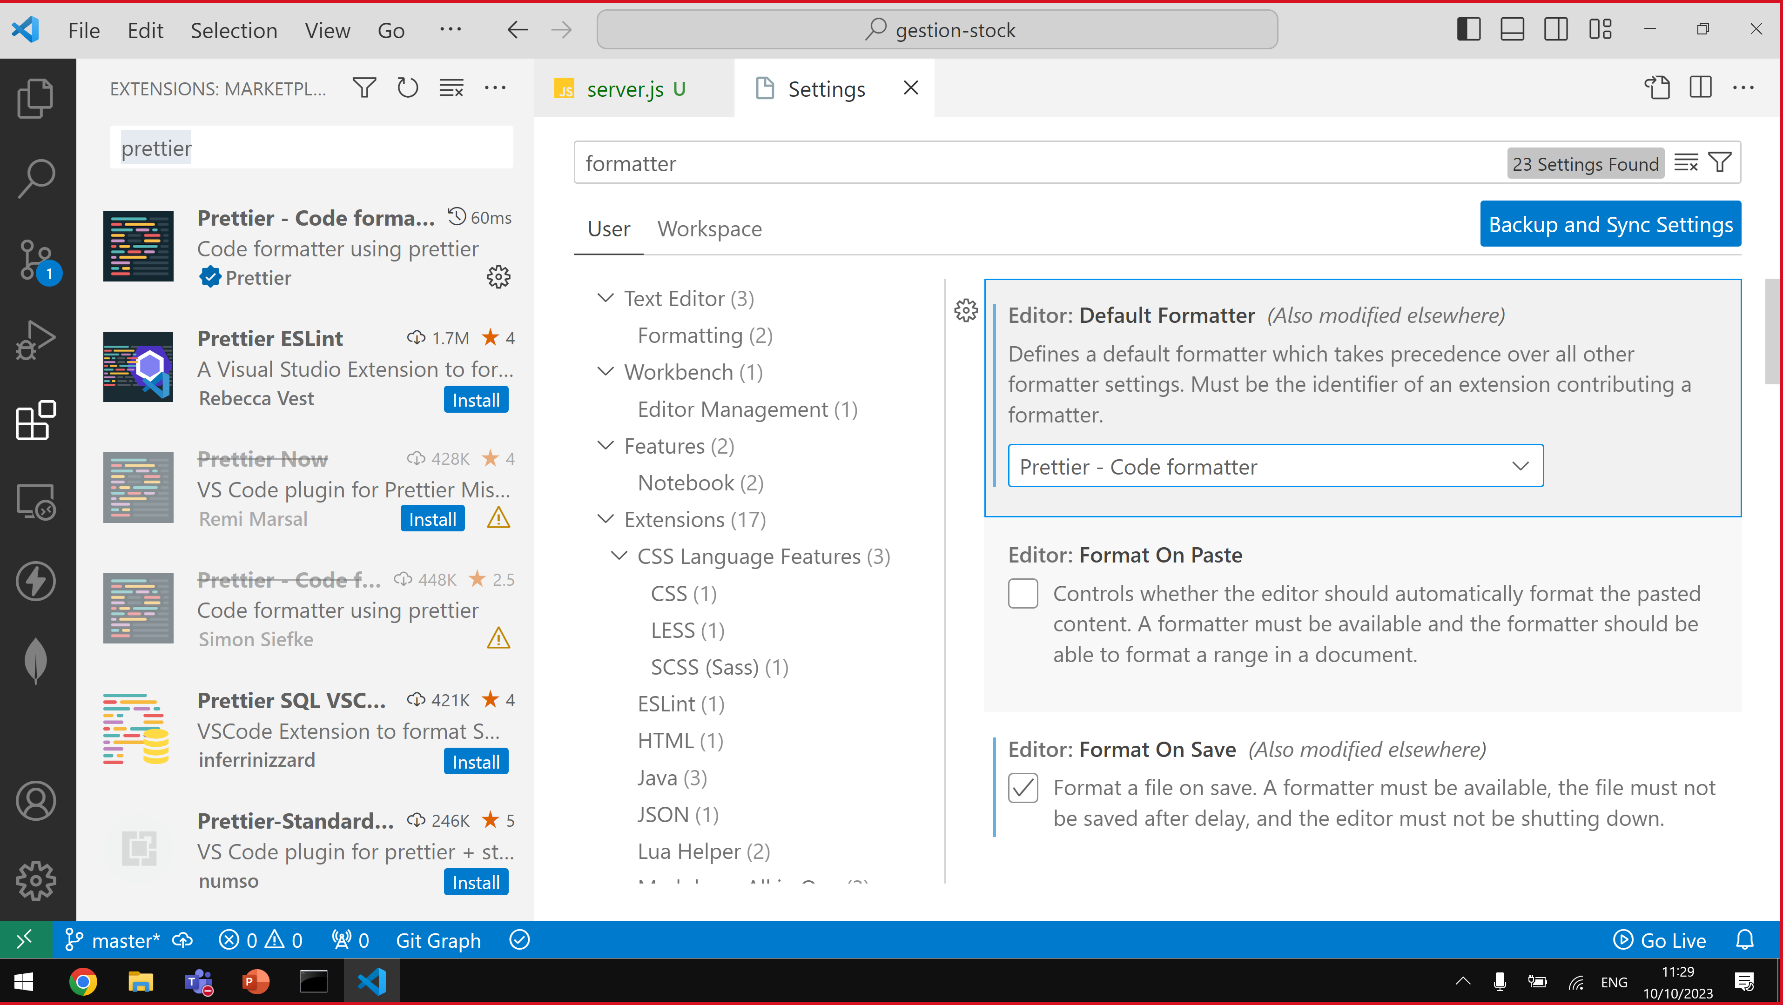
Prettier
2. Prettier
1. filter sur formatter
3. format on save

Slide 7
git commit
add
working dir
staging
commit
git

Slide 8
git commit config
git config --global user.name "Jean-Louis GUENEGO"
git config --global user.email jlguenego@gmail.com

Slide 9
HTTP
Hyper Text Transfer Protocol
client
server
Requete HTTP :
POST /toto?wwwwsdfsdf HTTP/3.0
ids: id1, id2, id3, id4
sdfsdffsd: asdfasdfas
asddddd: sdsdfsd
dfdffdf: asdfasd
Content-Length: 12
Content-Type: application/json
User-Agent: Chrome 133
[…]
Reponse HTTP :
HTTP/2.0 201 Created
rrtrtrtrt: fgfgfgfg
dfdfgdf: sdsdfdsf
Content-Length: 4
Content-Type: text/plain; encoding=utf8
tête

Slide 10
HTTP histoire
1990
HTML
HTTP
T. Berner Lee
1992
Client/Server
Mosaic
Chicago univ.
Mark Andreesson
1994
Netscape
1996
RFC HTTP
2015
RFC HTTP/2.0
2022
RFC HTTP/3.0

Slide 11
Javascript history
1998
ES2
1995
JavaScript
1997
ECMAScript
1999
ES3
2007
Chrome
v8
2009
ES5
2015
ES6
ES6=ES2015
ES2016
ES2017
…
ES2023
ESNext
v8 sur OS=
nodejs
CommonJS
require
module.exports
2012
Typescript
const/let
class, extends
import/export
typage explicite

Slide 12
node logiciels
node.exe : sert a lancer des scripts javascript
npm.exe : gère des librairies externe
telecharger des librairies depuis internet
…
npx.exe : alias de "npm exec"

Slide 13
les commandes npm
npm init
npm init -y
npm install <librairie>
npm install
npm install -D <librairie>
npm run <script>
npm exec = npx
npm view <librairie> versions

Slide 14
modules
module node (package) : répertoire contenant package.json
module commonjs : fichier avec const x = require('x') et module.exports = result
module ES : fichier qui contient l'instruction import ou export
module typescript

Slide 15
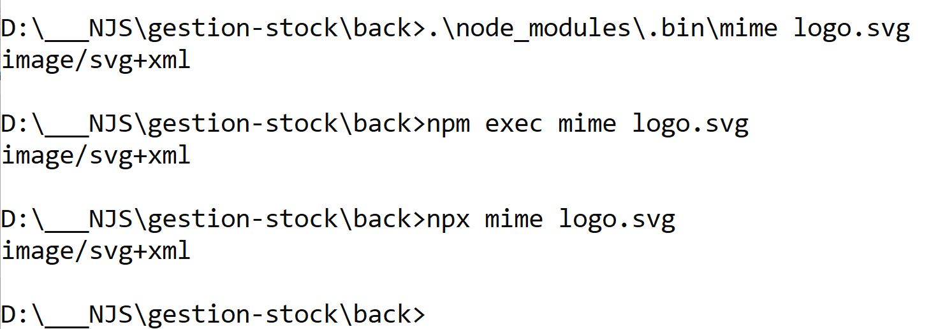
npx

Slide 17
asynchrone
CPU
click
hover
keydown
CtrlDD
const articles = fs.readFileSync('articles.json')
fs.readFile('articles.json', (err, result) => {
…
})
CPU
RAM

Slide 18
node 20 custom loader
Voir le lien : https://github.com/barhun/extensionless

Slide 19
CORS
npm run dev
localhost:5173
client
localhost:3000
CORS
back

Slide 20
CORS
client
localhost:3000
CORS
back

