Slide 1
Notes

Slide 2
Git
git init

Slide 3
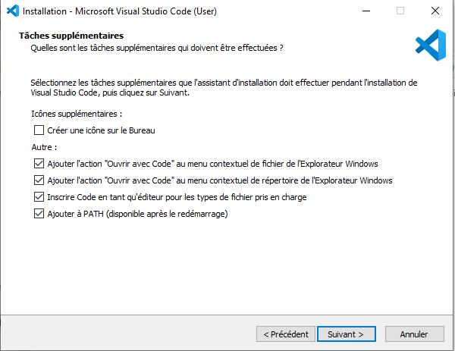
vscode
checker ces cases

Slide 4
1998
ES2
1995
Netscape
Javascript
1999
ES3
2009
ES5
1997
ECMAScript
2015
ES6
2007
v8
2009
require
module.exports
CommonJS
2012
Typescript
let/const
class/extends
import/export
typage explicite

Slide 5
CPU
var response = get(url)
...
get(url, () => {...})

Slide 6
CPU
CPU

Slide 7
HTTP Request
client
server
HTTP Response
GET / HTTP/2.0
azerazer: qsdfqsdf
reterter: uiouio
dfgdfgdfg: dfgdfgree
Content-Length: 13
Content-Type: text/html
<html><html/>
HTTP/1.1 201 Created
azerazer: qsdfqsdf
reterter: uiouio
dfgdfgdfg: dfgdfgree
Content-Length: 12
Content-Type: application/json
{‘’toto’’:123}

Slide 8
CORS
localhost:5173
vite
client
localhost:3000
CORS
back

