Slide 1
Notes

Slide 2
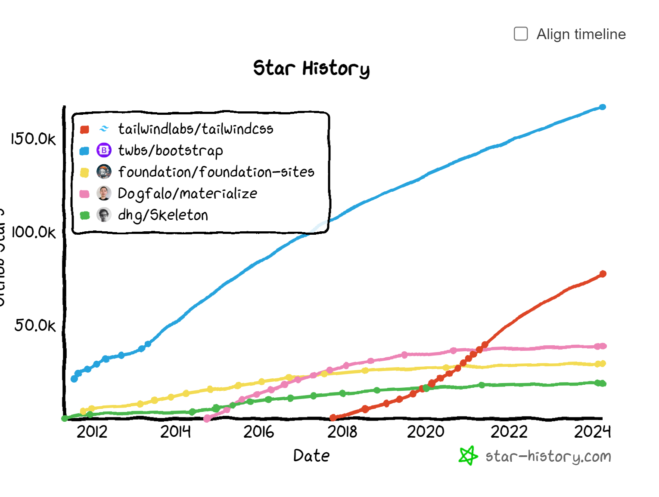

Slide 3
vscode
Intellicode
Intellicode completion
JavaScript (ES6) code snippets
javascript console utils (whtouche)
Prettier
Error Lens
ESLint
Tailwind CSS Intellisense
Tailwind Fold
Simple React Snippet
Surround
Typescript Class Organizer
Template String Converter

Slide 4
npm
npm init
npm init -y
npm install <librairie>
npm install
npm ci

Slide 5
1998
ES2
1995
Javascript
Netscape
1999
ES3
2009
ES5
2015
ES6
ES2015
1997
ECMAScriptv1
2007
v8
ES2015
ES2016
…
ES2024
ESNext
2012
Typescript
const/let
import/export
class, super, extends
template string
----------------------
typage explicite
2009
NodeJS
require/
module.exports

Slide 6
modules
CommonJS (node - 2009)
ES module (typescript - 2012, reprise en ES6, en 2015)

Slide 7
routing
créer les composants de page
homeview
legalview
listview
addview
dire ou inserer la page sur l'ecran
configurer les urls et le main.tsx :
/ -> homeview
/legal -> legalview
Mettre les liens

Slide 8
Webographie - Googlegraphie
"github refactoring ui"
https://github.com/irfanmauuu/ebook-for-everyone/tree/master/UI%20%26%20UX
"css flex"
https://css-tricks.com/snippets/css/a-guide-to-flexbox/
"css flex game"
"react router"

Slide 9
programmation asynchrone
CPU
Cext
Cext
() => {
longAsync(y, (x) => {
console.log(x)
})
}
() => {
const x = long(y)
console.log(x)
}
CPU
RAM

