Slide 1
Front End Development
DBW 2018
Josep Lluis Gelpí, Genís Bayarri

Slide 2
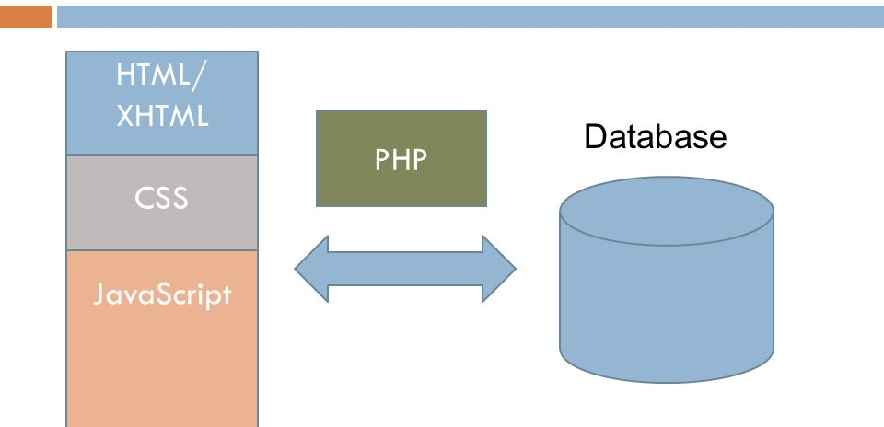
Website basic structure
Front – End
(Browser)
Back – End
(Server)

Slide 3
Website front
The front of a website is all the browser shows to us: colors, images, text, etc.
To say the browser how to show that information, we have to write some code in HTML and CSS languages.
Additionally, JS allows us to improve interaction with the HTML + CSS elements.

Slide 4
Website front (HTML + CSS)
HTML is the language for describing the structure of Web pages.
CSS describes how HTML elements are to be displayed on screen.
Page with css: http://mmb.irbbarcelona.org/webdev/bootstrap/
Page without css:
  http://mmb.irbbarcelona.org/webdev/bootstrap/no-css.html

Slide 5
Website front (HTML + CSS)
How it works?
The browser downloads the HTML and CSS files (and the rest of the media as images and fonts) from the server, interprets that info and show it to us as a web page.

Slide 6
Most Common HTML Tags
<!DOCTYPE> Defines the document type
<html> Defines an HTML document
<head> Defines information about the document
<title> Defines a title for the document
<body> Defines the document's body
<h1> to <h6> Defines HTML headings
<p> Defines a paragraph
<br> Inserts a single line break
<i> or <em> Italic font
<b> or <strong> Bold font
<ul> & <li> Unordered list & List item
<img> Image
<div> Layer
<!– text to comment --> Defines a comment

Slide 7
CSS Reference
.name_of_class Defines a class (used over more than one element)
#name_of_id Defines an id (used over a single element)
body, html, table, tr, td, etc Used over all the html items in the document
CSS units: %, px, em, cm, in, vh, vw, etc.
Syntax example:
.something {
color: red;
text-align: center;
}

Slide 8
Simple Page Example
<!doctype html>
<html lang="en">
<head>
<meta charset="utf-8">
<title>Title of your webpage</title>
<meta name="description" content=”Description of your webpage">
<meta name="author" content="Your Name">
<link rel="stylesheet" href="css/styles.css">
</head>
<body>
<div id="layer1">Hello world!</div>
<script src="js/scripts.js"></script>
</body>
</html>
https://www.sitepoint.com/a-basic-html5-template/

Slide 9
What is Bootstrap?
It is an HTML, CSS and JavaScript framework that you can use as basis for creating web sites or web applications.
A framework provides a standard way to build and deploy applications. It’s an universal, reusable software environment.

Slide 10
Why Bootstrap?
It's easy
It's free
It saves us a lot of work
It's responsive
http://getbootstrap.com/

Slide 11
Bootstrap example
https://github.com/gbayarri/bootstrap

Slide 12
Websites built with bootstrap
https://mmb.irbbarcelona.org/MCDNA/
https://vre.multiscalegenomics.eu

Slide 13
Useful links
http://www.cssbasics.com/
http://www.w3schools.com/
http://stackoverflow.com/
http://getbootstrap.com/getting-started/#examples
https://www.youtube.com/watch?v=RhcQXFeor9g
https://jquery.com/
https://www.google.com

