Slide 1
DBW – Data & Databases
DBW2018

Slide 2
Outline
Data modeling and Databases
Concept and types of Databases
  SQL vs NoSQL
Data modelling
Database design
ETLs
Interaction with Web apps
MySQL
SQL Language

Slide 3
What is data modeling?
All applications require to manage data
Simple data can be managed with primitive data types and simple arrays
Complex data require to design a data model
Data models provide Classes in object-oriented programming and are the basis for design database structures.

Slide 4
What is a database?
Collection of data organized and stored according to some purpose.
  Pile of papers, Flat text file, indexed store,…
Ideally, data is organized following a specific data model.
Provide permanent storage for data structures
DBMS (Database management software) takes care of storing and retrieving data
  MySQL, PostgreSQL, SQLite, Oracle, Access,…
Types
  Relational DB, Column DB, Document DB, XML DB, …

Slide 5
Databases need Web Applications
Databases are used for
  Storing Data
  Storing Meta-Data
  Managing user/session credentials
Databases always need an access application
  Databases can be accessed but this not practical for end users (permanent conections, not enough expertise)
  Most usual way is a REST API (a web service)
  /api/{store}/{id}/option.format?options
    /api/pdb/2ki5/entry

Slide 6

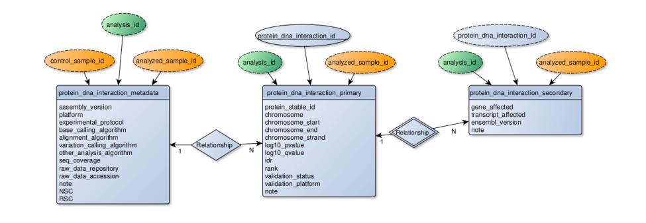
SQL vs noSQL
Oracle, MySQL, PostgreSQL,…
Google BigTable, MongoDB, Apache Hbase, …
Poorer scaling abilities
A.C.I.D.
Do not map transparently on object-oriented data or XML
More difficult design
Static design
Libraries everywhere
Great scalability, but require larger resources
Map complex data structures directly
No design apart from data structures
Libraries almost everywhere
Align better with “modern” data representation (JSON or XML)
25/04/2013

Slide 7
Relational databases (SQL)
Most used in general, and especially in bioinformatics
  This is changing, however…
Data is organized in “tables”
  Tables contain a number of “records” (rows)
  Each record has a number of “fields” (columns)
“Relational” means that logical relationships could be established between fields on different tables.
Efficiency on data management depends on a “correct” DB design.

Slide 8




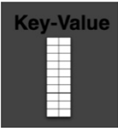











NoSQL Databases
Notes:
As opposed to the RDB, columns can change in type and even rows can have different number of columns, the schema is not as rigid as in a RDB.
MongoDB: ebay, linkedin
CouchDB: ebay, linkedin, paypal
Cassandra: facebook, Twitter
Hbase: Yahoo, Twitter

Slide 9
Data modeling
Protein
Name
Origin
….
Sequence
Aim: Define the structure of data types and components to be managed by the application
First step in any application (esp. Data oriented ones)
Data entities: everything that should be stored/managed
Entity attributes: information about the entity

Slide 10
Data modeling procedure
Reference
Authors
Journal
…
Identify data entities
  Data ítems that “exists” by themselves
Decide on data attributes
  Details of every data entity
Identify data relationships
  Which attributes relate data entities
If a Database is involved
  Define unique identifiers
  Normalize
Author-has-reference
Author
Name
Filiation
…

Slide 11
Relationships
Associations between entities
  Relational DBs include explicit keys
  O-Oriented DBs and languages often “denormalize” date including nested objects
  1:1 Rare, entities should be merged (common primary key)
    May be necessary to improve efficiency
  1:N most common
    The “N” classe includes “1” primary ley as attribute
  N:N: A new “Hidden” entity exists.
  The new entity is 1:N to the original entities.. Add attributes as necessary

Slide 12
Database design phylosophy
Structure of data should be
  Compact with minimum redundancies
    Data stored only once (consistency)
    Space saving
  Structure oriented to retrieval
    Most Bioinformatics DBs are store once, retrive many
    Obtaining data should be quick
  Able to grow
    Data evolves, structure should be flexible
Relational DBs requires known and fixed data structures
For unforeseen data structures use noSQL approach!!

Slide 13
Physical design
Depends on the language/Database type
Traditional Relational Databases
  Saving space and avoiding redundancies is the main issue
NoSQL databases / O-O Programming
  Space is not an issue, data can be redundant, efficiency in insertion/retrieval is the main issue

Slide 14
Physical design
Entities become classes, tables, collections, …
Attributes become fields (Columns in tables)
Unique identifiers become primary keys
  not NULL, never changes
  Unique identification of a record
  Can be a combination of several fields
In SQL DBs Relationships become “foreing keys”
Keys are usually integers (often with auto-increment), although can be any field.

Slide 15
Normalization of Relational DBs
Rules to Reduce (eliminate) data redundancies
  Avoids inconsistencies
  Allows non-complete insertions or deletions
  Make easier queries
1st Normal Form (1NF)
  Unique identifiers. Records are independent to each other. All attributes have single values. Lists of values show hidden entities
2nd Normal Form (2NF)
  All attributes depend entirely on the entity. Attribute is misplaced or a new entity
3rd Normal Form (3NF)
  Data attributes are independent to each other. Show hidden entitites.

Slide 16
ETLs
Extract, Transform, & Load
  Software designed to populate DBs from the original data sources
  Normally offline command-line scripts
  Typically scripting languages (Perl, Python)
  Data is usually obtained from text files or from Web Services
Extract:
  Parsing data input
Transform:
  Do the necessary modifications on the data
  Add new “calculated” fields if necessary
Load
  Insert into the DB

Slide 17
From Web apps
Server side
  Server-side languages include specific drivers and helpers
  The usual ones issues database commands (SQL, JSON, …)
    $result = $db -> mysql_query(“SELECT ^ FROM foo”);
    $result = $foo_collection->find( array(‘_id’ => ‘any_id’));
  More elaborated drivers map DB tables/objects into program objects
    Interaction with DB is made in the background
    Common in pure o-o languages and programming frameworks
  DB connections are persistent . Connection is usually made once at the initialiation phase for each script.
Client side
  Jquery / AJAX may include direct DB connections

Slide 18
MySQL
Created in 1979 by Michael Widenius
MySQL 1.0 in 1995
Uses SQL as query language
Used in most bioinformatics applications
  Free, easy to install
  Now (v. 5.x) has most features of a commercial DBMS

Slide 19
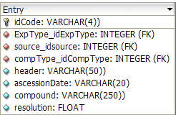
CREATE TABLE Entry (
idCode VARCHAR(4)) NOT NULL,
ExpType_idExpType INTEGER UNSIGNED NOT NULL,
source_idsource INTEGER UNSIGNED NOT NULL,
compType_idCompType INTEGER UNSIGNED NOT NULL,
header VARCHAR(50)) NULL,
ascessionDate VARCHAR(20) NULL,
compound VARCHAR(250)) NULL,
resolution FLOAT NULL,
PRIMARY KEY(idCode),
INDEX Entry_FKIndex1(compType_idCompType),
INDEX Entry_FKIndex3(source_idsource),
INDEX Entry_FKIndex4(ExpType_idExpType)
);

Slide 20
MySQL numeric data types
Integer (Tinyint, smallint, mediumint, int, bigint)
Bit = Bool = tinyint(1)
Float (M,D)
Double (M,D)
Decimal (M,D) (=dec, fixed)

Slide 21
MySQL text data types
Char(n), varchar(n) (char is fixed length!)
Binary(n), varbinary(n)
Tinyblob, blob(n), mediumblob, longblob
Tinytext, text(n), mediumtext, longtext
Enum (‘val1’, ‘val2’,…)
Set (‘val1’, ‘val2’,…)
Check character sets!!

Slide 22
MySQL Date/time types
Date yyyy-mm-dd
Datetime yyyy-mm-dd hh:mm:ss
Timestamp
Time hh:mm:ss
Year (2|4)
  Be careful with order, can depend on O.S.!!

Slide 23
Data initialization
DEFAULT constant
Auto-increment
NOT NULL
ZEROFILL (left padding)
SIGNED/UNSIGNED

Slide 24
Table types
MyISAM.
  Default. Each table, index, etc. is a file
InnoDB.
  transaction safe, allows advanced operations
Memory
  Hash indexes
Merge
  Several MyISAM identical tables accessed together
Archive
  Good for long term storage (no Update or delete)
Federated
  Distributed among diferent servers
NDB
  Fast
CSV
  Text oriented
Blackhole

Slide 25
Basic SQL
Table manipulation
  CREATE TABLE, ALTER TABLE, DROP TABLE, RENAME TABLE, CREATE INDEX, DROP INDEX
  Usually done with helper software (Mysql Workbench, PhpMyAdmin)
Storing data
  INSERT INTO table (col1, col2,…) VALUES (val1,val2,…)
  LOAD DATA INFILE ‘file_name’
  REPLACE
    Like INSERT but replaces rows with the same primary key
  UPDATE table SET col1=val1, coln=valn WHERE ‘some_condition’
Retrieving data
  SELECT col1, …. FROM table1, table2,… WHERE ‘some condition’ ORDER BY col

