Slide 1

DBW – Databases and Web development

Slide 2
Aims
Review a number of technologies to handle bioinformatics data:
  Computer communication, design of web applications, basic database design and optimization.
  This is NOT a programming course, it is about building applications in an heterogenous scenario
The final objective is to built a fully operative application using the appropriate combination of the techniques reviewed.

Slide 3


Bioinformatics & Internet
Tools and data should be available through web
Ex. Nucleic Acid Research reviews:
  Database Issue (January) 1170 DBs
  Web Server Issue (July) 1200 Servers

Slide 4
Web applications by access type
Web interfaces
  Provide a user friendly interface (web based) to “human” users
    Users known how to use the interface
    There is no need to install software
    Single operations (no large scale)
    Must adapt to navigation uses (low latency, synchronous answers,…)
Web services
  Provide a programmatic interface (using Web protocols)
  Intented to interact with software, not humans
    Well-defined data formats required.
    Adequated for large scale operations
Modern applications will normally offer both

Slide 5
Web application anatomy
External Apps
USER
Application
Web browser
Web server
Back-End
Web service Client
Front-End
DB
CLIENT
SERVER
DB SERVER

Slide 6
Web application styles
Access to data
  Friendly interface to data repositories
Web Interfaces to stand-alone software
  Collect input parameters and redirect output
Workbenches (e.g. Galaxy)
On-purpose applications & DBs
Web services (programmatic access)

Slide 7
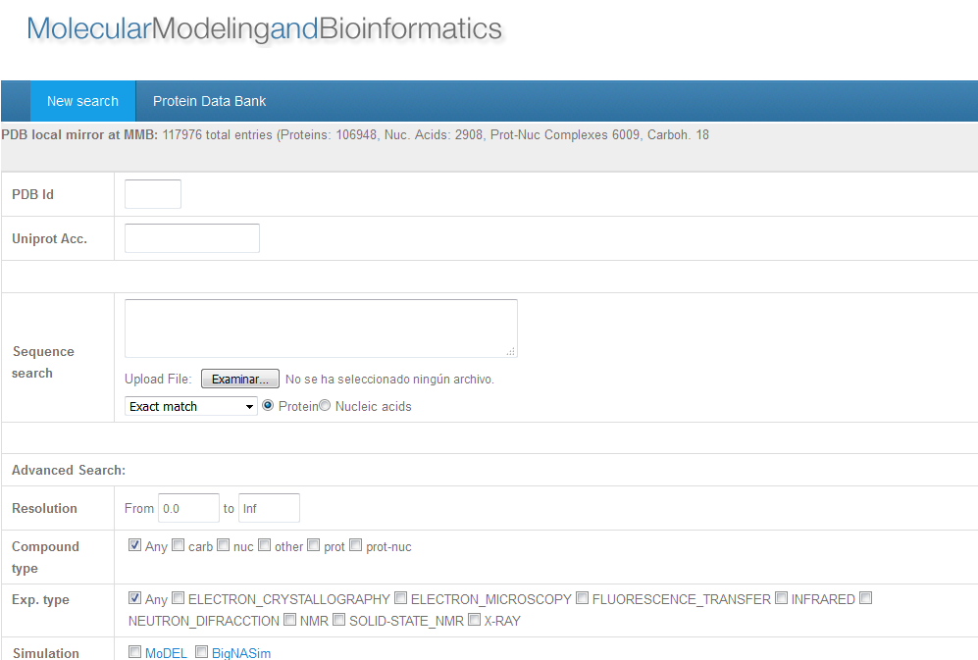
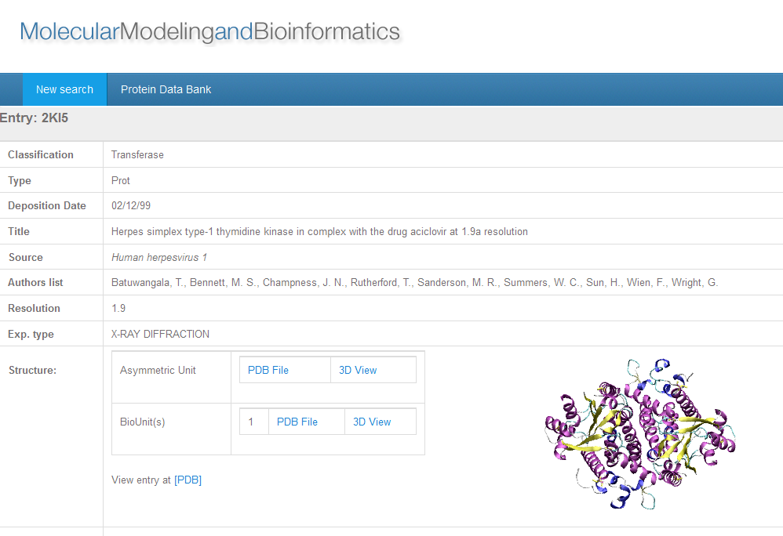

Slide 8
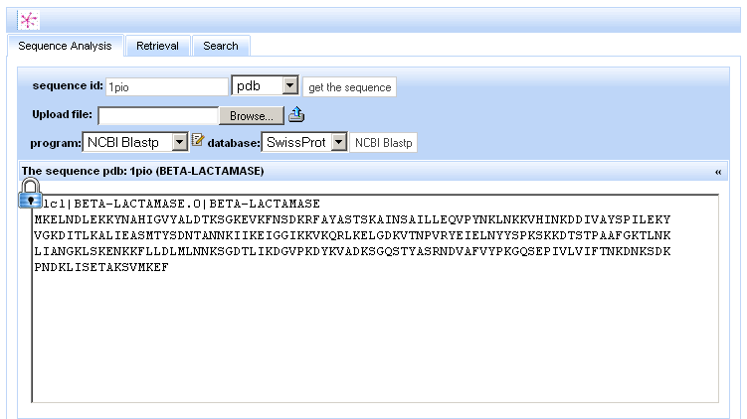
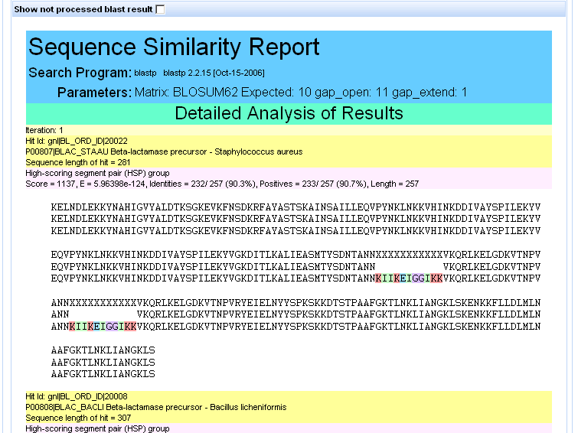
Web interfaces to apps.

Slide 9
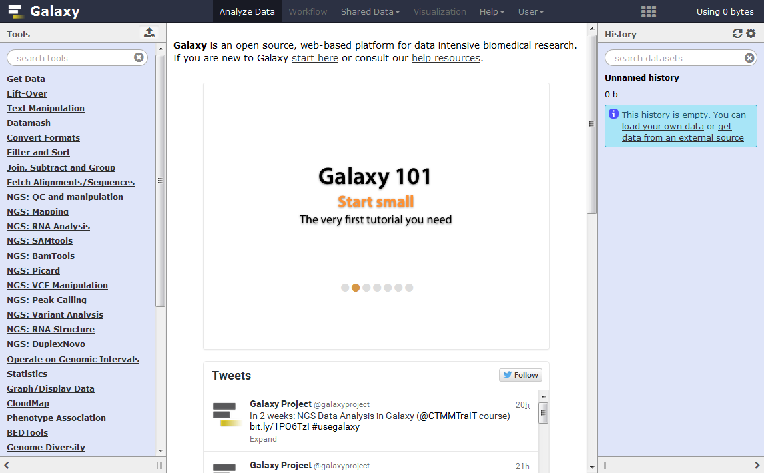

Slide 10

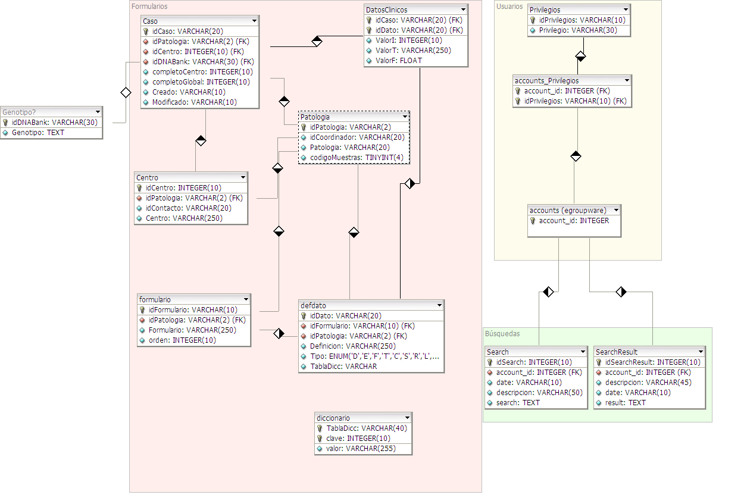
Special purpose applications & DBs

Slide 11
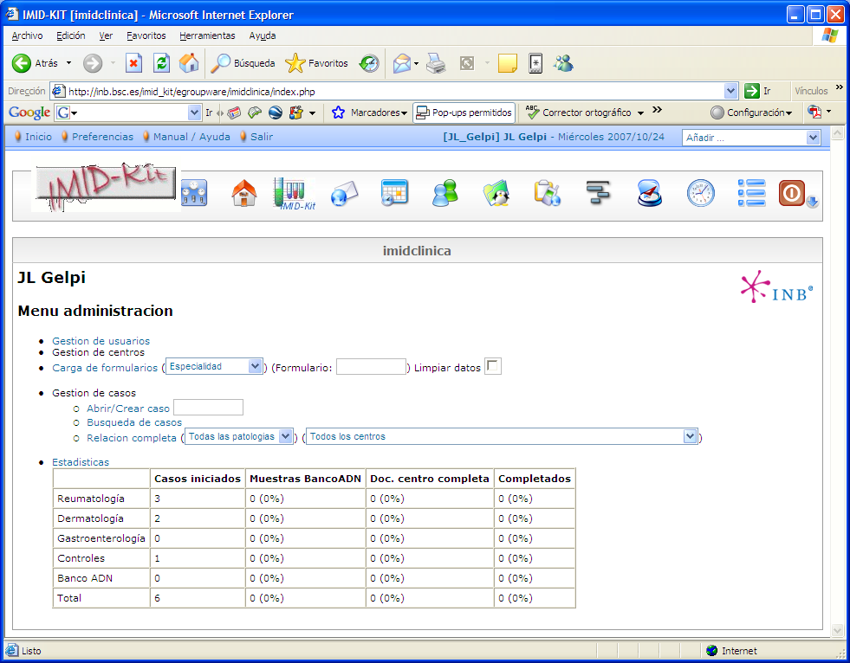
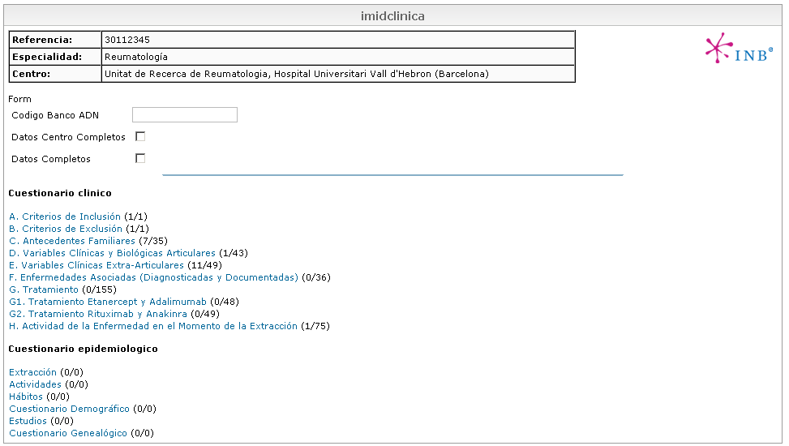
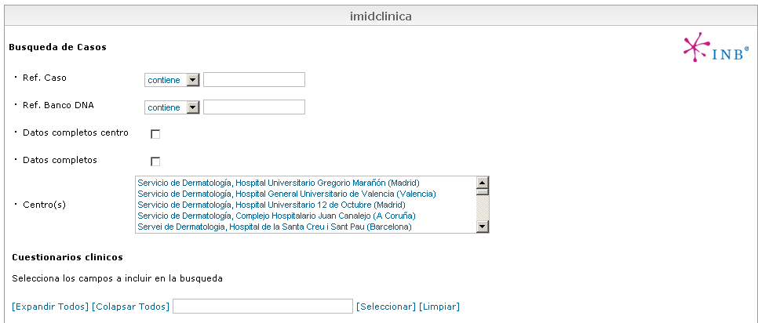
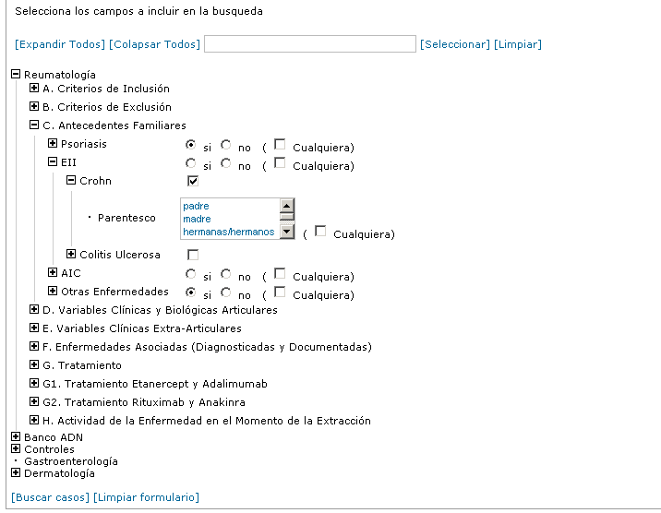
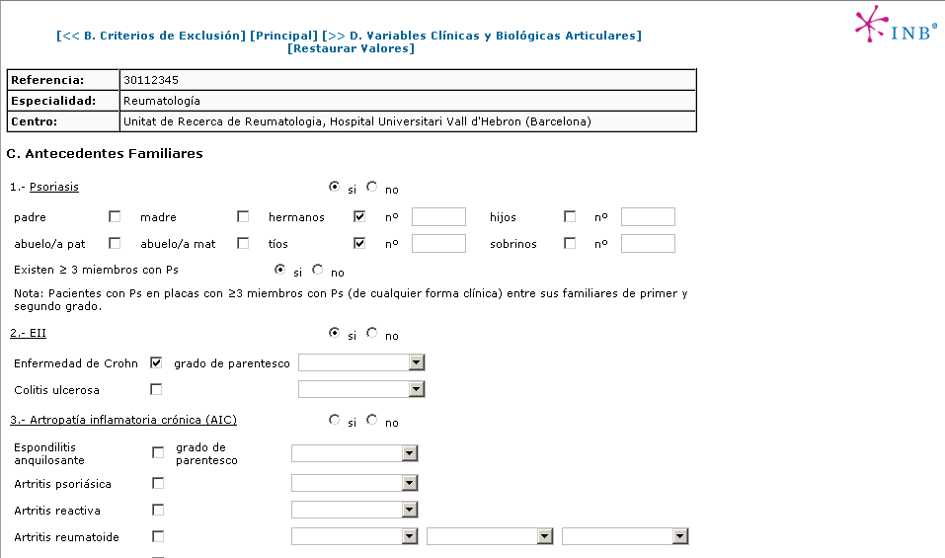
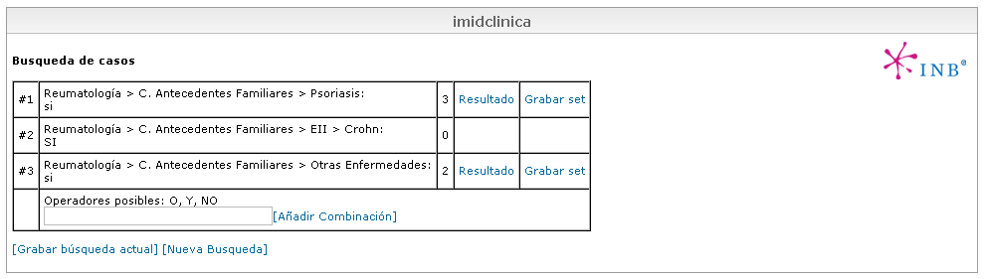
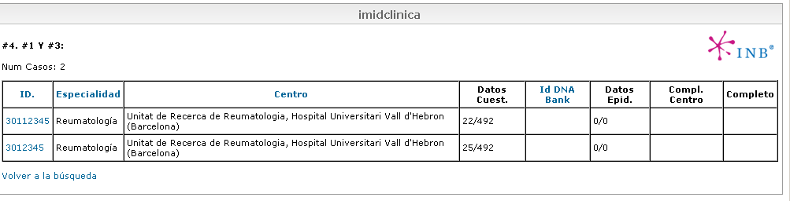

Slide 12
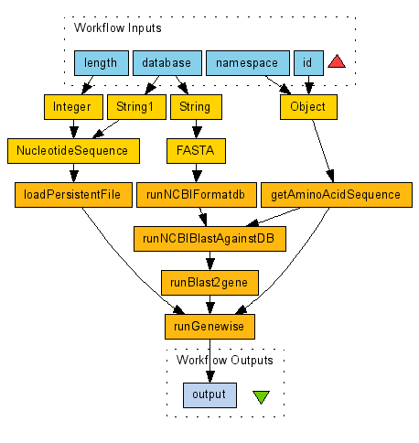
Bioinformatics web-services and workflows
Input: Protein Id and DNA genomic sequence
Building of Blast Database from DNA seq.
BLAST Search
Run GeneWise to detect gene structure

Slide 13
Building a (web) application
Define specifications
Analyze data and built a data model
Decide/prepare Database implementation
Build ETL if necessary
Define interfaces
Define and prepare files/scripts layout
Write application code
Test, debug, document…

Slide 14
Course logistics

Slide 15
Web site(s)
  Course materials:
    http://mmb.pcb.ub.es/formacio/
  Personal sites:
    http://mmb.pcb.ub.es/formacio/~dbwXX
  SSH Access
    ssh mmb.pcb.ub.es –p 22021 –l dbwXX
  Mysql Access (port 13306)
    DB: DBWXX, same user/password

Slide 16
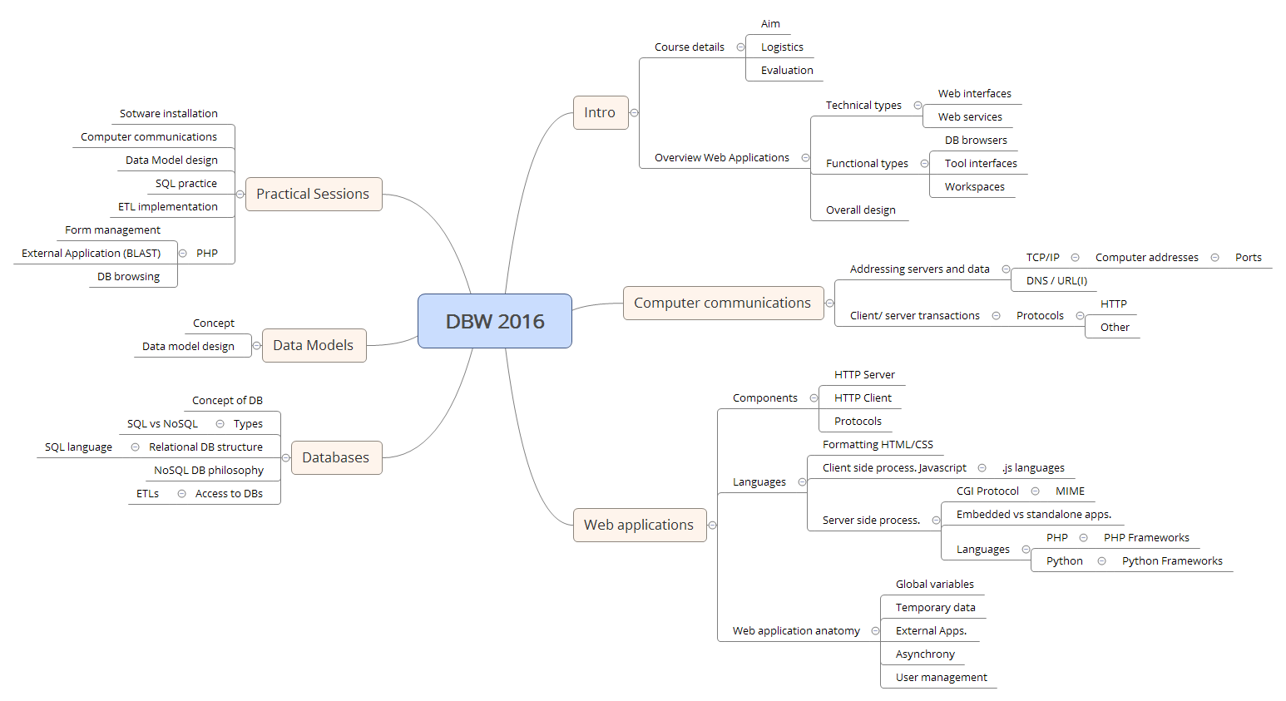
Subjects overview

Slide 17
Software to install
Ideally Linux (may need root privileges)
From Linux distribution
  Apache Web Server (v. 2.x)
    With PHP 5.x and mysql support
  MYSQL server (v. 5.x)
  MYSQL Workbench or phpMyAdmin
Netbeans (PHP module) (optional)
MongoDB (optional)

Slide 18
Evaluation
Exercices, in-class projects (20%)
Personal web site (20%)
Web application project (60%)
  Progress presentations
  Fully operative web application using DBs

Slide 19
Evaluation
Web application project
  3-4 people / group
  Free subject (bioinformatics preferred)
  Should include DB management, web interface, users management
  May use fake data if necessary
  Available at the personal web site
  Preferred languages: PHP, Perl, Mysql

Slide 20
Evaluation
Web application project
  Steps:
    Initial specification (16 Jan)
    Data analysis & Database design (21 Jan)
    Project Demo (6 Feb)
    Final application (~6 Mar)
Installed on server
  mmb.pcb.ub.es/formacio/~dbwXX
    Account dbwXX . DB DBWXX

Slide 21
Basic computer communication protocols

Slide 22
Aim & Outline
Understand the basic components of computer communication protocols
  Concepts of client and server
  Addressing servers and data
    Computer addresses (MAC Address, IP Address)
    Ports
    Resource identification
      DNS
      URL/URI concept
  Client/server transactions
    HTTP protocol

Slide 23
Present internet
Huge network of computers using common communication protocols (TCP/IP, HTTP)
Distributed, no central servers
  (Well, not really true in bioinformatics)
Common language: HTML/CSS (XML)
Content mostly static, but dynamic behaviour is possible through web applications

Slide 24

Components
Request
Answer
Network
Client
Server
Client and Server logic and physical addresses
Data
Data meta-information
  Nature of data
  Request (what to do)
  Applications involved (email, web, etc.)

Slide 25
How it works: TCP/IP
Packet switching
  Packet switching breaks the signal in small fragments (“packets”) each of them containing the complete information about source and destination
    Packets can share a single communication line
  Users have the idea of a dedicated line but, in fact, it is not. Of course, the bandwidth is limited.
Computers connected to internet should have addresses
  MAC Address: Address of the physical interface
  IP Address: Address of the computer

Slide 26
IP addresses
Allow to find destination irrespective of the nature of the network media.
Each device has a “unique” IP address
IPv4: 32 bits (4 x 1 byte (0-255) numbers)
  Max: 2³² : aprox 4.3 x 10⁹
  P.ex. 161.116.222.59 (mmb.pcb.ub.es)
  4 levels are hierarchical
Some addresses are reserved, and some networks are “local”
IPv6: 128 bits (16 bytes). Max: 2¹²⁸ (3.4 x 10³⁸)

Slide 27
Names vs addresses (Domain Name System)
IP addresses are not easy. Most hosts have also a “name”:
  f. ex. www.ncbi.nlm.nih.edu
Host names have a structure similar to IP addresses: Top domains (.es, .edu, correspond to full class domains and subnets are indicated by prefixes.
  ub.es (161.116.x.x)
  bq.ub.es (161.116.154.x)
  www.bq.ub.es (161.116.154.18)

Slide 28
How to address applications in a server: Port ids.
Each host has one IP address but has several ports for known services
Ports are 2-Byte numbers.
  0-1023 are “Well known ports” (Telnet: 23, FTP: 21, HTTP: 80, ...).
  1024-49151 are “Registered ports”, usually managed by applications (MySQL: 3306)
  49,152-65,535 are “Dynamic and/or private ports” freely usable.
Communication to ports triggers the specific application to deal with the data
However, different ports from official ones can be used to:
  Hide applications
  Have more then one server in the same IP address
  Hide servers in internal networks.

Slide 29
URI/URLs
Resources must be identified in a way that includes all the necessary details:
  http://mmb.pcb.ub.es:80/courses/master.htm#top
  Missing parts of the URL are filled by default!!
protocol
host
port
resource
in the host
label
Optional

Slide 30
Client – server communication
Most Web Applications use HTTP (hypertext transfer protocol), although sometimes FTP, SMTP
HTTP is a client-server communication protocol
  Link between client and server is dynamic
  Usually limited to a single transaction
  Requests composed by a query operation and a variable set of headers.
  Answers: headers + data

Slide 31
Client – server communication
Relevant Operations: GET, POST
  GET: Simple retrieval, all information/parameters included in the URL
    Simple queries, static information
    Required to be used as hypertext links
  POST: Query defines the resource, but input data follows
    Input data can be of any type (including binaries, whole files) or size (within limits)
Relevant HTTP headers
  Content-type (POST): input data format
  Content-type (Answer): Data MIME type (text/html, image/jpg, …)
  Location: Redirects browser
  Set-cookie: Set a “cookie” on users’ software.

Slide 32
Cookies
Small information tags sent as HTTP headers and stored in the browser side
  Are associated with a URL, and are sent back to the server whenever that URL is visited within a expiration date
  Set-Cookie: PHPSESSID=bb56ee648aeac6923e3360a7b8284a6f; path=/
Useful to “remember” clients, but some people disables them!

