Slide 1
Impact of Soda Tax
Lai Jiang
Sarah Lewkowicz
Jack Ying

Slide 2
Research Question
How does soda tax affect retail stores?

Slide 3

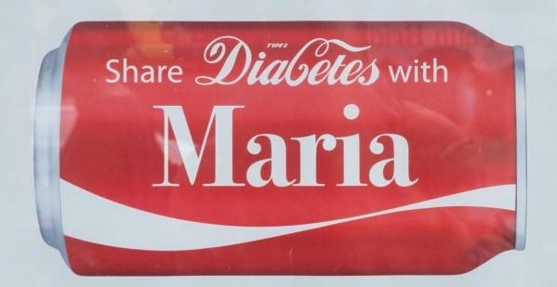


Slide 4
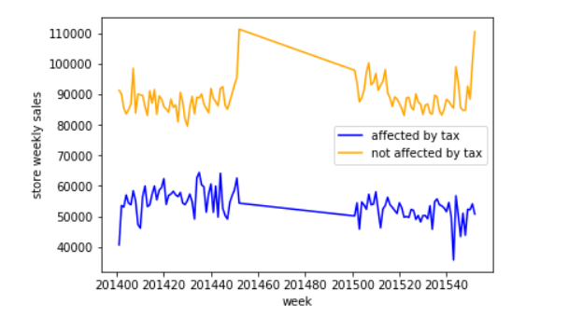
Data
100 stores inside and surrounding Berkeley
Weekly sales from 2014-2015

Slide 5
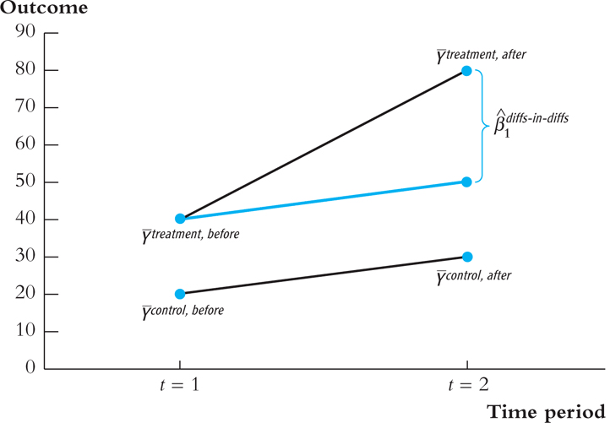
The differences-in-differences estimator, ctd.
= ( – ) – ( – )

Slide 6

Linear Regression Model
Weekly sales $=$⍺ + β D_affected D_soda tax
+ 𝛾 store fixed effects + 𝛉 week fixed effects + ε

Slide 7
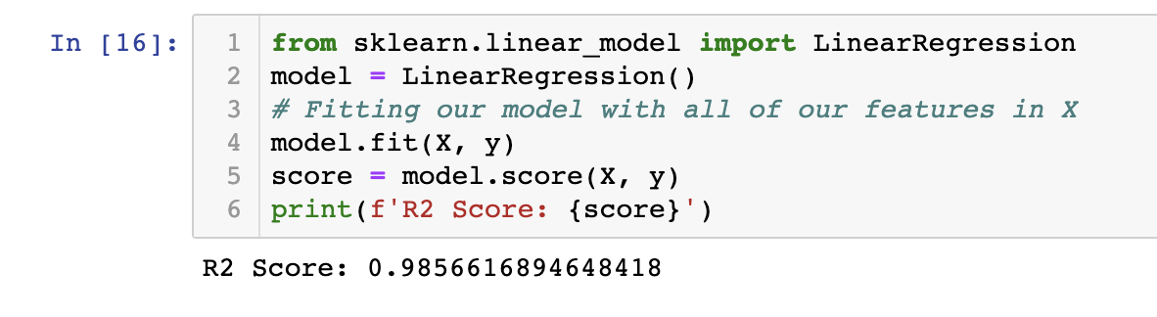
Machine Learning

Slide 8
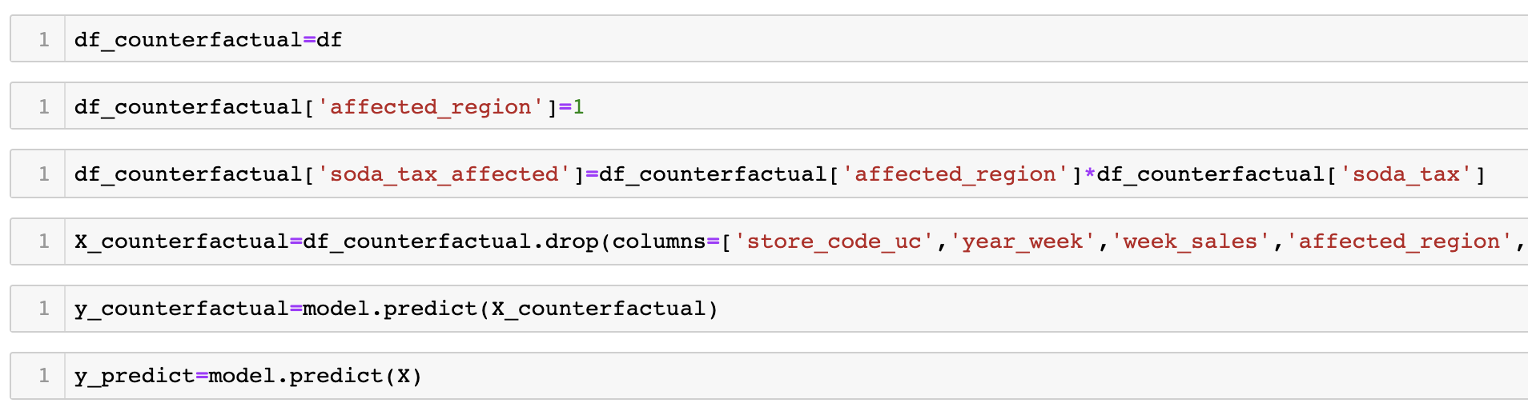
Predictive Analysis

Slide 9
Link to Heroku
Heroku App : https://soda-tax.herokuapp.com/

