Slide 1
Real Estate Company's Portfolio Analysis
Tim, Sarah, Lai, Jack

Slide 2
Real Estate Trends
What kind of data trends could we find looking at the different types of exits over 12 years of data?
Which exit is commonly used?
Which states had the highest activity of transactions?

Slide 3
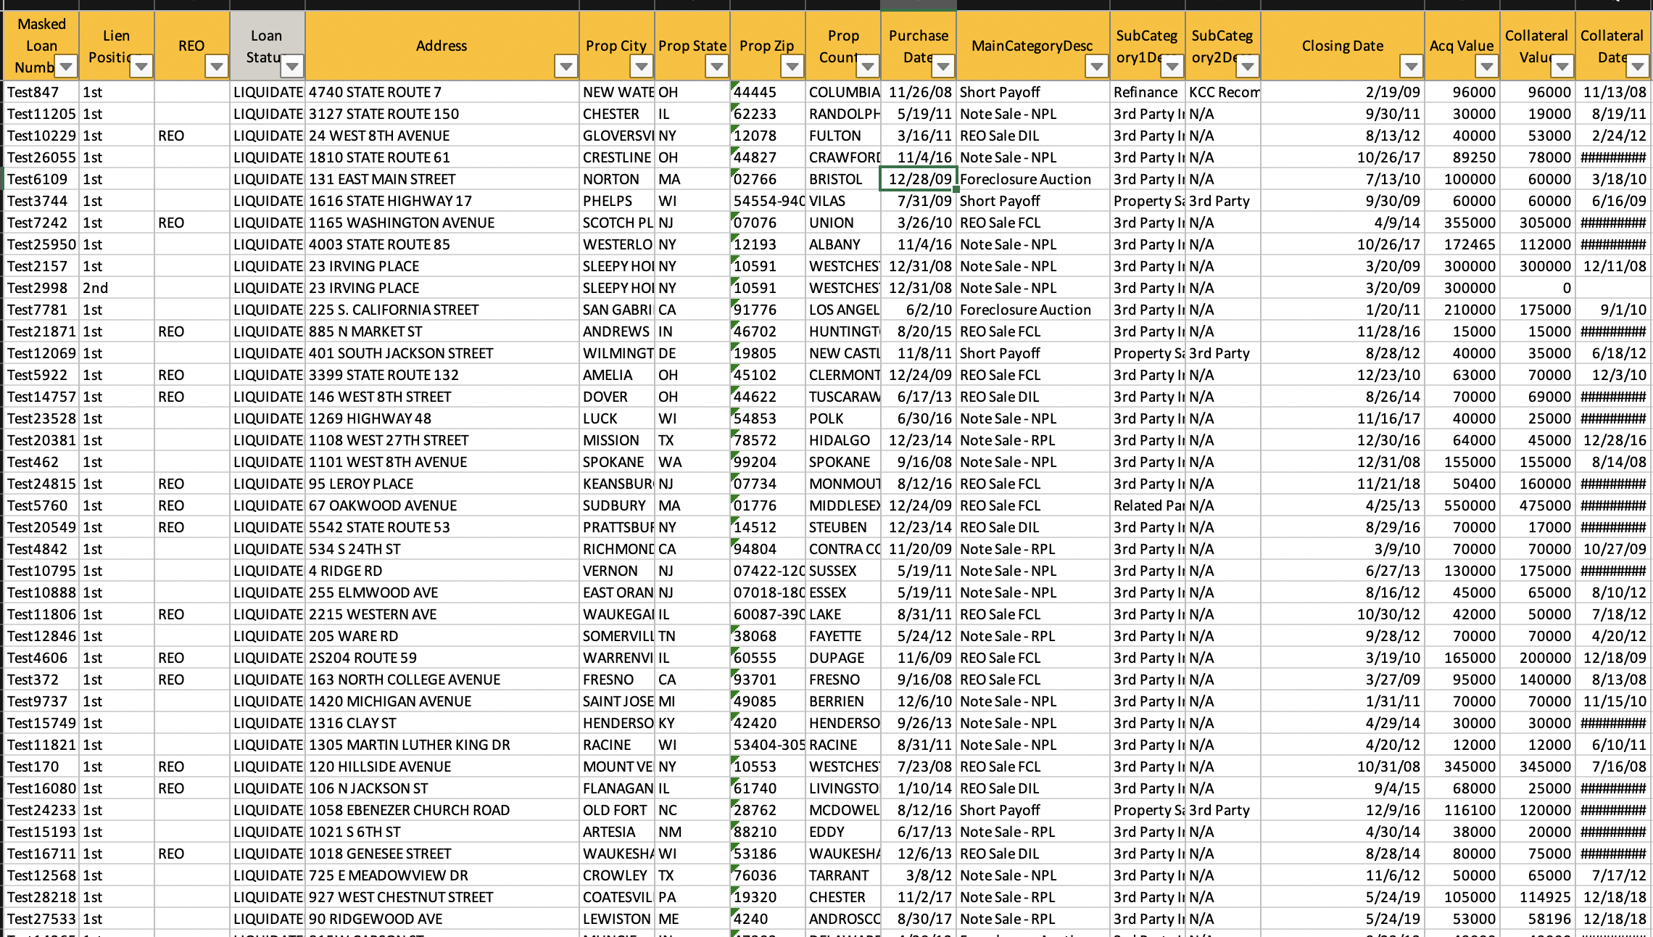
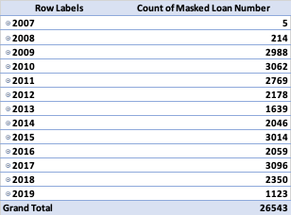
12 years of Closed Out Real Estate Transactions
Our Data

Slide 4
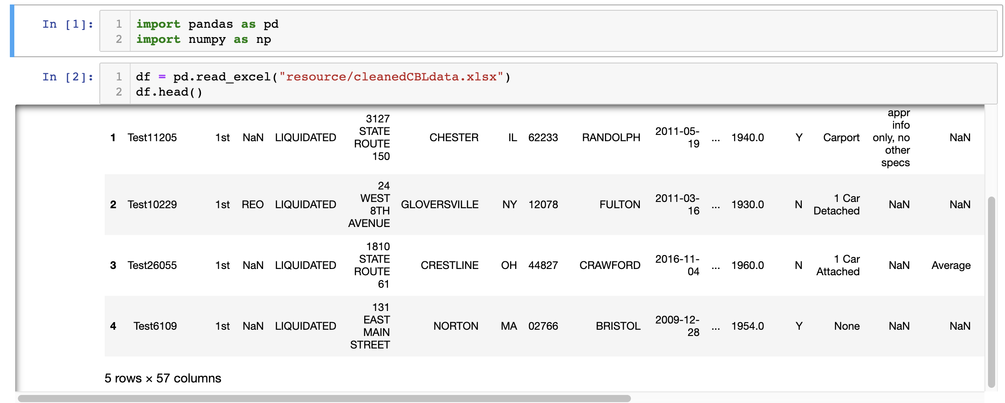
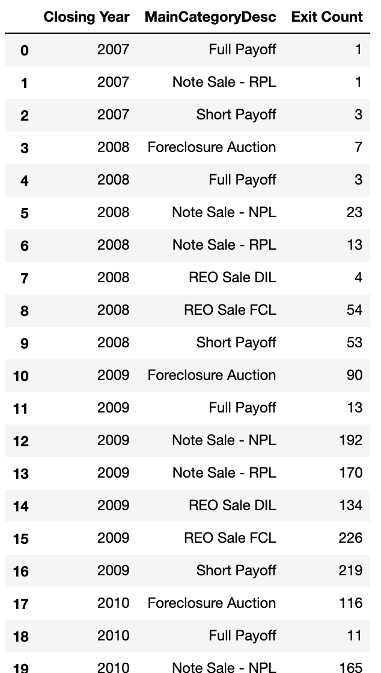
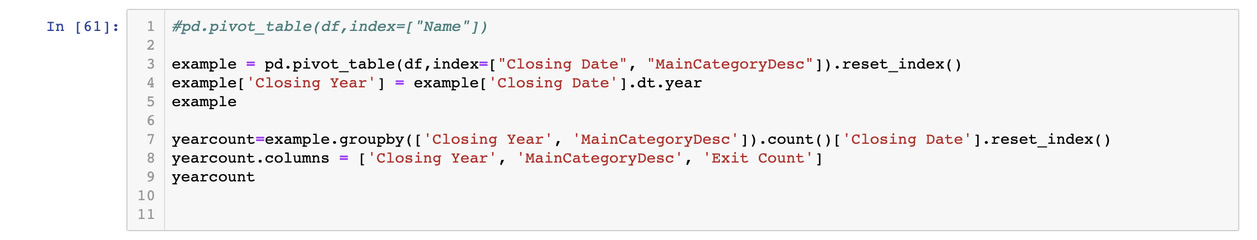
ETL with Python

Slide 6
Historical Exit Trends

Slide 8
Overall count by State

