Slide 1
JSCOPE Presents…
Fund Good Deeds
JSCOPE Team: Connor Bashaw, Oliver Gomes, Jonathan Ho, Patrick Lebeau
Notes:
connor
Hi everyone this is Release 2 for jscope fund good deeds app, we will walk through our solution, our architecture, show you what we built, and what we learned along the way

Slide 2
Team
Oliver - Model Lead
Need , Funding, Ledger Entities and business Rules
Patrick - Persistence Lead
CSV Load / Save
Repositories
Data integrity
Jonathan - Controller Lead
Need Controller, Funding Controller, Master Controller
Connor - View Lead + PM
Swing UI, CLI, story breakdowns, pacing.
Notes:
Connor
Broke the system down by responsibility so we werent stepping on toes, MVC split nicely amidst our strengths.
Oliver took on model work for needs funding and ledger entities, along with business rules
Jon took on the controllers and secured clean data flow between views, repositories, and the master workflow logic
Patrick handled csv load/ save and kept repository data consistent, stable and safe from formatting errors.
Connor built the swing ui and cli flows and kept the team aligned on story breakdowns, pacing and integrations.

Slide 3
What We’re Solving
Expand Fund Good Deeds App with funding sub system
Implement new repos, and Master Controller to coordinate workflow
Add GUI Functionality
Update Architecture diagrams
Maintain MVC Compliance
Follow V2 Requirements from site.
Notes:
Connor
Release 1 go the basics working now we're really turning this into a maintainable nice looking application users can enjoy! This expands on requirements of the project site, specifically adding the funding subsystem and requiring a true master controller to coordinate data across needs, funding, and ledger.
Our goal was to extend functionality and keep strict mvc boundaries

Slide 4
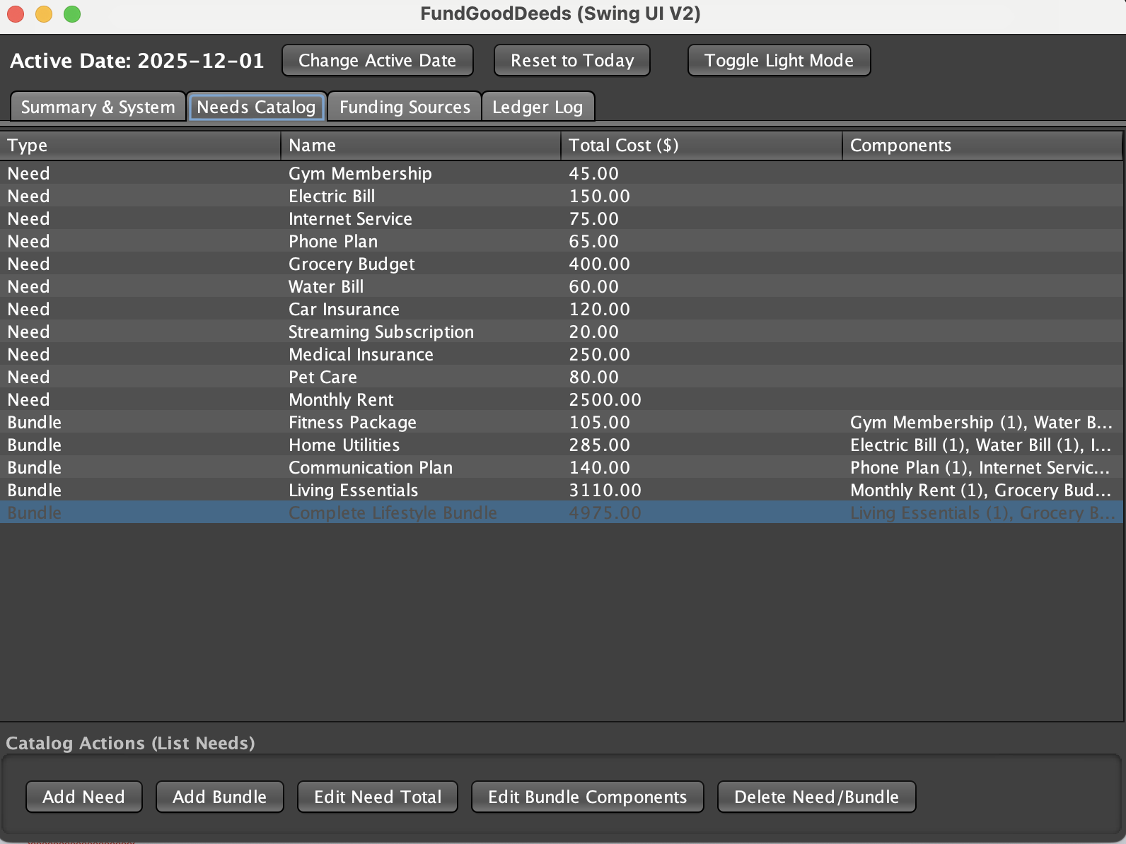
R2 Solution
Funding Source Implementation
  Funding Controller, and Funding Repository
Master Controller for cross subsystem actions
Need and Funding allocation actions
Swing UI Implementation
Observer Based UI Refresh
Update class + sequence Diagrams
Notes:
Connor
We took requirements literally and reogranized architecture
Fund good deeds now supports full funding management. We added funding controller, funding repo, and integrated them with master controller. We also improved the allocation logic and connected everything to an updated swing ui.

Slide 5
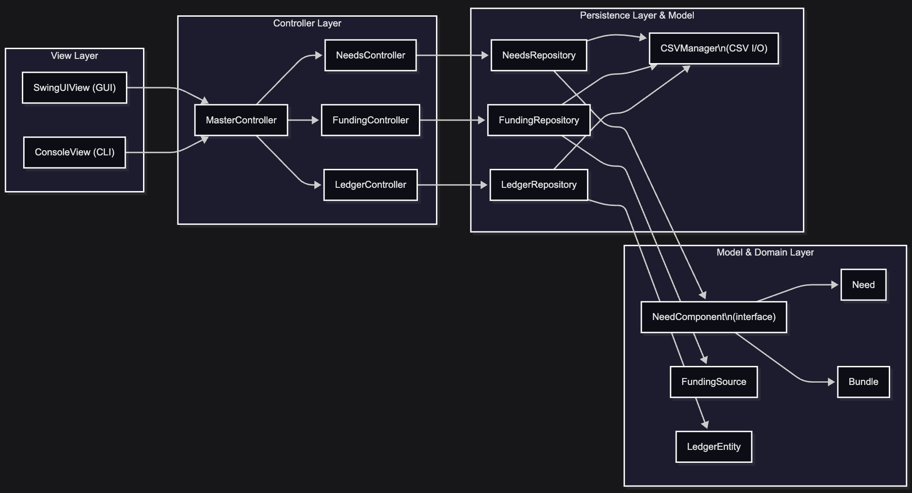
Architecture Overview (MVC + REPOS)
Notes:
Oliver
High level architecture overview, everything flows through the master controller. VIew never talks directly to repositories or models. Each Feature controller owns one repository, and the CSV manager isolates all persistence logic. This clean layering let us debug and expand the system efficiently.

Slide 6
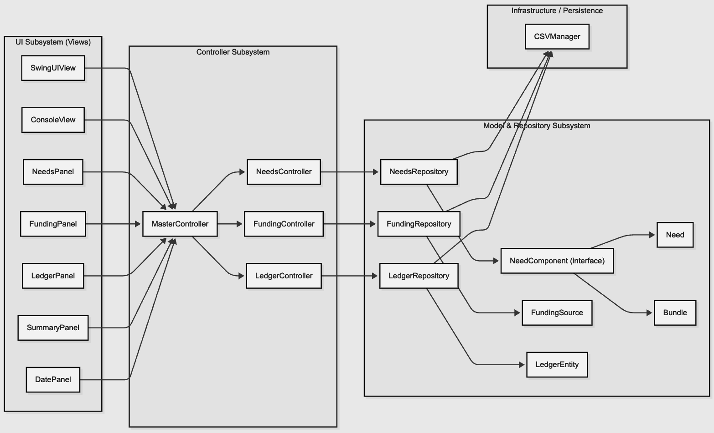
Subsystem Breakdown
Notes:
Oliver
Each sub system has on responsibility, UI components trigger actions on Master Controller. The Master controller delegates to needs, funding, or ledger controllers. Repositories store and load data and the model substem handles domain rules. This diagram shows the exact flow for any operation in the system.

Slide 7
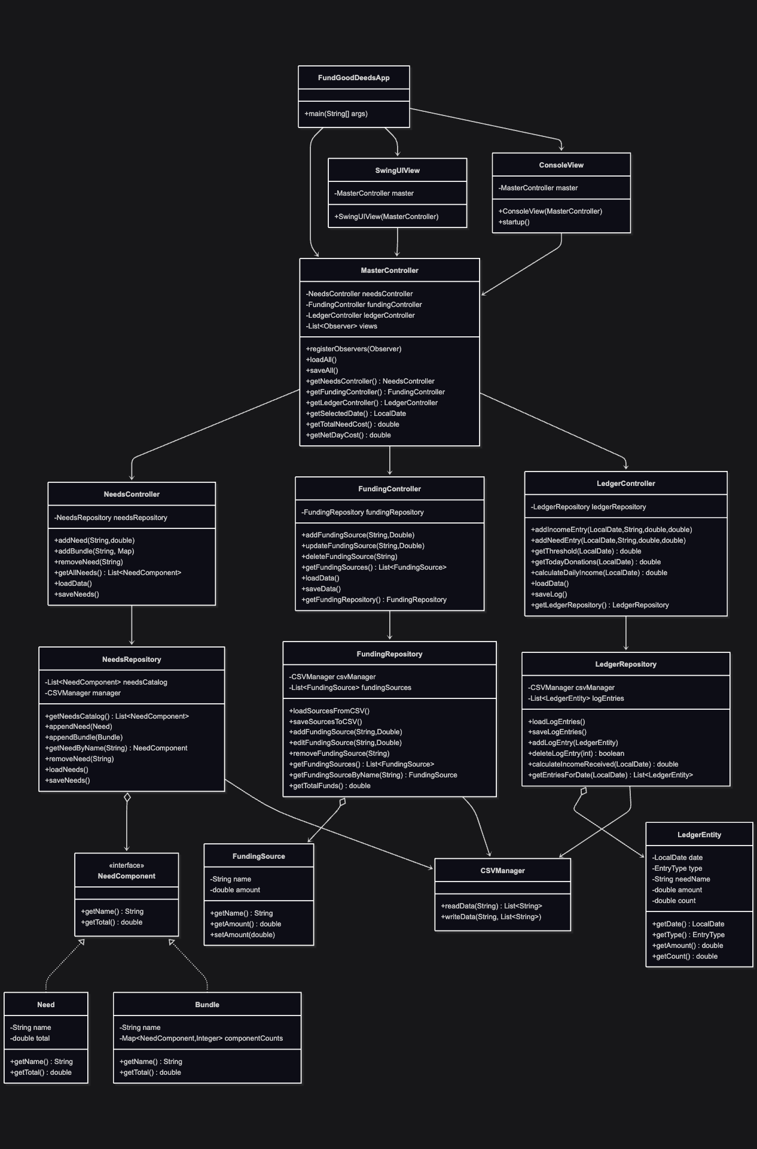
View + Controller
Relationship
Notes:
Jon
This is the release 2 class diagram split from left to right (top is left, bottom is right)
The biggest additions include funding repo, funding controller, and strengthened master controller.
You can see clean one directional dependencies
Views -> Controllers -> repositories -> Model.
Strong cohesion

Slide 8
Controller + Model
Relationship
Notes:
Jon
This is the release 2 class diagram split from left to right (top is left, bottom is right)
The biggest additions include funding repo, funding controller, and strengthened master controller.
You can see clean one directional dependencies
Views -> Controllers -> repositories -> Model.
Strong cohesion

Slide 9
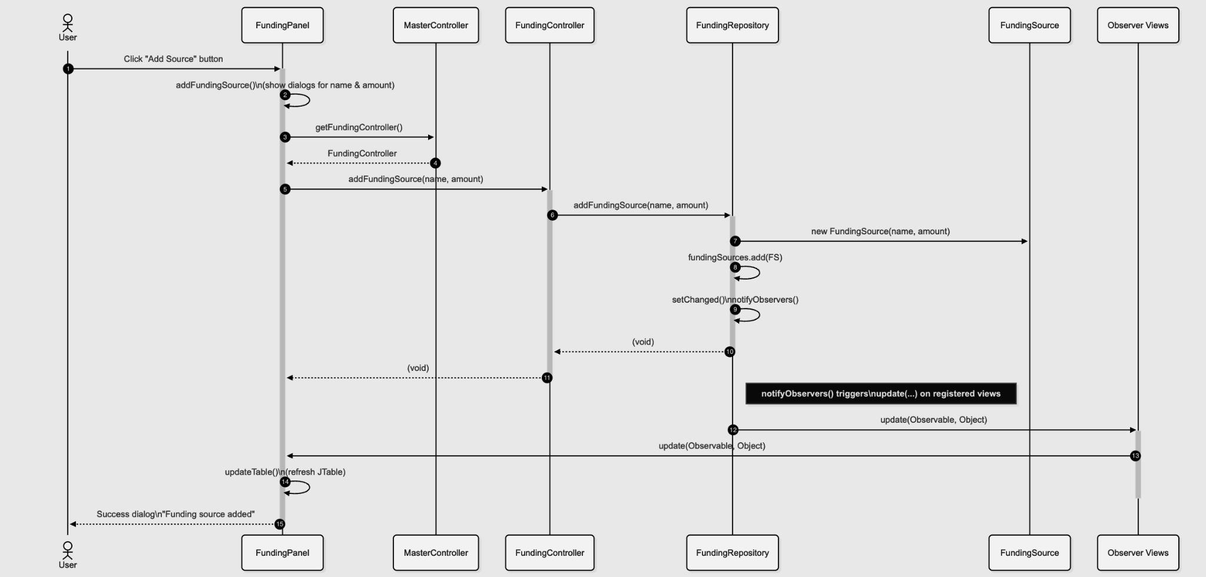
Sequence Diagram Add Funding Source
*Observer Views = GUI or CLI classes
Notes:
Jon
This diagram shows what happens when the user adds a funding source. Funding panel gathers input, calls the funding controller through the master controller, and the repository creates a new Funding Source. Once the repository saves and calls the notify observers, then the UI refreshes automatically. This sequence highlights the observer usage and controller delegation.

Slide 10
Live Demo
Load needs + funding from csv
Add new funding source
Allocate funding
Show updated gui response
Show ui persistence validation
Open and launch app with maven commands
Show needs and bundle page
  Create a need/bundle
    Could be as simple as (NEEDTEST / BUNDLETEST)
  Edit a need (name or total cost)/bundle (quantity of a component)
  Delete a need/bundle
Move to funding page
  Add a funding source (FUNDINGTEST or something)
Move to ledger
  Add a ledger entry (a need/bundle/funding source) to the point the threshold is exceeded
  Change to a future date, and then set a daily threshold or something
Show the summary that the threshold is exceeded
Can show persistence with exiting and reentering the app upon savingto show it sticks
Notes:
Patrick
For the demo we will show the full path from loading a CSV, adding a funding source, allocating funds, and watching the GUI reflect those changes instantly. We will also validate csv to show persistence works end to end and launch the app to show all data is stored.

Slide 11
Challenges We Hit
Ensuring CSV files matched the Specs
GUI State Refresh
Conflicts during integrations ( model and controller expectations)
Learning to work with Master Controller
Notes:
Oliver
Most challenges happened during integrations. Each sub system would originally assume slightly different data flows. Especially around our funding and ledger rules. Getting everything to match the Master Controllers expectations took most of the time. We also ran into a few swing refresh issues and matching CSV formatting constraints.

Slide 12
Principles and patterns We Applied
Patterns
Observer
  Updating based on changes in model
Repository Pattern
  Storage modularity
Principles
SRP
Low Coupling / High Cohesion
  Clear subsystem lines
DRY
  Shared Helper Methods
Notes:
Oliver

Slide 13
Improvements Going Forward to R3
Refactor gui to have less “repetitive” looking code
Improve UX
Try as a web service with HTML display
Users
  Splitting Bills with people
  Savings planning for kids educations
Introduce repository interfaces for DIP
Notes:
Jon
For release 3 we would reduce GUI repetition, improve UX, add and possibly explore a web based version. We also like to support user specific scenarios like bill splitting or partner saving goals. Let controllers depend on NeedsRepository / FundingRepository instead of concrete classes.

Slide 14
Lessons Learned
Subsystem Boundaries Matter
Good Diagrams Prevent Design Drift
Communication Saves Hours
MVC only works if used properly
Integration days always take longer than expected
Captioning Services are amazing and helped us so much
Notes:
connor
Subsystem boundaries matter. Good diagrams save us from confusion, and we learned that MVC only works when everyone follows it. Integration days always cost more time than expected. And thank the lord for the use of captioning services to allow ample communication with our teammate who happens to be deaf.

Slide 15
Q & A

