Slide 1

Computational Tools Workshop
Session 1: Getting Started
Notes:
all the new tools and methods can feel overwhelming
what it feels like: it’s a giant hill and it feels like everyone else has a head start
the reality:
its become way easier for people who don’t have a background in computer science to do some really cool stuff
in behavioral sciences:
machine learning has always been a great set of tools
newer deep learning architectures are really well suited for our work, given the complexity (and parallelism) inherent to many of our questions
our goal today: give you a “road in” to a set of tools that can help you incorporate some of these methods into your research
take what you like, leave the rest!

Slide 2
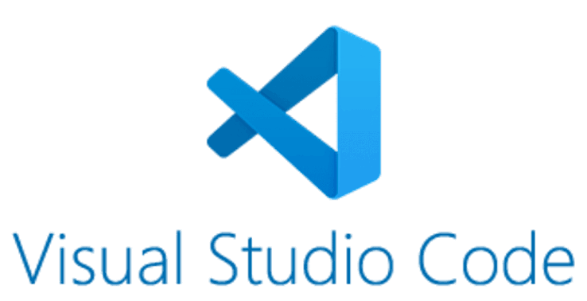
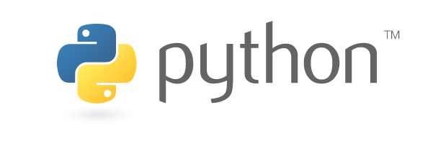


Slide 3
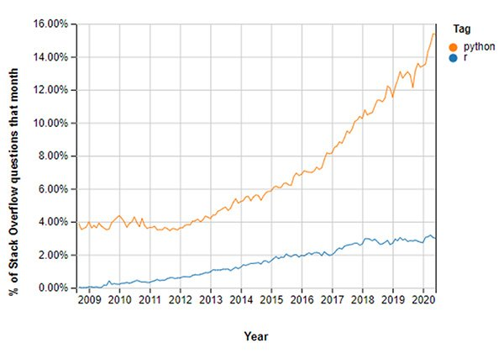
Why Python?
Open source (free)
This is where scientific software development is happening
  brain imaging analysis software
  physio analysis
  data science (mining public databases, etc.)
  deep learning
Python is used all over the place!
  more likely to be useful to students outside of academia
It can do a lot more
  Analysis
  Stimulus presentation
  Interfacing with hardware
  Standalone programs, graphical interfaces, etc.
Great for student CV’s 😎

Slide 4
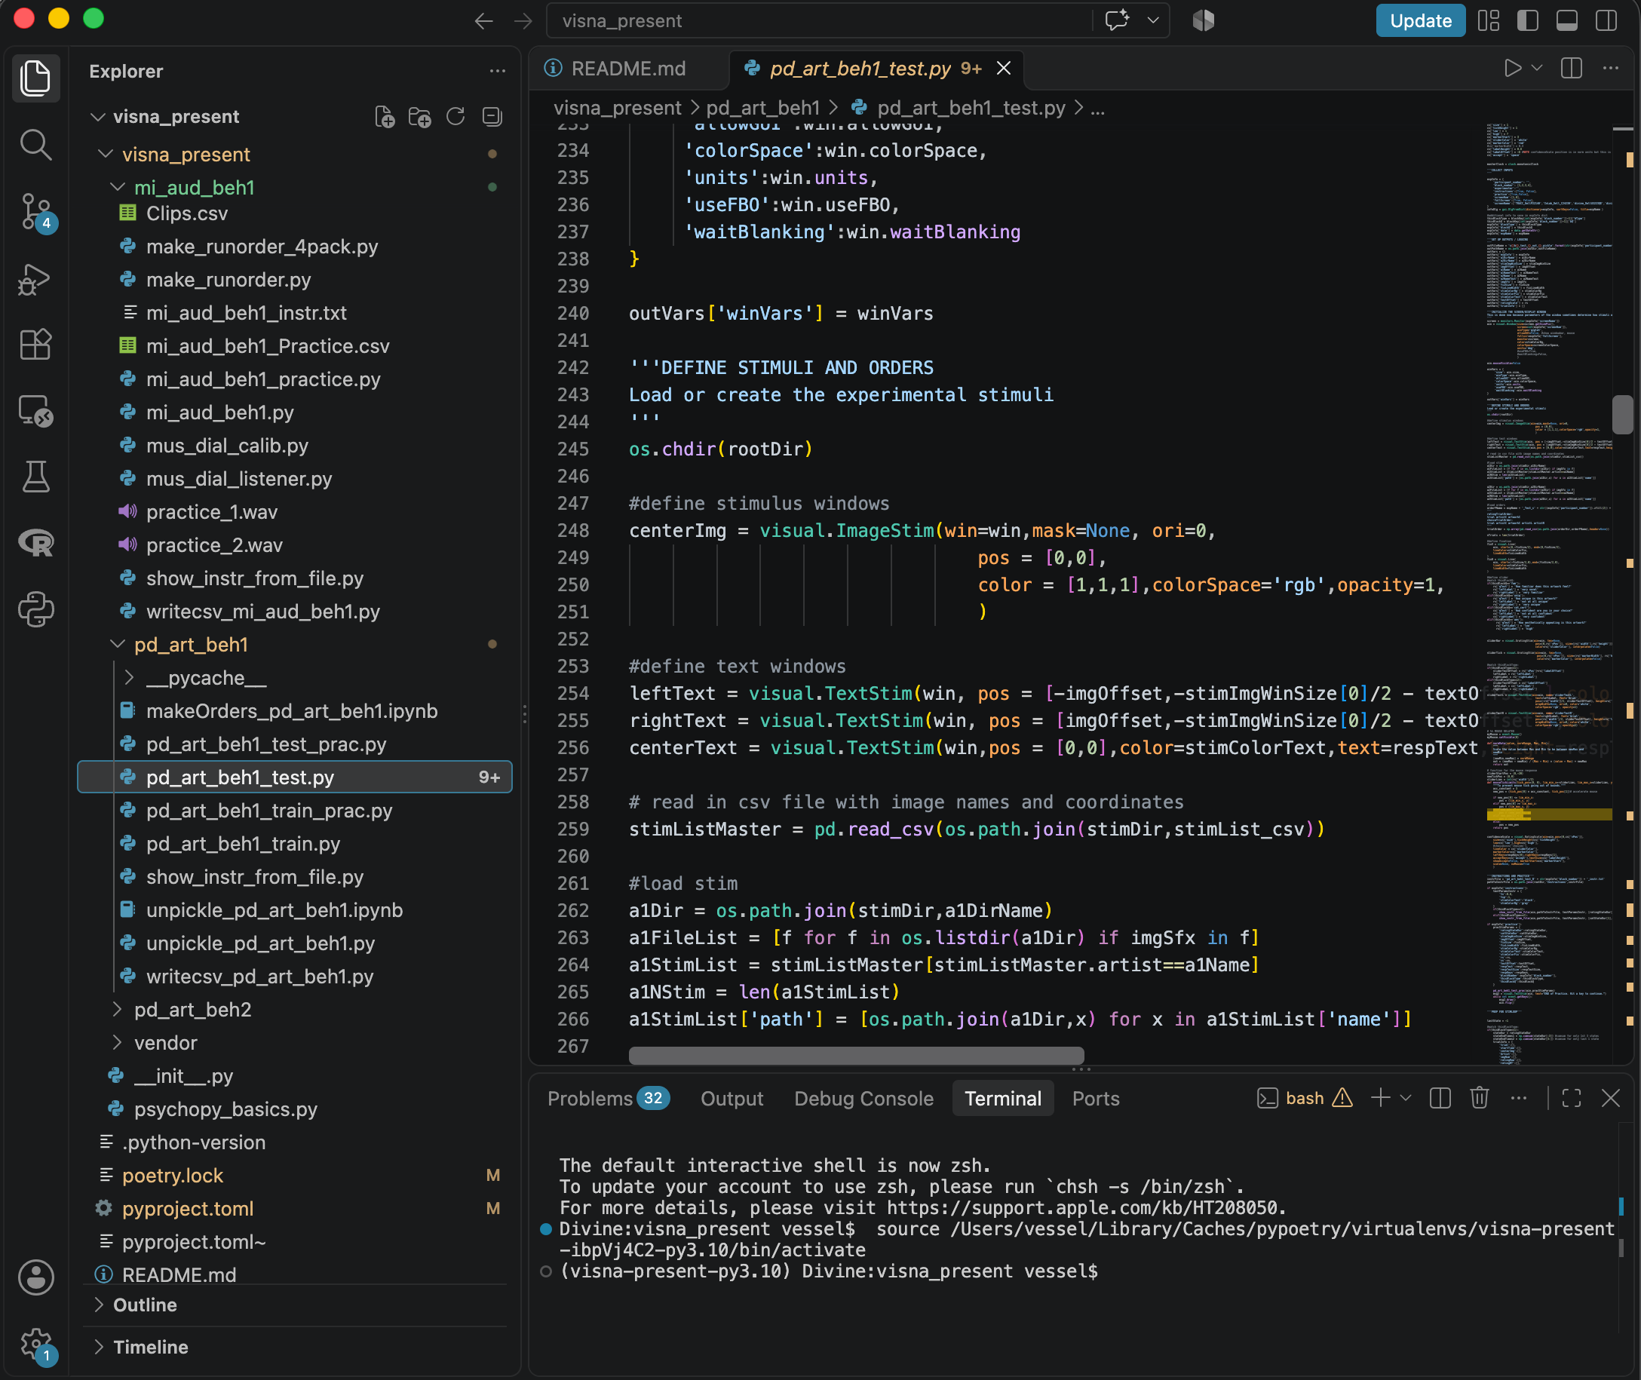
Why VS Code?
Its free
Really nice built-in visual interpreter for Python
  can also use it for R, C, any other programming language
Easy navigation around a project folder
Integrates well with Github
Integrated coding agents

Slide 5
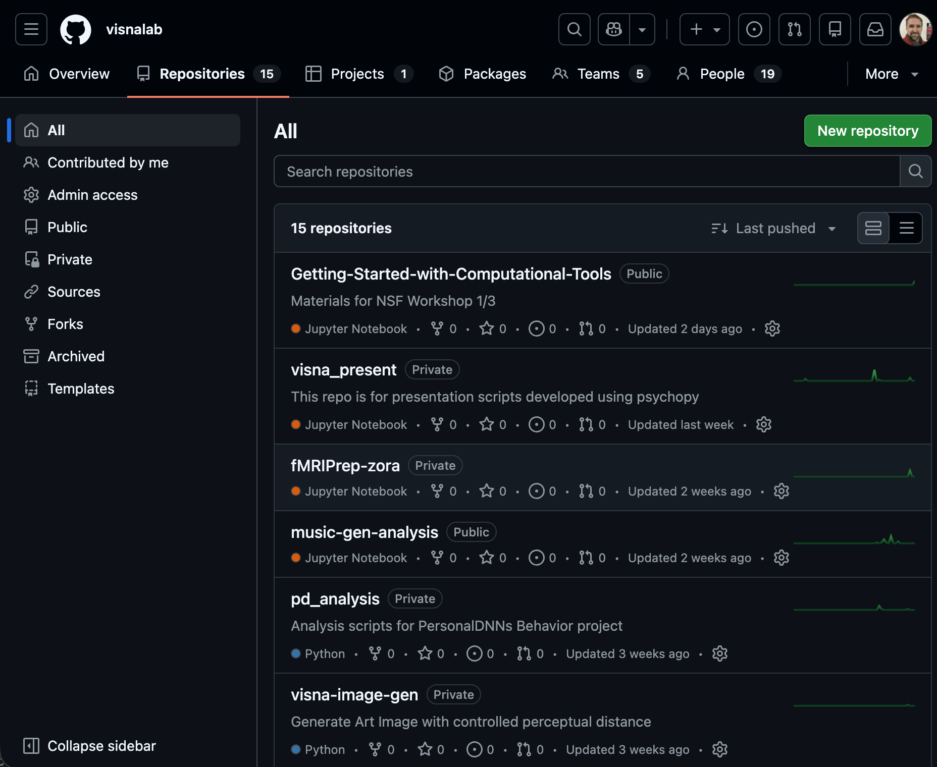
Why GitHub?
Share code across your team!
  Manage different people working on the same code
  Keep track of versions/changes
    (git = version control system)
Share code and projects more widely
Access a huge world of useful tools written by others
For students: document your effort on coding projects

Slide 6
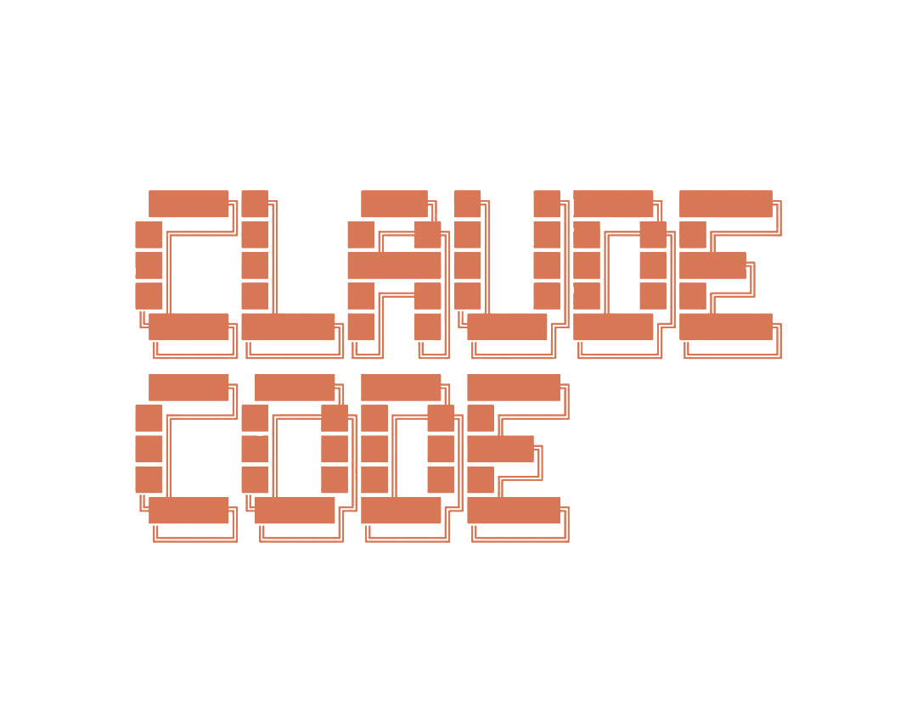

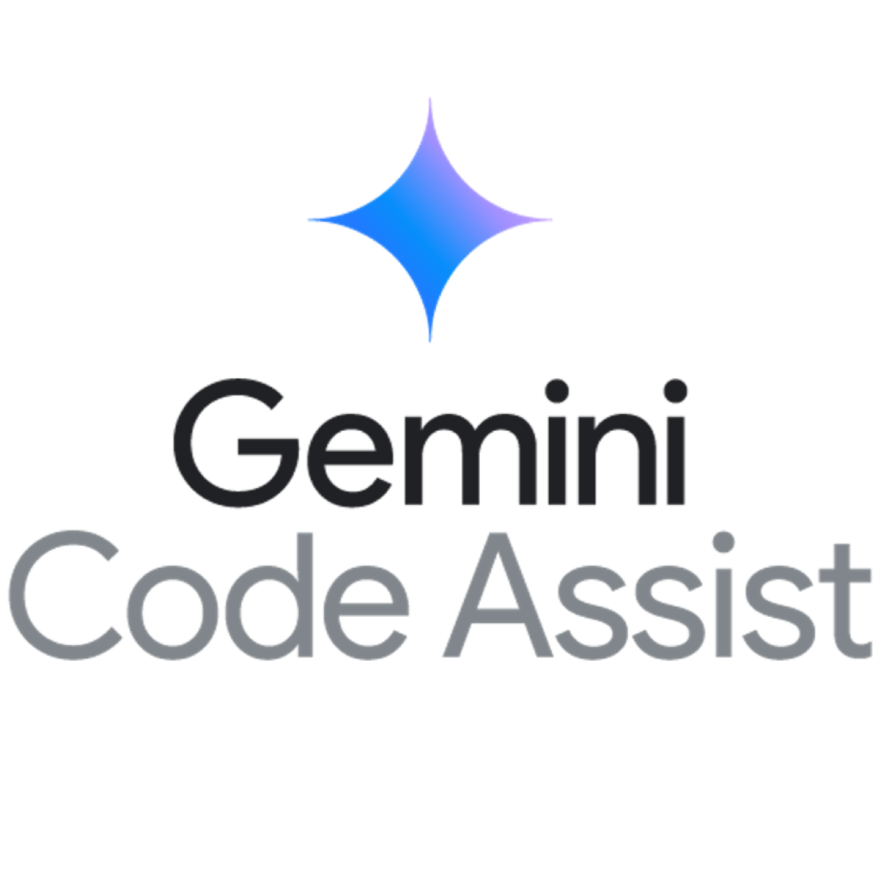
Coding Agents
Why:
can help you turn a recipe (e.g. pseudocode) into short code snippets
can help you parse/understand existing code
advanced: create more complex code or modify existing code
How:
Start small! Have an agent help you do small steps
Use what you know to check its output
Figure out ways to verify

Slide 7
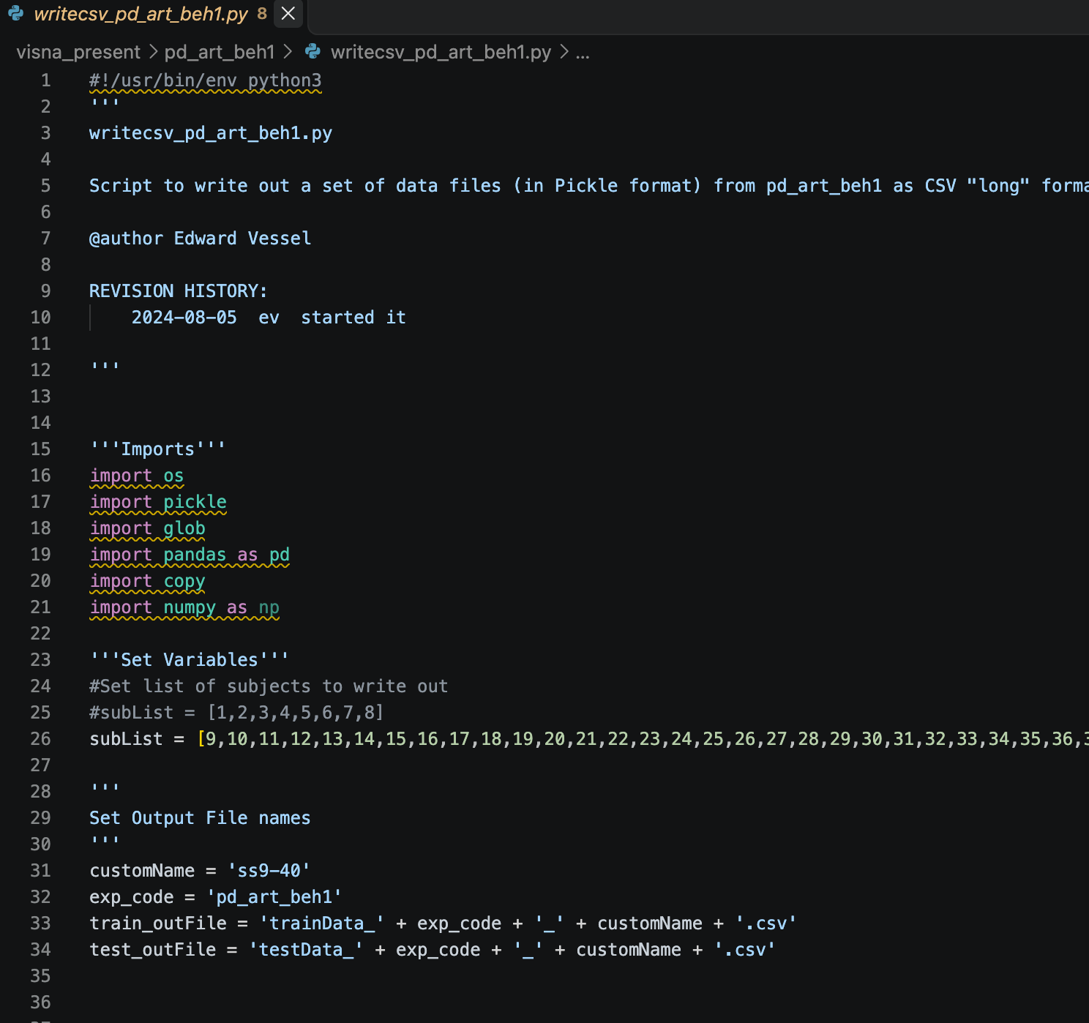
A few Python Basics
Python script (myscript.py):
A full program
You write it as a script
You “run” it and it executes from top to bottom
Q: is there an interactive ”command window” or “console” to try things out line-by-line?
not by default!
you can set up an “interactive” python shell to mimic Matlab/R, but …

Slide 8
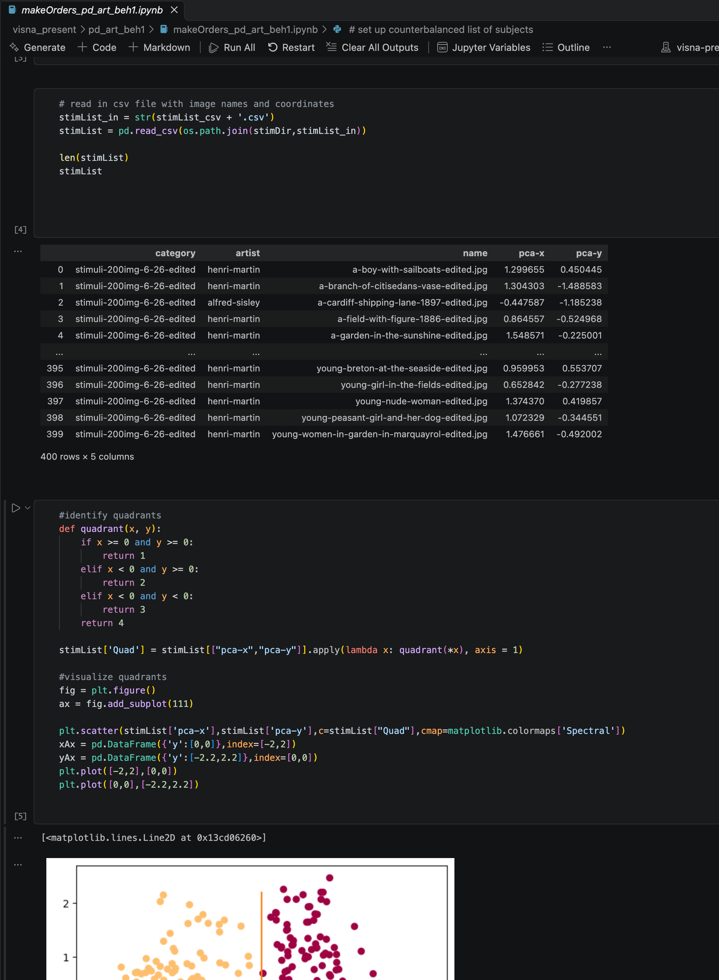
A few Python Basics
Jupyter Notebook (mynotebk.ipynb):
A series of “cells”
Each cell contains code or text
You run each cell one at a time, see the output, and save the whole thing
Great for sharing/teaching
Notes:
use Notebooks instead!

Slide 9

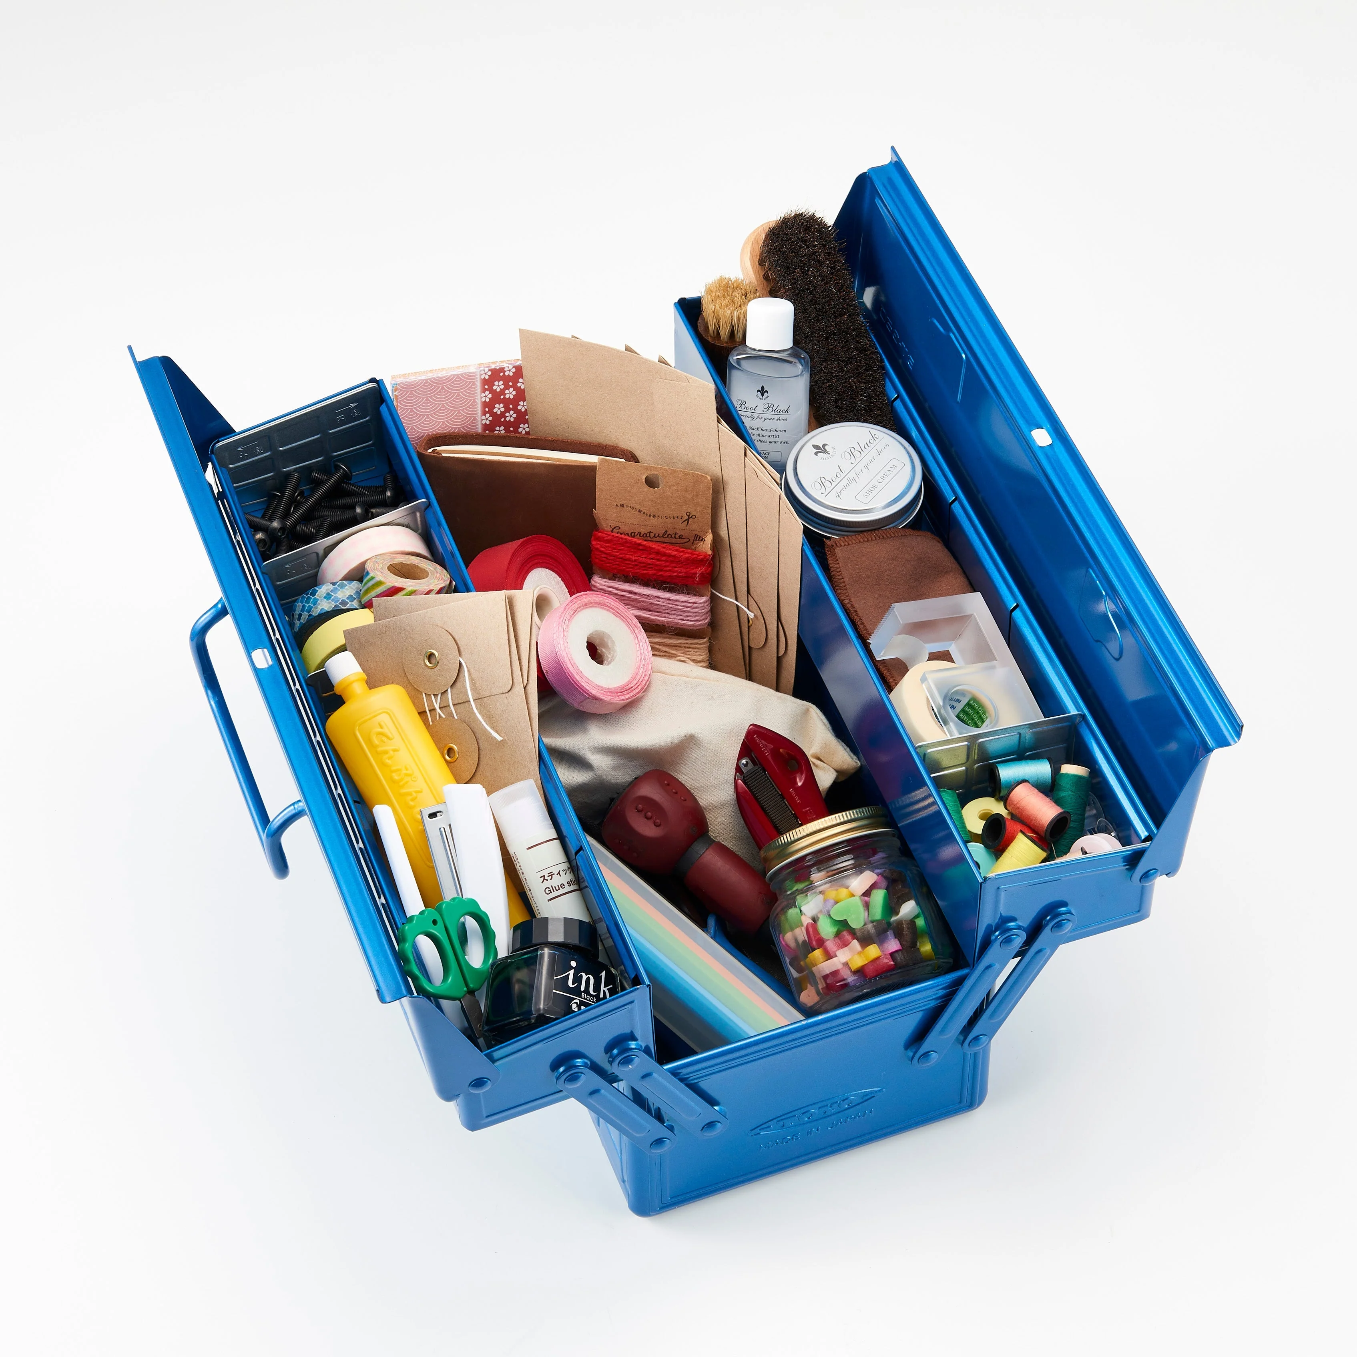
A few Python Basics
A python virtual environment:
A version of python, plus all the packages/libraries you need for a project
  where everything has been verified to be compatible
  “dependencies” are “solved”
Different projects:
  have different needs!
  so you might load different libraries
.. you can have many different versions of Python on the same computer!!
R / Matlab | Python
When a new version is released, you upgrade and hope your projects work (and fix them when they break) | You create a project with a version of Python. That project will stay in that version of Python. A new project may use a newer version of Python.
When you borrow someone’s old code, you modify it to make it compatible with the most recent version | When you borrow someone’s old code, they can package it with the version of python (and libraries) that all work together
Notes:
your project will always work, bc it can be packaged w/ the old version of Python!
you can send the whole project to someone else and they can install it, and it will have everything it needs

Slide 10
A few Python Basics
Basic set of Python packages used for scientific computing:
numpy (arrays, math functions)
pandas (dataframes)
matplotlib (plotting)
≈ basic Matlab
+ statistics:
scipy
statsmodels
seaborn (visualization)
More advanced stuff:
scikit-learn
sympy
nipy
psychopy
… and many many others

